Slide 1
Societal communication/interaction: Zeta Potential measurement on exosome as an example
Sharon Ku & Frederick Klaessig

Slide 2
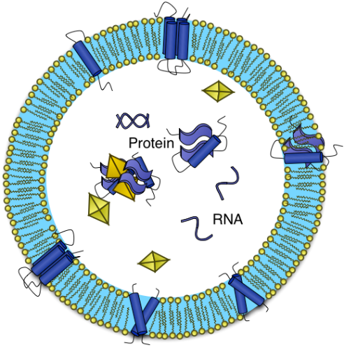
Can exosome, a entity in biology, be characterized by zeta potential analysis, a technique in chemistry?
Bio
Re-situating zeta potential and exosome in a biology-chemistry interface in-the-making
Both chemists and biologists have to leave their discipline-based comfort zones to form a new research ensemble:
1) Open the “history” of zeta potential and exosome for clarifications on concepts, terminologies, protocols and applicable conditions
2) Reflection on disciplinary limitations and taken-for-granted assumptions
3) Integration and reinvention (ex: NCL/DLS/endotoxin)

Slide 3
Structured dialogues, facilitators and Integration capability building
Source: Zachary Piso, Michael O’Rourke, and Kathleen C. Weathers (2015) “Out of the Fog: Building Integrative Capacity in Interdisciplinary Research”, manuscript in preparation.
Translation (two-way communication) and displacement (resituating expertise) are both required to build the bio-chemical interface.

Slide 4
