Slide 1



The CEINT Database
Sandra Karcher
Carnegie Mellon University / CEE
sck@andrew.cmu.edu
To the Nanotechnology Working Group
on September 4, 2014
with Christine Hendren and Yuan Tian
www.ceint.duke.edu
1

Slide 2
Goal: Database and Tools
Data
Visualization
Data
Analysis
Risk
Assessment
Database
2

Slide 3
Our Design Fundamentals
Structure for storage
Protocols for populating
Key fields for querying
database software, such as MySQL or Access, requires the use of a specific structure
can be challenging - requires planning and thorough documentation to facilitate consistency
very challenging - requires understanding of the interconnections between all the individual pieces of information
3

Slide 4
Target Information
Nanomaterial characterization (intrinsic and extrinsic)
Nanomaterial meta-data (synthesis methods and protocols, characterization protocols)
System characterization (relevant information to describe the nanomaterial surroundings throughout the duration of the experimental process, including experimental, environmental, and biological system parameters)
System meta-data (synthesis or growth protocols, characterization protocols)
Nanomaterial dosing information
Experimental methods
Experimental results (raw and derived or calculated)
Associated laboratory and/or field quality control information
Modeled results (internal to a specific research group and/or spanning across research groups)
4

Slide 5
Design Concepts
an Experiment
occurs at a Location
in a System
of Matrix (Matrices)
At specified time points:
Sample(s) are collected, something (nanomaterial, plant, fish, etc.) is added, and/or something is measured
following a set of Methods
resulting in a Parameter measurement and/or description
5

Slide 6
What can we do with it?
6

Slide 7
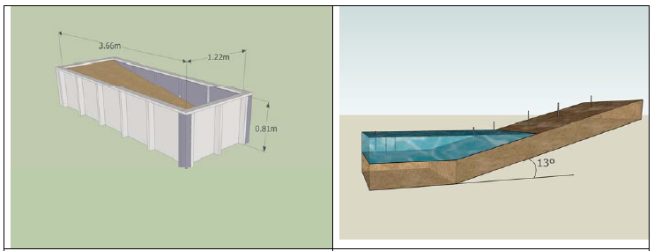
Example – Two Mesocosms
Surface Water Interface (set at 0)
Reference: Long-Term Transformation and Fate of Manufactured Ag Nanoparticles in a Simulated Large Scale Freshwater Emergent Wetland (Lowry et al, Environ. Sci. Technol. 2012, 46, 7027−7036)
One mesocosm dosed with AgNPs in soil, one dosed in water
~ 6 measurements above 0 of surface water interface – measured dissolved oxygen
18 samples (3 x 6 grid) at 4 depth intervals – determined mass of silver in sediment/soil
7

Slide 8
Find the Average - 1
What is the average dissolved oxygen concentration, found in both mesocosms, just above the surface water interface?
      We find the relevant records (just above the surface water interface, with the parameter of dissolved oxygen).
SsdmGrpType | SsdmSBDep | SsdmSEDep | DepUnit | SsdmMx | SsdmMxSpc | parLabel | parValue | parUnit
Mes02 | -1.08 | -1.08 | millimeter | water | surface water interface | dissolved oxygen | 157.8 | micromolar
Mes02 | -2.03 | -2.03 | millimeter | water | surface water interface | dissolved oxygen | 185.2 | micromolar
Mes02 | -2.99 | -2.99 | millimeter | water | surface water interface | dissolved oxygen | 202.1 | micromolar
Mes02 | -4.09 | -4.09 | millimeter | water | surface water interface | dissolved oxygen | 200.5 | micromolar
Mes02 | -5.01 | -5.01 | millimeter | water | surface water interface | dissolved oxygen | 216.1 | micromolar
Mes02 | -6.04 | -6.04 | millimeter | water | surface water interface | dissolved oxygen | 221.8 | micromolar
Mes01 | -4.17 | -4.17 | millimeter | water | surface water interface | dissolved oxygen | 208.4 | micromolar
Mes01 | -3.19 | -3.19 | millimeter | water | surface water interface | dissolved oxygen | 202.8 | micromolar
Mes01 | -2.14 | -2.14 | millimeter | water | surface water interface | dissolved oxygen | 203.2 | micromolar
Mes01 | -1.12 | -1.12 | millimeter | water | surface water interface | dissolved oxygen | 191.8 | micromolar
8

Slide 9
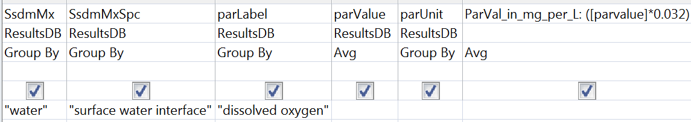
Find the Average - 2
  2) Then we compute an average.
SsdmMx | SsdmMxSpc | parLabel | AvgOfparValue | parUnit
water | surface water interface | dissolved oxygen | 199.0 | micromolar
ParVal_in_mg_per_L
6.4
We can also build in unit conversions
(using 1 micromole of oxygen = 0.032 mg/L)
Simple Query
9

Slide 10
Associate Lab QC
What does the Lab QC tell us about potential bias in our samples?
  Find the Lab QC records
  Find samples associated with the Lab QC
  Compute an adjusted sample result based on the reported recovery in the Lab QC
10

Slide 11
Associate Lab QC - 1
Sample | Field Name | Mesocosm 1 | Mesocosm 2 | Mesocosm 1 | Mesocosm 2
sample | ResManGrp | Lowry Lab at Duke | Lowry Lab at Duke | Lowry Lab at Duke | Lowry Lab at Duke
both | ExpGrp | GVL2012Long-Term | GVL2012Long-Term | GVL2012Long-Term | GVL2012Long-Term
sample | ExpPurGrp | Nano Material Partitioning | Nano Material Partitioning | Nano Material Partitioning | Nano Material Partitioning
sample | SrcData | GVL2012Long-Term | GVL2012Long-Term | GVL2012Long-Term | GVL2012Long-Term
sample | ExpType | mesocosm | mesocosm | mesocosm | mesocosm
sample | SsdmGrpType | Mes01 | Mes02 | Mes01 | Mes02
sample | SsdmLocType | Exp01 | Exp02 | Exp01 | Exp02
sample | SsdmXcoord | -77.1521633 | -77.1521633 | -77.1521633 | -77.1521633
sample | SsdmYcoord | 36.62772656 | 36.62766651 | 36.62772656 | 36.62766651
sample | SsdmSBDep | 2.000000000000 | 2.000000000000 | 2.000000000000 | 2.000000000000
sample | SsdmSEDep | 3.000000000000 | 3.000000000000 | 3.000000000000 | 3.000000000000
sample | SsdmColMth | core | core | core | core
sample | SsdmMx | sediment | sediment | sediment | sediment
sample | AnayMth | So_ICPMS-002 | So_ICPMS-002 | So_ICPMS-002 | So_ICPMS-002
sample | parValue | 2.99 | 5.75 | 2.99 | 5.75
sample | parUnit | milligram per kilogram | milligram per kilogram | milligram per kilogram | milligram per kilogram
labQC | SsdmMx | soil | soil | soil | soil
labQC | ExpType | labQC | labQC | labQC | labQC
labQC | AnayMth | So_ICPMS-002 | So_ICPMS-002 | So_ICPMS-002 | So_ICPMS-002
labQC | SsdmGrpType | SRM | SRM | SRM | SRM
labQC | SsdmLocType | Lqc01 | Lqc01 | Lqc01R | Lqc01R
labQC | parValue | 78.1 | 78.1 | 82.5 | 82.5
labQC | parUnit | percent recovered | percent recovered | percent recovered | percent recovered
labQC | parLabel | silver | silver | silver | silver
Find the Lab QC samples
LabQC sample
Replicate LabQC sample
11

Slide 12
Associate Lab QC - 2
Sample | Field Name | Mesocosm 1 | Mesocosm 2 | Mesocosm 1 | Mesocosm 2
sample | ResManGrp | Lowry Lab at Duke | Lowry Lab at Duke | Lowry Lab at Duke | Lowry Lab at Duke
sample | ExpGrp | GVL2012Long-Term | GVL2012Long-Term | GVL2012Long-Term | GVL2012Long-Term
sample | ExpPurGrp | Nano Material Partitioning | Nano Material Partitioning | Nano Material Partitioning | Nano Material Partitioning
sample | SrcData | GVL2012Long-Term | GVL2012Long-Term | GVL2012Long-Term | GVL2012Long-Term
sample | ExpType | mesocosm | mesocosm | mesocosm | mesocosm
sample | SsdmGrpType | Mes01 | Mes02 | Mes01 | Mes02
sample | SsdmLocType | Exp01 | Exp02 | Exp01 | Exp02
sample | SsdmXcoord | -77.1521633 | -77.1521633 | -77.1521633 | -77.1521633
sample | SsdmYcoord | 36.62772656 | 36.62766651 | 36.62772656 | 36.62766651
sample | SsdmSBDep | 2.000000000000 | 2.000000000000 | 2.000000000000 | 2.000000000000
sample | SsdmSEDep | 3.000000000000 | 3.000000000000 | 3.000000000000 | 3.000000000000
sample | SsdmColMth | core | core | core | core
sample | SsdmMx | sediment | sediment | sediment | sediment
sample | AnayMth | So_ICPMS-002 | So_ICPMS-002 | So_ICPMS-002 | So_ICPMS-002
sample | parValue | 2.99 | 5.75 | 2.99 | 5.75
sample | parUnit | milligram per kilogram | milligram per kilogram | milligram per kilogram | milligram per kilogram
labQC | SsdmMx | soil | soil | soil | soil
labQC | ExpType | labQC | labQC | labQC | labQC
labQC | AnayMth | So_ICPMS-002 | So_ICPMS-002 | So_ICPMS-002 | So_ICPMS-002
labQC | SsdmGrpType | SRM | SRM | SRM | SRM
labQC | SsdmLocType | Lqc01 | Lqc01 | Lqc01R | Lqc01R
labQC | parValue | 78.1 | 78.1 | 82.5 | 82.5
labQC | parUnit | percent recovered | percent recovered | percent recovered | percent recovered
sample | parLabel | silver | silver | silver | silver
Find the samples associated with the Lab QC (use key field that indicates experimental group)
12

Slide 13
Associate Lab QC - 3
Sample | Field Name | Mesocosm 1 | Mesocosm 2 | Mesocosm 1 | Mesocosm 2
sample | ResManGrp | Lowry Lab at Duke | Lowry Lab at Duke | Lowry Lab at Duke | Lowry Lab at Duke
both | ExpGrp | GVL2012Long-Term | GVL2012Long-Term | GVL2012Long-Term | GVL2012Long-Term
sample | ExpPurGrp | Nano Material Partitioning | Nano Material Partitioning | Nano Material Partitioning | Nano Material Partitioning
sample | SrcData | GVL2012Long-Term | GVL2012Long-Term | GVL2012Long-Term | GVL2012Long-Term
sample | ExpType | mesocosm | mesocosm | mesocosm | mesocosm
sample | SsdmGrpType | Mes01 | Mes02 | Mes01 | Mes02
sample | SsdmLocType | Exp01 | Exp02 | Exp01 | Exp02
sample | SsdmXcoord | -77.1521633 | -77.1521633 | -77.1521633 | -77.1521633
sample | SsdmYcoord | 36.62772656 | 36.62766651 | 36.62772656 | 36.62766651
sample | SsdmSBDep | 2.000000000000 | 2.000000000000 | 2.000000000000 | 2.000000000000
sample | SsdmSEDep | 3.000000000000 | 3.000000000000 | 3.000000000000 | 3.000000000000
sample | SsdmColMth | core | core | core | core
sample | SsdmMx | sediment | sediment | sediment | sediment
sample | AnayMth | So_ICPMS-002 | So_ICPMS-002 | So_ICPMS-002 | So_ICPMS-002
sample | parValue | 2.99 | 5.75 | 2.99 | 5.75
sample | parUnit | milligram per kilogram | milligram per kilogram | milligram per kilogram | milligram per kilogram
labQC | SsdmMx | soil | soil | soil | soil
labQC | ExpType | labQC | labQC | labQC | labQC
labQC | AnayMth | So_ICPMS-002 | So_ICPMS-002 | So_ICPMS-002 | So_ICPMS-002
labQC | SsdmGrpType | SRM | SRM | SRM | SRM
labQC | SsdmLocType | Lqc01 | Lqc01 | Lqc01R | Lqc01R
labQC | parValue | 78.1 | 78.1 | 82.5 | 82.5
labQC | parUnit | percent recovered | percent recovered | percent recovered | percent recovered
both | parLabel | silver | silver | silver | silver
The adjusted value of silver in mesocosm 1 = 3.7 (2.99/0.803)
And the adjusted value of silver in mesocosm 2 = 7.2 (5.75/0.803)
(could adjust the measured results, or perhaps use the recoveries to determine an upper an lower bound)
Both samples are each associated with two lab QC results (since the lab QC was performed in replicate).
The average recovery of the two lab replicates is 80.3%
13

Slide 14
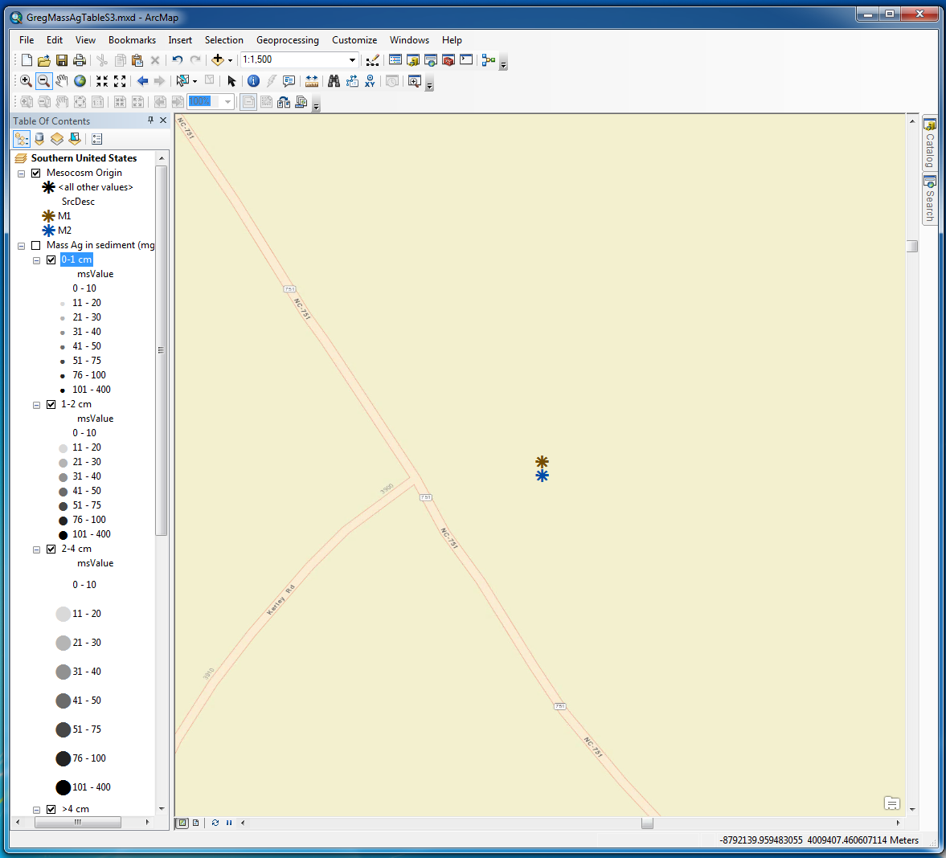
Example: Two Mesocosm Study
Location and orientation of mesocosms estimated using Google Maps.
Locations imported into GIS.
Mass of Ag in sediment also imported into GIS.
Visualize Results in GIS
We zoom in and….
14

Slide 15
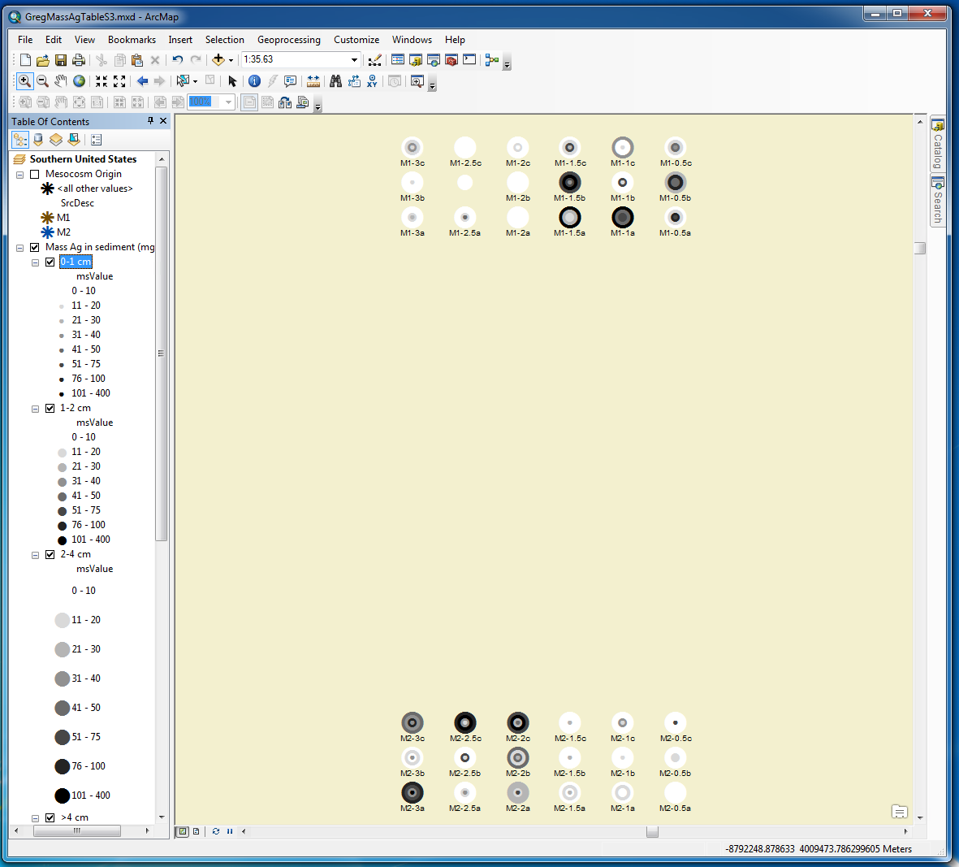
soil
side
This mesocosm was dosed in the soil compartment
Notice mass is in mg and the same gradient (shade of grey) is used at all sample depths
(0-1, 1-2, 2-4, 4-22 cm).
We see 18 core sample locations in each mesocosm.
This mesocosm was dosed in the water compartment
water
side
15

Slide 16
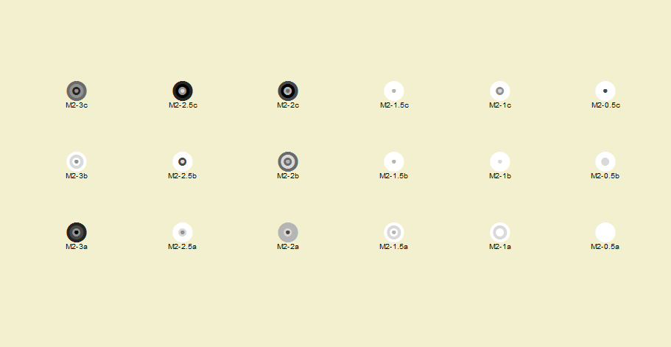
Focusing on the water dosed mesocosm
water side
soil side
The diameter of the circles increases with depth.
The darker the shade of grey, the more silver mass found in the sediment.
16

Slide 17
Still Considering
What other visualizations do we want to perform?
When do we need raw data? What level of aggregation would be acceptable?
Do we have all the appropriate grouping fields we need?
Do we need more “query friendly” fields in some parts of our database?
How can we best engage researchers during the curation process?
17

Slide 18





Acknowledgements
CEINT Data Integration Team
  Duke: Christine Hendren, Yuan Tian, Lichen He, Mark Wiesner
  Carnegie Mellon: Jeanne VanBriesen, Greg Lowry, and Sandra Karcher
This material is based upon work supported by the National Science Foundation (NSF) and the Environmental Protection Agency (EPA) under NSF Cooperative Agreements EF-0830093 and DBI-1266252, Center for the Environmental Implications of NanoTechnology (CEINT). Any opinions, findings, conclusions or recommendations expressed in this material are those of the author(s) and do not necessarily reflect the views of the NSF or the EPA. This work has not been subjected to EPA review and no official endorsement should be inferred.
18

