Slide 1
DICOM WG 30 Small Animal Imaging DICOM Training Introduction and Basic Concepts
David Clunie (dclunie@dclunie.com)
PixelMed Publishing

Slide 2
DICOM – Learning Objectives
Brief history
File formats and Storage Services
Data Set encoding principles
Transfer Syntaxes
Information Object Definitions
Storage SOP Classes
Other DICOM services than storage
Conformance statements
Association Negotiation
DICOM Message Service Elements (DIMSE)
DICOM Upper Layer Protocol (DUL)

Slide 3
Who Needs to Know What?
User/customer
services and objects relevant to domain (esp. storage)
conformance statement interpretation and matching
Installer/integrator
+ network addressing, more detail about services
+/- integration with non-imaging (IS, workflow) systems
Application designer/developer
detailed knowledge of (relevant) services, objects, attributes
uses toolkit to abstract (most) encoding/network details
Problem solver/troubleshooter
+ data sets: interpret dumps and validation tool output
+ network: DIMSE/DUL to interpret network logs/traces/dumps
Toolkit designer/developer
everything: objects, encoding, services, network
Standard writer: new modality
IOD structure, reusable modules, encoding limits, precedents

Slide 4
DICOM – Brief History
1982 – 1st PACS Conference – session on standards
1982 – AAPM Report 10 – Standard Format for Image Interchange
1983 – ad hoc meeting between FDA, ACR & NEMA
1983 – 1st meeting of ACR-NEMA “Digital Imaging and Communications Standards” Committee
1985 – ACR-NEMA 300-1985 (“version 1.0”) issued
1988 – ACR-NEMA 300-1988 (“version 2.0”) issued
1990 – Inter-vendor testing of version 2.0 at Georgetown
1992 – Trial of DICOM (“version 3.0) at RSNA
1993 – DICOM 3.0 issued

Slide 5
DICOM – Brief History
1982 – 1st PACS Conference – session on standards
1982 – AAPM Report 10 – Standard Format for Image Interchange
1983 – ad hoc meeting between FDA, ACR & NEMA
1983 – 1st meeting of ACR-NEMA “Digital Imaging and Communications Standards” Committee
1985 – ACR-NEMA 300-1985 (“version 1.0”) issued
1985 – IEEE 802.3 Ethernet (based on 1976 Metcalfe)
1986 – Aldus TIFF (version 3; prior versions drafts only)
1987 – CompuServe GIF
1988 – ACR-NEMA 300-1988 (“version 2.0”) issued
1990 – Inter-vendor testing of version 2.0 at Georgetown
1992 – Trial of DICOM (“version 3.0) at RSNA
1992 – JPEG (ITU T.81; ISO 10918-1 1994)
1993 – DICOM 3.0 issued

Slide 6
DICOM – Brief History
ACR-NEMA versions 1 and 2
50-pin 16 bit parallel interface
no network (assumed “network interface unit”)
layered
messages with commands and data
tag-value pairs
described patients, studies, images
described modality, acquisition, 3D position, etc.

Slide 7
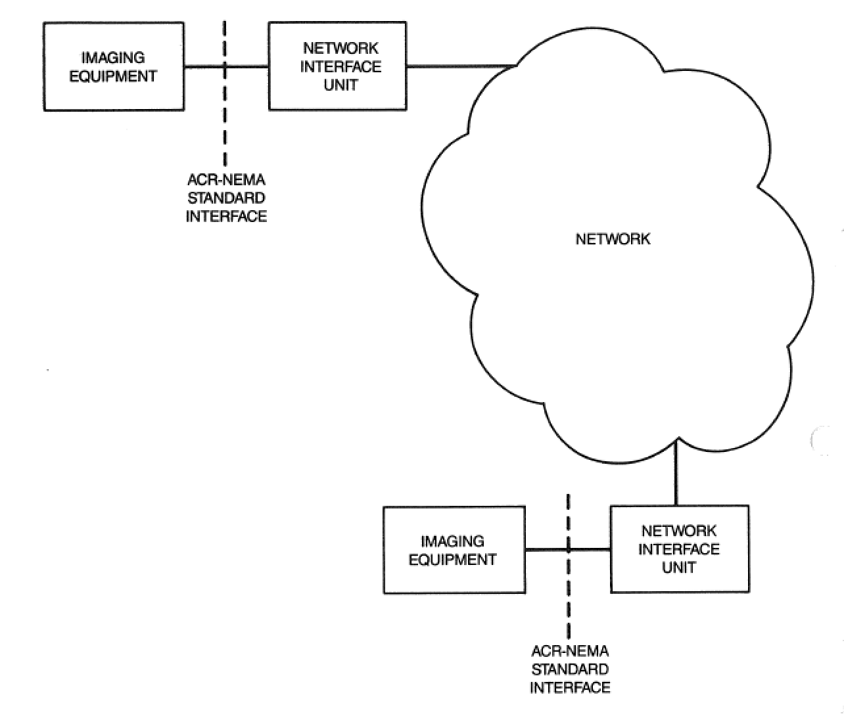
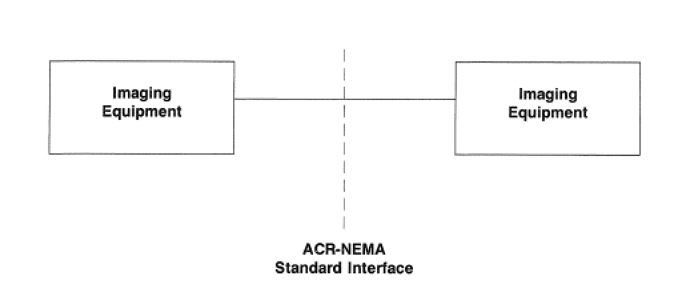

Slide 8
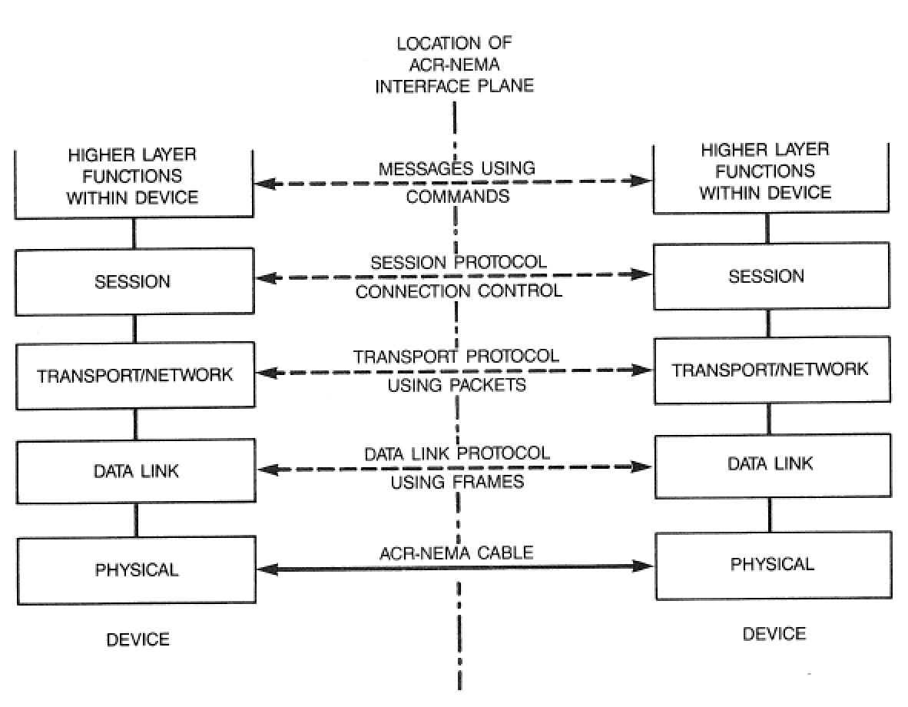

Slide 9
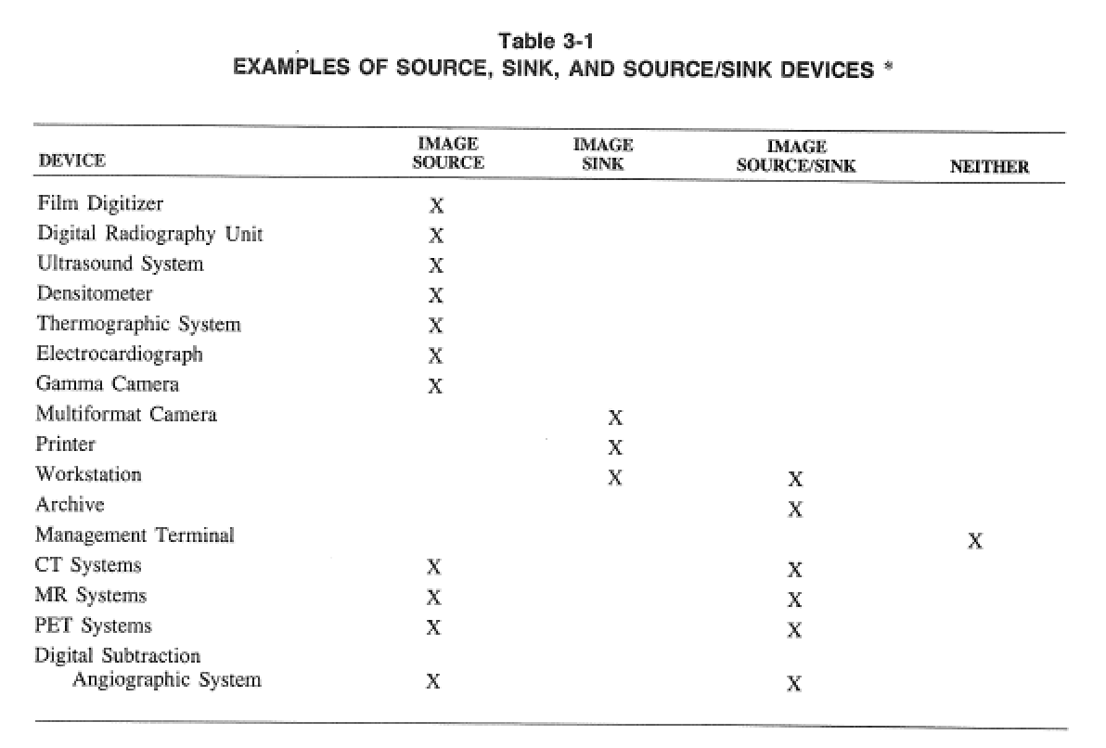

Slide 10
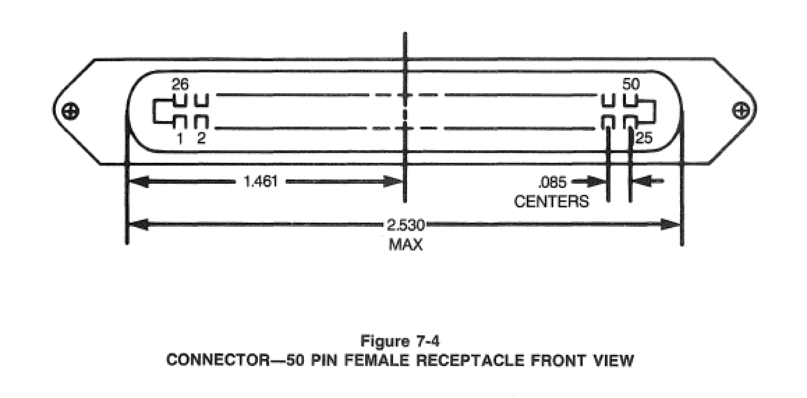
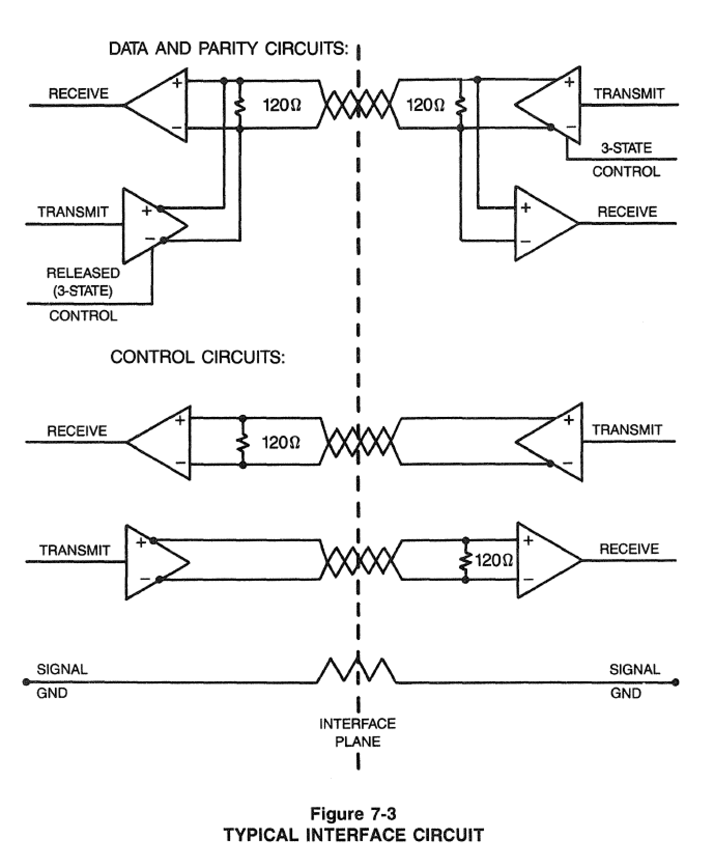
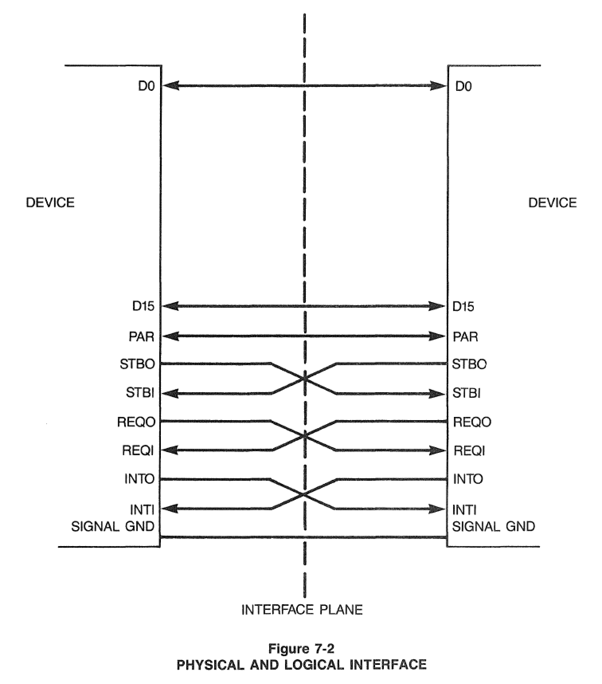

Slide 11
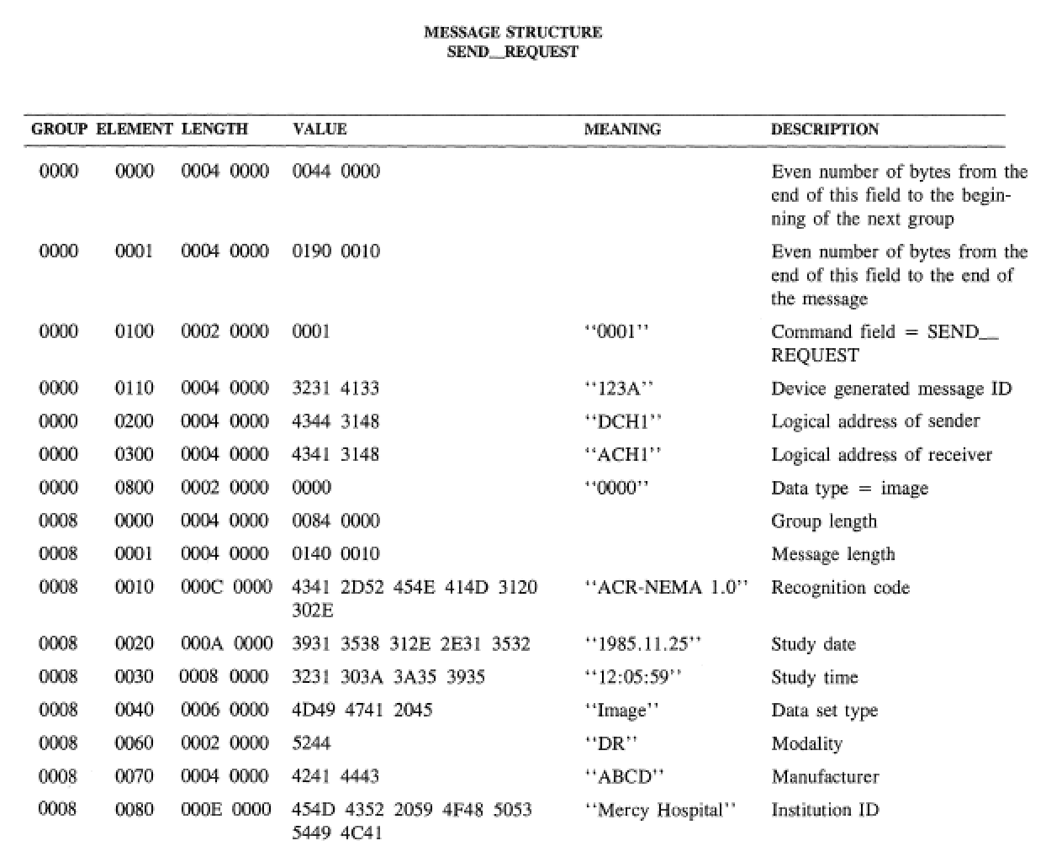

Slide 12
DICOM – Brief History
ACR-NEMA versions 1 and 2
50-pin 16 bit parallel interface
no network (assumed “network interface unit”)
layered
messages with commands and data
tag-value pairs
described patients, studies, images
described modality, acquisition, 3D position, etc.
DICOM “3.0”
TCP/IP network protocol (and OSI semantics)
“object-oriented” description & conformance

Slide 13
DICOM – Scope
Implicit in the standard’s name: “Digital Image and Communications in Medicine”
Images and image-related information
All acquisition modalities
1993: CR, CT, MR, US, NM, SC (DF and DV)
2014: XA, XRF, DX, MG (+DBT), IO, PT, VL (Photo, Endo, Slide), WSI, OCT (OP,IV)
RT, SR (+CAD), waveforms, OP measurements and maps, surface scans, implants, segmentations
Storage + other services

Slide 14
DICOM – Scope
Interchange of medical images
radiology, cardiology, pathology .... any ‘ology
network (TCP/IP) or media (CD, DVD, MOD)
Printing
grayscale and color
network rather than point-to-point (TCP/IP)
Information System Integration
reports, worklists, performed procedures

Slide 15
Why does DICOM exist ?
Previous solutions closed (proprietary)
Real world requires open standards
heterogeneous modalities
heterogeneous workstations
heterogeneous archives, PACS, etc.
Consortium of
industry (NEMA)
users (ACR, ACC, CAP ...)

Slide 16
Why interchange images ?
Archiving
Interpretation
softcopy reading
filmless operation
Advanced processing
3D visualization, quantitative analysis
fusion of images from multiple modalities
Teaching, research ...

Slide 17
Why (open) standards at all ?
Too many permutations of ...
Acquisition device vendors
general
GE, Siemens, Philips, Toshiba, Shimadzu, Hitachi, ...
special
Bruker, iTheraMedical, Mediso, PerkinElmer ...
Processing and archive device vendors
general
GE, Siemens, Philips, ... (+ open source)
special
InViCRO, ...

Slide 18
Why not existing standards ?
Didn’t “exist” when ACR-NEMA formed
Pure imaging standards (TIFF, etc.)
limited support for medical image types
don’t encode domain specific information
Other domains inappropriate
military, remote sensing, astronomical, etc.
ISO standards (e.g., IPI) never adopted
Medical standards that didn’t do images
HL7, MIB (IEEE 1073), etc.
Needed more services than just storage
query/retrieve, printing, workflow, etc.

Slide 19
DICOM – Why?
Domain-specific fields
patient identification & characteristics
device identification & characteristics
acquisition protocol parameters
study management identifiers, dates and times
Need to handle binary bulk pixel data
e.g., HL7 text based and no image support
Need to be extensible
evolving technology, private extensions
variable rather than “fixed” length headers

Slide 20
Key goals of DICOM
Support interoperability
NOT (necessarily) interfunctionality
WITHOUT defining (restricting) architecture
Define conformance
specific services and objects
documentation (Conformance Statement)
negotiation
Consensus standard
Voluntary compliance
Open (license fee free)

Slide 21
DICOM does NOT define:
PACS or IM Architecture
Picture Archiving Communications System
Image Management
Distributed Object Management
Radiology/Hospital Information System
Complete Electronic Medical Record
Integrating the Health Care Enterprise (IHE) does define some aspects of architecture on top of DICOM, HL7, etc.

Slide 22
What is Interoperability ?
Analogy of web server/browser:
Interconnectivity - both talk TCP/IP
Interoperability - both talk HTTP and HTML
Interfunctionality – approached, not guaranteed:
“versions” of HTML poorly controlled
layout and other behavior not constrained by HTML
optional/additional “features”
use of extensions (plug-ins, applets, scripts, stylesheets)
Not (always) sufficient for clinical needs
interoperability is necessary but not sufficient
reality check on user/customer expectations

Slide 23
DICOM and Interoperability
For example, conformance to DICOM
will guarantee network connection
will guarantee storage of MR image:
from Modality to Workstation
will NOT guarantee (but will facilitate):
Workstation will display image “correctly”
Workstation can perform analysis (e.g., diffusion tractography)
facilitated by mandatory attributes for:
identification, annotation, positioning, etc.
IHE profiles define functionality, e.g., DIFF, PERF, MAMMO, Cardiac NM

Slide 24
DICOM and Interoperability
“Object-oriented” definition
data structures, e.g., MR image object
composite model of real world entities
patient, study, series
general image, specialized to MR image
services, e.g., image storage
together -> service/object pairs (SOP)
Roles (user or provider) (SCU or SCP)
Role + SOP Class -> Conformance

Slide 25
DICOM SOP Classes/Roles
MR scanner may say:
“I am an MR Image Storage Service Class User (SCU)”
Workstation may say:
“I am an MR Image Storage Service Class Provider (SCP) (amongst other things)” MR images may be transferred

Slide 26
DICOM SOP Classes/Roles
Angiography device may say:
“I am an XA Image Storage Service Class User (SCU)”
Workstation may say:
“I am not an XA Image Storage Service Class Provider (SCP) (though I do support other kinds of images like CT and MR)” This pair cannot transfer XA images

Slide 27
Why is DICOM so specific ?
For example,
MR Image
single frame, 12-16 bit grayscale image
MR acquisition - pulse sequence parameters
3D patient relative co-ordinate/vector position
X-Ray Angiography Image
multi-frame, 8-10 bit grayscale image
XA acquisition - radiation/collimation/motion
dynamic C-arm/table relative positioning

Slide 28
DICOM SOP Classes/Roles
Workstation may say:
“I am a Basic Grayscale Print Management Meta SOP Class SCU”
Printer may say:
“I am a Basic Grayscale Print Management Meta SOP Class SCP” Images may be printed

Slide 29
DICOM SOP Classes/Roles
Ultrasound scanner may say:
“I am a Basic Color Print Management Meta SOP Class SCU”
Printer may say:
“I am only a Basic Grayscale Print Management Meta SOP Class SCP” This pair cannot print images

Slide 30
Modality is Important
Different acquisition characteristics
X-Ray-based v. not
cross-sectional v. projectional (planar)
transmissive v. emissive
structural v. functional
different mechanisms of contrast (endogenous or exogenous)
hybrids

Slide 31
Modality is Important
Different image characteristics
single or multiple channels (grayscale, color)
use of pseudo-color (palette color)
broader dynamic range than displayed
values may be > 8 bits in depth and signed
non-linear transformation (or linear window)
physical significance of pixel values (counts, HU, velocity)
physical significance of size (measurements)

Slide 32
Modality-specific DICOM IODs
Information Object Definition (IOD)
one (or more) for each modality
more if conformance reason for variants
“Composite”
multiple real-world entities in same IOD
“Object-oriented” (sort of)
“inherit” same (composite) real-world/information “model”
patient/study/procedure step/series/image/frame
re-use common general Modules
e.g., Patient, General Study, General Image Module
re-use common technology Modules
e.g., Contrast/Bolus, Frame of Reference, X-Ray Grid Module
“specialize” with modality-specific Modules
e.g., CT Image, MR Image Module

Slide 33
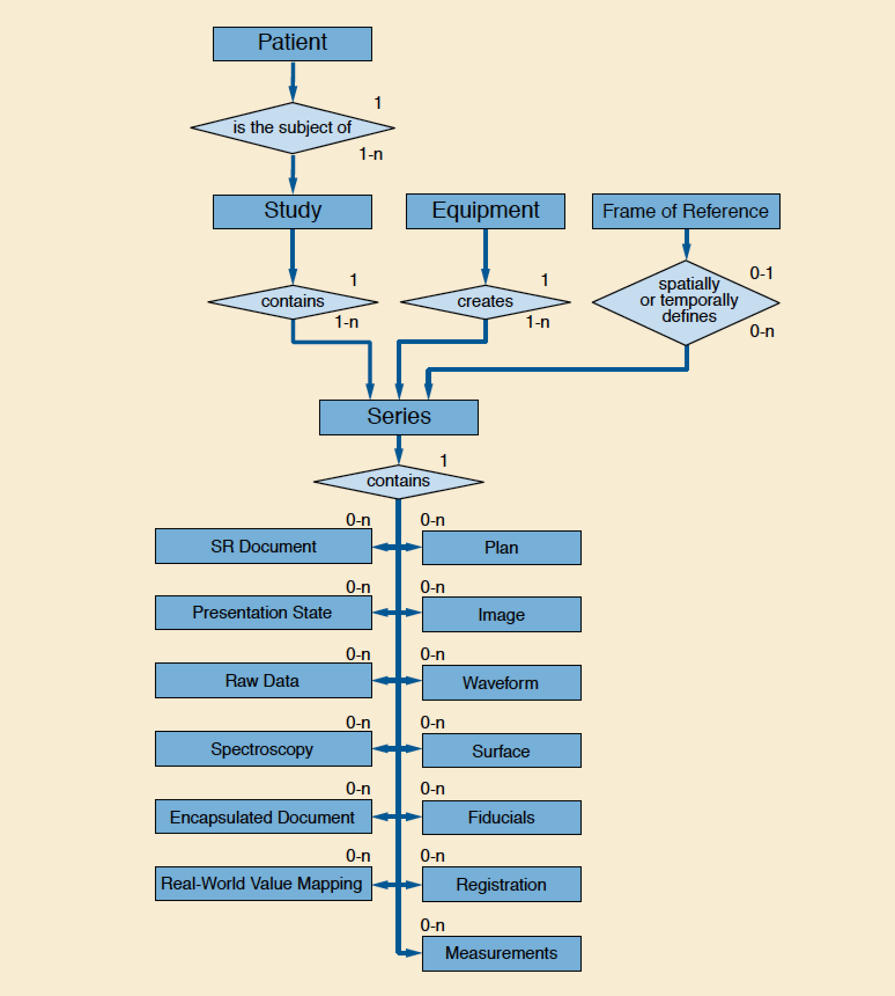
Composite Information Model

Slide 34
MR Image IOD

Slide 35
Image Plane Module
Type: 1 – required, 2 – may be empty if unknown, 3 – optional

Slide 36
Encoding – Data Elements
Flat list of sorted unique “Data Elements”
IOD/Module structure is NOT encoded
Module Attributes encoded as Data Elements
Each Data Element is a Tag-Value pair
Tag-Type-Value triple with explicit type (VR) encoding
Data Element Tag: pair of 16 bit numbers
16 bit “group number” (historical distinction)
16 bit “element number”
encoded in binary, described in hexadecimal
e.g., (0008,0020) means “Study Date”
“meaning” is not encoded – need “data dictionary” to look them up (PS3.6) – i.e., not “self-describing”

Slide 37
Encoding – Data Elements
Value
Value Representation (VR) (“type”)
Value Length (16 or 32 bits; limits max size)
Value (even length padded; 16 bit parallel legacy)
VRs (“types”)
binary: US, SS, UL, SL, FL, FD, AT
bulk binary: OB, OW, OF, OD, UN (“unknown”)
numeric string: AS, DS, IS, DA, DT, TM
string: AE, CS, LO, PN, SH, UI
text: LT, ST, UT

Slide 38
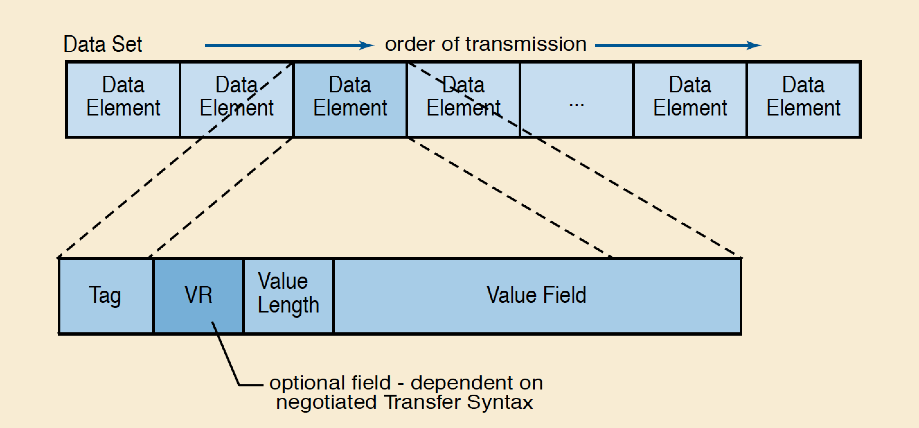

Slide 39
Example MR Image Dataset
(0x0008,0x0005) CS Specific Character Set VR=<CS> VL=<0x000a> <ISO_IR 100>
(0x0008,0x0008) CS Image Type VR=<CS> VL=<0x0010> <ORIGINAL\PRIMARY>
(0x0008,0x0016) UI SOP Class UID VR=<UI> VL=<0x001a> <1.2.840.10008.5.1.4.1.1.4>
(0x0008,0x0018) UI SOP Instance UID VR=<UI> VL=<0x002e>
<1.2.840.113619.2.1.2.1909421756.1.1.602501582>
(0x0008,0x0020) DA Study Date VR=<DA> VL=<0x0008> <19890203>
(0x0008,0x0021) DA Series Date VR=<DA> VL=<0x0008> <19890203>
(0x0008,0x0022) DA Acquisition Date VR=<DA> VL=<0x0008> <19890203>
(0x0008,0x0023) DA Image Date VR=<DA> VL=<0x0008> <19890203>
(0x0008,0x0030) TM Study Time VR=<TM> VL=<0x0006> <092618>
(0x0008,0x0031) TM Series Time VR=<TM> VL=<0x0006> <093221>
(0x0008,0x0032) TM Acquisition Time VR=<TM> VL=<0x0006> <093302>
(0x0008,0x0033) TM Image Time VR=<TM> VL=<0x0006> <093302>
(0x0008,0x0050) SH Accession Number VR=<SH> VL=<0x0000> []
(0x0008,0x0060) CS Modality VR=<CS> VL=<0x0002> <MR>
(0x0008,0x0070) LO Manufacturer VR=<LO> VL=<0x0012> <GE MEDICAL SYSTEMS>
(0x0008,0x0080) LO Institution Name VR=<LO> VL=<0x001c> <THOMAS JEFF UNIVHOSPITAL MRI>
(0x0008,0x0090) PN Referring Physician's Name VR=<PN> VL=<0x0004> <HUME>
(0x0008,0x1010) SH Station Name VR=<SH> VL=<0x0008> <FOR.IC0 >
(0x0008,0x1030) LO Study Description VR=<LO> VL=<0x0004> <KNEE>
(0x0008,0x103e) LO Series Description VR=<LO> VL=<0x0006> <COR T2>
(0x0008,0x1060) PN Name of Physician(s) Reading Study VR=<PN> VL=<0x0004> <BODY>
(0x0008,0x1070) PN Operator's Name VR=<PN> VL=<0x0002> <RB>
(0x0008,0x1090) LO Manufacturer's Model Name VR=<LO> VL=<0x000e> <GENESIS_SIGNA >
(0x0010,0x0010) PN Patient's Name VR=<PN> VL=<0x000c> <* GRX KNEE *>
(0x0010,0x0020) LO Patient's ID VR=<LO> VL=<0x0006> <RSNA2 >
(0x0010,0x0030) DA Patient's Birth Date VR=<DA> VL=<0x0000> []
(0x0010,0x0040) CS Patient's Sex VR=<CS> VL=<0x0002> <M >
(0x0010,0x1010) AS Patient's Age VR=<AS> VL=<0x0004> <034Y>
(0x0010,0x1030) DS Patient's Weight VR=<DS> VL=<0x000a> < 90.718000>
(0x0010,0x21b0) LT Additional Patient History VR=<LT> VL=<0x0008> <R/O TEAR>
(0x0018,0x0020) CS Scanning Sequence VR=<CS> VL=<0x0002> <SE>
(0x0018,0x0021) CS Sequence Variant VR=<CS> VL=<0x0004> <OSP >
(0x0018,0x0022) CS Scan Options VR=<CS> VL=<0x0004> <NPW >
(0x0018,0x0023) CS MR Acquisition Type VR=<CS> VL=<0x0002> <2D>
(0x0018,0x0025) CS Angio Flag VR=<CS> VL=<0x0002> <N >
(0x0018,0x0050) DS Slice Thickness VR=<DS> VL=<0x0008> <5.000000>
(0x0018,0x0080) DS Repetition Time VR=<DS> VL=<0x000c> < 2000.000000>
(0x0018,0x0081) DS Echo Time VR=<DS> VL=<0x000a> < 20.000000>
(0x0018,0x0082) DS Inversion Time VR=<DS> VL=<0x0008> <0.000000>
(0x0018,0x0083) DS Number of Averages VR=<DS> VL=<0x0008> <0.500000>
(0x0018,0x0084) DS Imaging Frequency VR=<DS> VL=<0x0010> < 638746840.00000>
(0x0018,0x0085) SH Imaged Nucleus VR=<SH> VL=<0x0002> <H1>
(0x0018,0x0086) IS Echo Number(s) VR=<IS> VL=<0x0002> < 1>
(0x0018,0x0087) DS Magnetic Field Strength VR=<DS> VL=<0x0006> <15000 >
(0x0018,0x0088) DS Spacing Between Slices VR=<DS> VL=<0x0008> <6.000000>
(0x0018,0x0091) IS Echo Train Length VR=<IS> VL=<0x0002> <0 >
(0x0018,0x0093) DS Percent Sampling VR=<DS> VL=<0x000a> < 53.125000>
(0x0018,0x0094) DS Percent Phase Field of View VR=<DS> VL=<0x000a> <100.000000>
(0x0018,0x1088) IS Heart Rate VR=<IS> VL=<0x0002> <0 >
(0x0018,0x1090) IS Cardiac Number of Images VR=<IS> VL=<0x0002> <0 >
(0x0018,0x1094) IS Trigger Window VR=<IS> VL=<0x0002> <10>
(0x0018,0x1100) DS Reconstruction Diameter VR=<DS> VL=<0x000a> <140.000000>
(0x0018,0x1314) DS Flip Angle VR=<DS> VL=<0x0002> <0 >
(0x0018,0x1315) CS Variable Flip Angle Flag VR=<CS> VL=<0x0002> <N >
(0x0018,0x1316) DS SAR VR=<DS> VL=<0x0008> <0.052993>
(0x0018,0x5100) CS Patient Position VR=<CS> VL=<0x0004> <FFS >
(0x0020,0x000d) UI Study Instance UID VR=<UI> VL=<0x0028>
<1.2.840.113619.2.1.2.139348932.602501178>
(0x0020,0x000e) UI Series Instance UID VR=<UI> VL=<0x002a>
<1.2.840.113619.2.1.2.596272627.1.602501541>
(0x0020,0x0010) SH Study ID VR=<SH> VL=<0x0002> <2 >
(0x0020,0x0011) IS Series Number VR=<IS> VL=<0x0002> < 1>
(0x0020,0x0012) IS Acquisition Number VR=<IS> VL=<0x0002> < 0>
(0x0020,0x0013) IS Image Number VR=<IS> VL=<0x0002> < 1>
(0x0020,0x0032) DS Image Position (Patient) VR=<DS> VL=<0x0020>
<-70.000000\ 18.000000\ 75.000000>
(0x0020,0x0037) DS Image Orientation (Patient) VR=<DS> VL=<0x0038>
< 1.000000\0.000000\0.000000\0.000000\0.000000\ -1.000000>
(0x0020,0x0052) UI Frame of Reference UID VR=<UI> VL=<0x002c>
<1.2.840.113619.2.1.2.596272627.1.602501541.0>
(0x0020,0x0060) CS Laterality VR=<CS> VL=<0x0000> []
(0x0020,0x0110) DS Temporal Resolution VR=<DS> VL=<0x000a> <1120403456>
(0x0020,0x1040) LO Position Reference Indicator VR=<LO> VL=<0x0002> <KN>
(0x0020,0x1041) DS Slice Location VR=<DS> VL=<0x000e> <-18.0000000000>
(0x0028,0x0002) US Samples per Pixel VR=<US> VL=<0x0002> [0x01]
(0x0028,0x0004) CS Photometric Interpretation VR=<CS> VL=<0x000c> <MONOCHROME2 >
(0x0028,0x0010) US Rows VR=<US> VL=<0x0002> [0x100]
(0x0028,0x0011) US Columns VR=<US> VL=<0x0002> [0x100]
(0x0028,0x0030) DS Pixel Spacing VR=<DS> VL=<0x0012> < 0.546875\0.546875>
(0x0028,0x0100) US Bits Allocated VR=<US> VL=<0x0002> [0x10]
(0x0028,0x0101) US Bits Stored VR=<US> VL=<0x0002> [0x10]
(0x0028,0x0102) US High Bit VR=<US> VL=<0x0002> [0x0f]
(0x0028,0x0103) US Pixel Representation VR=<US> VL=<0x0002> [0x01]
(0x0028,0x0120) XS Pixel Padding Value VR=<SS> VL=<0x0002> [0x00]
(0x7fe0,0x0010) OX Pixel Data VR=<OW> VL=<0x20000> []

Slide 41
Encoding – Sequences
Sequence (SQ) VR allows “nesting” of lists
Data Element with an SQ VR
no “value” field per se
may have a fixed or undefined length
zero or more Sequence Items
Sequence Delimiter tag (if was undefined length)
Sequence Item
Item tag (may have a fixed or undefined length)
list of (sorted, unique) data elements
Item Delimiter tag (if was undefined length)

Slide 42
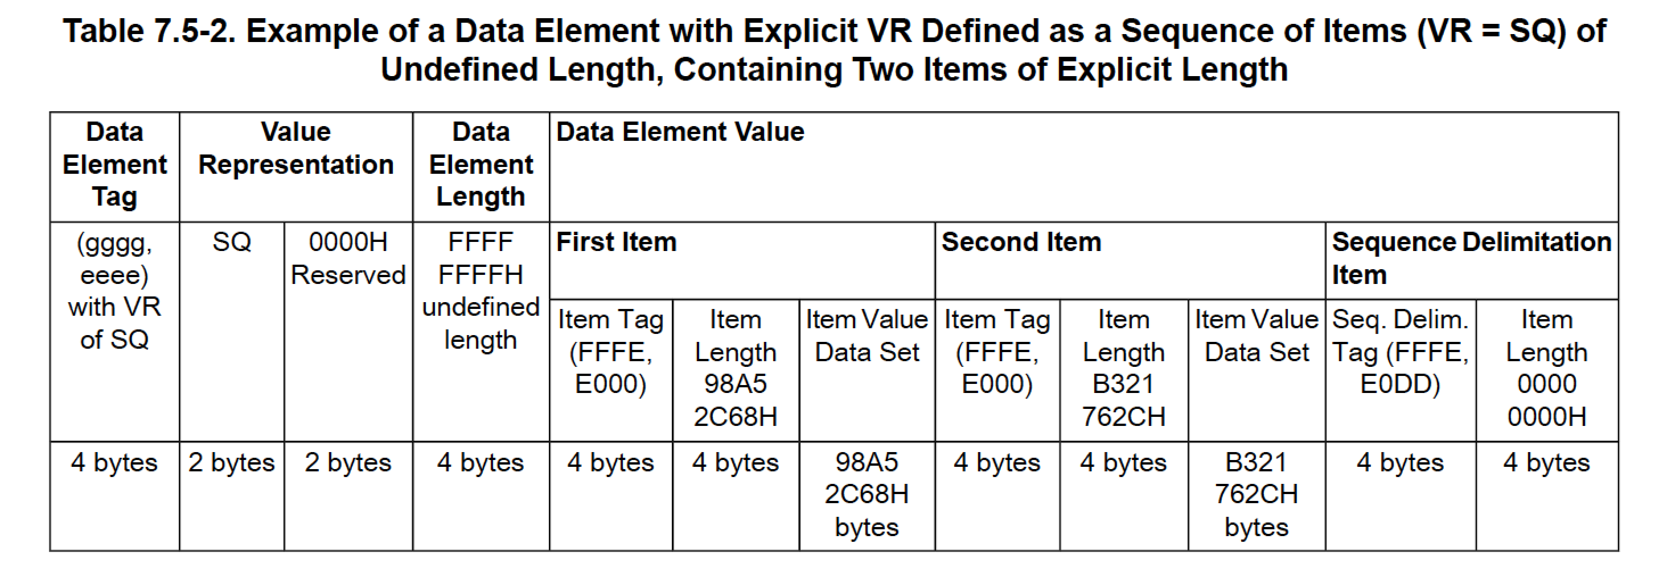

Slide 43
Dump Tool Output for Sequence
%item
(0x0040,0xa010) Relationship Type <HAS OBS CONTEXT>
(0x0040,0xa040) Value Type <PNAME >
(0x0040,0xa043) Concept Name Code Sequence
%item
(0x0008,0x0100) Code Value <000555>
(0x0008,0x0102) Coding Scheme Designator <LNdemo>
(0x0008,0x0104) Code Meaning <Recording 0bserver>
%enditem
%endseq
(0x0040,0xa123) Person Name <Smith^John^^Dr^ >
%enditem

Slide 44
Actual Binary Encoding
...
(0x0028,0x0002) Samples per Pixel VR=<US> VL=<0x0002> [0x0001]
(0x0028,0x0004) Photometric Interpretation VR=<CS> VL=<0x000c> <MONOCHROME2 >
(0x0028,0x0008) Number of Frames VR=<IS> VL=<0x0004> <124 >
(0x0028,0x0010) Rows VR=<US> VL=<0x0002> [0x0100]
(0x0028,0x0011) Columns VR=<US> VL=<0x0002> [0x0100]
(0x0028,0x0100) Bits Allocated VR=<US> VL=<0x0002> [0x0010]
(0x0028,0x0101) Bits Stored VR=<US> VL=<0x0002> [0x0010]
(0x0028,0x0102) High Bit VR=<US> VL=<0x0002> [0x000f]
...
...
00000560 .. .. .. .. .. .. 28 00 02 00 55 53 02 00 01 00 |..........US....|
00000570 28 00 04 00 43 53 0c 00 4d 4f 4e 4f 43 48 52 4f |(...CS..MONOCHRO|
00000580 4d 45 32 20 28 00 08 00 49 53 04 00 31 32 34 20 |ME2 (...IS..124 |
00000590 28 00 10 00 55 53 02 00 00 01 28 00 11 00 55 53 |(...US....(...US|
000005a0 02 00 00 01 28 00 00 01 55 53 02 00 10 00 28 00 |....(...US....(.|
000005b0 01 01 55 53 02 00 10 00 28 00 02 01 55 53 02 00 |..US....(...US..|
...
*names shown in test tool dump are not actually encoded

Slide 45
You Need a Library or Toolkit
You can hand-code reading & writing
But:
legal variations in encoding (Transfer Syntax)
sequence handling is non-trivial
need a “data dictionary” to understand tags
need an “IOD” library to map flat list of data elements as encoded to/from IODs/Modules (or “classes”)
need utilities for dumping, testing, editing, etc.
Not to mention files, services, protocols!
Fortunately, are available for all platforms

Slide 46
Private Data Elements
Odd group numbers are all private
(gggg,00xx) is a private creator string
(gggg,xxyy) is the block defined by that creator
(0019,0010) “David’s Stuff”
(0019,0011) “Harry’s Stuff”
(0019,1001) 1st of david’s private data elements
(0019,1002) 2nd of david’s private data elements
…
(0019,1101) 1st of harry’s private data elements
(0019,1102) 2nd of harry’s private data elements
…

Slide 47
DICOM – Is it a “File Format”?
Yes and no
since 1995 – a formal “file format” has been defined (PS3.10 aka. “part 10”)
but, it applies only to files on specified media (e.g., CD) with DICOMDIR (directory) (“File Set”)
strictly speaking, no standard conformance requirements for files “by themselves”
In practice
esp. for research and testing, “DICOM files” are often stored and exchanged informally
even old ACR-NEMA data sets were stored in files and interchanged

Slide 48
File Format v. Data Set
Data Set
“an instance of a real world Information Object”
“constructed of Data Elements”
is what is exchanged on network using the C-STORE “command”
File Format
“a means to encapsulate in a file the Data Set”
“byte stream of the Data Set is placed into the file after the DICOM File Meta Information”
“each file contains a single SOP Instance”

Slide 49
Data Set
Data Set Data Elements

Slide 50
Data Set
Data Set Data Elements
Pixel Data Element

Slide 51
Data Set
Data Set Data Elements
Pixel Data Element
Data Set Data Elements

Slide 52
Data Set
“header”
Data Set Data Elements
Pixel Data Element
Data Set Data Elements

Slide 53
Data Set
“header”
Data Set Data Elements
offset to start of pixel data not fixed length
Pixel Data Element
Data Set Data Elements

Slide 54
File Meta Information
128 byte preamble (ignored)
“DICM” prefix (magic #)
File Meta Information Data Elements
Data Set
Data Set Data Elements
Pixel Data Element
Data Set Data Elements

Slide 55
“header”
File Meta Information
128 byte preamble (ignored)
“DICM” prefix (magic #)
File Meta Information Data Elements
Data Set
“header”
Data Set Data Elements
Pixel Data Element
Data Set Data Elements

Slide 56
DICOM File
File Meta Information
128 byte preamble (ignored)
“DICM” prefix (magic #)
File Meta Information Data Elements
Data Set
Data Set Data Elements
Pixel Data Element
Data Set Data Elements

Slide 57
File Meta Information
128 byte preamble (ignored)
“DICM” prefix (magic #)
File Meta Information Data Elements
Data Set
Network
Data Set Data Elements
Pixel Data Element
Data Set Data Elements

Slide 58
Why Meta Information Header?
Make the “file” recognizable as a DICOM file
if just Data Set stored, would have to “guess”
Describe the encoding of the Data Set
the “Transfer Syntax”
little or big endian? compressed?
negotiated on network; needs to to be explicitly specified for file
Describe contents of the Data Set
SOP Class and SOP Instance UIDs
allows decision to use or ignore before decoding Data Set

Slide 59
Transfer Syntax
Term inherited from ISO/OSI
“a set of encoding rules”
Uncompressed
Default: little endian implicit VR (no “type” is sent)
Little endian explicit VR (“type” is sent)
Big endian explicit VR (byte order affected speed)
Compressed
Entire Data Set: Deflate (gzip-like) (rarely used)
Pixel Data: JPEG (8,12,DCT,lossless), JPEG-LS, JPEG 2000, MPEG2, MPEG4, RLE

Slide 60
DICOM Services - PACS
DICOM
DICOM
PACS +/- RIS
Modality
Archive
Modality
Modality
Workstations
Manager
Modality

Slide 61
Original DICOM Services
Verification
Storage
Query/Retrieve
Study Content Notification (*)
Detached Management (*)
patient/visit/study/results/interpretation
Print Management (* = not widely used)

Slide 62
Newer DICOM Services
Media Storage
Storage Commitment
(Modality) Worklist Management
(Modality) Performed Procedure Step
…
Display Function Standard
Structured Reporting

Slide 63
Query/Retrieve Classes
Hierarchical or relational (*)
Models
Patient/Study/Series/Image
Study (including Patient)/Series/Image
Patient/Study only (*)
Services:
Find, Move, Get (*) (* = rarely used)

Slide 64
Print Service Classes
Basic vs. Referenced
Images included or referenced
Basic is far more common
Grayscale vs. Color
grayscale for traditional laser images
color for dye sub, etc.
CR, CT, MR vs. NM, US

Slide 65
Modality/IS Related Services
Modality Worklist (MWL)
modality queries IS for list of work
patient name, id etc.
attributes to identify images of study in stored output (UIDs)
Modality Performed Procedure Step (MPPS)
modality reports what was done
Storage Commitment
modality asks archive/workstation to take responsibility for subsequent storage of images
Basis for IHE Scheduled Workflow Profile

Slide 66
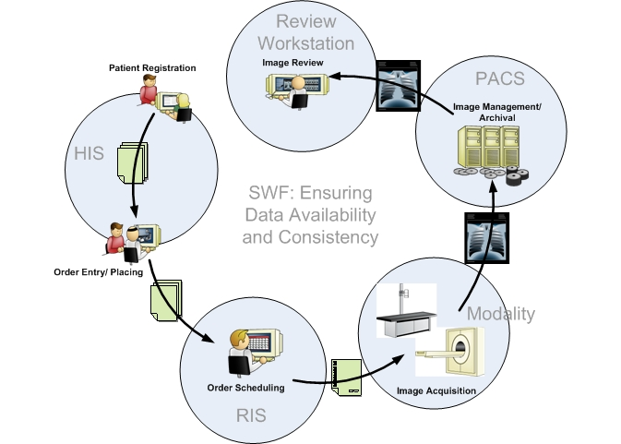
IHE Scheduled Workflow

Slide 67
IHE Scheduled Workflow
DICOM STORE Q/R
HL7V2
DICOM STORE MPPS COMMIT
HL7V2
DICOM MWL

Slide 68
Display Function Standard
Inconsistencies of grayscale display
monitor vs. workstation
display vs. printer
between printers (vendors, calibration)
Standard curve
perceptually linearized (Barten)
input step is Just Noticeable Difference
output is luminance, optical density
calibration of display device

Slide 69
Example of DICOM Services
CT scanner
acquire; archive and print over the network
Workstation
3D reconstruction of CT and MR images
store results on network and media
print over the network
Archive
Printer (laser imager)

Slide 70
DICOM Services – No PACS
Print
Laser Printer
Print
Store
Store
Q/R
CT Modality
Workstation
Q/R
Store
Shared Archive

Slide 71
Conformance Statement
DICOM Conformance Statement
defines services
including modality-specific storage classes
defines roles (user or provider)
defines other specific conformance issues
Transfer Syntax (encoding) - there is a default
limitations
configuration
physical network
required by the standard, in a standard format
a public document, usually shared on web site

Slide 72
Conformance Statement Example CT Scanner Specifications - SCU Role
“This Application Entity provides Standard Conformance to the following DICOM v3.0 SOP Classes as an SCU:”

Slide 73
Conformance Statement Example CT Scanner Specifications - SCP Role
“This Application Entity provides Standard Conformance to the following DICOM v3.0 SOP Classes as an SCP:”

Slide 74
Integration using DICOM
Define primary functions
Define boundaries between functions
Identify equipment with functions
Define primary services
Define support services
Identify DICOM service/role per device
Match Conformance Statements
Don’t assume “plug and play”
Define expected functionality a priori
Just specifying “DICOM” is meaningless

Slide 75
Integration using DICOM
Delineation of Responsibility
One source
vendor takes responsibility
Multiple sources in one purchase
integrator (user ?) takes responsibility
Multiple sources, multiple purchases
integrator ? user ? new supplier ?
Upgrades
upgrade supplier takes responsibility
evolution v. revolution (data/image migration)

Slide 76
More DICOM Specifics
Information Object Definitions
Structures and Encoding
Media Format
Service Classes
Upper Layer Protocol (DUL)
Association Establishment (ACSE)
Message Service Element (DIMSE)

Slide 77
Service Classes
Verification
Storage
Query/Retrieve
Print Management
Storage Commitment
Basic Worklist Management.
Modality Performed Procedure Step
…

Slide 78
Service Classes
Concept of user (SCU), provider (SCP)
like “client” and “server”, or “source” and “sink”
Message services used (DIMSE)
e.g., Storage Service uses C-STORE message
e.g., Query Service uses C-FIND message
Service-Object Pair (SOP) Classes
combine a service with an object (IOD)
e.g., CT Image Storage SOP Class
Storage Service Class
CT Image IOD

Slide 79
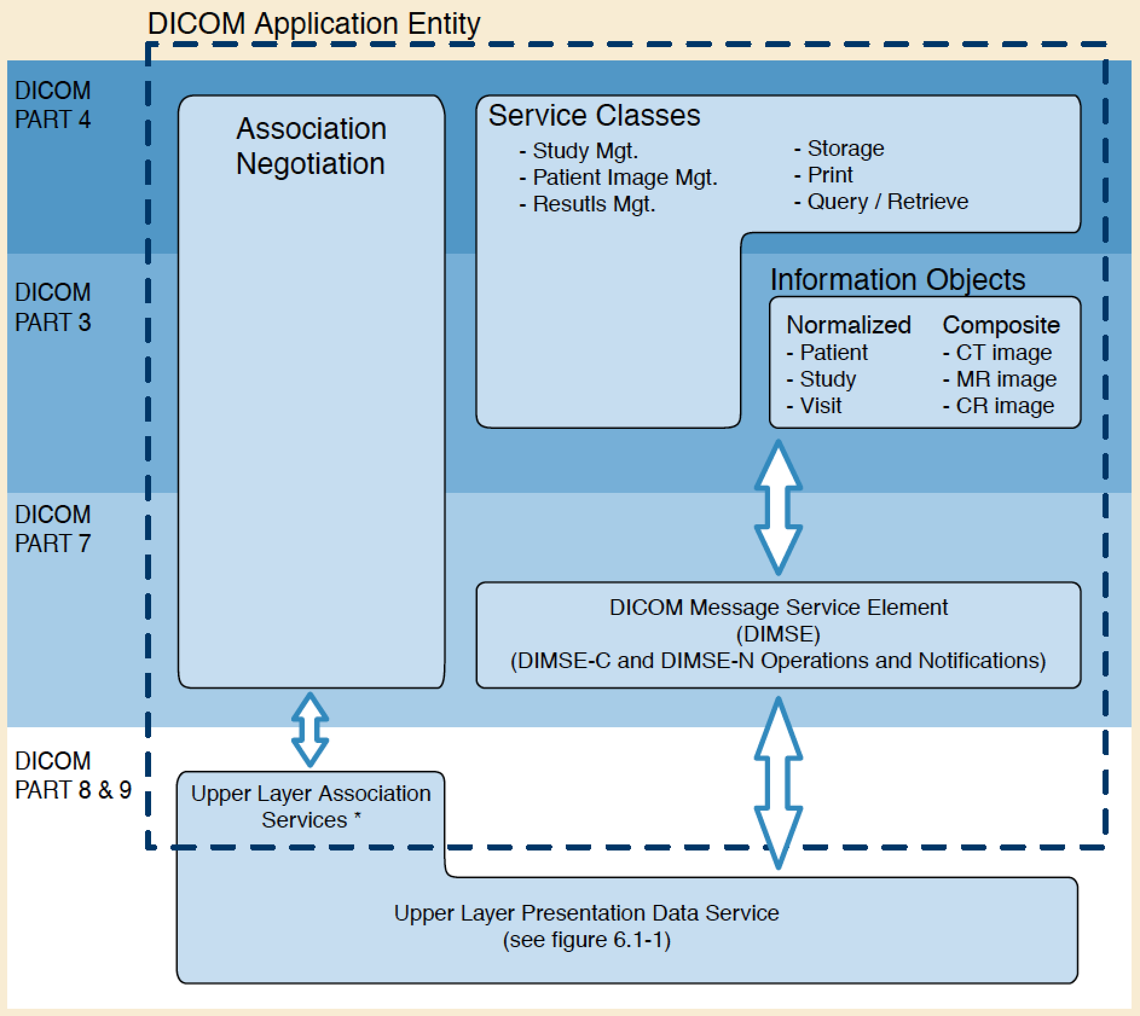
DICOM Application Layer

Slide 80
DICOM Upper Layer Protocol

Slide 81
DICOM Upper Layer Protocol

Slide 82
DICOM Upper Layer Protocol
TCP/IP over usual physical layers
may be secured using TLS (or VPN)
Presentation Data Service
P-DATA-TF
Association Control Service Element (ACSE)
A-ASSOCIATE-RQ,-AC,-RJ
A-RELEASE-RQ,-RSP
A-ABORT

Slide 83
DUL – Addressing
Who am I and who am I talking to ?
Application Entity Titles (AETs)
Calling AET
tells other end who (what device) I am
other end can filter on this (access control)
logging/audit trail
Called AET
who (what device) I want to talk
need mapping to Presentation Address
IP address (or hostname via table/NIS/DNS)
Port: 11112 or 104 (though often others used)

Slide 84
Association Establishment
Association Control Service Element (ACSE)
Key feature is negotiation
Presentation Context
Abstract Syntax (SOP Class)
Transfer Syntax (encoding, compression)
Other parameters
Maximum PDU length
Implementation Class UID
Asynchronous Operations
SCP/SCU Role selection

Slide 85
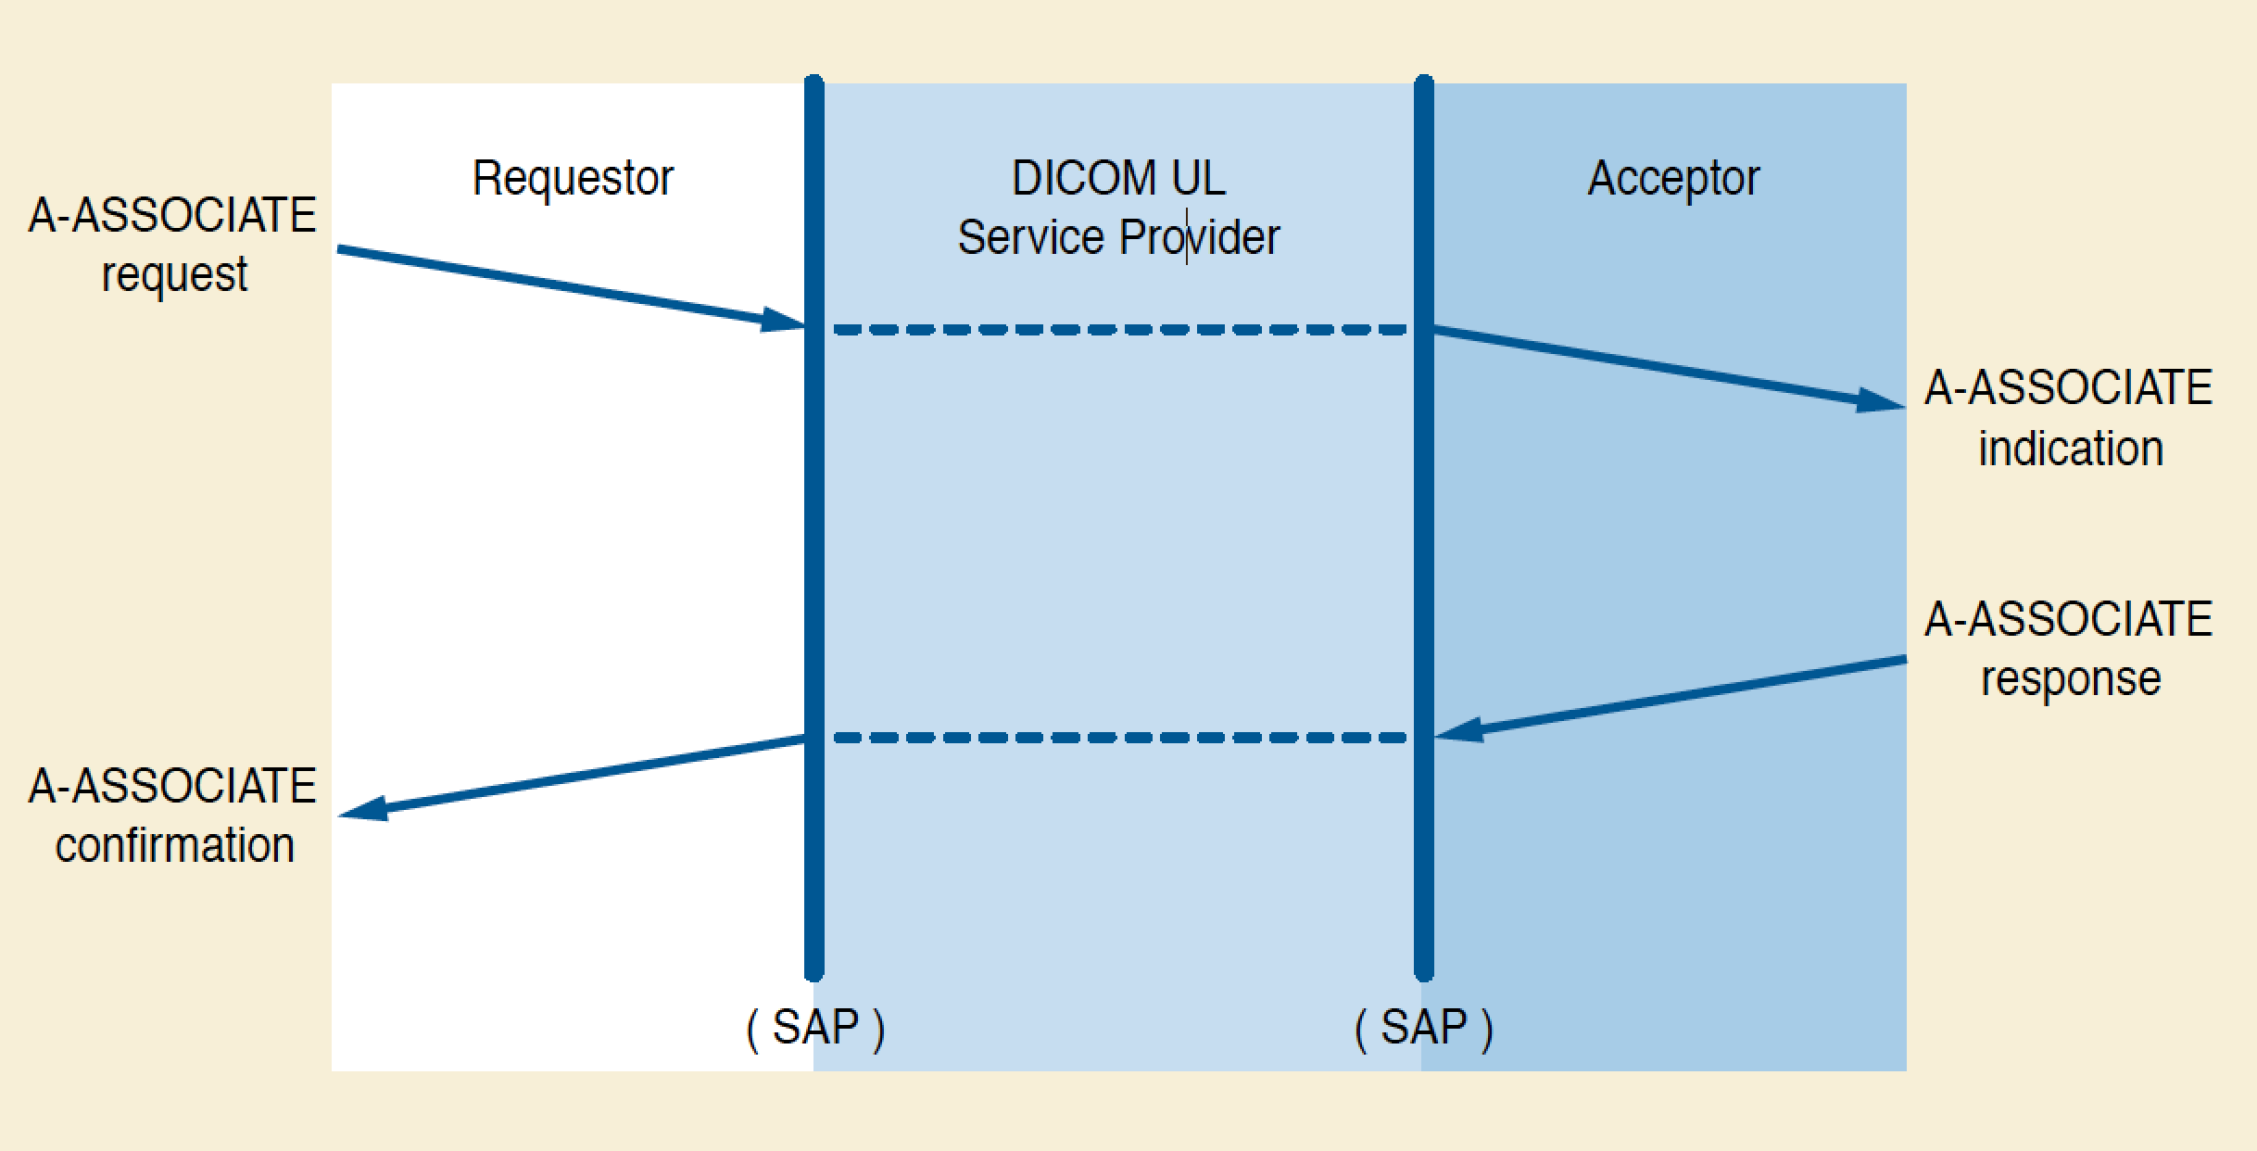
DUL – Association Request

Slide 86
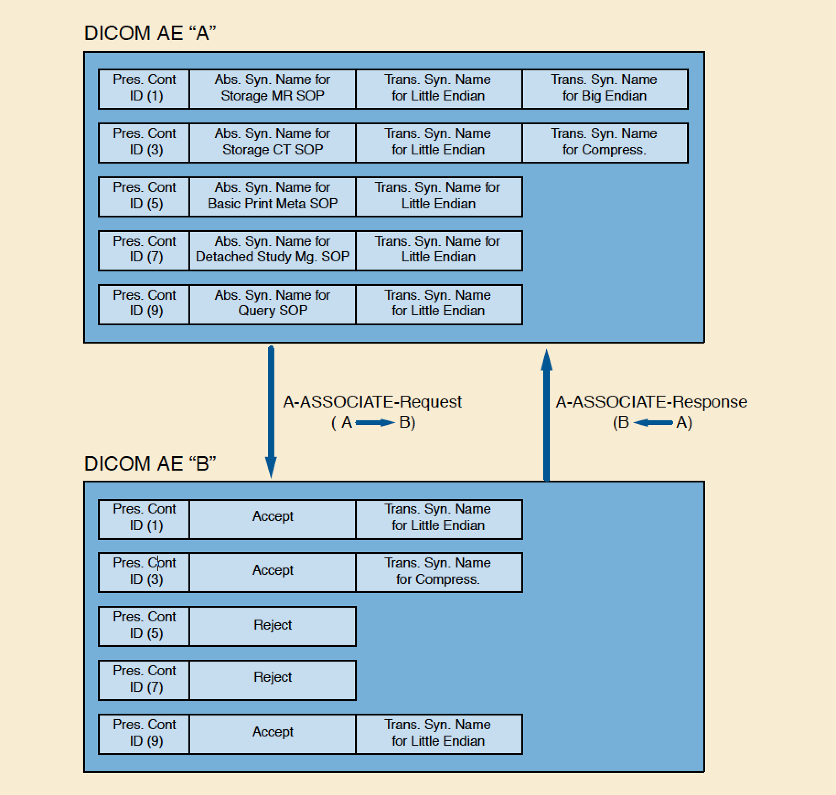
Presentation Context

Slide 87
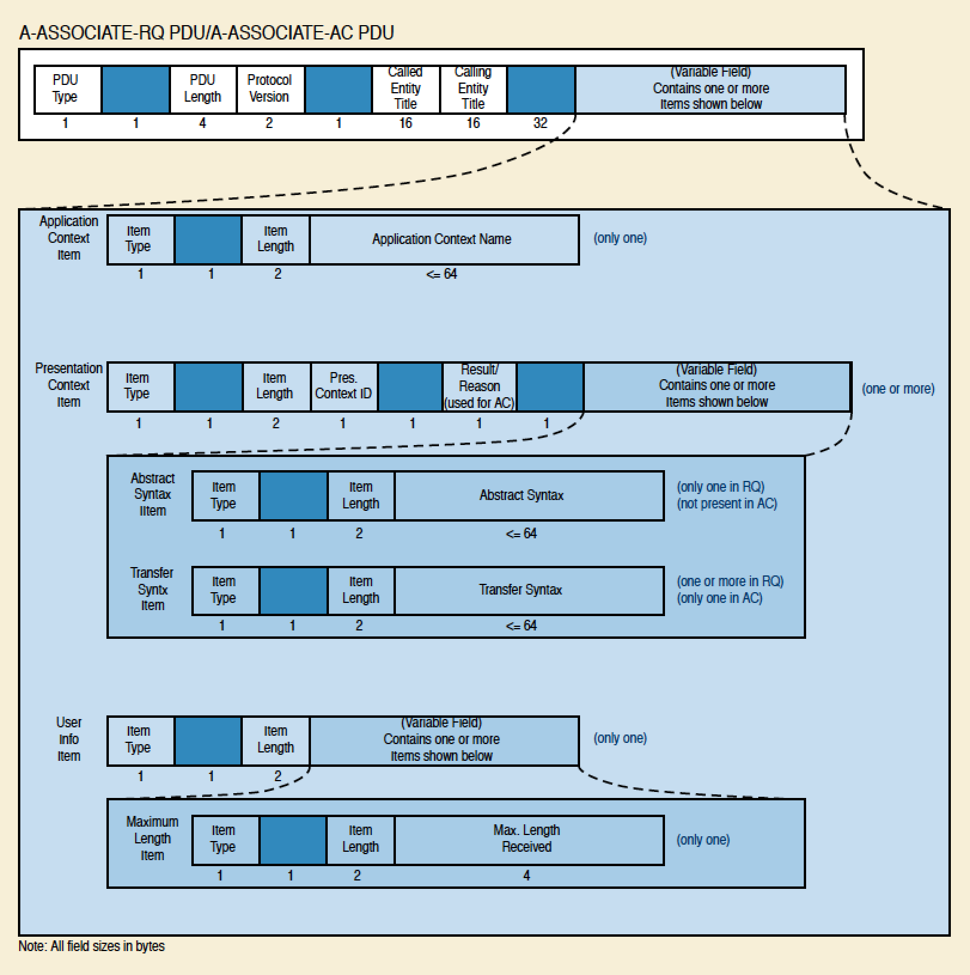
A-ASSOCIATE-RQ/-AC PDU

Slide 88
Message Service Elements
DIMSE-C
C-STORE
C-GET
C-MOVE
C-FIND
C-ECHO
C-CANCEL
DIMSE-N
N-EVENT-REPORT
N-GET
N-SET
N-ACTION
N-CREATE
N-DELETE

Slide 89
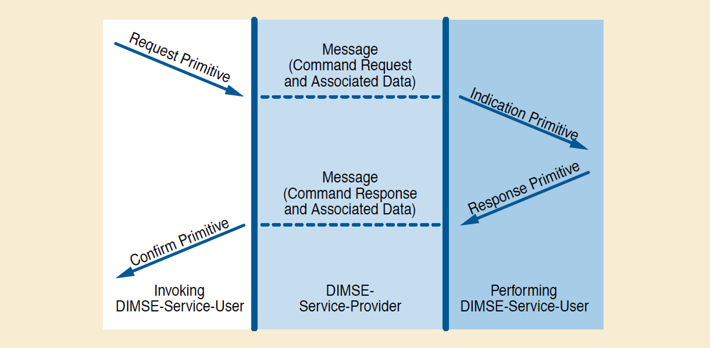
DIMSE Service Primitives

Slide 90
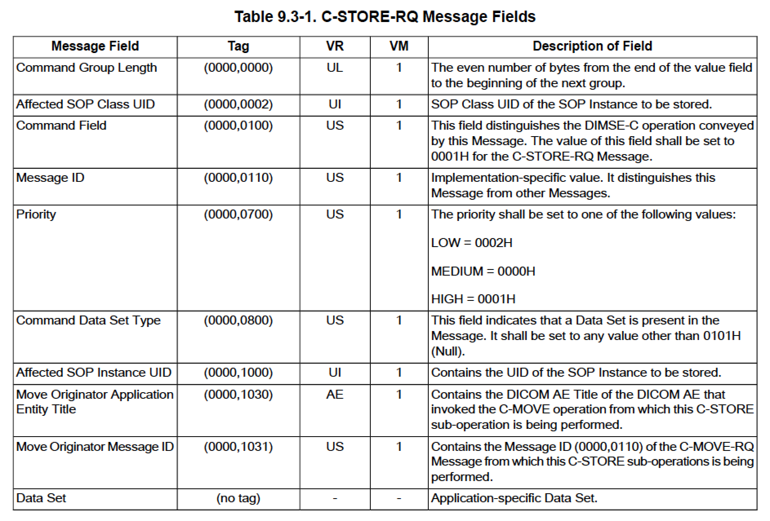
DIMSE Protocol - Commands

Slide 91
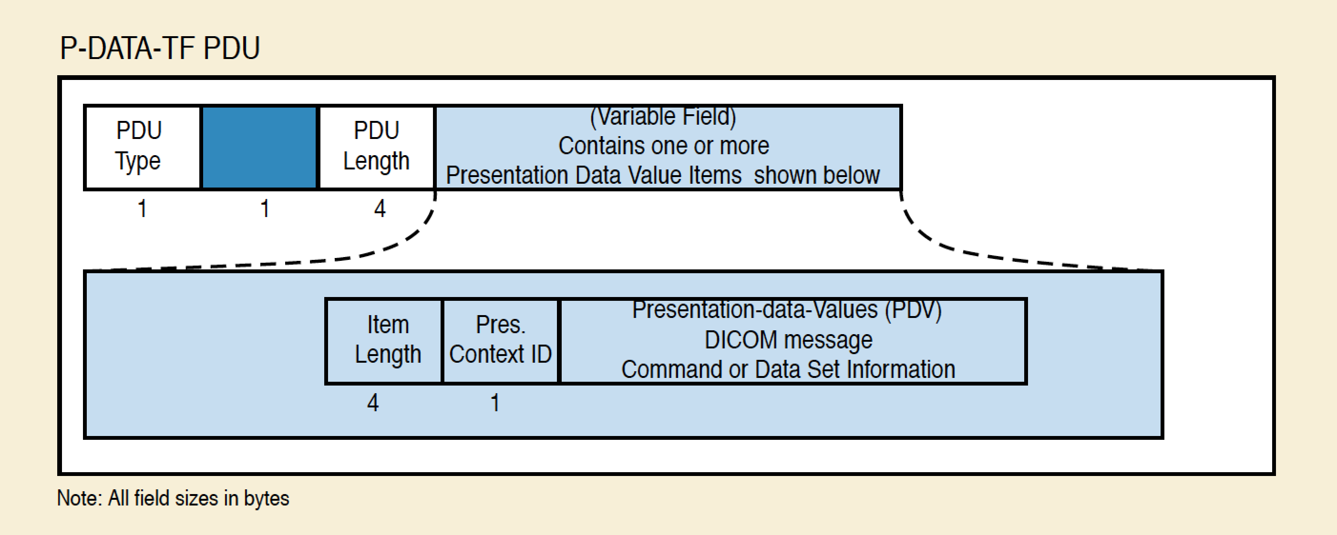
P-DATA-TF PDU

Slide 92
DUL and DIMSE Example
SCU
SCP
Establish TCP/IP Connection
to IP/port deduced from AET
A-ASSOCIATE-RQ
offer CT Image Storage, default TS
A-ASSOCIATE-AC
accept CT Image Storage, default TS
P-DATA-TF
C-STORE-RQ Msg: Command
P-DATA-TF
C-STORE-RQ Msg: Data Set
P-DATA-TF
C-STORE-RSP Msg: Command
A-RELEASE-RQ
A-RELEASE-RSP
Close TCP/IP Connection

Slide 93
DUL and DIMSE Example
SCU
SCP
Establish TCP/IP Connection
to IP/port deduced from AET
A-ASSOCIATE-RQ
offer CT Image Storage, TS1, TS2
A-ASSOCIATE-AC
accept CT Image Storage, TS1
P-DATA-TF
C-STORE-RQ Msg: Command
Loop
P-DATA-TF
C-STORE-RQ Msg: Data Set
P-DATA-TF
C-STORE-RSP Msg: Command
A-RELEASE-RQ
A-RELEASE-RSP
Close TCP/IP Connection

Slide 94
DUL and DIMSE Example
SCU
SCP
Establish TCP Connection
to IP/port deduced from AET
A-ASSOCIATE-RQ
offer CT Image Storage, TS1, TS2
A-ASSOCIATE-AC
accept CT Image Storage, TS1
Loop
P-DATA-TF
C-STORE-RQ Msg: Command
Loop
P-DATA-TF
C-STORE-RQ Msg: Data Set
P-DATA-TF
C-STORE-RSP Msg: Command
A-RELEASE-RQ
A-RELEASE-RSP
Close TCP Connection

Slide 95
Summary
Brief history
File formats and Storage Services
Data Set encoding principles
Transfer Syntaxes
Information Object Definitions
Storage SOP Classes
Other DICOM services than storage
Conformance statements
Association Negotiation
DICOM Message Service Elements (DIMSE)
DICOM Upper Layer Protocol (DUL)

