Slide 1
Containers on HPC
The view from Biowulf
Dave Godlove, NIH HPC, Publicis/Sapient

Slide 2
Outline
What’s a container? And what’s it good for?
Container platforms (Docker and Singularity)
Unique challenges of running containers on HPC
Singularity’s approach to address these challenges
Use cases for containers in HPC (the view from Biowulf)
Ongoing challenges and future directions
Q&A

Slide 3
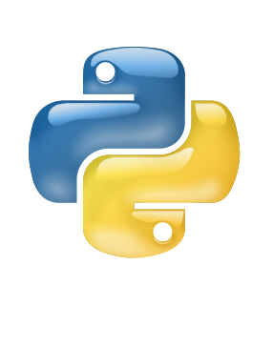
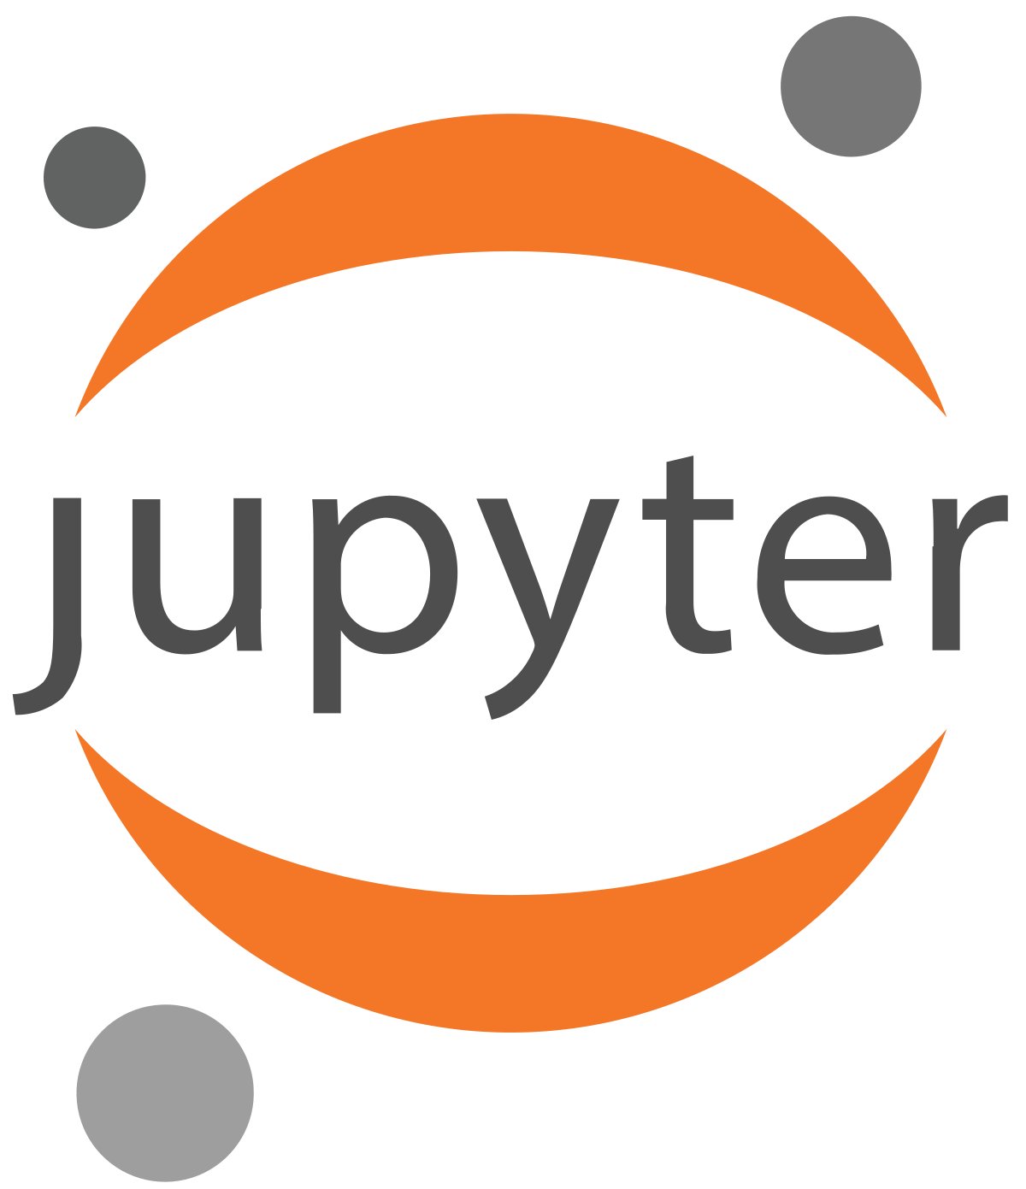
What is a container?
SAMtools
Containers 101
Containers are encapsulations of operating system environments
Includes all applications, libraries, configs, and dependencies
Workflows are completely self-contained and portable
Makes it easy to share, distribute, validate, and reproduce

Slide 4
How does it work?
Virtualized
like a virtual machine (but different)
Application
Application
Application
Native
Native
Contained
File System
A is always less then B due to C
Containers run at the same speed as native apps
Kernel
C
Virtualized Hardware
Application
Application
Application
Application
Application
Application
Application
Application
B
File System
File System
Container
Host Kernel
Host Kernel
Physical Hardware
A
Physical Hardware
Virtual Machine Architecture
Container Architecture

Slide 5
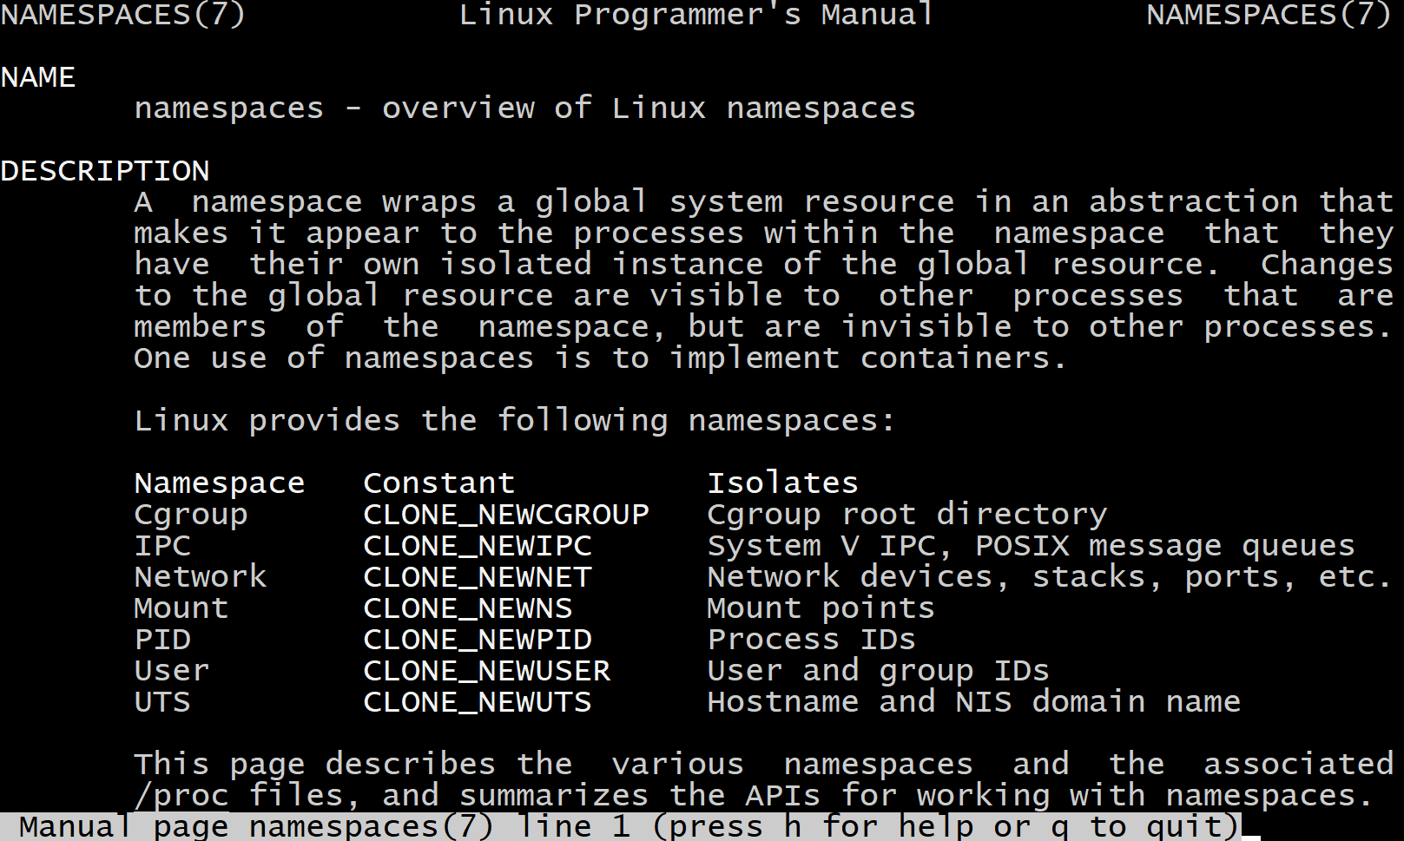
How does it work?
leveraging existing kernel features

Slide 6
What is it good for?
Common use cases
Microservices / Cloud native app development and management
CI/CD
Software distribution
Bring Your Own Environment (BYOE)
Reproduce results
Improve security

Slide 7
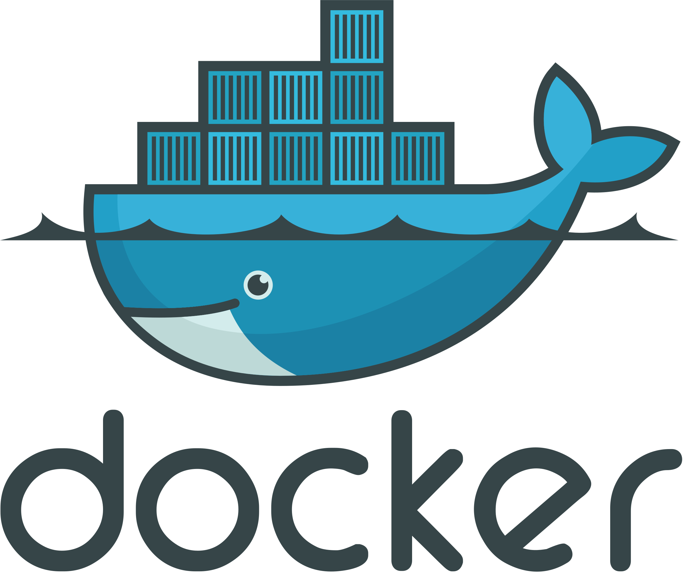
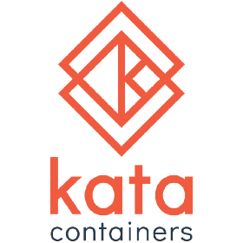
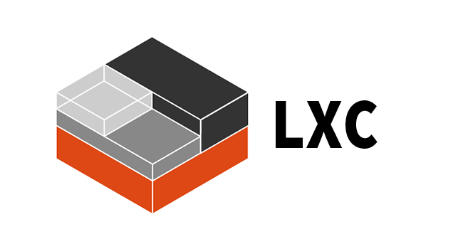
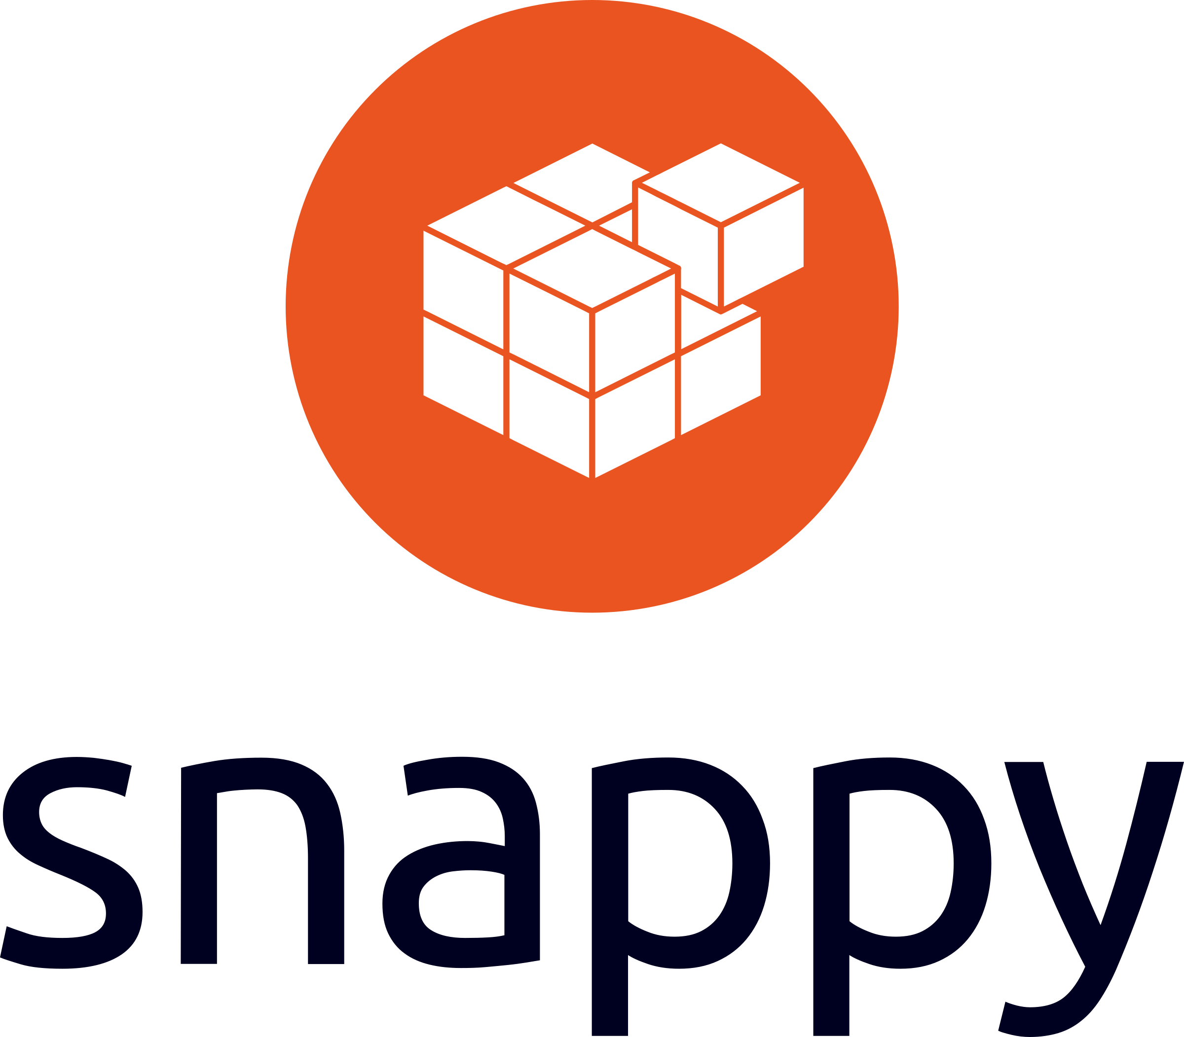
Container platforms
choosing the right tool for the job
Singularity

Slide 8
Docker
target audience and defining characteristics
Made containers popular!
Microservices / Cloud native app development and management
Layered file system created at runtime with manifest
Isolation as a primary goal
Docker Hub!

Slide 9
HPC and containers
challenges
Users cannot have root privileges inside or outside of containers
Containerized workflows must run within the confines of a resource manager (like Slurm)
Some namespaces (like PID and network) are unwanted in HPC
Need to use hardware like infiniband, GPUs, and parallel file systems to keep the “HP” in “HPC”
Need to work with HPC technology like MPI

Slide 10
Singularity
target audience and defining characteristics
Built for HPC (by HPC)
Built for untrusted users running untrusted containers safely
Single file container format (SIF)
Extreme mobility
Compatible with batch schedulers, HPC hardware, MPI etc.
Will work with many container formats including Docker!
Singularity container services
Library
Remote Builder
Keystore

Slide 11
Resource managers
HPC Scheduler
Singularity compatibility
HPC Resource Manager
Scheduler and Resource Manager work together to orchestrate jobs in HPC
Traditional container daemons operate outside context of the Resource Manager
Singularity maintains original execution context
Jobs running within Singularity containers are just like any other jobs!
User’s shell / Batch Script
Container Daemon runs as root
Singularity
Contained Program / Workflow
Contained Program / Workflow
User Privilege and PID Context

Slide 12
GPUs
Singularity compatibility
Singularity was the first container platform to offer seamless integration with NVIDIA GPUs
NIH HPC staff were critical to developing and testing this capability
Singularity now supports both AMD and NVIDIA GPUs thanks to contributions from developers working at these companies

Slide 13
Integration over Isolation
Singularity compatibility
Bind mounted directories by default
You are the same user inside and outside of your containers
Only mount namespace joined by default; network, PID table, etc. are all accessible!
Notes:
=

Slide 14
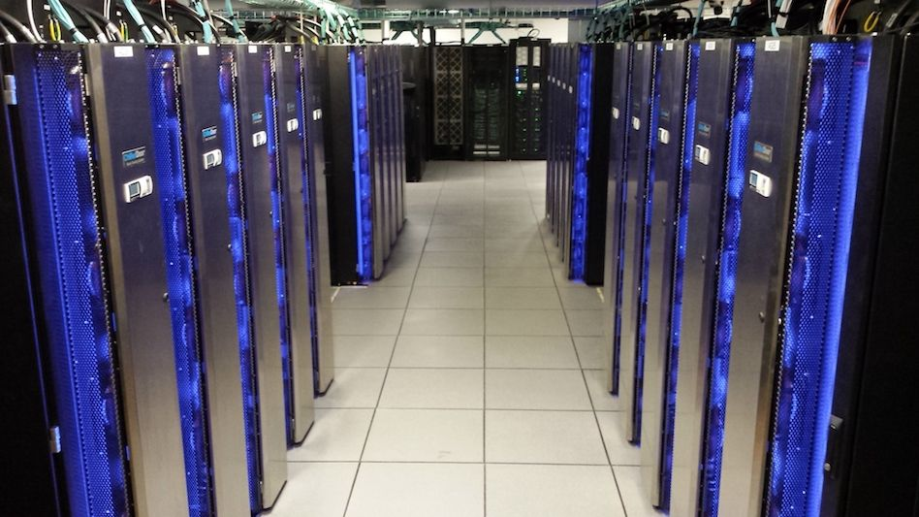
Containers on Biowulf
use cases

Slide 15
Early adoption
first uses on Biowulf
Tensorflow and associated Deep Learning apps on RHEL 6
Developed integration with GPUs
Still useful for apps that require newer, older, or different operating systems
+
RHEL6
Notes:
=

Slide 16
Empowering HPC users
The power to install almost anything
Most users don’t have administrative access on Biowulf (for obvious reasons)
Singularity allows users to install apps in any environment where they have admin access and then bring those environments to Biowulf
Can use package managers that normally require administrative access
Can leverage environments created by others
Environments are portable and reproducible

Slide 17
Empowering Admins too
NIH HPC staff containerize user requested apps
100+ applications have been installed using Singularity containers
Difficult or impossible to install applications are often made possible or even easy using containers
These applications can be re-installed on a new OS as simply as copying files
Notes:
=

Slide 18
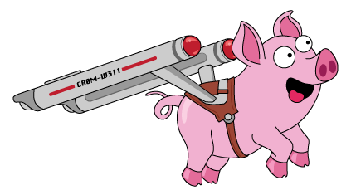
Workflow managers
many workflow managers can leverage singularity containers natively
Cromwell

Slide 19
The future of containers
Remaining challenges and upcoming features
More work should be done to abstract workflow tools
Security is an ongoing topic
Container encryption

Slide 20
Learn more
https://hpc.nih.gov/apps/singularity.html
https://github.com/sylabs/singularity
https://sylabs.io/
https://cloud.sylabs.io/home
Thank you!
Notes:
=

Slide 21
Parallel file systems
Python on bare metal vs containerized
bare metal
100
containerized
Singularity compatibility
Compared scaling of a standard python installation with an identical containerized installation ( Singularity )
Underlying file system is NFS, max jobs was 5120 over 320 nodes, graph is logarithmic on both axis.
Total time [s]
10
Dr. WOLFGANG RESCH
https://github.com/wresch/python_import_problem
10
100
1000
Total number of concurrent interpreters
Notes:
=

