Slide 1
Acceleration of Hyperparameter Optimization via Task Parallelism for Information Extraction from Cancer Pathology Reports
Hong-Jun Yoon¹, John Gounley¹, M. Todd Young¹, Mohammed Alawad¹, Xiao-Cheng Wu², and Georgia Tourassi¹
1. Computational Sciences and Engineering Division
2. Louisiana State University, Louisiana Tumor Registry

Slide 2
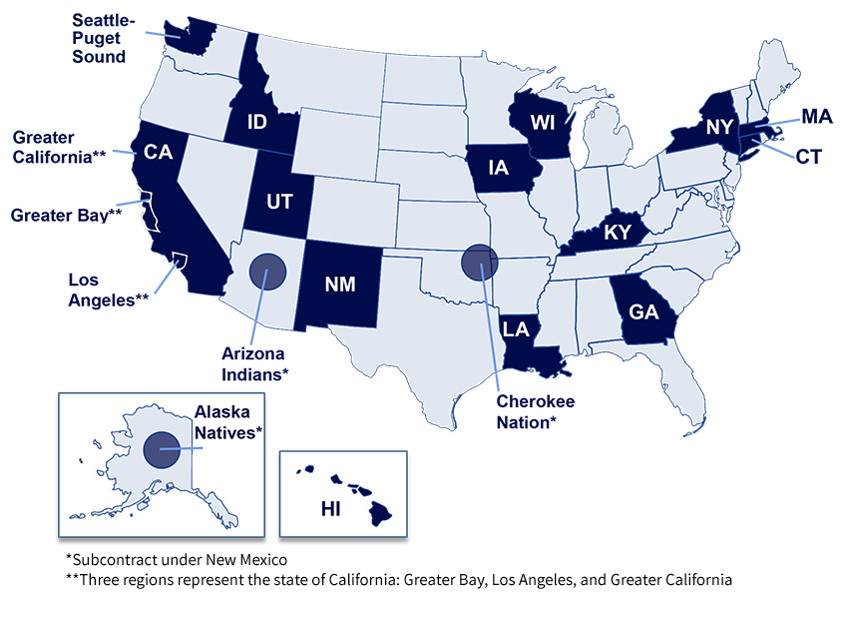
Pilot 3: Population-scale information extraction and analysis of unstructured clinical/phenotype data
Classification tasks
Precision medicine
Specialized cohorts

Slide 3
Data extraction from cancer pathology reports
NLP Model Search
Scalability across pathology labs, SEER registries, and cancer phenotypes
Development & deployment
Multi-task neural networks
Supervised
API
Convolutional neural networks
Self-attention neural networks
Increasing robustness to label quality
Recurrent neural networks
Semi-supervised
Cancer phenotypes
Site
Histology
Grade
Behavior
Laterality
…
Data setup
Complete workflow
Generation: Character-based recurrent neural network
Unsupervised
CORAL-2
Word embeddings: Word2Vec, CUI2Vec, and FastText
O(10000) cancer phenotypes
Population-scale deep learning supporting data-driven cancer epidemiology

Slide 4
Data partitioning
Why partition dataset?
Expose additional levels of parallelism during training
Improve models themselves
Targeting
Robustness
How to partition dataset?
Group similar reports
Randomly
ePathReport dataset
~1 million reports

Slide 5
Example topographical/morphological data partitioning
Topography | Histology | # cases
Digestive organs | Adenocarcinomas | 44,795
Respiratory system | Squamous carcinomas | 14,588
Respiratory system | Adenocarcinomas | 18,992
Respiratory system | Other specific carcinomas | 11,077
Hematopoietic and reticuloendothelial systems | Leukemia | 20,828
Skin | Other specified types of cancer | 14,955
Breast & female genital organs | Adenocarcinomas | 92,246
Male genital organs | Adenocarcinomas | 28,149
Urinary tract | Squamous carcinomas | 18,021
Lymph nodes, other & ill-defined sites | Lymphomas | 14,278

Slide 6
HPO workflow
Data partition: Group by high-level topological-morphological classification
Hyperparameter optimization:
Train many models per grouping
ePathReport dataset
Breast, carcinoma
HPO iterations
Kidney, sarcoma
Model parameter inheritance
HPO iterations
Lung, carcinoma
Skin, melanoma
HPO iterations
…
Optimal hyperparameters per group
HPO iterations

Slide 7
Multi-task convolutional neural network architecture

Slide 8
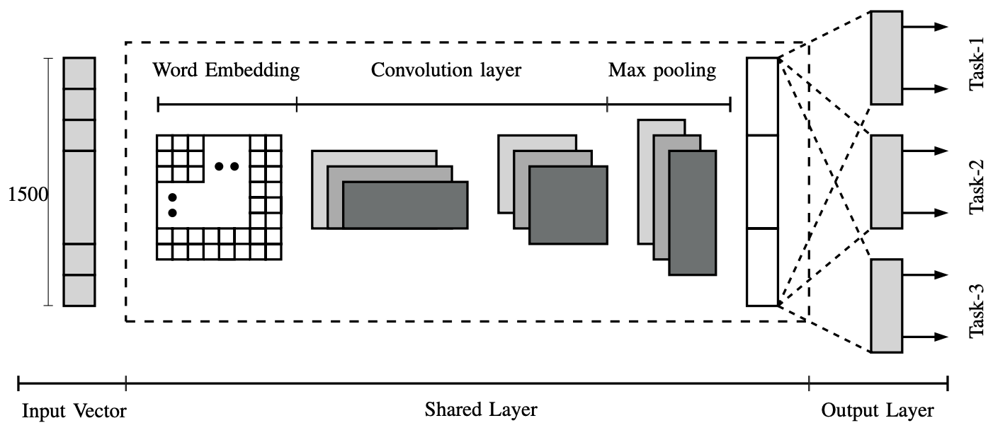
Optimization for training models via parameter inheritance
Save weights from one model and use to initialize subsequent models
During HPO:
Train maximally sized model
Randomly select subset of weights fitting hyperparameter sizes

Slide 9
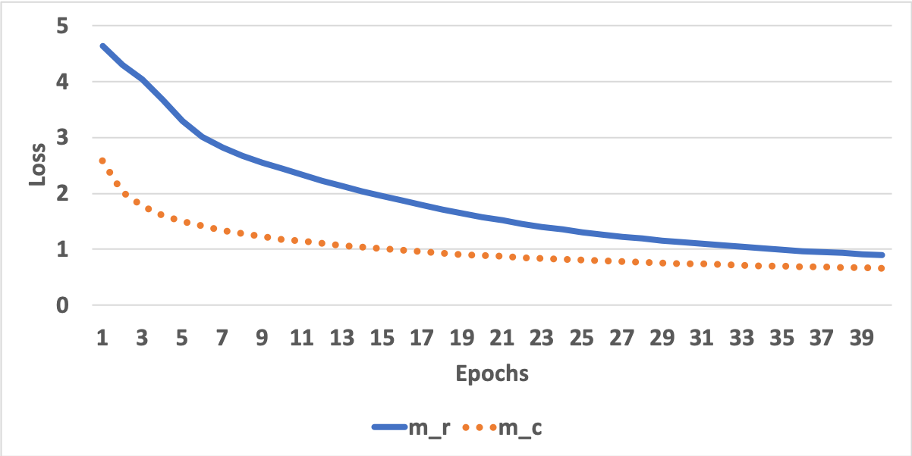
Model parameter inheritance
Improves
time-to-solution
by 2-3x
Training loss
Validation loss

Slide 10
Hyperparameter optimization: convergence
Model-based optimization
5 iterations
274 propose points/iteration
Hyperparameters
Batch size
Dropout rate
Convolution filter sizes
Number of convolution filters
Word-vector length
Number of fully connected layers
Size of fully connected layers
Dropout of fully connected layers

Slide 11
Does data partitioning influence accuracy in HPO?
Data | Site |  | Subsite |  | Laterality
 | Macro | Micro | Macro | Micro | Macro | Micro
Partitioned | 0.937 | 0.503 | 0.607 | 0.252 | 0.902 | 0.504
Standard | 0.937 | 0.534 | 0.589 | 0.267 | 0.903 | 0.529
Data | Histology |  | Behavior |  | Grade
 | Macro | Micro | Macro | Micro | Macro | Micro
Partitioned | 0.772 | 0.216 | 0.963 | 0.887 | 0.724 | 0.718
Standard | 0.769 | 0.231 | 0.965 | 0.893 | 0.718 | 0.724
Similar overall accuracy but:
Additional parallelism
Partition-specific convergence in parameter space

Slide 12
Ensembles workflow
Data partition: Group by high-level topological-morphological classification
Bootstrapping:
Train with ~2000 samples per grouping
Aggregating:
Voting and confidence intervals
ePathReport dataset
Breast, carcinoma
Sample model
Kidney, sarcoma
Sample model
Lung, carcinoma
Sample model
Skin, melanoma
Sample model
Sample model
…
Sample model

Slide 13
Acknowledgements
This research was supported by the Exascale Computing Project (17-SC-20-SC), a collaborative effort of the U.S. Department of Energy Office of Science and the National Nuclear Security Administration.
This work has been supported in part by the Joint Design of Advanced Computing Solutions for Cancer (JDACS4C) program established by the U.S. Department of Energy (DOE) and the National Cancer Institute (NCI) of National Institutes of Health. This work was performed under the auspices of the U.S. Department of Energy by Argonne National Laboratory under Contract DE-AC02-06-CH11357, Lawrence Livermore National Laboratory under Contract DE-AC52-07NA27344, Los Alamos National Laboratory under Contract DE-AC5206NA25396, and Oak Ridge National Laboratory under Contract DE-AC05-00OR22725.
The authors wish to thank Valentina Petkov of the Surveillance Research Program from the National Cancer Institute and the Louisiana SEER registry for the pathology reports used in this investigation.
This research used resources of the Oak Ridge Leadership Computing Facility at the Oak Ridge National Laboratory, which is supported by the Office of Science of the U.S., Department of Energy under Contract No. DE-AC05-00OR22725.

