Slide 1

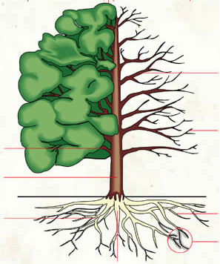


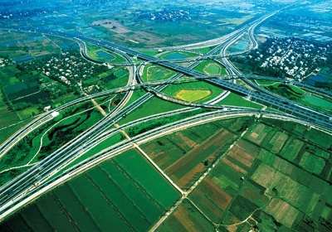

Challenges & Opportunities of
Quantitative Imaging Network (QIN) in China
Yan Kang, Ph.D.
Dean/Prof., Sino-Dutch Biomedical & Information Engineering School
Northeastern University
Neusoft Proprietary & Confidential

Slide 2
Prof. Dr. Yan Kang, Ph.D.
Current Position:
Prof. & Dean, Sino-Dutch Biomedical and Information Engineering School at Northeastern University, China;
Director, Institute of Healthcare Research, Neusoft Xikang Healthcare Ltd.
Chief Knowledge Officer, Medical IT Division, Neusoft Group.
Education:
2005, Postdoctoral fellow, Stanford University, Image Guidance Lab, USA
2002, Ph.D., Institute of Medical Physics, University of Erlangen-Nürnberg, Germany
1990, ME, 1987 B.E. , Xi'an JiaoTong University, China
Social Activity:
Chairman, IEC-62B (Diagnostic Imaging Equipment )
Chairman, China Standards Committee for Medical X-ray Equipment and Devices
Chairman, Liaoning Medical Information and Healthcare Engineering Society
Vice Chairman, China Digital Medicine and Medical Informatization Society

Slide 3
Profile of Medical and Healthcare in China
Population: 1.4 billion people, aging population-above 65 years(6.97%)
Health: Only 15% of Chinese people live to the definition for Health by WHO, and15% are being sick and the rest 70% are sub healthy.
In China, there are 961,000 healthcare units including 24,000 hospitals. Among them, there are public (13440) and private (10877).
Medical and healthcare: passive medical; poor accessed and high-cost medical service
Industrial, academic, and education: mostly imported products, Local-enterprises weak & followers, High-end R&D not enough, Innovation Capability very low.
Government and society: Total expenditure on health (2012) in China increases by 18%, but still is very low (5.57% GDP). It is 2135.8 RMB (<400 $) per capita health expenses. There are 14.2 doctors per million persons.
Rank | Site | Mortality (1/10⁵)
1 | malignant tumor | 135.59
2 | cerebrovascular disease | 111.01
3 | heart disease | 95.77
4 | respiratory disease | 72.64
5 | injury and poisoning | 31.92
Area | ASR | Cum. risk (%) | ASR | Cum. risk (%)
China | 286 | 22.0 | 181 | 13.0
More dev. areas | 300 | 30.1 | 144 | 15.0
Less dev. Areas | 160 | 17.0 | 119 | 12.7
ASR indicates age-standardized rate per 100,000
Rank | Site | Mortality (1/10⁵)
1 | Lung | 45.57
2 | Liver | 26.04
3 | Stomach | 25.88
4 | Esophagus | 16.77
5 | Colorectum | 14.23

Slide 4
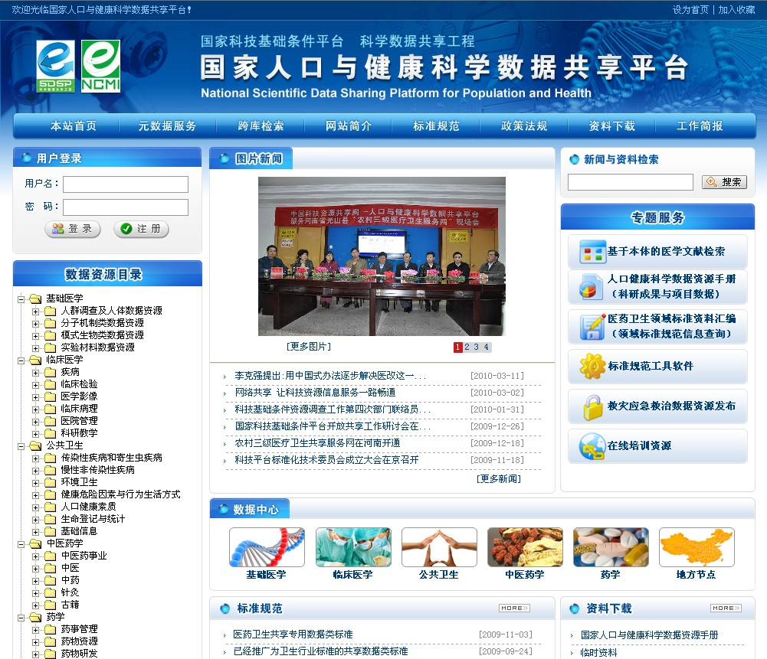
Quantitative Medical Imaging in China
Evolution Trends of QI
  Digital Technology: less creative, more application Oriented, well equipped hospitals;
  Clinical methods: qualitative → semi-quantitative → quantitative; Traditional Chinese medicine ←→ western medicine;
  Industrial: Stronger Medical IT, Weaker Medical Equipment
National Scientific Foundation Committee (NSFC):
  National Scientific Funding (freely chosen research)
  973 program (Given topic research)
Ministry of Science & Technology (Most), Ministry of Health (MoH), Ministry of Education (MoE), etc.
  863 program (MoST, Application oriented); 2011 program (MoE, talent base oriented); Clinical Information Program (MoST & MoH);
  National Special Program: Scientific Data Sharing Project
    National Scientific Data Sharing Platform for Population and Health
    Phase 1: 2003-2004; Phase 2: 2005-2008; Phase 3：2008-Now
Number of Tumor Projects
1. Digestive
2. Urology
3. Respiratory
Notes:
国家人口与健康科学数据共享平台是该共享网已启动的五个中心之一。2003年在科技部立项，2004年4月正式启动。项目的总体目标是建立一个物理上分布、逻辑上高度统一的医药卫生科学数据管理与共享服务系统，为政府卫生决策、科技创新、医疗保健、人才培养、百姓健康和企业发展提供数据共享和信息服务。
基础医学科学数据中心的依托单位是中国医学科学院基础医学研究所，共建单位有：中科院生物物理所、中科院计算所、清华大学、北京大学、华大基因研究所、第三军医大学、首都儿科研究所、军事医学科学院放射与辐射医学研究所、南京大学模式动物研究所、中国医学科学院阜外心血管病医院等。
中心以健康和疾病为主题，进行基础医学研究数据的收集、加工和汇交；挖掘和整合与人类健康－亚健康－疾病动态发展过程相关的基础数据和发病机制研究等数据；围绕国家医学科技发展规划和用户需求，重点遴选和整合质量好、与研究重大疾病相关的和使用率高的精品数据库，向国内外科研人员提供中国科学家获得的原始创新性基础医学和生命科学领域相关研究数据，推动有影响和重要的国家科技成果的有效利用；开发和实现跨库和跨中心的关联查询和搜索功能，实现全方位的多级别、分权限的共享服务功能。
按照国家医药卫生科学数据共享工程建设的总体要求，采取“先易后难、成熟一个整合一个、边建设、边共享、边完善”的原则，建立基础医学科学数据汇交、管理工作流程和共享服务平台。目前已完成四大类二十五个数据库的整合和四个工具软件的整合，实现了统一的浏览界面、统一的查询界面、统一的返回界面，使用者可以随机点击，动态共享。实现了跨操作系统、支持多语言、支持多种浏览器。支持的操作系统有Solaris10、Linux Server、Win2000 Server、Win2003 Server等；支持的浏览器种类有Internet Explorer、火狐[Firefox]、傲游[Maxthon]、Opera等；实现了平台站内搜索、整合数据库的数据检索和元数据检索等三大检索功能。
中心要继续努力开发动态跨库检索和基于网络的动态主题数据库软件，实现基础医学科学数据多学科、多层次和多级别共享；在符合和遵循科学数据共享标准体系的前提下，继续完成基础医学科学数据共享相关数据类、技术类和管理类专用标准的建设；加强科学数据共享政策法规、共享标准体系建设和共享标准规范工作；巩固和加强网络的整体安全性建设，形成高效优质的共享服务技术平台，不断完善基础医学科学数据中心门户网站，为促进我国医学科学研究事业的发展做出我们应有的贡献。
2. Natural Science Foundation of China
National Scientific Fundamental Research Program of China (973 Program)
Basic research of GPCR new drug targets related to major cardiovascular disease
New large-scale population study of gastric cancer screening markers and the role of early warning and early diagnosis
Study on some key problems of Shanghai light source for major disease based on medical image

Slide 5
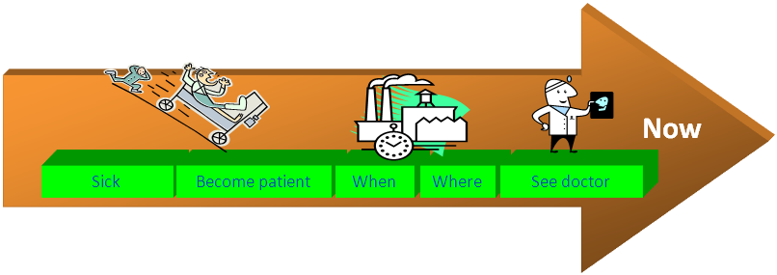
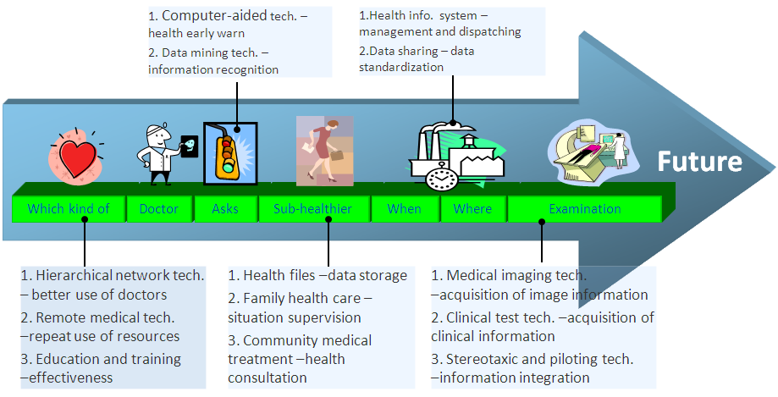
Trends of Medical and healthcare in China
Current situation= Passive Model driven by Patient
Future = Active Model
driven by preventive healthcare data analysis & doctor
Precise medicine
Disease oriented medicine to health oriented ecosystem
Quantitative Network will be anywhere: Cloud computing; Big Data, Mobile, Wireless …

Slide 6
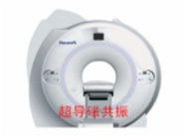
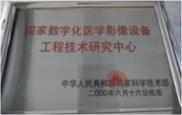
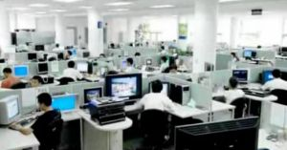
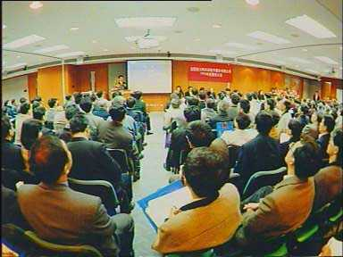

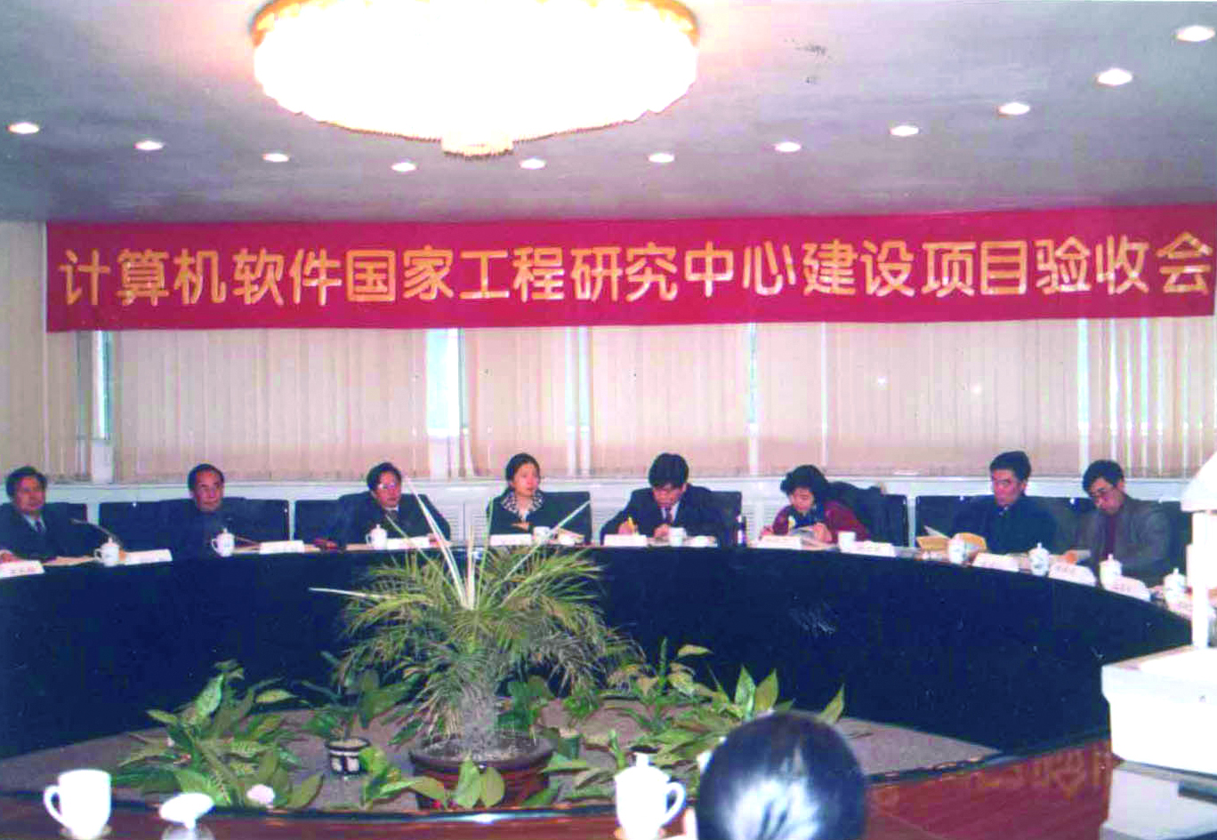

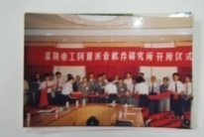
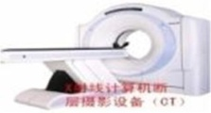
QI Progress within Northeastern Uni. Ecosystem
Industrial Business Development:
Covered Area: Medical IT(1995) → Medical Imaging Equipment (1998) → HealthCare (2009)
Increasing Quantitative: EMR, PHR, Healthcare data service, Xikang Healthcare Cloud
Diseases Orentied QI Solutions:
Medical Imaging Equipment + QI: UroCARE (FDA), ColonCARE, BrainCARE CT Etc.
Medical IT + QI: PACS, MamoCADx, LungCADe
Big Data + QI: EMR, PHR, Healthcare data service, Xikang Cloud
Over 20 years
Key Lab for Medial Imaging and Computing
NEU IT-BT Magic Cube
2012-
Medical IT
Manufacturer service
Individual health information
Disease control centre
MRI
Bureau of drug supervision
NEU Academy of Research
2011
National Digital Medical Imaging EngineringCenter
2009
Research Institute
National Software Center
Neusoft into Stock market
2005
2007
Medical centre
2004
Noval Period
2003
Neusoft -Shengjing Xikang Health Service
NEU IT-BT Magic Cube
Sanitary Bureau
1991
1993
1994
1996
1999
2000
Sino-Dutch BMIE School
Software Institute
1st CT Scanner in China
NEU-CAS Research Center for Medical Imaging
National Medical Imaging Center (Shengjing)
Clinic
Bureau of labor security
Family
Phase I: Transfering
（1991－2000）
Phase 2：Interacting（2001－2011）
Phase 3: multi-collaborating
（2012－）

Slide 7
Opportunity & Strategy for QIN USA & CHN
Differently Positioning and Focusing:
CHN: Screening , Disease Preventing, Therapy; Clinical Trial
USA: Therapy; Research
National and Local Platform at Hand:
Collaborative Innovation Center for Medical Imaging Equipment and Cloud Application (AMIC)
National Scientific Data Sharing Platform for Population & Health, Liaoning Data Service Center）
Industry (Neusoft) – education (BMIE) - research (AMIC) – Applications (A few Hospital Alliance)
National Cloud Computing Center (Liaoning Center for medical & healthcare Cloud)
IEC – TC 62B （Diagnostic Imaging Equipment）
Sino-Euro Vision & Brain Institute (CHN: He’s Eye Hosp. + NEU; NL: TU/e + UM; US: WSU)
Strategy:
Entry Point: working on solving social important problems, choose 1-2 diseases
Collaboration: QIN protocol generalization and cooperative clinical trial project
Development: promote applications by leveraging emerging technologies
Actions:
U01: Start with cooperative clinical trial project and established QIN protocol
QIN-US-CN: Define QIN demonstration project and promote teamwork with complementary team
Team-US-CN: Regularly interact with each other and create a collaborative environment

Slide 8

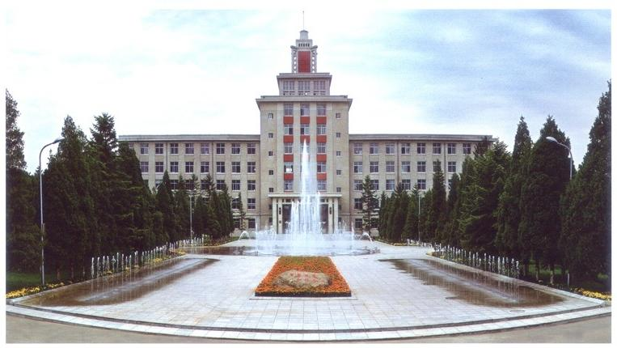
Thank you

