Slide 1
GDC API and Pipelines
NCI Cloud Pilot Collaboration Meeting
August 10, 2015

Slide 2
Agenda
GDC API
Overview
Authentication
Entity Endpoints
Download Endpoint
GDC Pipelines
GRCh38 Reference Genome
BWA (DNA-Seq)

Slide 3
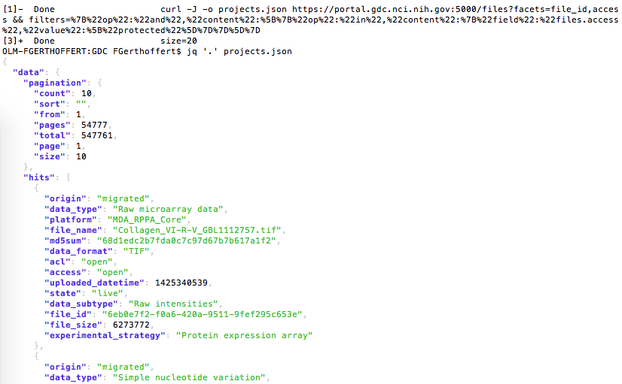
GDC API Overview
REST API for programmatically interfacing with the GDC to query and download data
Drives the current data portal
Current features include:
Search an indexed view of the GDC data model for projects, files, cases, and annotations
Gather details about a project, file, case, or annotation
Download files
API URL
Endpoint
Optional Entity ID
Query parameters
https://gdc-api.nci.nih.gov/files/5003adf1-1cfd-467d-8234-0d396422a4ee?fields=state

Slide 4
GDC API: Endpoints
Query and retrieve
Expose GDC data through a query mechanism that returns JSON output
Six endpoints available:
Four search and retrieval endpoints, return JSON output:
/projects
/cases
/files
/annotations
One for download, returns single file or tar.gz:
/data
One for reporting the API status: /status

Slide 5
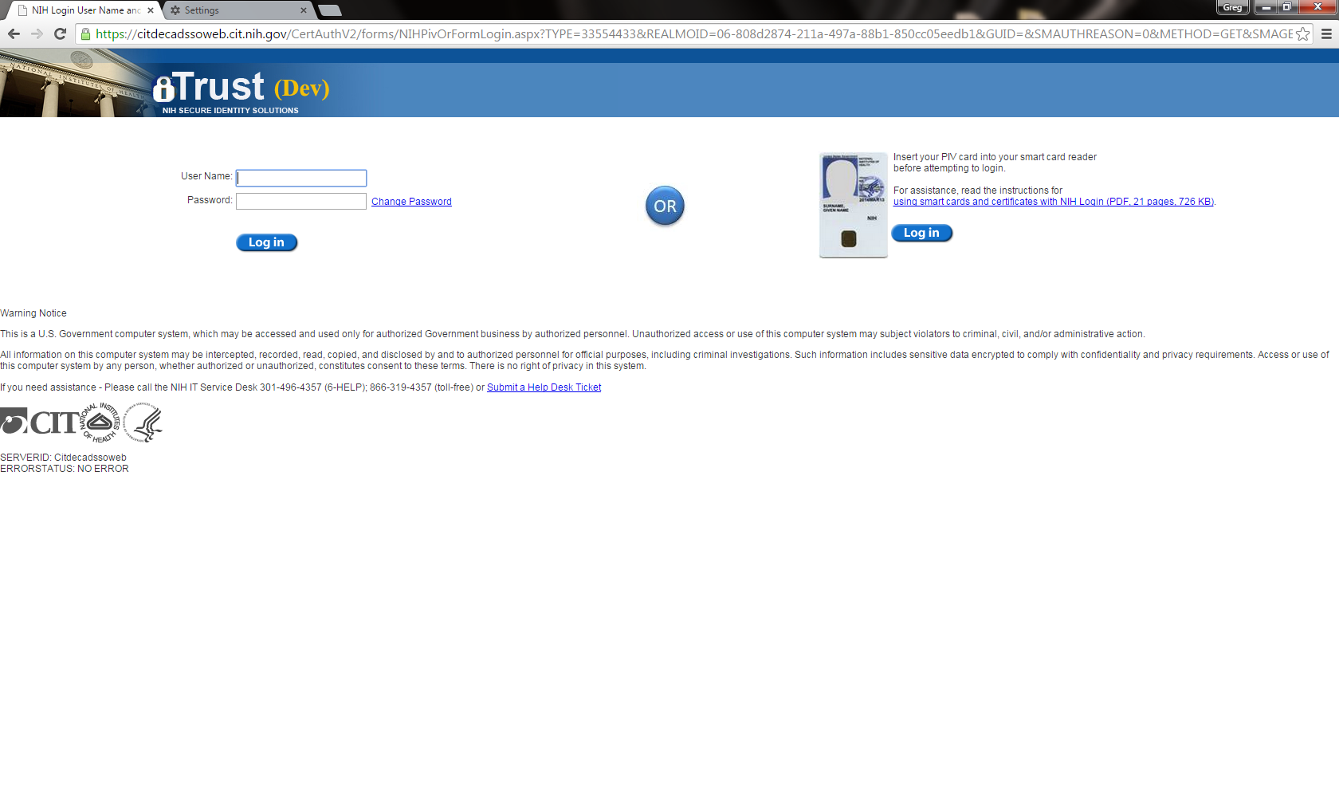
GDC API: Token-Based Authentication
Browser must be used to first obtain a token
No direct API access due to limitations of current SAML protocol, see https://wiki.shibboleth.net/confluence/display/CONCEPT/ECP
To obtain a token:
Login to the GDC portal using your eRA Commons
After login, the option to download a token appears under your username in the upper right
Provided using the X-Auth-Token header
GDC Token
eRA Commons Login

Slide 6
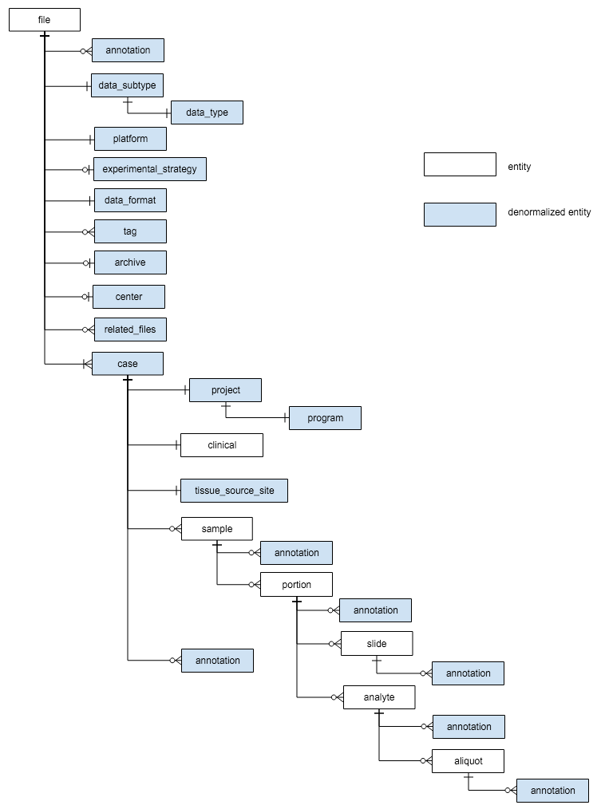
GDC API: Search and Retrieval Endpoints
Utilizes ElasticSearch to provide an indexed view of the GDC data model
For each endpoint type, a walk is done on the graph to create a nested JSON document
Each endpoint has a “_mapping” function for obtaining the current document structure, including query fields and their types
https://gdc-api.nci.nih.gov/projects/_mapping

Slide 7
GDC API: Query by Filtering
Direct API querying is done by using the “filter” parameter
Portal provides ‘GQL’, a more human friendly syntax that gets translated
Single Field Example:
{"op": "=",
"content": {
"field": "cases.clinical.gender",
"value": ["male"]
}
}
Multi Field Example
{"op": "and",
"content": [
{
"op": "=",
"content": {
"field": "cases.clinical.gender",
"value": "female"
}
},
{
"op": "=",
"content": {
"field": "files.platform",
"value": "Affymetrix SNP Array 6.0"
}
}
]
}
The full URL:
https://gdc-api.nci.nih.gov/files?filters={"op":"=","content":{"field":"cases.clinical.gender","value":["male"]}}
Single field operators: =, != , <, <=, =, >, >=, in, is, not, range, exclude
Multi field operators: and, or

Slide 8
GDC API: Search and Retrieval Endpoint Parameters
All of the entity endpoints take the same query string parameters:
Facets, specify for which fields to include a document count
Fields, specify which fields to include the response, _mapping will report the defaults if none are specified
Filters, as described on previous slide
From, specify the first record to return for pagination
Size, number of results to return
Sort, specify a field to sort by
Pretty, prettify JSON response

Slide 9
GDC API: Sample Call (projects endpoint)
List projects or retrieve details about a specific project
Retrieve a list of projects
Example: https://gdc-api.nci.nih.gov/projects?fields=project_id,primary_site&facets=primary_site&pretty=true
Retrieve project-specific details
Example: https://gdc-api.nci.nih.gov/projects/TCGA-BRCA?fields=name,summary.case_count&pretty=true
{
"data": {
"hits": [
{"project_id": "TCGA-SKCM”,"primary_site": "Skin”}
, {"project_id": "TCGA-PCPG”,"primary_site": "Nervous System”}
, {"project_id": "TCGA-LAML”,"primary_site": "Blood”}
, {"project_id": "TCGA-CNTL”,"primary_site": "Not Applicable”}
, {"project_id": "TCGA-UVM”,"primary_site": "Eye”}
, {"project_id": "TARGET-AML”,"primary_site": "Blood”}
, {"project_id": "TCGA-SARC”,"primary_site": "Mesenchymal”}
, {"project_id": "TCGA-LUSC”,"primary_site": "Lung”}
, {"project_id": "TARGET-NBL”,"primary_site": "Nervous System”}
, {"project_id": "TCGA-PAAD”,"primary_site": "Pancreas”}
] ,
"aggregations": {
"primary_site": {
"buckets": [
{"key": "Blood", doc_count": 6},
{"key": "Kidney", "doc_count": 6},
// Portion remove for readability
}}}
{
"data": {
"name": "Breast Invasive Carcinoma",
"summary": {
"case_count": 1101
}
},
"warnings": {}
}
Retrieving project-specific details
Retrieving list of projects

Slide 10
GDC API: Data Endpoint
Stream single file or gzipped (tar.gz) files back to the user
Accept one or more UUID (comma separated)
Token provided as X-Auth-Token header required to access restricted files
{
"origin": "migrated",
"data_type": "Raw microarray data",
"platform": "MDA_RPPA_Core",
"file_name": "Collagen_VI-R-V_GBL1112757.tif",
"md5sum": "68d1edc2b7fda0c7c97d67b7b617a1f2",
"data_format": "TIF",
"acl": "open",
"access": "open",
"uploaded_datetime": 1425340539,
"state": "live",
"data_subtype": "Raw intensities",
"file_id": "6eb0e7f2-f0a6-420a-9511-9fef295c653e",
"file_size": 6273772,
"experimental_strategy": "Protein expression array"
},
{
"origin": "migrated",
"data_type": "Simple nucleotide variation",
"platform": "Affymetrix SNP Array 6.0",
"file_name": "DUNGS_p_TCGA_b84_115_SNP_N_GenomeWideSNP_6_C09_771624.birdseed.data.txt",
"md5sum": "a2a8e75e08dec27035f4af89c81f6e08",
"data_format": "TXT",
"acl": "phs000178",
"access": "protected",
"uploaded_datetime": 1425340539,
"state": "live",
"data_subtype": "Genotypes",
"file_id": "178c2af5-181a-4312-b45e-0320b6daefb1",
"file_size": 20851964,
"experimental_strategy": "Genotyping array"
},
Open-access file (no authentication needed)
Restricted-access file (no authentication needed)

Slide 11
API References
GDC Resources
GDC Web Site (Contains User’s Guides)
https://gdc.nci.nih.gov
GDC Data Portal URL
https://gdc.nci.nih.gov/access-data/about-gdc-data-portal
https://gdc-portal.nci.nih.gov
GDC Application Programming Interface (API)
https://gdc.nci.nih.gov/developers/gdc-application-programming-interface-api
https://gdc-api.nci.nih.gov
Questions?

Slide 12
GDC Alignment Pipeline Overview
GDC reference based off of GRCh38p0-no-alt
DNA-Seq Alignment Pipeline
BAM Validation and Convert to FASTQ
Alignment and QC by Read Groups
BAM Merge and Validation
RNA-Seq Alignment Pipeline

Slide 13
GDC Reference Genome

Slide 14
BAM Validation and Convert to FASTQ

Slide 15
Alignment and QC by Read Groups

Slide 16
QC Metrics
Alignment metrics collected
Samtools flagstat
Samtools stats
Samtools idxstats
Picard Tools CollectWgsMetrics/ CollectHsMetrics
Picard Tools CollectMultipleMetrics
CollectAlignmentSummaryMetrics
CollectInsertSizeMetrics (and histogram)
QualityScoreDistribution (and histogram)
MeanQualityByCycle (and histogram)
CollectBaseDistributionByCycle
CollectGcBiasMetrics (and summary)

Slide 17
BAM Merge and Validation

Slide 18
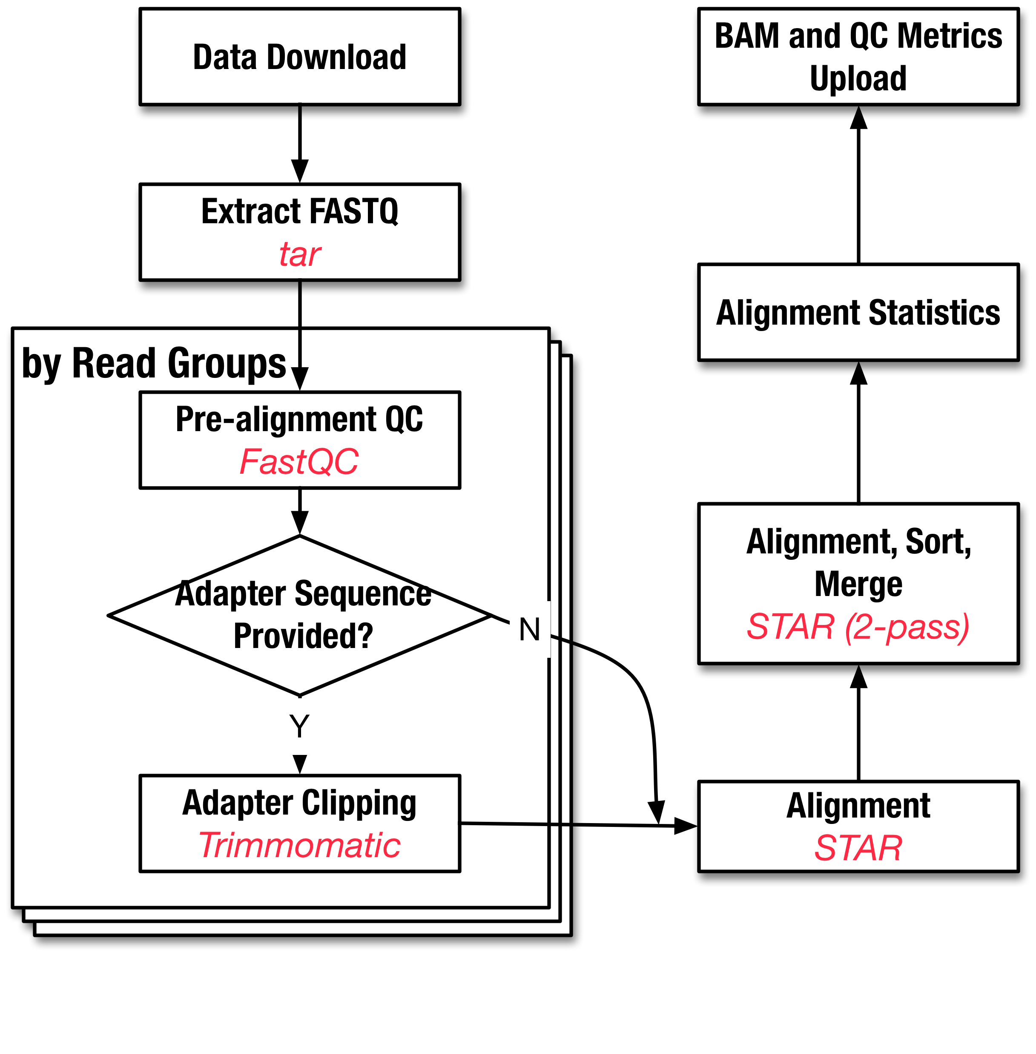
Pipelines in the Works
RNA-Seq: Based on ICGC STAR 2-pass, QC metrics still TBD
miRNA: basing on BWA based pipeline created by BCCA for TCGA

Slide 19
Discussion and Questions?

