Slide 1
ITCR Collaborative Project: Integrating PANGEA and CNVnator
Kai Tan (U01 CA226187)
Alexej Abyzov (U24 CA220242)

Slide 2
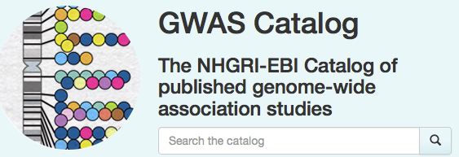
Vast majority of variants are non-coding

Slide 3
Genome in 3D
Chromatin Loops
(5kb resolution)
TADs
(10kb resolution)
Compartments
(50kb resolution)
Adapted from
Dekker et al, Nat. 2017;
Bonev & Cavalli, Nat. Rev. Genet. 2016
Interchromosomal

Slide 4
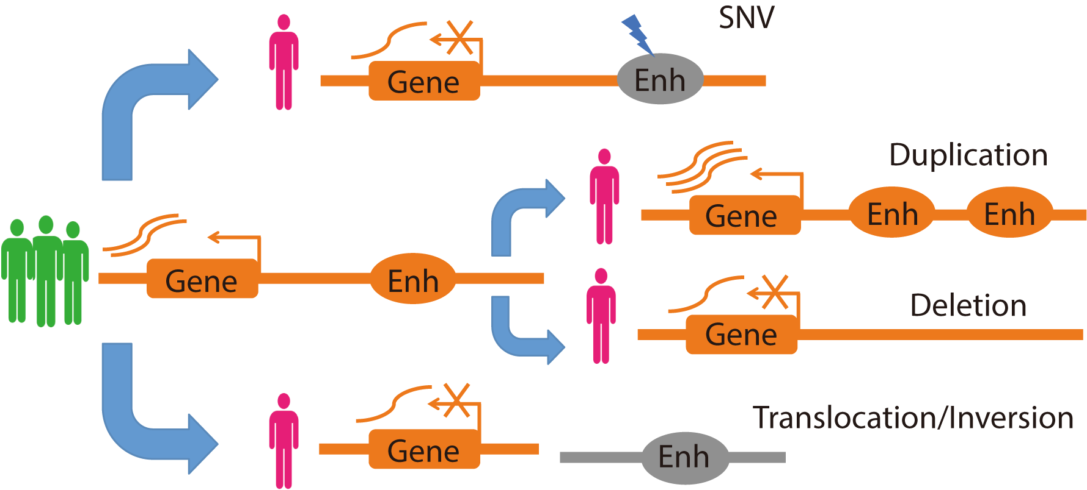
Many ways to break function of noncoding regulatory sequences
& small indels
Cowper-Sal, Nat Genet 2012; Groschel, Cell 2014; Huang, Nat Genet 2014; Mansour Science, 2014;
Lupianez, Cell 2015; Oldridge, Nature 2015; Franke, Nature 2016; Soldner, Nature 2016; Hnisz, Science 2016.

Slide 5
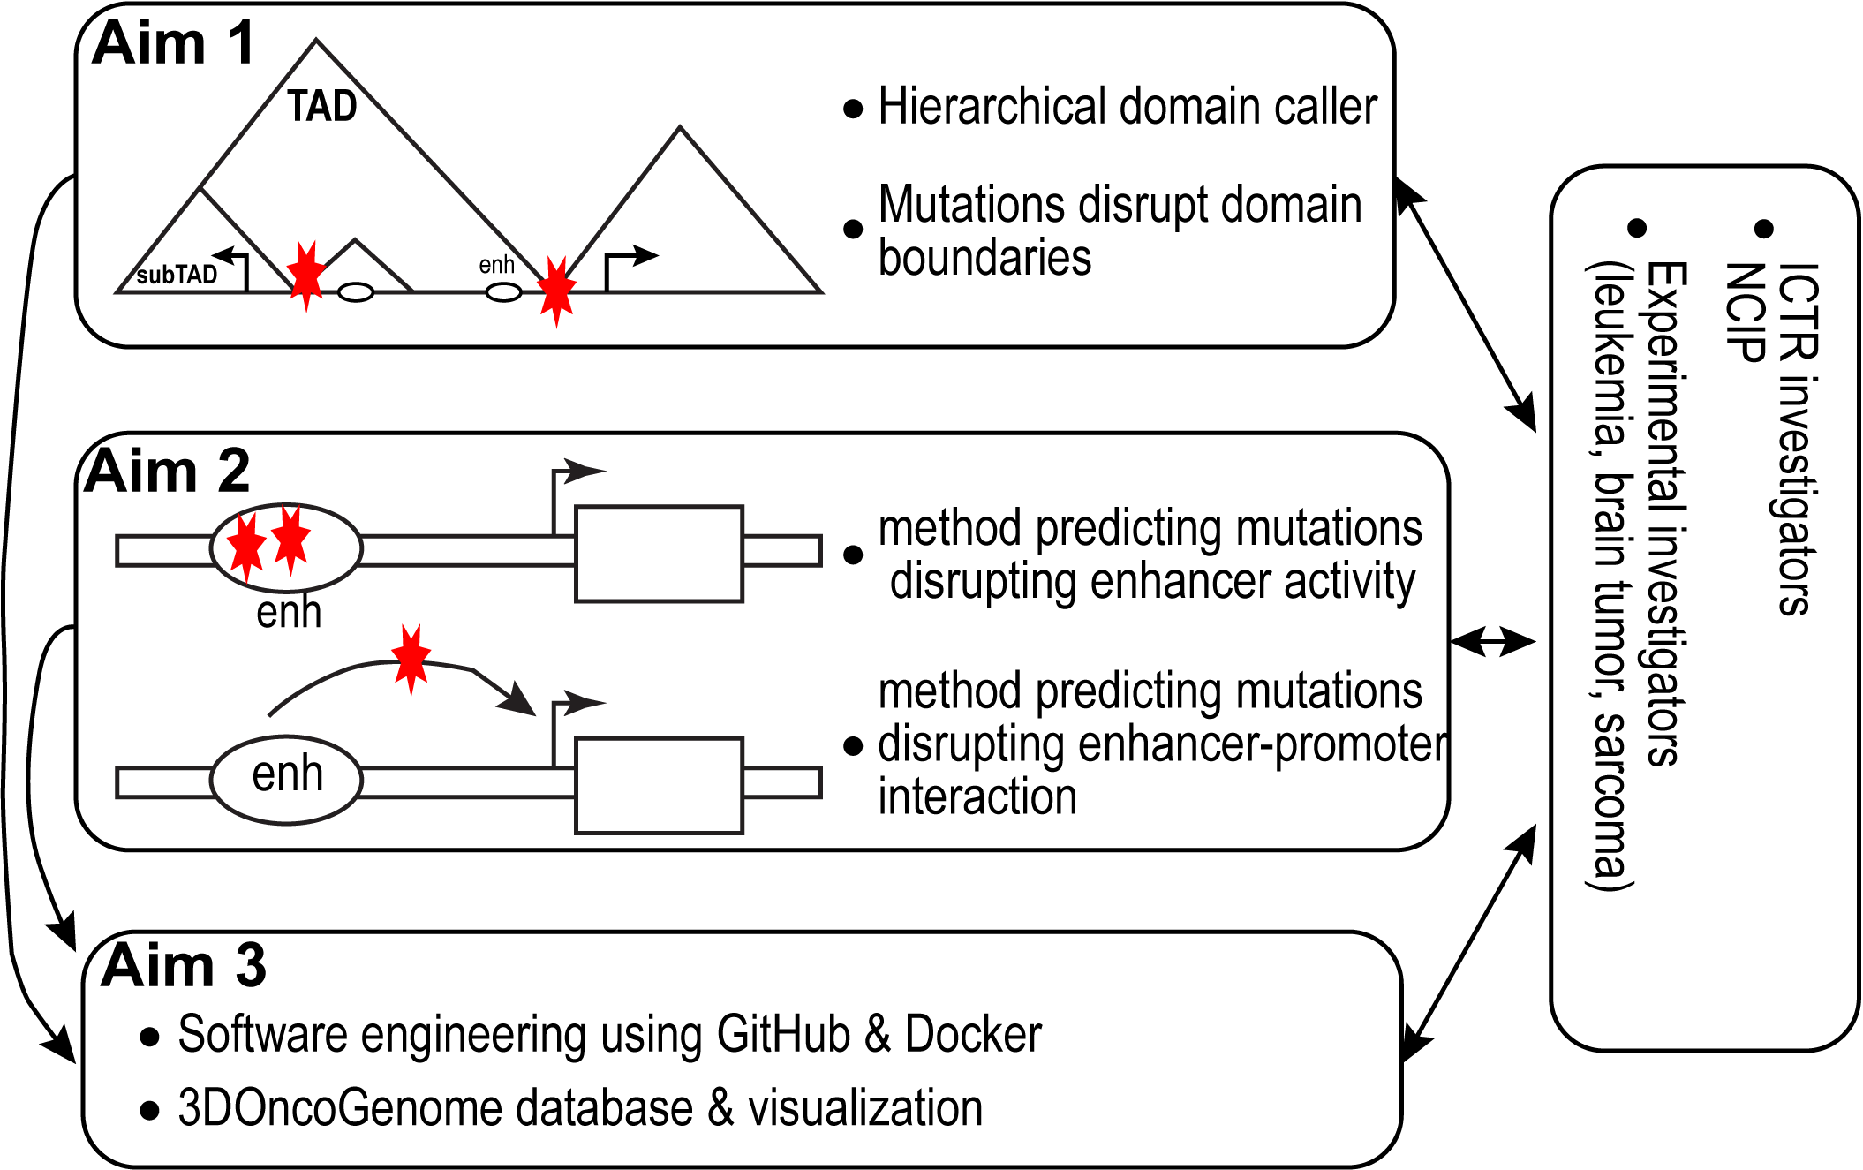
Tan U01 Project Overview

Slide 6
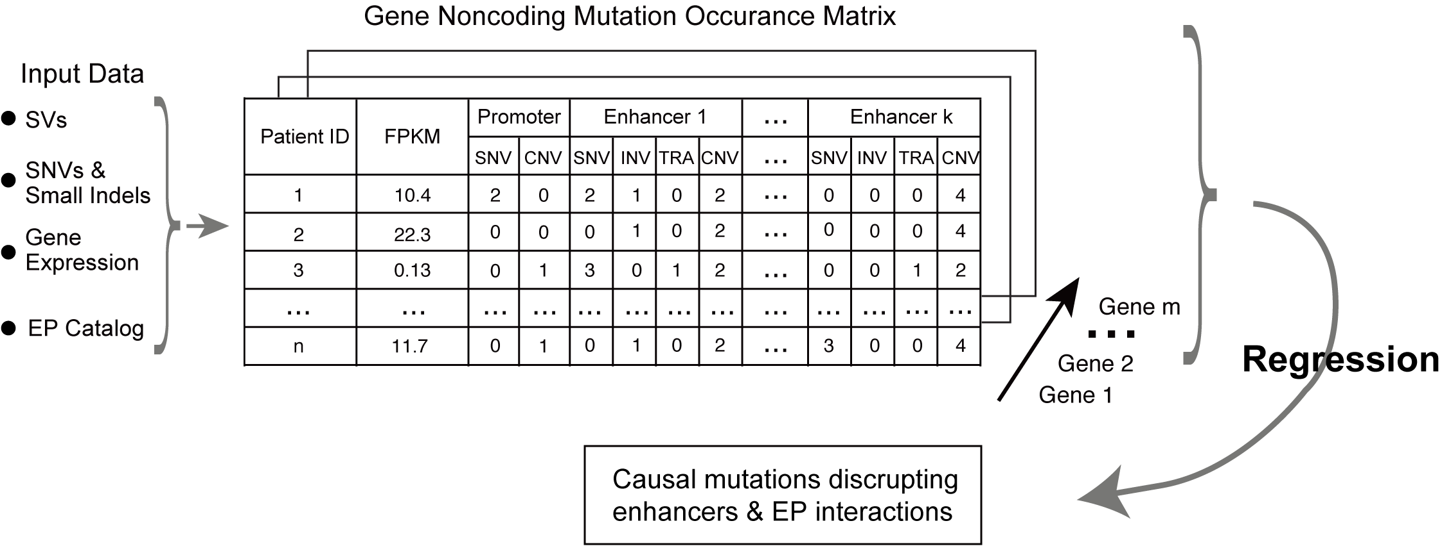
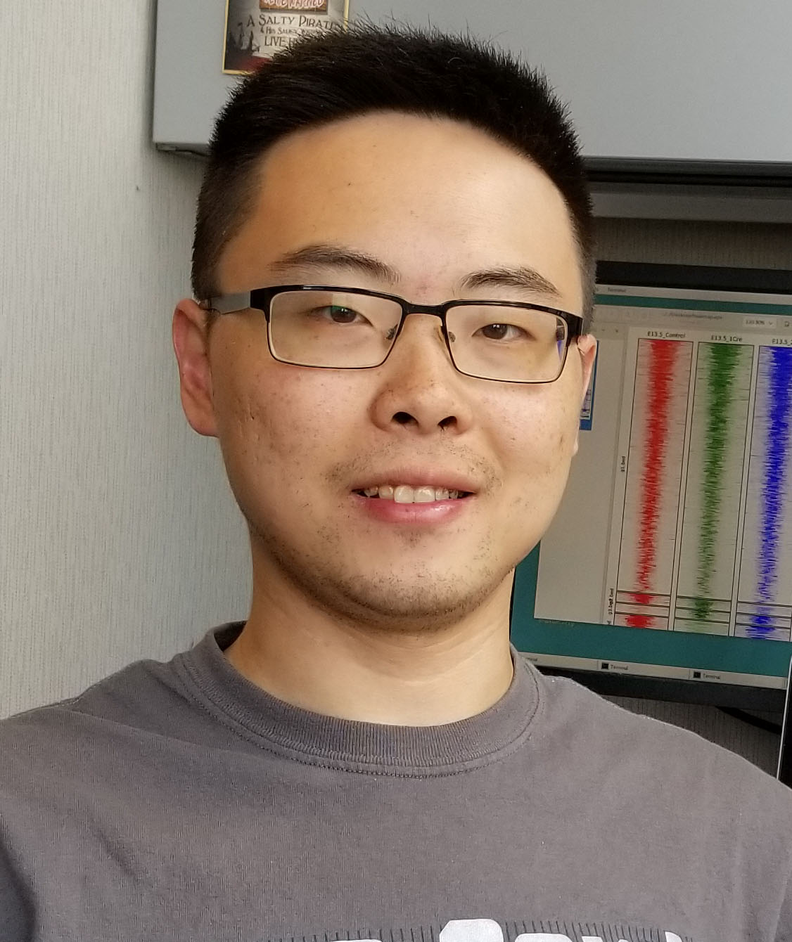
PANGEA: Predictive Analysis of Noncoding Genomic Enhancer/promoter Alterations
expression x noncoding mutation count matrix
Weighted
penalized
regression
Software available @ GitHub & ITCR informatics tool portal
Bing He
He et al. Science Adv 2020

Slide 7
Therapeutically Applicable Research To Generate Effective Treatment
Cancer types
Acute lymphoblastic leukemia
Acute myeloid leukemia
Kidney tumor
Neuroblastoma
Osteosarcoma
Matched WGS & RNA-Seq
153 patients
163 patients
53 patients
100 patients
32 patients

Slide 8
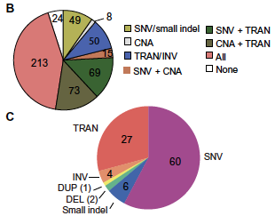
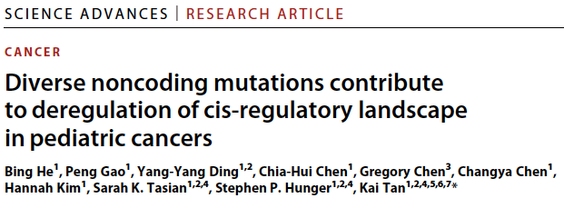

Slide 9
CNVpytor

Slide 10
CNVpytor: a Python extension of CNVnator
GitHub: https://github.com/abyzovlab/CNVpytor
HDF5 format to store data:
RD & BAF information .pytor file takes less than 50Mb
Interactive plotting command line interface with tab completion
Different plot styles and image formats
Easy to install
Can be used as python module with all functionalities
Can be used in Jupyter notebook
Installable in Colab Google
Suvakov et al. Biorxiv 2021.01.27.482472

Slide 11
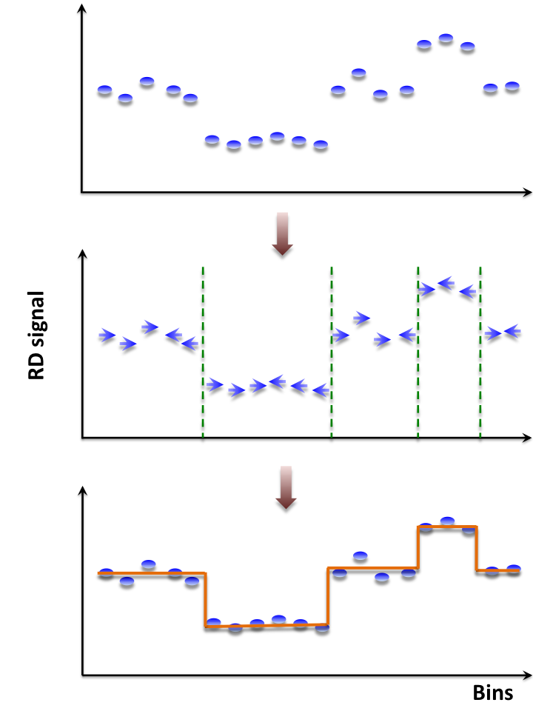
CNVnator: mean-shift approach
Derived from image-processing applications
For each bin, attraction (mean-shift) vector points the direction of bins with most similar RD signal
Not model-based, with minimum assumptions and parameters
Local segmentation
No prior assumptions about number, sizes, frequency and density of CNV regions
Achieves discontinuity-preserving smoothing
Highest sensitivity to find CNVs detected by aCGH and fosmid end sequencing
Abyzov et al., Genome Research, 2011
Mills et al., Nature, 2011

Slide 12
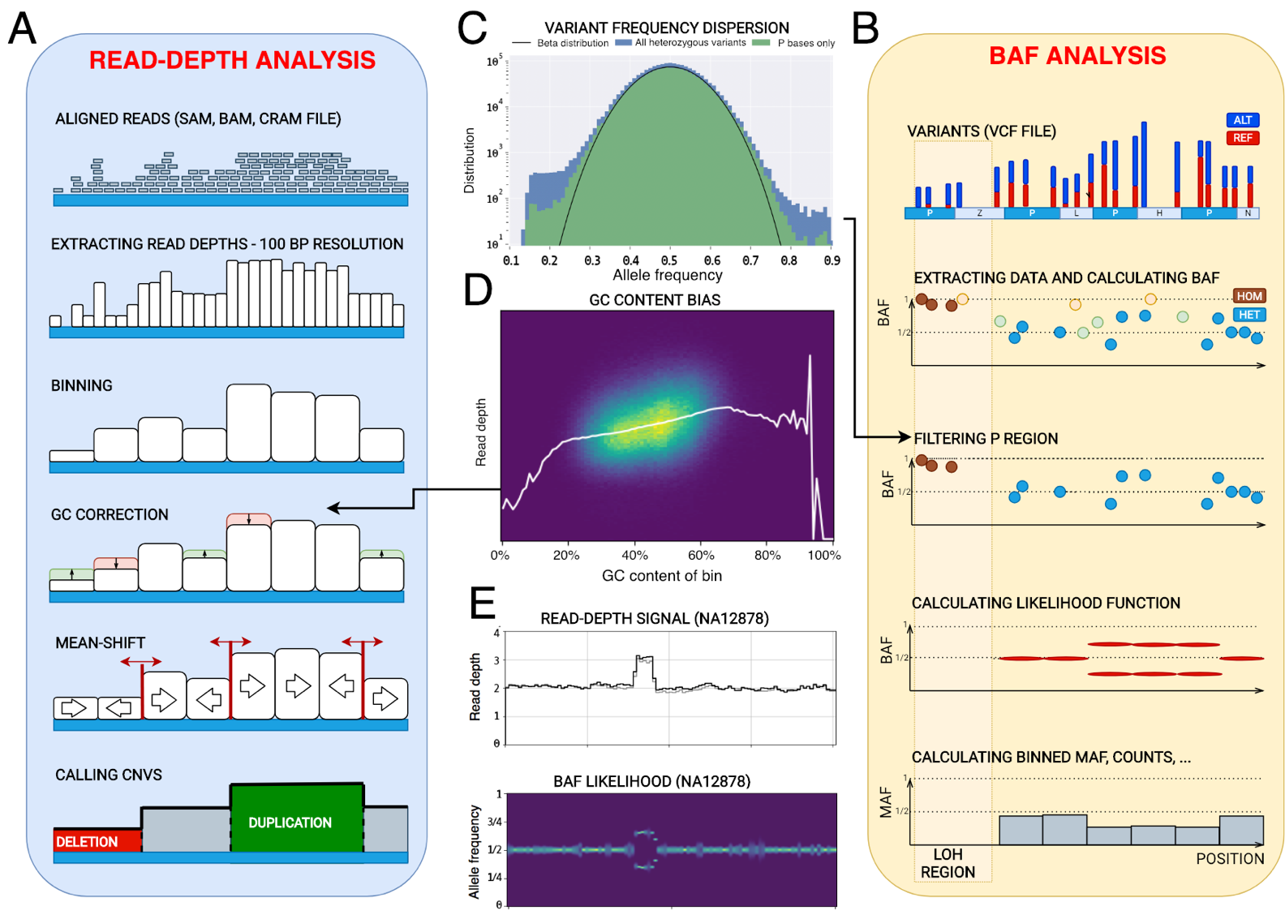
CNVpytor

Slide 13
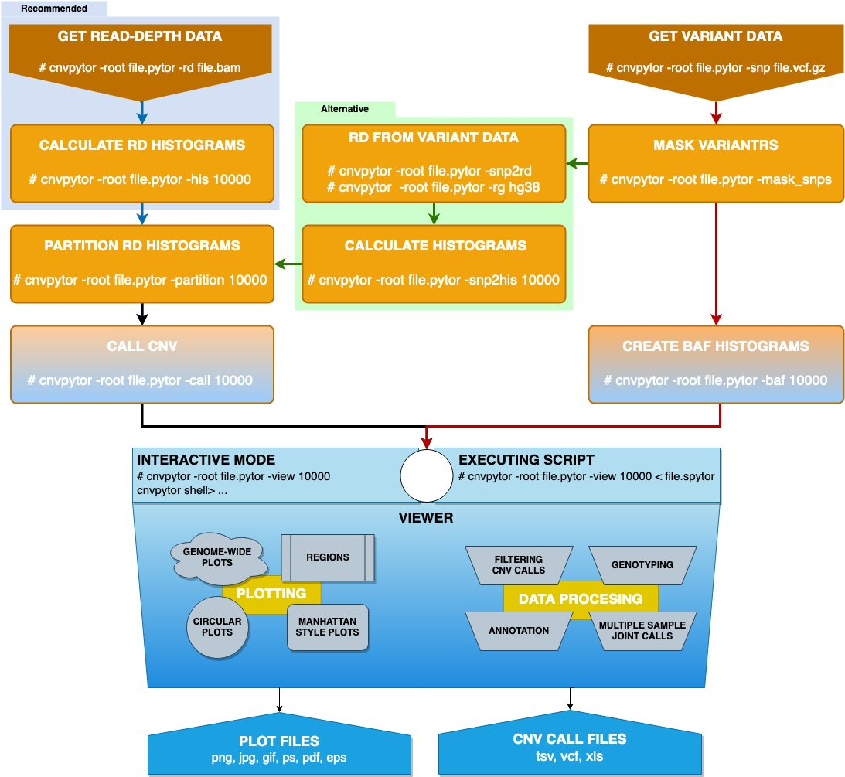
Usage

Slide 14
Example

Slide 15
Aims of collaborative project
Aim 1: Develop NoncodeCNA that combines CNVnator and PANGEA for annotating risk CNAs that disrupt cis-regulatory sequences.
Aim 2: Incorporate the analytic functions of NoncodeCNA in the 3DOncoGenome database.

Slide 16
Risk CNVs predicted by PANGEA & visualized by CNVnator (neuroblastoma)

Slide 17
Risk CNVs predicted by PANGEA & visualized by CNVnator (osteosarcoma)

Slide 18
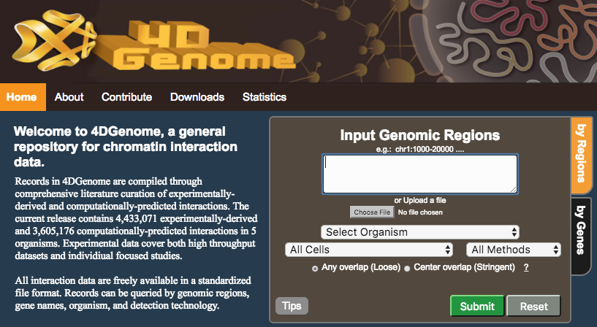
3DOncoGenome Database
Teng et al. Bioinformatics 2015

Slide 19
Future work
Develop NoncodeCNA software package that uses CNVpytor as the default CNV caller.
Incorporating the genome viewer function of CNVpytor in 3DOncoGenome.

Slide 20
Acknowledgement
CHOP
Bing He
Peng Gao
Chia-hui Chen
Steve Hunger
Sarah Tasian
Mayo Clinic
Milovan Suvakov
Arijit Panda
Funding
ITCR U01 CA226187
ITCR U24 CA220242

