Slide 1

The Federated Tumor Segmentation (FeTS) Initiative:
The First Real-World Large-Scale Federation Focusing on NeuroOncology
Sarthak Pati and Spyridon Bakas
On behalf of the Team
ITCR Annual Meeting – 2021

Slide 2
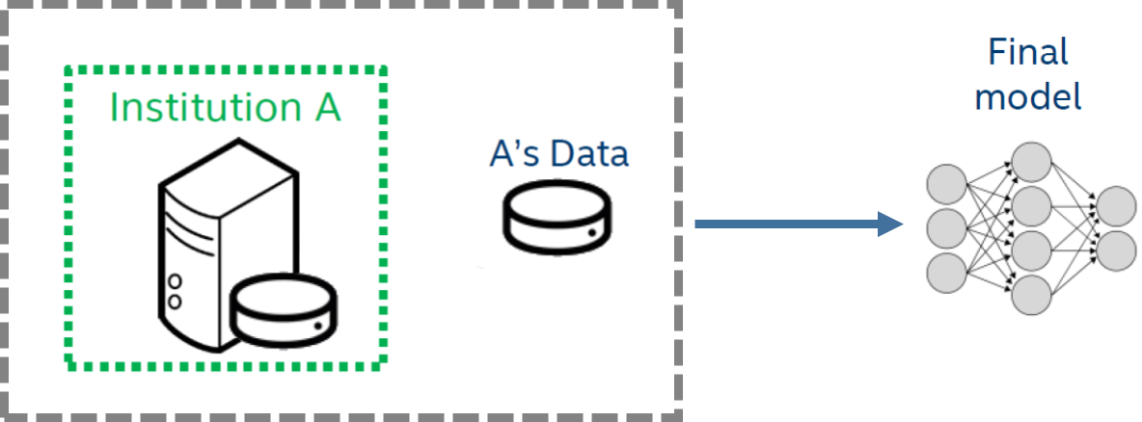
Single Institution Studies
The problem?
    Model performance is limited by the dataset:
Size → Accuracy
Diversity → Generalizability
Single institution data cannot fix these issues
www.fets.ai
contact@fets.ai
Notes:
Traditionally, research studies are based on training a machine learning model on a single institution’s data. (next) the issue, however, is that (next) the performance of the machine learning model is limited by the dataset size and diversity, which hamper accuracy and generalizability.

Slide 3
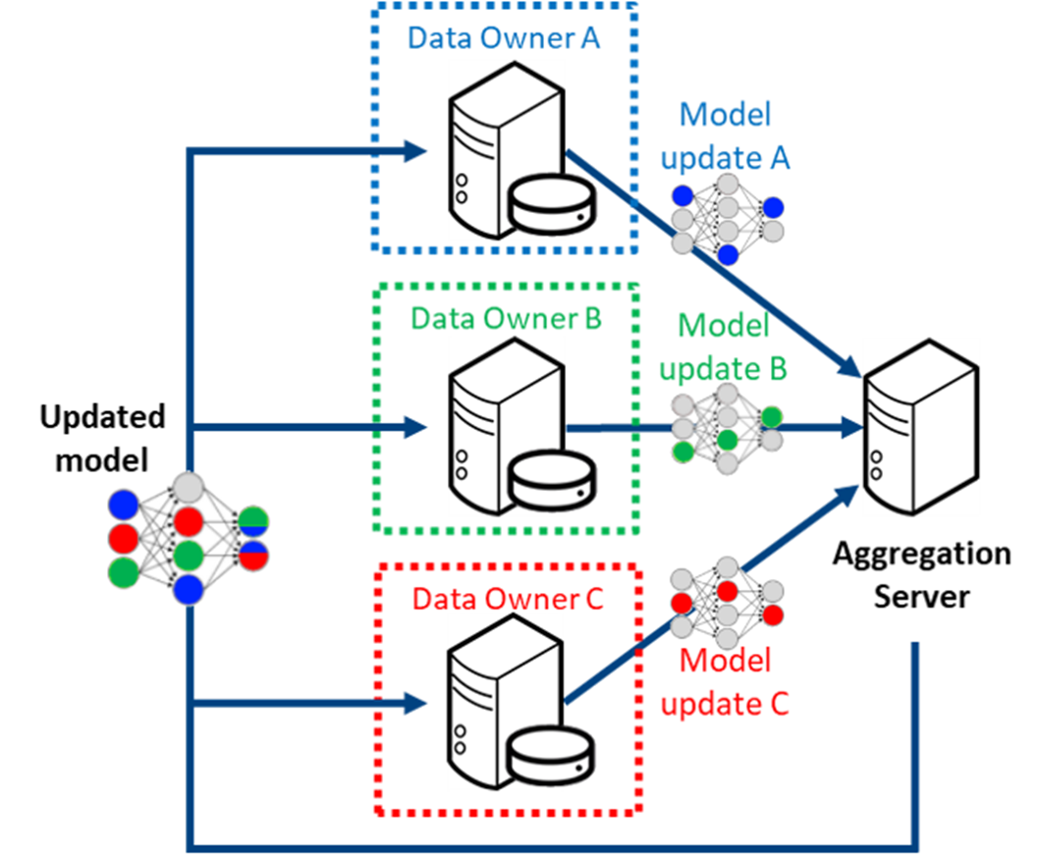
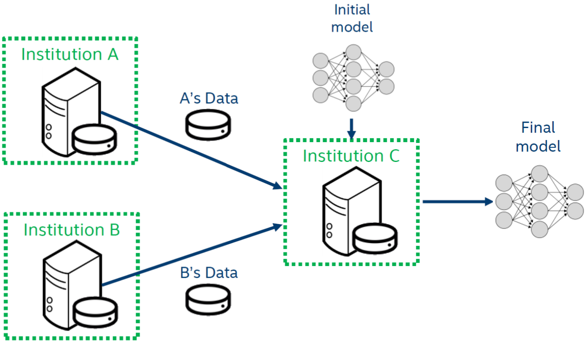

Multi-Institutional Collaborations
Current Paradigm
Proposed Paradigm
Does NOT scale
UNLOCKS Data Silos
3
www.fets.ai
contact@fets.ai
Notes:
There are 2 ways to solve this (next): the current paradigm involves pooling datasets from different sites into a single location and then training a model (next), which does not scale. (next) the proposed paradigm leverages federated learning, where the data rests with individual institutions and each trains their own model, an aggregator collects individual models and combines them to create a consensus model, which is then passed back on to partner institutions. (next) this unlocks data silos

Slide 4
Multi-Institutional Collaborations
Current Paradigm: Data-Sharing / Pooled Datasets
DOES NOT SCALE DUE TO:
TECHNICAL, LEGAL, PRIVACY, &
DATA-OWNERSHIP
CONCERNS
www.fets.ai
contact@fets.ai
Notes:
For multi-site collaborations, (next) the CURRENT PARADIGM involves pooling datasets from different sites into a single central location, (next) and then train a machine learning model, (next). This cannot be scaled because of various regulatory, confidentiality, and cultural concerns.

Slide 5

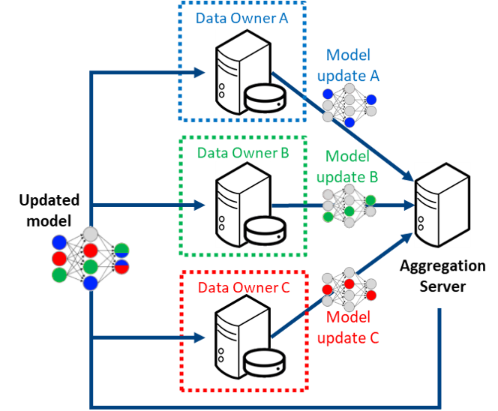

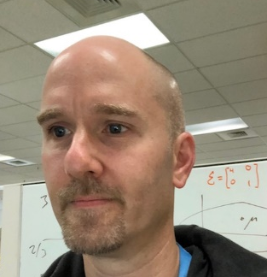


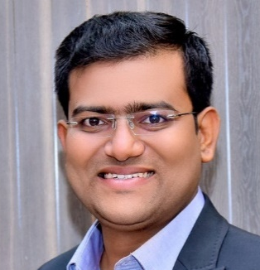

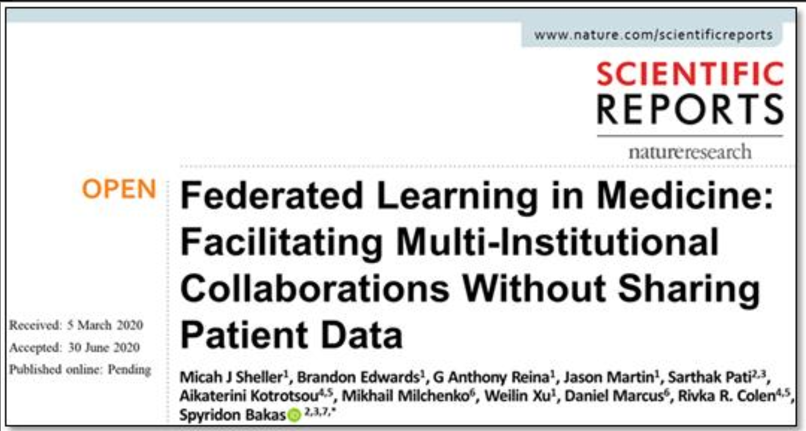

Multi-Institutional Collaborations
Proposed Novel Paradigm:
Federated Learning
UNLOCKS Data Silos
Micah Sheller
Brandon Edwards
Jason Martin
Sarthak Pati
Ujjwal Baid
Spyridon Bakas
www.fets.ai
contact@fets.ai
Notes:
Working in collaboration with Intel, we propose an alternative paradigm for multi-institutional collaborations leveraging federated learning, (next) where the data rests with individual institutions and (next) each trains their own models, (next) an aggregator collects individual models and combines them to create a consensus model, which is then passed back on to partner institutions. This consensus model has knowledge gained from all collaborating institutions without any data sharing

Slide 6
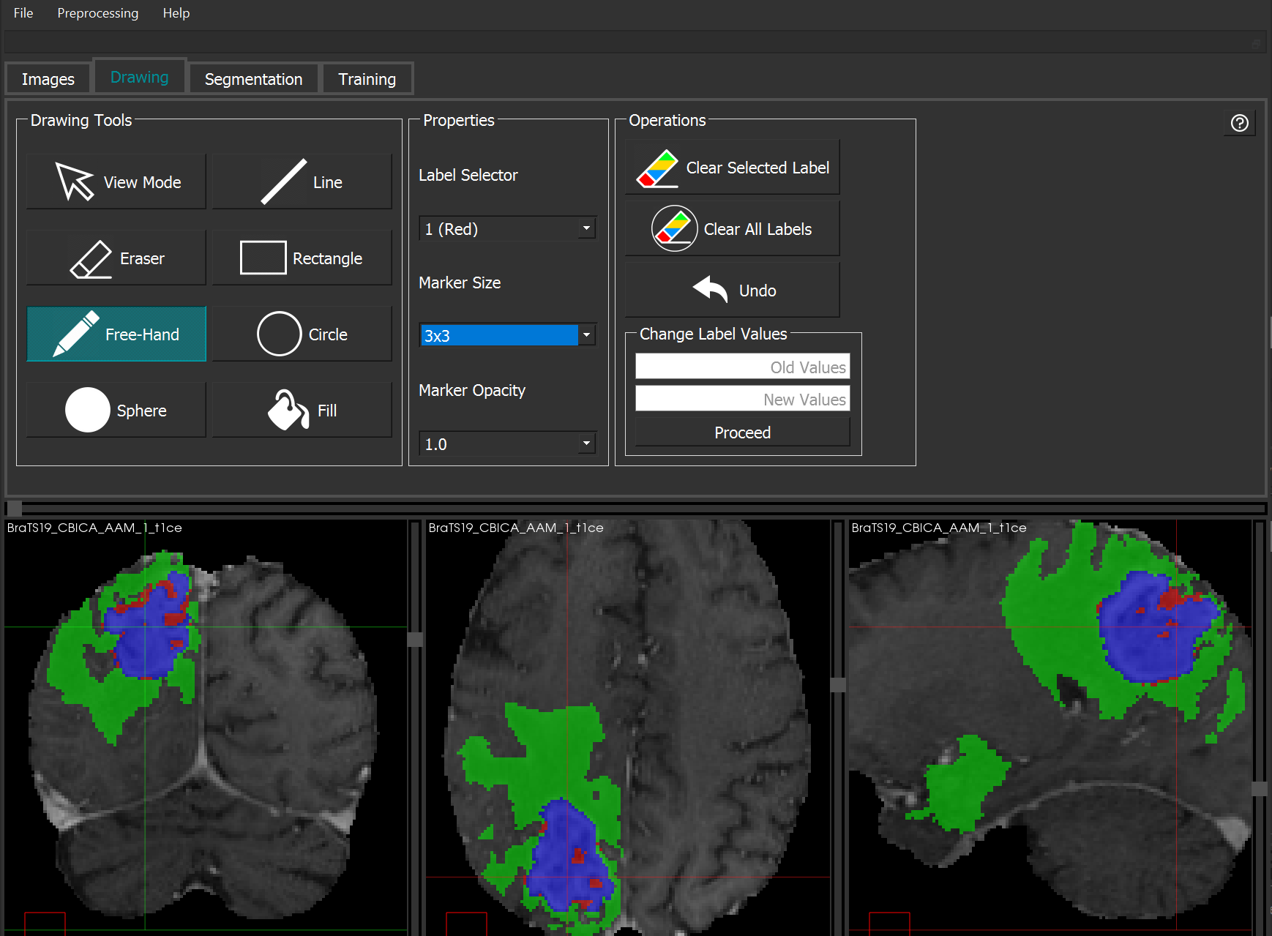
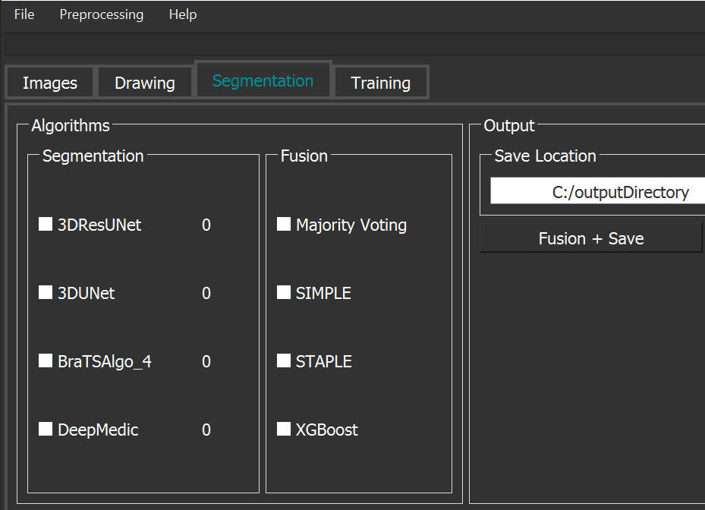
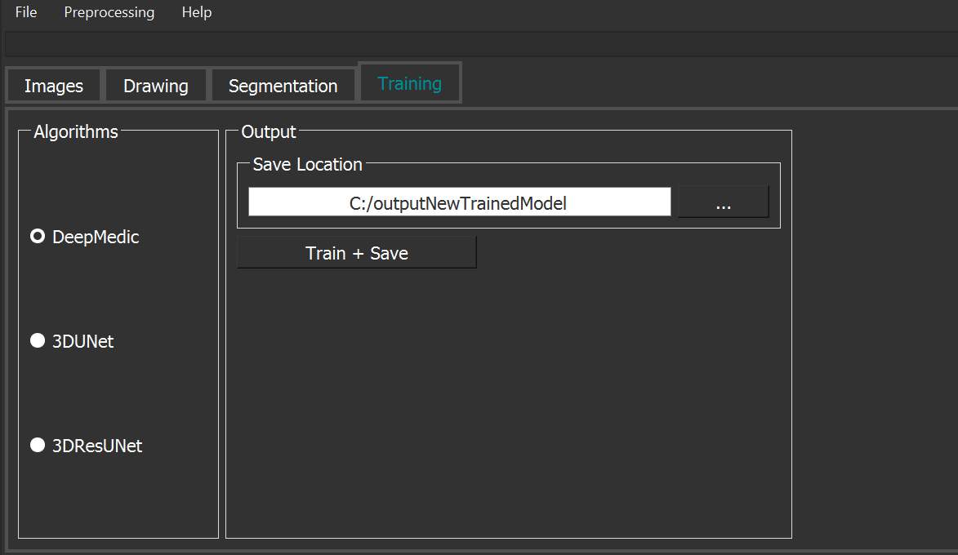
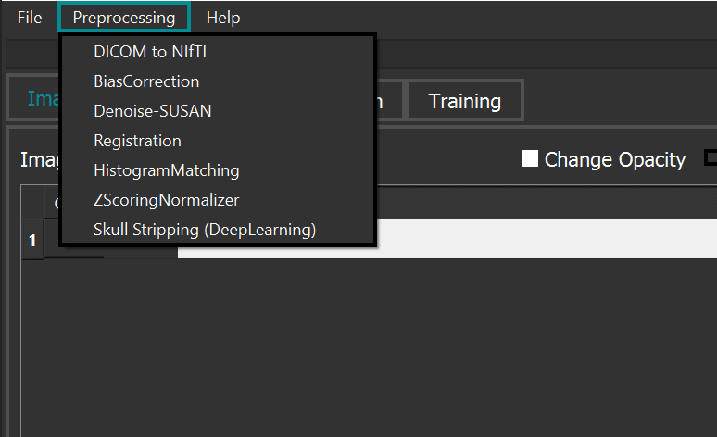
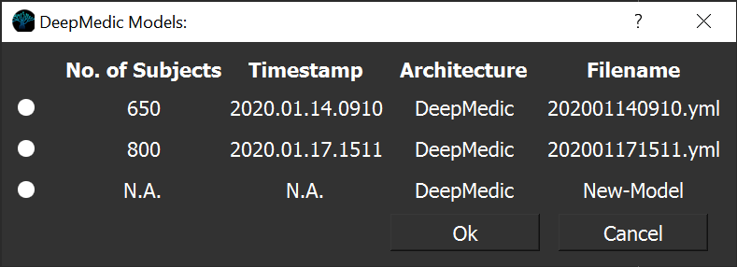
FeTS Components
Harmonized
Pre-processing
Model
Library
Annotation
Training
Harmonized
Pre-processing
Model
Library
Annotation
Training
Enabling the user to:
  Segment tumors in radiographic scans using pre-trained ML models
  Train their own ML model based on their data for further research
  Be part of the existing FeTS federation and contribute knowledge from their data to the FeTS consensus model
  Curate images uniformly
  Refine obtained segmentations towards creating ground truth labels
www.fets.ai
contact@fets.ai
Notes:
We developed a completely open-source tool to enable people to participate in the federation, and which makes end-to-end ML possible. (next) starting with harmonized pre-processing steps, which allows a user to uniformly curate their data, (next) a library of pretrained models, which lets a user to perform inference and automatically segment the lesions in their data, (next) annotation tools, which allow the user to refine these automatic segmentations to generate ground truth labels, and (next) the training module, which allows the user to train a model using their data for either their own research, or be part of the FeTS federation, so that they can contribute their model’s knowledge towards the consensus model.

Slide 7
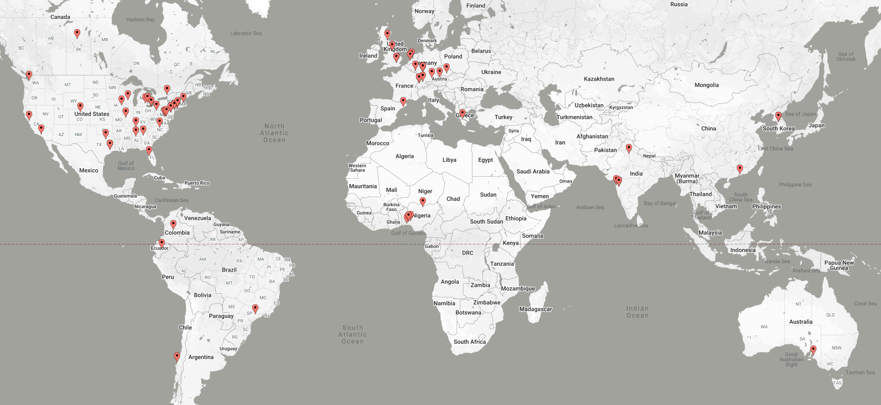






FeTS Collaborating Sites (May 2021)
55+ collaborating institutions across the globe!
1st large-scale real-world federation in medicine.
Train an AI model to detect the boundaries of tumor sub-regions.
The largest & most diverse dataset of glioblastoma patients (~7K).
Data are always retained within each institution.
Average performance improvement of ~27%
www.fets.ai
contact@fets.ai
Notes:
… Facilitated the first large-scale, real-world federation in medicine

Slide 8
Key Takeaways
Robust AI Models
Large and Diverse Data
Pass regulatory hurdles
Continuous Improvement
Enabled via FL
FeTS enables this, and:
Trains brain tumor segmentation model on the most diverse dataset
Available by end of 2021
Talk to us!
Poster Session 1
In-person @ SNO and RSNA Annual Meets!
Funding:
NIH / NCI / ITCR: U01 CA242871
NIH / NINDS: R01 NS042645
NIH / NCI / ITCR: U24 CA189523
ITMAT of the UPenn
www.fets.ai
contact@fets.ai
Notes:
I would like to conclude by mentioning a few key takeaways. Training robust AI models requires large and diverse datasets, and this needs the passage of complex regulatory hurdles; continuous improvement of these models is necessary to enable precision guided medicine, and all this can be enabled via federated learning.
Our FeTS initiative enables all of this and will result making a brain tumor segmentation model trained on the largest and most diverse dataset publicly available, while none of the collaborators shared any data outside their institutions.
Please feel free to drop by in poster session 1 or meet us in person at SNO and RSNA to talk more!

