Slide 1
Development of an Open-Source Preclinical Imaging Informatics Platform for
Cancer Research
Kooresh Shoghi, PhD
Associate Professor of Radiology and Biomedical Engineering
shoghik@wustl.edu
Daniel Marcus, PhD
Professor of Radiology and Biomedical Engineering
dmarcus@wustl.edu

Slide 2
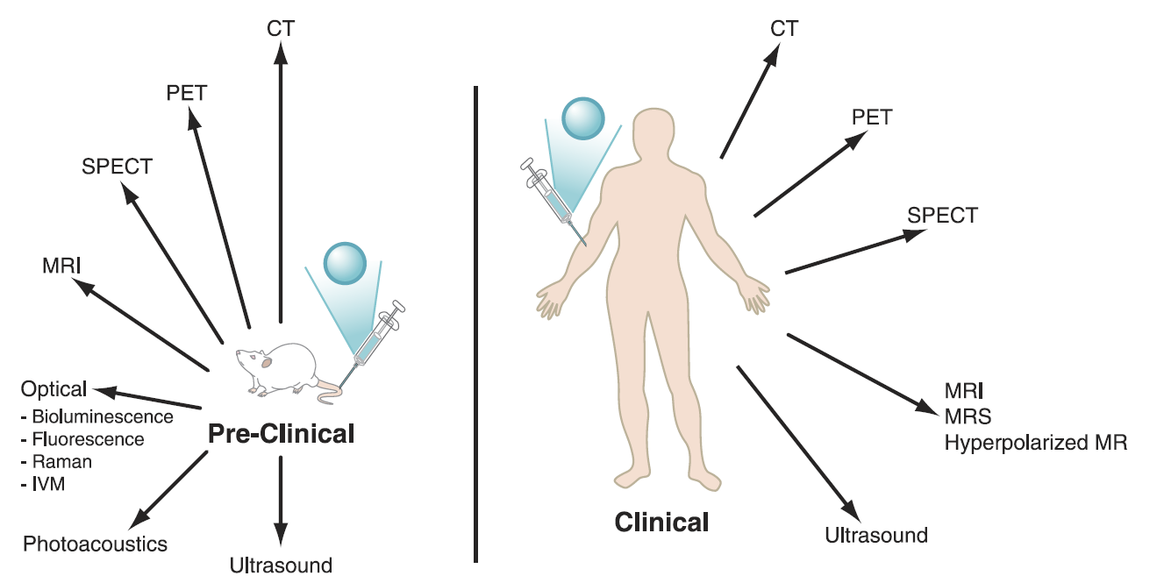
Co-Clinical Instruments
James and Gambhir, Physiol Rev 92: 897–965, 2012

Slide 3
Co-Clinical Instruments
James and Gambhir, Physiol Rev 92: 897–965, 2012

Slide 4
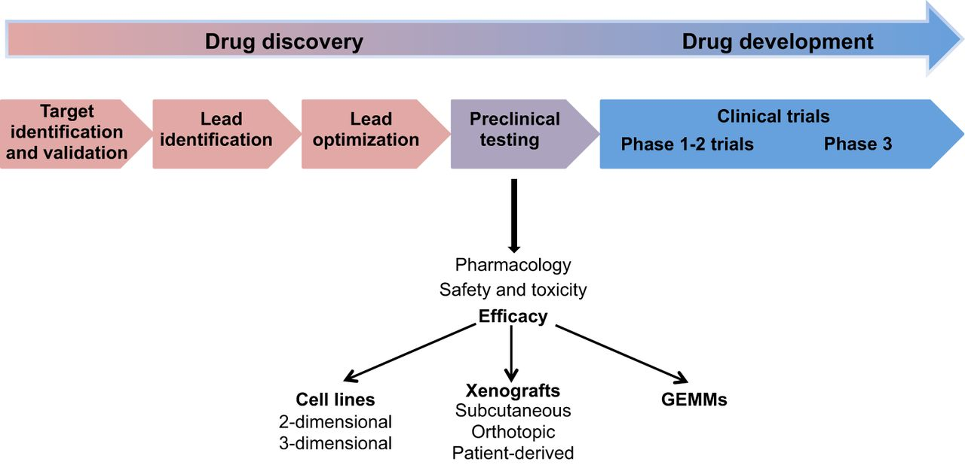
Translational Imaging in Drug Discovery
Molecular
Probe/
Target/
Mechanism
Preclinical
Studies
FDA
Approval
In Vitro Validation
Clinical
Studies

Slide 5
The Scope & Unmet Need
NCI’s precision medicine initiative emphasizes the use of translational oncology models (PDX, GEMMs, etc.), reproducible, impactful, and open science.
Vast datasets (# of animals, # of time points,# modalities, drug therapies, probes, sequences, etc.) and dynamic/complex workflow.
Non-tractable data results in poor reproducibility and presents obstacles for data mining and open science collaboration.
Current databases are not compatible with the complexity and growing demands in preclinical cancer imaging which include big data needs and collection of metadata/annotation to support NCI’s precision medicine initiative.

Slide 6
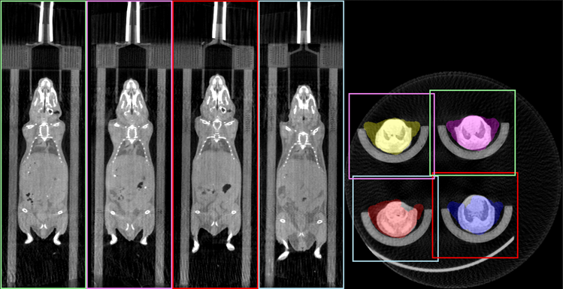
Mouse hotel

Slide 7
Objective
Develop an open-source preclinical imaging informatics platform—Preclinical Imaging XNAT-enabled Informatics (PIXI)—to:
Manage the workflow of a preclinical imaging laboratory
Harmonize imaging databases
Develop and enable deployment of analytic and computational pipelines in preclinical imaging

Slide 8
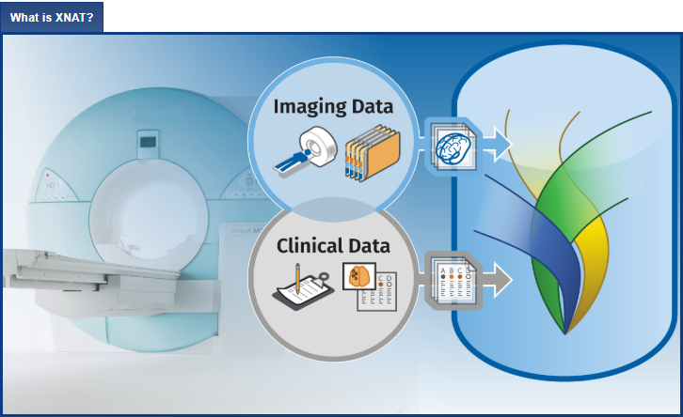
The “classic” XNAT Workflow
Open source imaging informatics platform developed by the Neuroinformatics Research Group at Washington University
Used by over 200 academic institutions and industry entities
Data organized in secure projects
Individual user access control
Built-in data search and reporting
Allows developers to easily add new data types and extend the REST API to provide new automated functions
Native Docker interface
https://www.xnat.org
This will be the first instance of XNAT development for preclinical imaging.

Slide 9
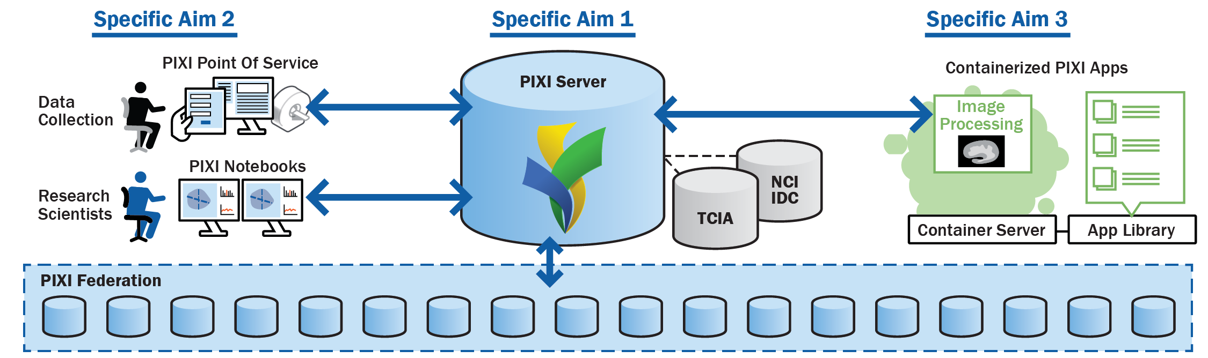
Overview of Project

Slide 10
Overview of Project
Specific Aim 1
File formats (Preclinical imaging formats, DICOM, segmentation, AIMs, etc.)
Networking, communications, and programming interfaces (site-to-site, TCIA, IDC, etc.)
Database elements unique to animal models, workflow
User interface

Slide 11
Overview of Project
Specific Aim 2
Electronic lab notebook to capture imaging data and metadata
SDK & notebook interfaces
Third Party Interfaces

Slide 12
Overview of Project
Specific Aim 3
Development of the container environment
App library
Visualization and analysis applications

Slide 13
Overview of Project
Dissemination plan:
Early Adopters
Web portal (TBD)
Presentations & demos in relevant scientific meetings/symposia, etc.
Exhibit booths

Slide 14
NCI CIRP
Baylor/UT@A/Stanford
UCSF
MD Anderson
University of Pennsylvania
Duke
U. Of Michigan
Washington University School of
Medicine
(initial) Early adopters
MD Anderson
University of Pennsylvania
Duke
WUSM
PIXI
Advisory Board
Dr. David Clunie
Dr. Charles Manning
Dr. Rong Zhou
Dr. Cristian Badea
Dr. Walter Akers
(initial) NCI ITCR collaborators
Dr. Ron Kikinis
Dr. Daniel Rubin
Dr. Gordon Harris
Notes:
Profiles
QI/
Standards for reproducibility

Slide 15
Opportunities for Collaboration
Pathology
Multi-OMICs
Quantitative imaging
Image processing
AI/DL
Bioinformatics
And more…

