Slide 1
Development of Small Area Interactive Risk Maps for Cancer Control Efforts
Jake Oleson Dept of Biostatistics College of Public Health University of Iowa
Jacob-Oleson@uiowa.edu
August 5, 2022

Slide 2
Team members
Mary Charlton, Dept of Epidemiology, University of Iowa
Sarah Nash, Dept of Epidemiology, University of Iowa
Grant Brown, Dept of Biostatistics, University of Iowa
Caglar Koylu, Dept of Geography, University of Iowa
Jacob Clark, Center for Public Health Stat, University of Iowa
W. Jay Christian, Department of Epidemiology, University of Kentucky
Bin Huang, Division of Cancer Biostatistics, University of Kentucky
Chuck Wiggins, Division of Epidemiology, University of New Mexico

Slide 3
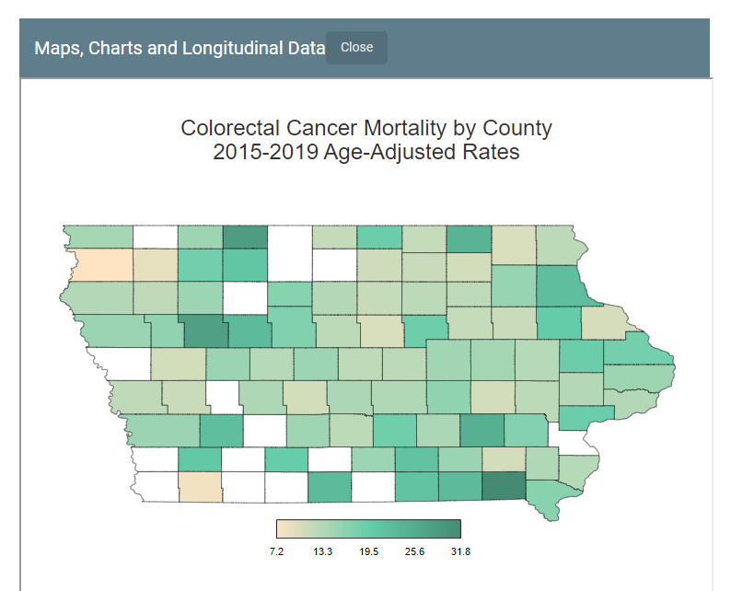
Inspiration for the work
Iowa Cancer Registry maps
Typically county level maps
No estimates for rural areas

Slide 4
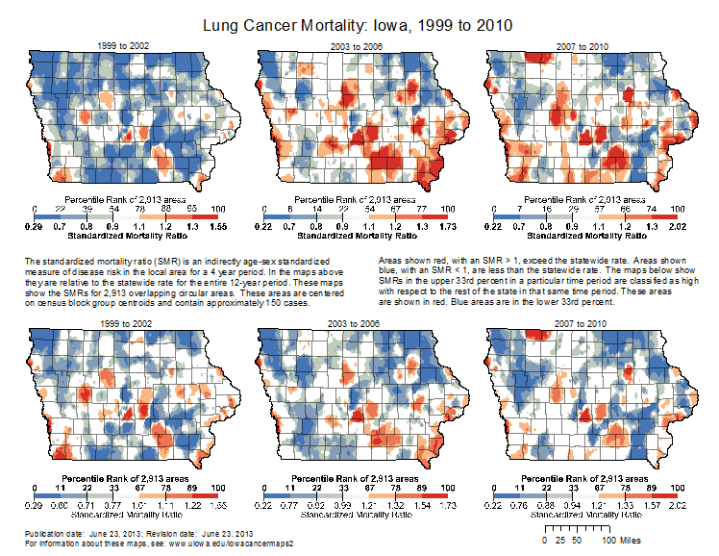
Inspiration for the work
Continuous space?
Cannot tell risk for where we live

Slide 5
New Iowa Cancer Registry Maps
Bayesian modeling
Calculates Relative Risk
Compute Risk Probability
D3 to hover over ZCTA and show info
https://shri.public-health.uiowa.edu/iowa-cancer-maps/

Slide 6
Study Aims for New Developments
Develop a Bayesian hierarchical statistical model to create small area estimates of age-adjusted cancer rates per ZCTA for SEER regions over time
Develop and implement data visualization through interactive graphics that demonstrate how risk evolves in small areas over time
Determine feasibility of implementing the tools developed in Aims 1 and 2 within the SEER program

Slide 7
Bayesian population modeling for small areas with excess zeros
At the ZCTA level there will be an excess number of 0 cases
Compute Age-Adjusted Rates for each ZCTA
Adjust models for demographic factors
Risk Mediation models

Slide 8
Graphical Innovation
ZCTA level estimates in rural areas
Adjust maps for demographics
Show changes in rates over time
Visualize variability in estimates

Slide 9
Implementing Tools within SEER program
Partners: Iowa, Kentucky, and New Mexico
Survey users
Open Source Software
Generalizable to more states

Slide 10
Thanks for listening!

