Slide 1
ITCR Monthly Teleconference
April 1, 2022
Please add your name and institution to the GoogleDoc

Slide 2
The ITCR RFAs have been reissued!
R21 | RFA-CA-22-021 | Development of Innovative Informatics Methods and Algorithms for Cancer Research and Management (R21 Clinical Trial Optional)
U01 | RFA-CA-22-022 | Early-Stage Development of Informatics Technologies for Cancer Research and Management (U01 Clinical Trial Optional)
U24 | RFA-CA-22-023 | Advanced Development of Informatics Technologies for Cancer Research and Management (U24 Clinical Trial Optional)
U24 | RFA-CA-22-024 | Sustained Support for Informatics Technologies for Cancer Research and Management (U24 Clinical Trial Optional)
Receipt dates: June 14 and November 17, 2022

Slide 3
Upcoming receipt date for set-side proposals (U01/U24 awardees)
Next receipt date:
June 27, 2022
Future receipt date:
Late September, 2022
Steering Committee
Elana Fertig
Daniel Marcus
Guergana Savova
Juli Klemm
Satish Viswanath
Jing Zhu
Ben Raphael
Executive Secretary: Kelly Crotty

Slide 4
Questions?
kelly.crotty@nih.gov

Slide 5
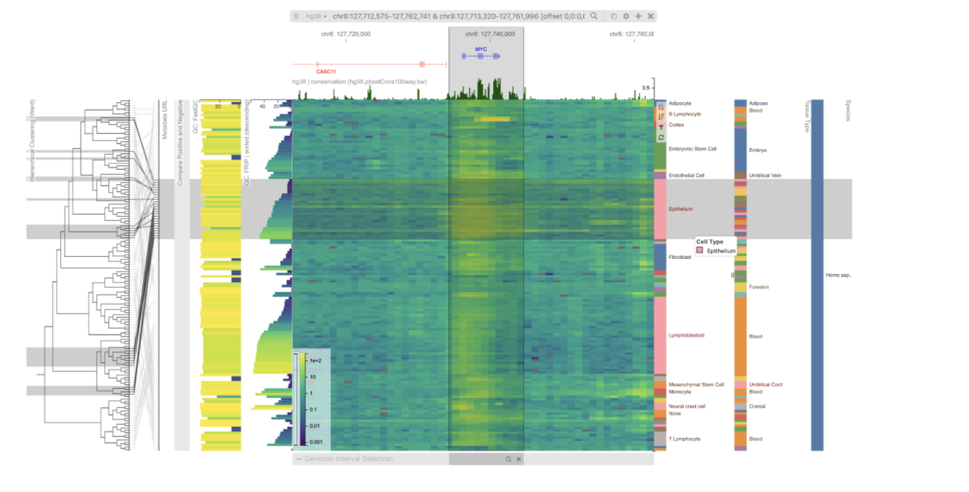
Training and Outreach Working Group Update
Next meeting: Thursday, April 14, 4:00-5:00pm ET
”One Tool, Many Topics: Cistrome Explorer”
Presenters: Cliff Meyer, Sehi L’Yi, DFCI
Future TOW topics available at: https://ncihub.org/groups/itcr/training_and_outreach_working_group_teleconference
Cistrome Explorer enables interactive and scalable visual analysis of chromatin accessibility, histone modification, and transcription factor binding data

Slide 6
NCI-Sponsored Session: “Informatics Tools and Training Opportunities”
Sunday, April 10, 4-5pm CT, room 298-299
Share your AACR presentations (talks/posters) and we will amplify on social media!
Link in the GoogleDoc for this meeting

Slide 8
PDMC/PDXNet/ITCR Collaborative Workshop
Patients
The Patient-Derived Models of Cancer (PDMC) program is developing and characterizing patient-derived models to define the biological mechanisms that drive cancer phenotype and response to perturbations.
The PDXNet was established to coordinate collaborative, large-scale development and pre-clinical testing of targeted therapeutic agents in patient-derived models to advance the vision of cancer precision medicine.
Patient-derived Models
Biology
Clinical
Trials
PDMC
PDXNet
ITCR
The scope of the ITCR program is to serve informatics needs that span the cancer research continuum.

Slide 9
Workshop 2022 Outline
What: Workshop between the PDMC, PDXNet and ITCR networks
Focus: Innovative patient-derived modeling approaches, data analysis and data management
Goal: Develop collaborations that support the application and integration of patient-derived cancer models across basic, translational and clinical research spectrums
When: Sometime in June. Virtual meeting (In person meeting in Fall at JAX-Farmington was also proposed).
Duration: 2 half days. 12-5pm ET
Presentations: Each network will have 3 groups present
Attendees: All members of the 3 networks

Slide 10
Workshop 2022 Outline
Logistical support: The PDXNet U24-supported coordination center (JAX and Seven Bridges).
Organization: Committee composed of 1-2 members from each network
Meeting Format:
Should be an inclusive meeting but also facilitate engagement between center investigators.

