Slide 1
Collaboration Update:
ClinGen Linked Data Hub
Melissa Cline, BRCA Exchange
May 6, 2022

Slide 2
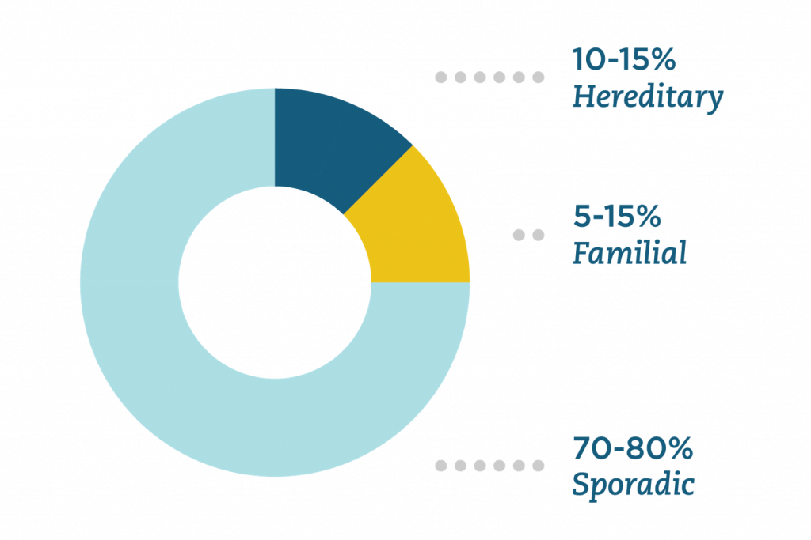
Heritable genetics significantly impact cancer risk
Source: Color Genomics

Slide 3
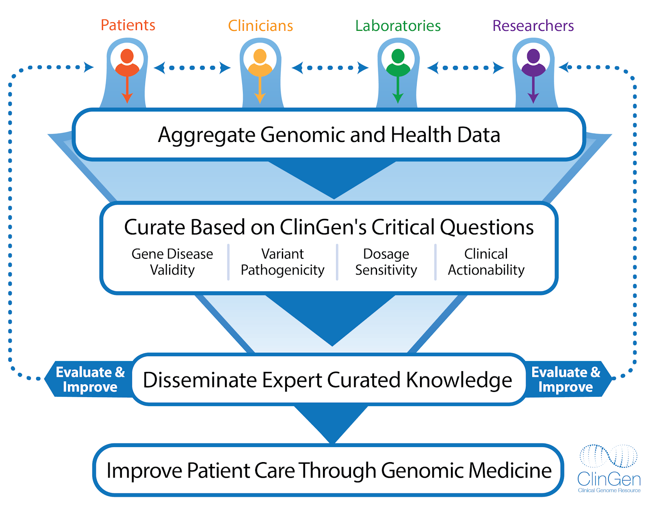
Cancer Variant Curation in ClinGen

Slide 4
Cancer Variant Curation in ClinGen

Slide 5
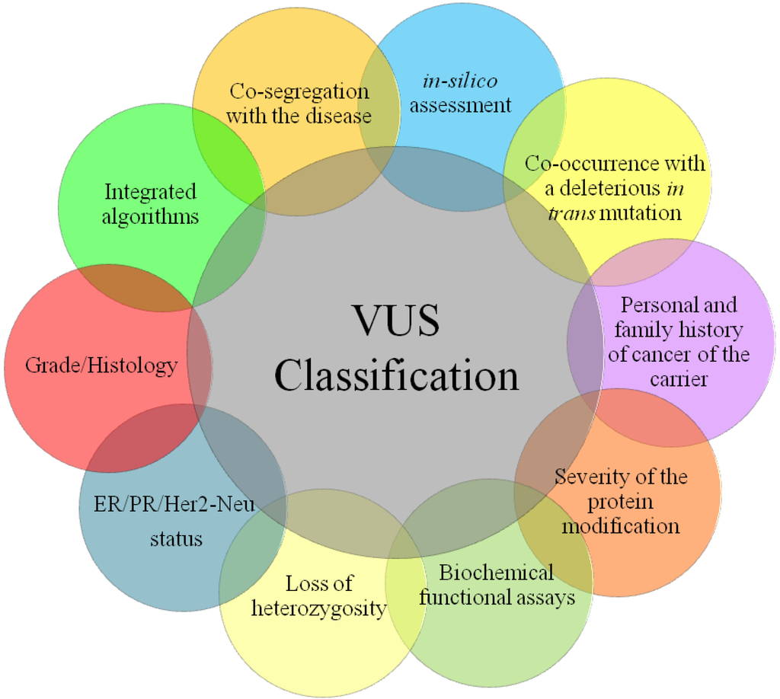
Germline Variant Curation in ClinGen
Variant Curation Expert Panels (VCEPs): gene/disease experts who
Establish curation rules
Determine when the assembled evidence merits an expert interpretation

Slide 6
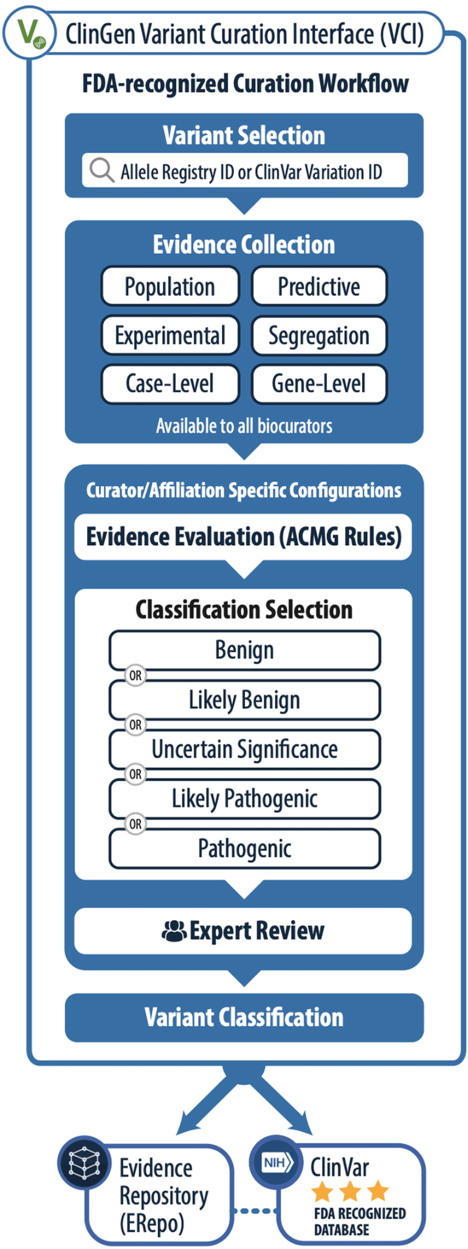
Curation with the Variant Curation Interface (VCI)

Slide 7
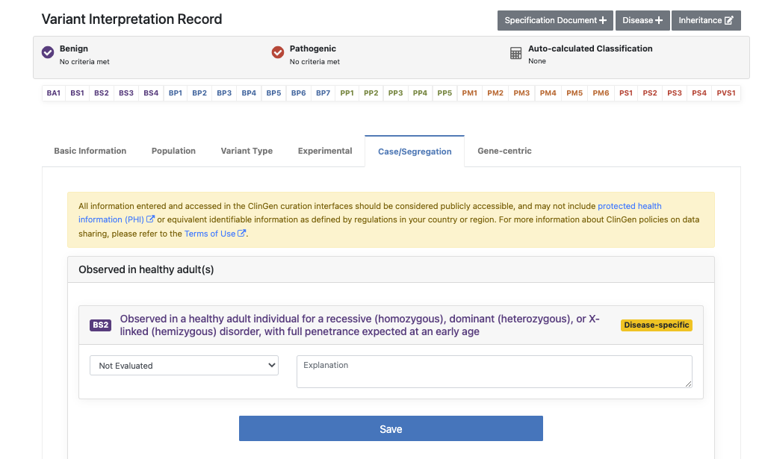
Curation with the Variant Curation Interface (VCI)

Slide 8
Curation with the Variant Curation Interface (VCI)
Unmet need: high-throughput integration of variant evidence into the VCI, and other parts of the ClinGen data ecosystem

Slide 9
ClinGen Data Flow
STEP 1: Allele Registration (Sequence & Structural Variations)
ClinGen Allele Registry (CAR)
API,
Message Stream*
ClinGen Variant Curation Interface (VCI)
ClinGen Variant Prioritization Tool (VPT)
STEPS 2 & 3: Linking information about genes & variants
Linked Data Hub* (LDH)
STEP 4: Dissemination of evidence used in variant interpretations
Evidence Repository (ERepo)
External Tools

Slide 10
Software to Facilitate Variant Interpretation
STEP 1: Allele Registration (Sequence & Structural Variations)
ClinGen Allele Registry (CAR)
API,
Message Stream*
ClinGen Variant Curation Interface (VCI)
ClinGen Variant Prioritization Tool (VPT)
STEPS 2 & 3: Linking information about genes & variants
Linked Data Hub* (LDH)
STEP 4: Dissemination of evidence used in variant interpretations
Evidence Repository (ERepo)
External Tools

Slide 11
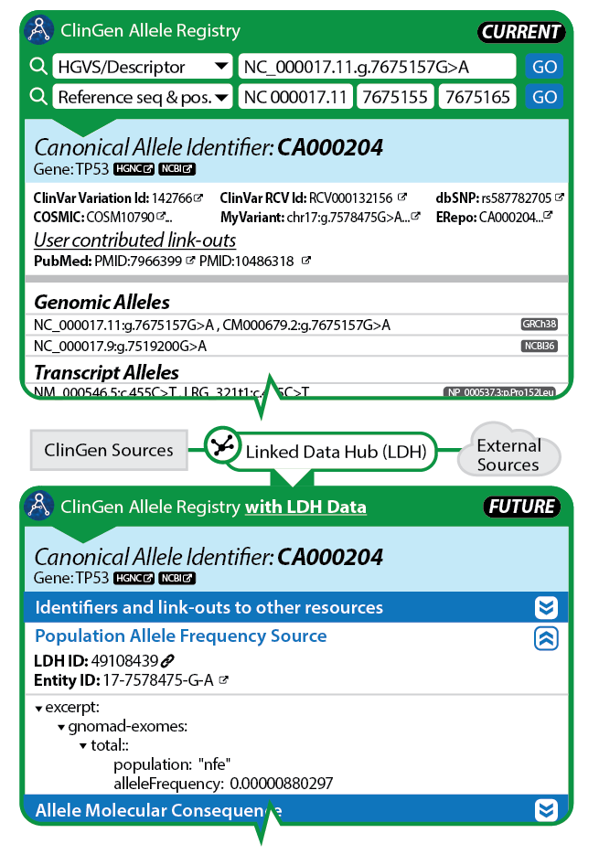
Linked Data Hub
Aims to be software infrastructure like “PubMed” for gene and variant knowledge
Producing low-level variant data to the VCI
Permanent reference for inclusion as “supporting evidence” in variant interpretation
Tracking of provenance
Standardization of data
Developing support for versioning of evidence

Slide 12
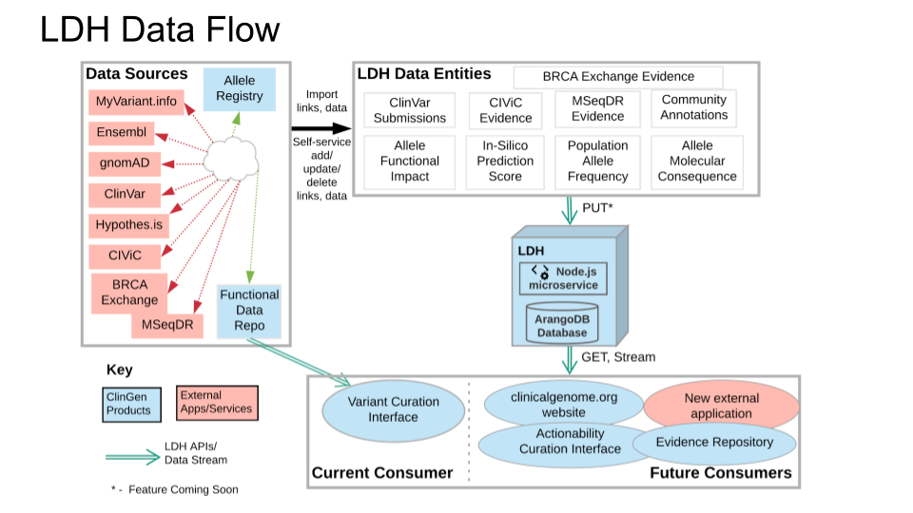
Set-Aside Proposal: Collaboration with LDH

Slide 13
Set-Aside Proposal: Collaboration with LDH

Slide 14
Linked Data Hub – External Databases – Active Development
Database | Introduction | Monthly Call Participant | Move Forward w/ LDH Integration? | Structured Data - First Pass | Initial LDH Ingestion
BRCA Exchange | ✅ | ✅ | ✅ | ✅ | ✅
CIViC | ✅ | ✅ | ✅ | ✅ | ✅
LOVD | ✅ | ✅ | ✅ | ✅
MaveDB | ✅ | ✅ | ✅ | ✅
MSeqDR | ✅ | ✅ | ✅ | ✅
* also will be working with tmVar to associate PMIDs with CA IDs

Slide 15
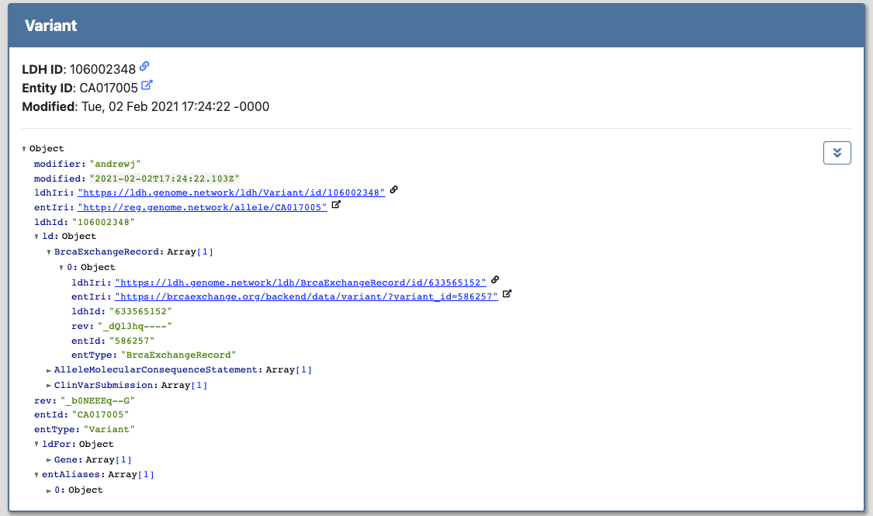
BRCA Exchange - LDH Data integration example

Slide 16
BRCA Exchange - LDH Data integration example

Slide 17
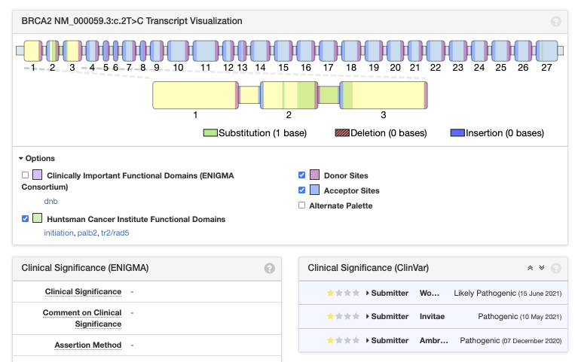
BRCA Exchange - LDH Data integration example

Slide 18
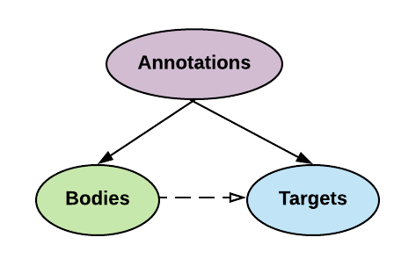
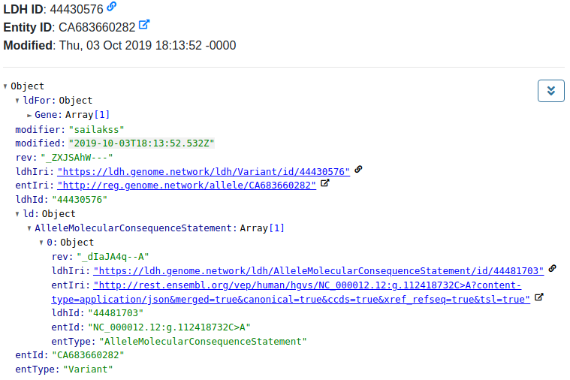
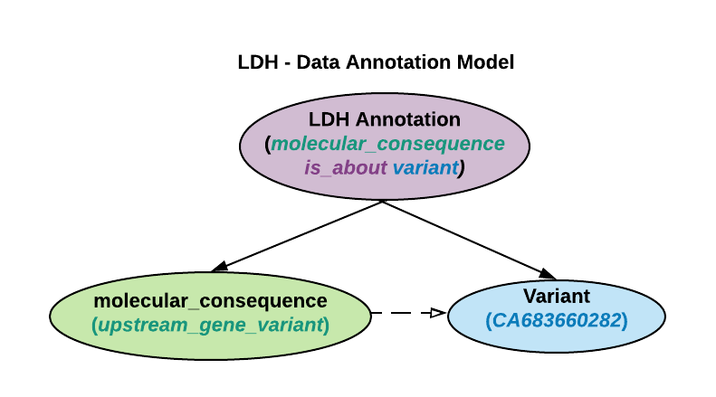
LDH - Structured Data
Annotations are envelopes for the body and the target
https://ldh.clinicalgenome.org/ldh/ui/Variant/id/CA683660282

Slide 19
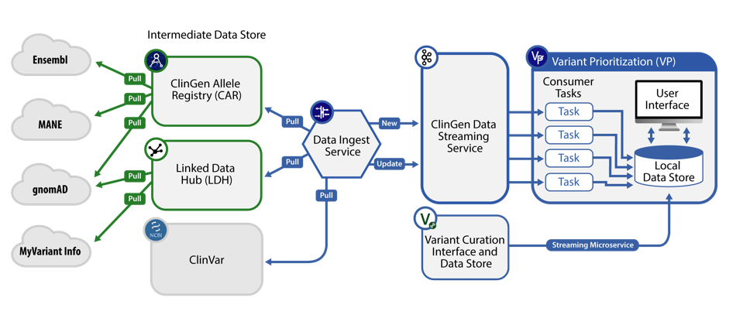
Next Steps for Data Integration: Variant Prioritization

Slide 20
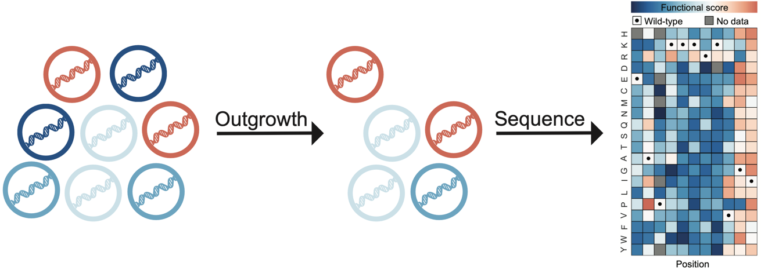
MaveDB:Multiplexed Assay of Variant Effect Database
MaveDB

Slide 21
MaveDB:Multiplexed Assay of Variant Effect Database
MaveDB

Slide 22
MaveDB:Multiplexed Assay of Variant Effect Database
MaveDB

Slide 23
Next steps in the collaboration
“Completing the circle”: setting up Variant Prioritization to leverage BayesDel prediction scores in LDH
Demonstration of variant interpretation with functional data from MaveDB and patient data from BRCA Exchange
Prototype “push” of variant curation evidence from BRCA Exchange or related project databases into LDH

Slide 24
Acknowledgements
BRCA Exchange
Zack Fischmann
Benedict Paten
Faisal Alqaddoomi
Marc Zimmerman
Gunnar Rätsch
James Casaletto
Baylor College of Medicine
Kevin Riehle
Sai Lakshmi Subramanian
Aleksandar Milosavljevic
Sharon Plon
ENIGMA Consortium
Amanda Spurdle
Michael Parsons
BRCA Challenge Steering Committee
MaveDB
Alan Rubin
Lea Starita
GA4GH
Matthew Brush
Alex Wagner
Reece Hart
Larry Babb
Stanford University
Matt Wright
Rao Madhavrao
Christine Preston
LDH External Collaboration Team
CIViC
LOVD
MSeqDR

