Slide 1
Collaboration Project Update:
TCPA-PRECISE pathway analysis
Han Liang, Ph.D.
Bioinformatics and Computational Biology
The University of Texas MD Anderson Cancer Center
3/4/2022
TCPA http://tcpaportal.org

Slide 2
Collaboration between two ITCR projects
Parent project Number: 5U24CA209851-05
PI: Han Liang (MD Anderson), Gordon Mills (OHSU)
Title: TCPA: an integrated bioinformatics resource for functional cancer
proteomic data
Collaborative project Number: 5R21CA220299-02
PI: Min Jin Ha (MD Anderson)
Veerabhadran Baladandayuthapani (Univ. of Michigan at Ann Arbor)
Title: Proteomic-based integrated subject-specific networks in cancer

Slide 3
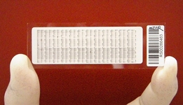
Reverse phase protein array (RPPA)
High-throughput antibody-based technique
Proteins extracted from tissues or cultured cells
MD Anderson RPPA platform allows for the analysis of >1000 samples using ~400 antibodies
Advantages
Cost effective
High throughput
Sensitive (detects ng of proteins)
Accurate quantification

Slide 4
MD Anderson RPPA Platform
Characterized >150,000 samples for users worldwide
Characterized ~8,000 TCGA patient samples
Characterized ~1,000 CCLE cell line samples
One of two NCI Genome Characterization Centers
Cancer Therapy Evaluation Platform (CTEP) site for sample characterization, recently approved by NCI.

Slide 5
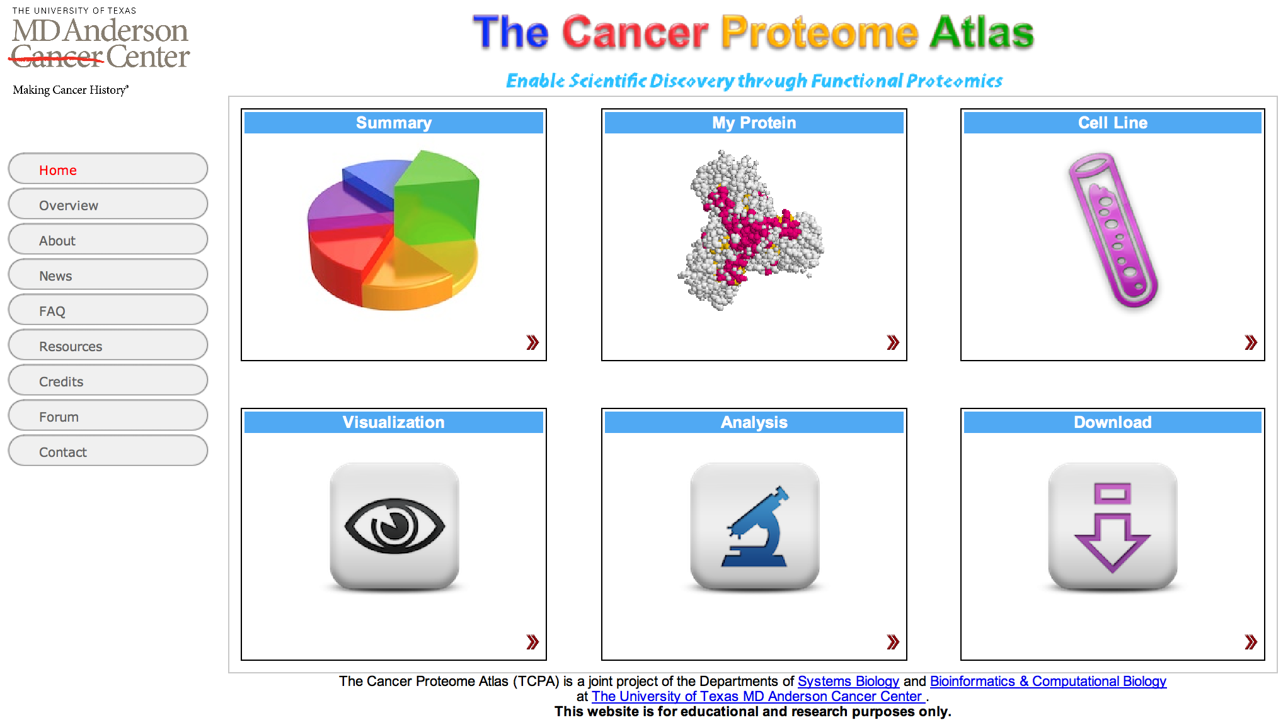
The Cancer Proteome Atlas
Li et al., Nature Methods, 2013

Slide 7
TCPA
Patient samples
TCGA PanCancer
MDACC
Cancer cell lines
MCLP (>800)
CCLE (~1000)
Other
(Japan, Philadelphia, France, etc.)
Perturbed response
Baseline
Drug
Compounds
Other pertubration
(e.g. Glucose , mutations)
Akbani et al., Nature Communications 2014
Chen et al., JCO Clinical Cancer Informatics 2020
Li et al., Cancer Res 2015
Chen et al., Mol Cell Proteomics 2019
Zhao et al., Mol Cell Proteomics 2018
Li et al., Cancer Cell 2017
Li et al., Nature Methods, 2013
Ghandi et al., Nature 2019
Zhao et al., Cancer Cell 2020
Ng et al., Cancer Cell 2018

Slide 8
Overview of PRECISE Algorithm
A general Bayesian framework that integrates priori existing knowledge databases, data-driven de novo causal structures, and diverse molecular profiling data
Ha et al., Scientific Reports 2018; Bhattacharyya et al. JCO Clinical Cancer Informatics 2020

Slide 10
Proposed Aims

Slide 11
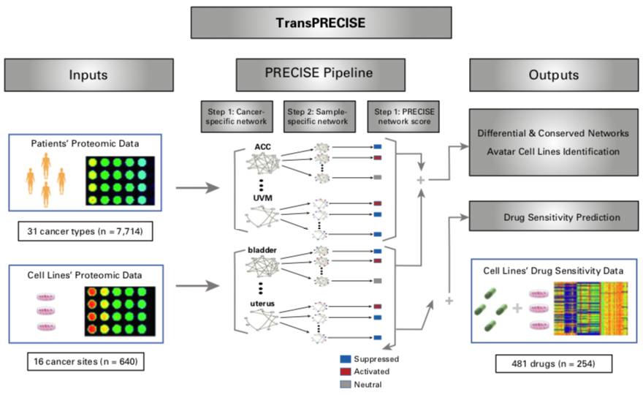
Overview of TransPRECISE framework

Slide 12
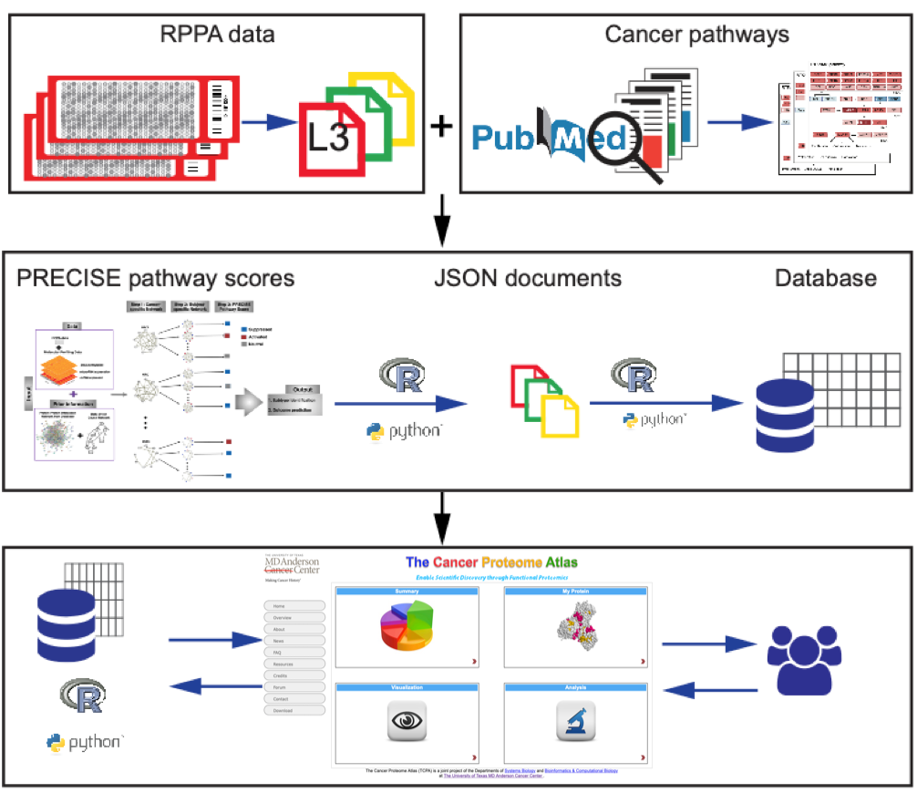
Workflow for TCPA pathway-centered analytics
(A) Data acquisition
(B) Pathway score
quantification
(C) Pathway-centered
analytics

Slide 13
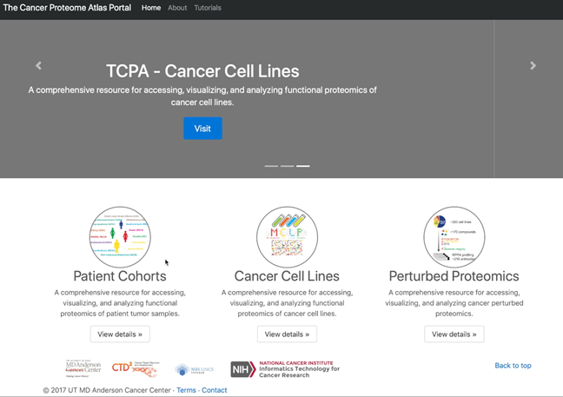
Demo1: TCPA-patient pathway analysis

Slide 14
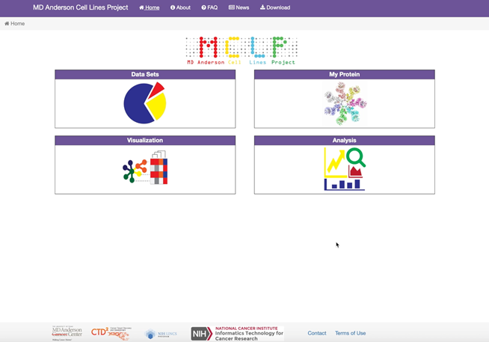
Demo2: TCPA-cell line pathway analysis

Slide 15

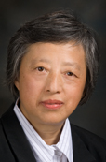
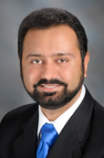


Acknowledgements
NCI ITCR program U24CA209851
Jun Li
Mei-Ju Chen
Wei Zhao
Liang Lab
Gordon B Mills
Yiling Lu
Rehan Akbani
John Weinstein
Wenbin Liu
Zhenlin Ju
Chris Vellano
Patrick Ng
Gordon Mills
Yiling Lu
Rehan Akbani
R21CA220299 Min Jin Ha Veerabhadran Baladandayuthapani
Jun Li
TCPA http://tcpaportal.org

