Slide 1
Utah-Michigan ITCR Collaboration
FHIR-based document extraction tool for EHRs

Slide 2
EMERSE
Search engine designed specifically for EHR data in clinical notes
~80% of all EHR data are only in free text
Groups notes by patient
Find cohorts
Supports chart reviews, collaborative work among team members
Powerful query expansion
http://project-emerse.org
Clinical notes are known to be difficult to access, often very locked down
Many academic institutions have limited capabilities for extracting/utilizing EHR notes

Slide 3
EMERSE used for family history NLP annotation @ Utah
Goal: develop NLP algorithms to extract family history documentation from clinical notes
NLP annotation is time consuming and data are sparse
EMERSE assists annotation process:
Identifying most relevant note types
Enriching annotation sample
Highlighting relevant family history terms in retrieved notes

Slide 4
EHRs (Epic as example)
Epic EHR
Chronicles
Clarity
Caboodle
“Simplified” reporting DB
Notes stripped of formatting
48 hr delay?
Transactional DB
Fully formatted notes in RTF
real time
Reporting DB
Notes stripped of formatting
24 hr delay
HL7 messages

Slide 5
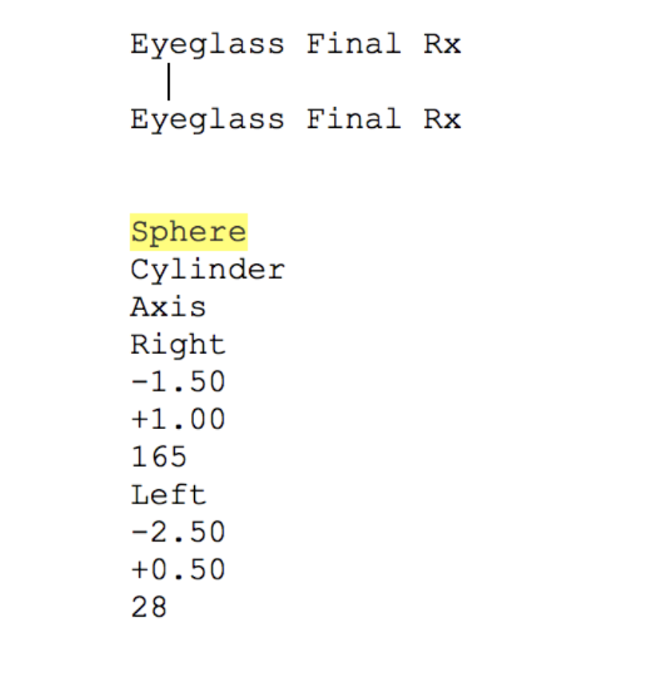
Note formatting

Slide 6
EHRs (Epic as example)
How to get data from here?
Epic EHR
Chronicles
Clarity
Caboodle
“Simplified” reporting DB
Notes stripped of formatting
48 hr delay?
Transactional DB
Fully formatted notes in RTF
real time
Reporting DB
Notes stripped of formatting
24 hr delay
HL7 messages

Slide 7
EHRs (Epic as example)
How to get data from here?
Chronicles
Vendor independent standard for interaction with EHRs (mostly data requests)
Originally envisioned to pull data for a single patient at a time
For EHR search tool, necessary to “bulk” extract data for many patients
Utah developed a FHIR-based tool for extracting notes in bulk

Slide 8
FHIR-based clinical note data export tool
EMERSE
EMERSE Web App
Synonym Vocabulary
Emerse
Data export
Clinical Text Index (Apache SOLR)
Patient Cohort Database
Epic
Clinical notes
Demographics
Bulk Data Loader
Epic's transactional database
Cohort Criteria Filter
FHIR API

Slide 9
What parts of FHIR are used
Version: STU4
Resources
Patient
DocumentReference
Binary
Queries
Patient (based on MRN)
For each patient, retrieve all DocumentReference resources
Leveraged EHR's native FHIR API

Slide 10
FHIR experience at Michigan
FHIR is standard but vendors have flexibility in how and how much of the FHIR spec they implement
Institutions may also differ in what underlying components are supported/turned on
Initially had limited environments for testing
Had to have FHIR servers enabled for our testing environments
Could successfully query Chronicles using Utah-developed FHIR API to get fully formatted HTML notes.

Slide 11
FHIR experience at Michigan
Technical capabilities and portability confirmed
Benchmarking: 3 documents/second
Local policies about access not defined
How much could we query the primary transaction system? Times of day? Volume/threads?
Still need additional queries regarding other operational aspects (e.g., deleted/changes notes, split/merged patient IDs, etc)
Final steps: documenting details, how the tool works, and adding code to GitHub repository

