Slide 1
The Childhood Cancer Data Initiative: Tools & Resources
ITCR Annual Symposium

Slide 3
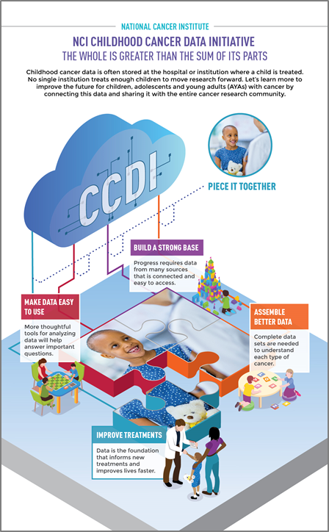
FISCAL YEAR 2020 (Initial Funding of $50M)
Laying the foundation
Accelerating progress in childhood/AYA cancer
Optimize future CCDI investments
FISCAL YEARs 2021 – beyond
CCDI Leadership actively planning research opportunities to build on:
Advisory recommendations
Insight from diverse stakeholders
Ongoing CCDI activities

Slide 4
CCDI Working Group Report
Types of Data for Collection and Aggregation
Landscape of Pediatric/AYA Cancer Research Data & Needs Analysis
Potential Barriers to Progress
Generating New Data
Distinction Between Research & Clinical Data
Engaging Diverse Array of Stakeholders for Input
Potential Opportunities for Transformative Discoveries
24 specific recommendations

Slide 5
CCDI Activities: Building On Recommendations
Enhance (Reduce Barriers) to Data Sharing
Establish Federated Infrastructure (cancer data ecosystem) – sharing/ analyzing research & clinical data:
Identify/ connect data (clinical, preclinical, research, surveillance) & tools
Develop enabling cancer technologies to enrich/ automate – data capture, curation, harmonization, use, & publication
= Moonshot Blue Ribbon Panel
= ad hoc NCAB Data Science WG
= ad hoc BSA WG on CCDI
Create Central Resource Catalog of available pediatric/AYA data, biospecimens, & tools
= CCDI Symposium Discussion
= CTAC Informatics WG
Aggregate preclinical testing & cancer model data to inform Rapid Clinical Translation (FDA Pediatric Molecular Targets List)
Develop a National Strategy of biospecimen collection/ archiving (germline & tumor) & genomic testing (tx data → outcome; relapse seq) for every child

Slide 6
Establish Infrastructure to Manage & Share Data
NCI Activities:
Develop a Federated Pediatric Cancer Data Ecosystem of research repositories & patient registries:
National Childhood Cancer Registry (NCCR)* – link clinical patient data (e.g. SEER, VPR, PPCR*, CCRN)
Pediatric Preclinical Data Commons (PPDC)*
Pediatric/ AYA Data from Care Centers (link/ transfer):
NCI data repositories (rare tumors/ clinically-relevant variants)
NCCR patient-linked registry
Searchable catalog of pediatric data, tools, & resources

Slide 7
Develop Resources to Analyze & Use Data
NCI Activities:
Develop or transfer tools & pipelines to NCI resources
Computational methods & tools – annotate, integrate, translate data from multiple repositories or registries
Interpreting pathology images & patient reports*
Identifying & validating molecular targets*
Automated curation of data (e.g. Natural Language Processing) for refining, scaling & real-world data capture
Interactive data portals – engagement & resource accessibility
Pediatric data model & terminology harmonization (PCDC)*

Slide 8
Create Comprehensive & Meaningful Data Sets for Discovery
NCI Activities:
Sequencing & characterization:
Germline & tumor samples (clinical trials: diagnosis, relapse)*
Pediatric pre-clinical models (PDX, cell lines)*
Secondary cancers from survivors*
Explore risk & susceptibility in patients/ survivors:
Environmental exposures
Metabolomic profiling (inherited predisposition)
Develop & characterize cancer models (pediatric brain & solid cancers: cell lines, organoids)

Slide 9
Moving Discoveries Into the Clinic
NCI Activities:
Analyze molecular & clinical data to validate variants on FDA Relevant Molecular Targets List*
Establish & translate Rare Pediatric Tumor Cell Atlas data to the clinic (MyPART)*
Improve & enhance efficiency of clinical trials data:
Comprehensive central monitoring & safety reports
Increased quality of data (self-reports, PRO) collected
Exploring genetic susceptibility to adverse events (post treatment); & risks/benefits of proton therapy*

Slide 10
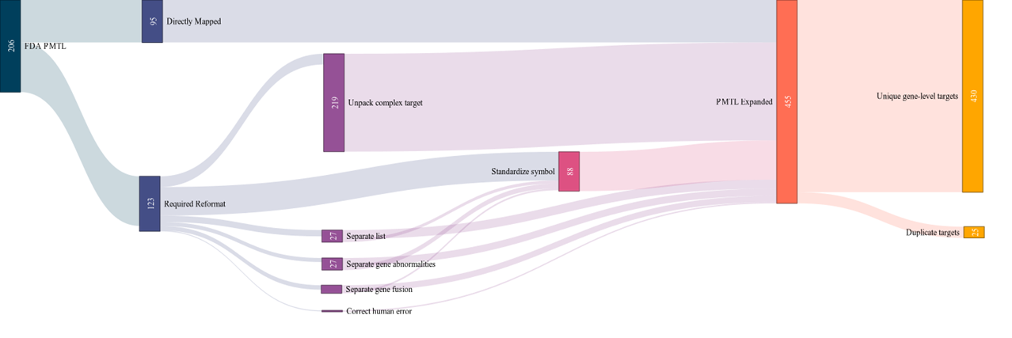
Pediatric Molecular Target List (PMTL)
Relevant Molecular Target: targets have evidence indicating their relevance in the growth or progression of pediatric cancers. Any new drugs developed for these targets in adult cancers must also be studied for use in pediatric cancers. https://www.fda.gov/media/120331/download
Non-Relevant Molecular Target: targets have evidence indicating that they are not relevant in the growth or progression of pediatric cancers. Any new drugs developed for these targets in adult cancers will receive an automatic waiver from also studying them in pediatric cancers. https://www.fda.gov/media/120329/download
430 unique, gene-level targets in Expanded PMTL
(455 including duplicates)
206 targets in FDA PMTL
Computable PMTL Artifact

Slide 11
Open Targets (OT) Platform for Childhood Cancers
Open Targets Platform is a knowledgebase of knowledgebases:
Reduce time spent monitoring, organizing, scientific, and medical literature
Easy access to early-stage drug discovery
Supporting data to take drugs to clinical trial
Help build hypothesis
Pharma companies are very familiar with the OT project with some partnering and utilizing internal versions
Data Types
(Genomic alterations, transcriptomics, gene mutation/fusions, etc.)
Target Identification & Prioritization
Data Curation
Development & Operations
Open Targets Platform – Childhood Cancers

Slide 12
CCDI - ITCR Supplements: Tools
Standardized and Genome-Wide Clinical Interpretation of Complex Genotypes for Cancer Precision Medicine (Dr. Obi Griffith, Washington University)
Adapting Functional Precision Oncology for Pediatric Brain Cancer (Dr. Gabor T Marth, University of Utah)
Data-driven QSP software for personalized colon cancer treatment (Dr. Leli Shahriyari, University of Massachusetts Amherst)
A statistical framework to systematically characterize cancer driver mutations in noncoding genomic regions (Dr. Eliezer M Van Allen, Dana-Farber Cancer Institute)

Slide 13
CCDI – P30 Supplements: Tools
Deployment of Tools on to NCI Cancer Genomics Cloud (CGC):
CICERO: enables discovery of diverse types of gene fusions, an important class of molecular target in pediatric and adult cancers. Application of CICERO in pediatric cancer RNAseq data has led to discoveries that are now part of the FDA Relevant Molecular Target List
RNAIndel: expands the utility of RNA-seq data for somatic variant detection while indel expression status facilitates validation of somatic indels as potential targets
Teltale: analyzes telomere abnormality by computing the ratio of telomeric reads present in paired tumor/normal whole-genome sequencing (WGS) data
Net-BID: enables discovery of hidden drivers in RNA-seq data by performing data-driven network based Bayesian inference analysis

Slide 14
CCDI Resources: Childhood Cancer Datasets Catalog

Slide 15
CCDI: Other Resources
CCDI Data Inventory
Data Submission Systems

Slide 16
Engage with CCDI
Visit the CCDI website to learn more. on the NCI website
Review the BSA CCDI Working Group final report
Receive email updates from NCI on the CCDI
Contact the CCDI with questions about engagement, ongoing activities, or funding opportunities

