Slide 1
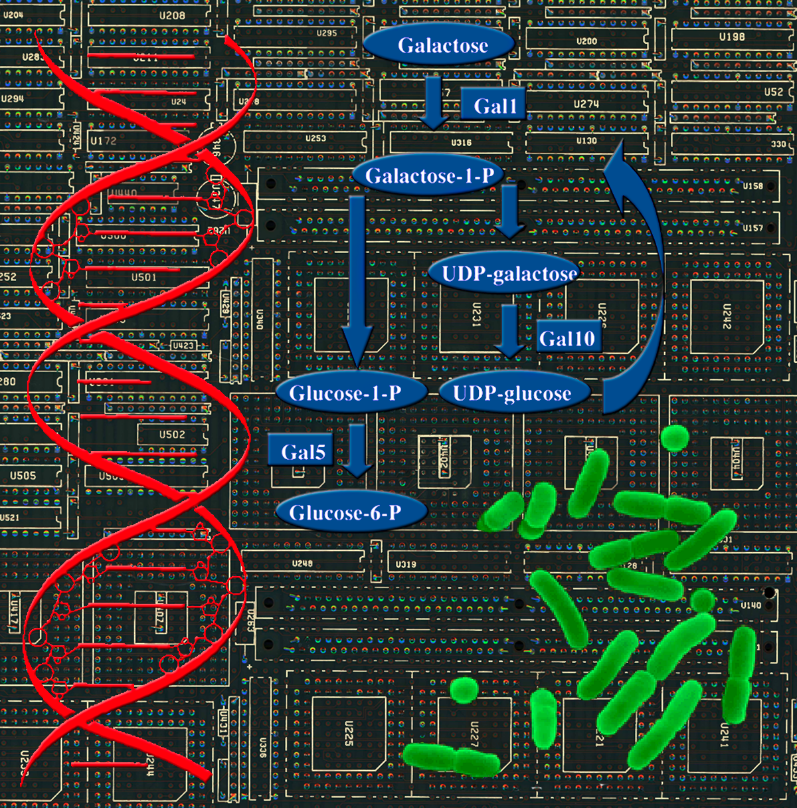
Department of Medicine
The Integrative Genomics Viewer (IGV)
for Cancer Research
PI’s: Jim Robinson and Jill P. Mesirov
ITCR monthly meeting, February 2022

Slide 2
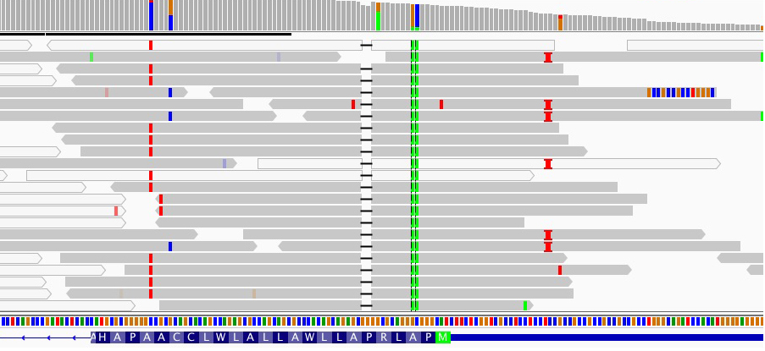
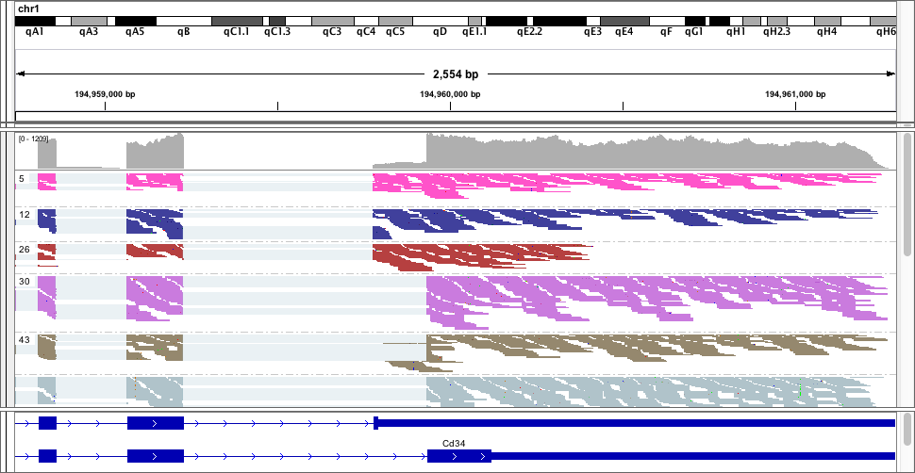
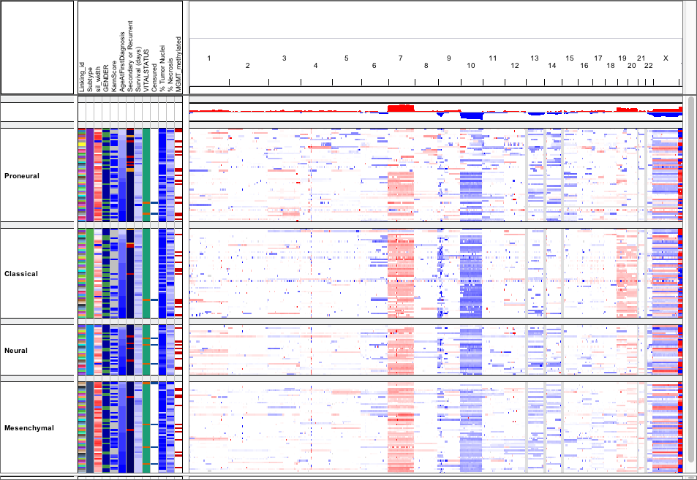
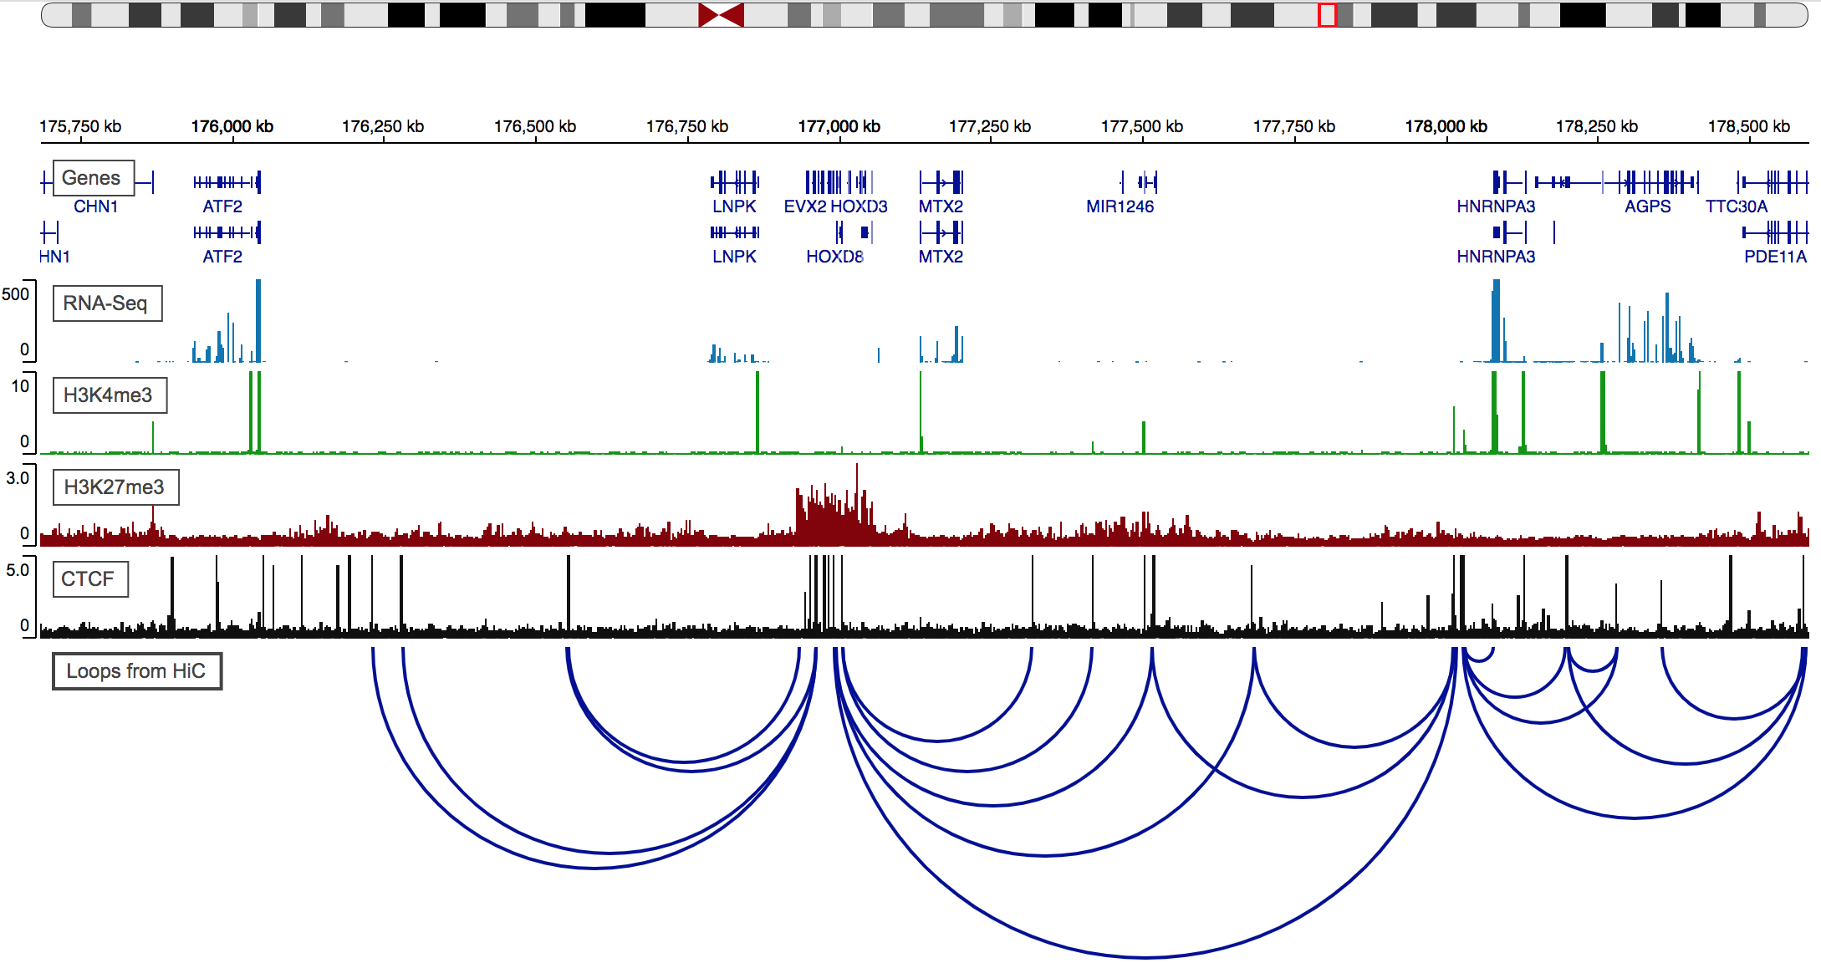
IGV Desktop
The original IGV
Desktop application for visualization of genomic data
Enables integration of investigators data with genome sequence, annotations, and other local, cloud, public, and private datasets
Current usage: ~90,000 launches per week

Slide 3
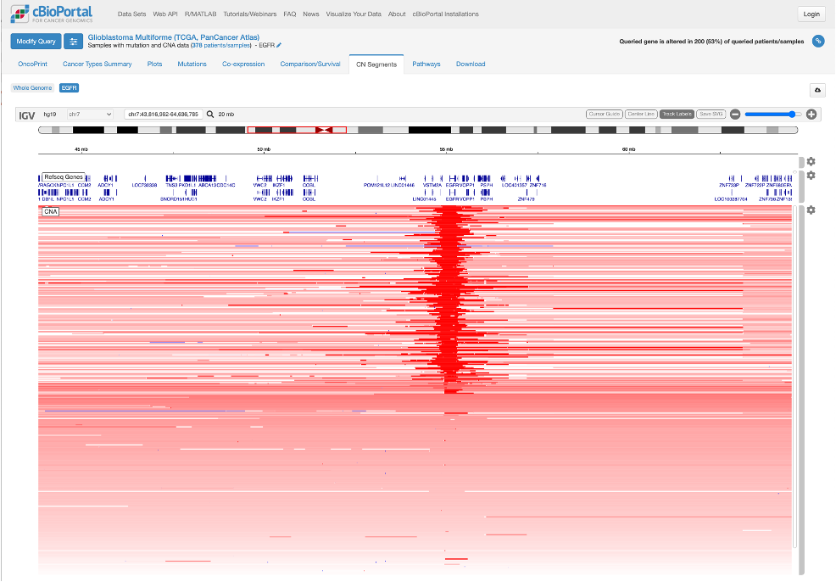
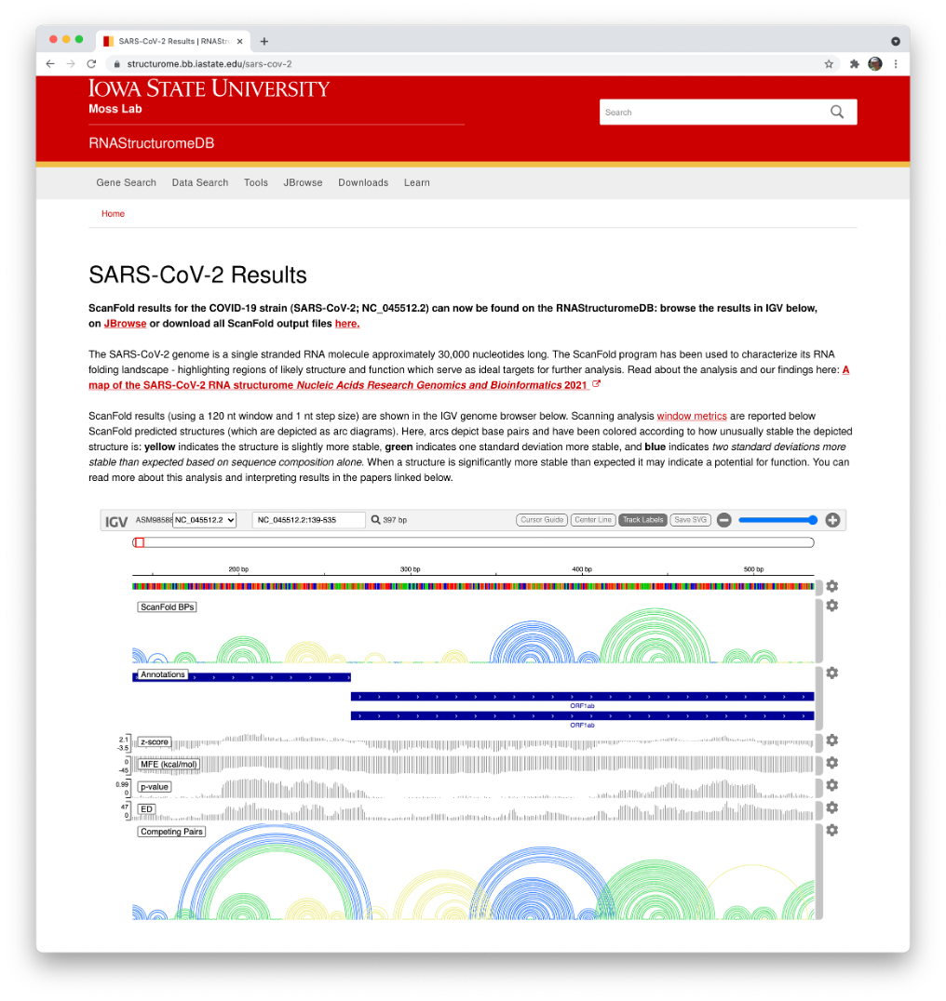
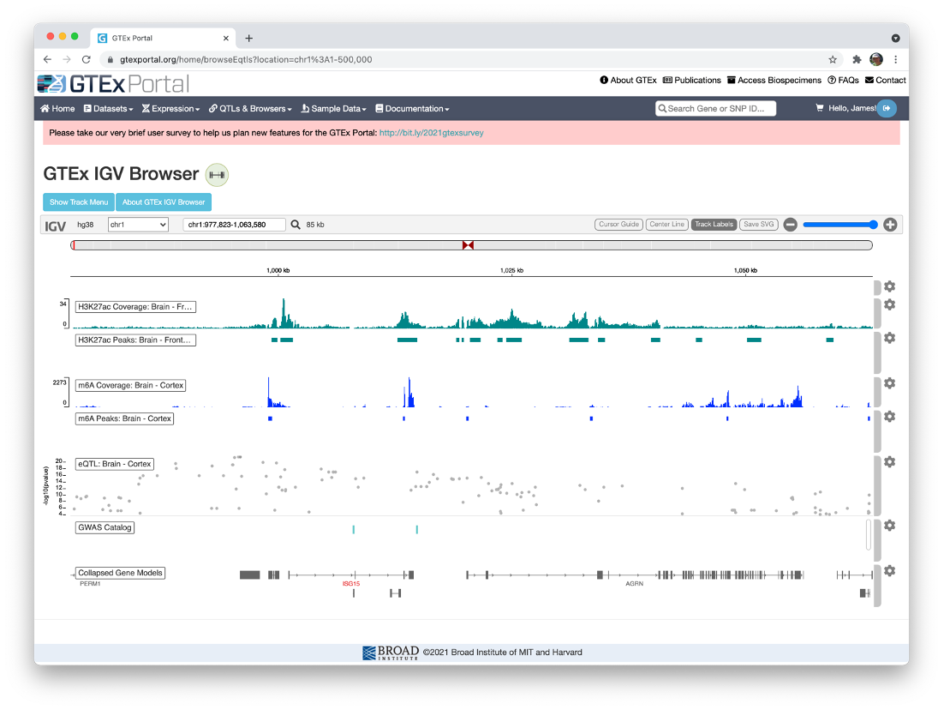
igv.js
JavaScript component implementing IGV visualizations
Focus on embedding – customers are developers
Ease of use, no external dependencies, customizable

Slide 4
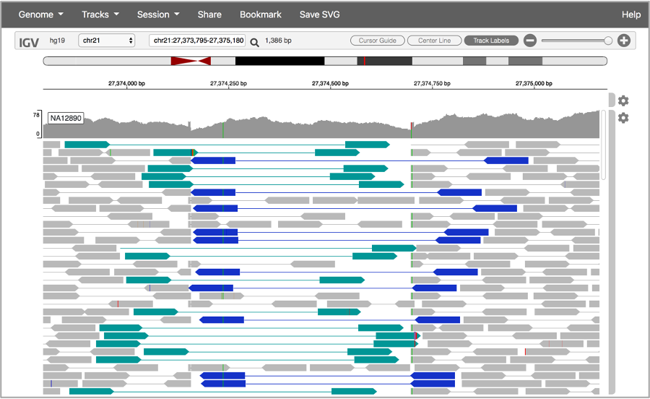
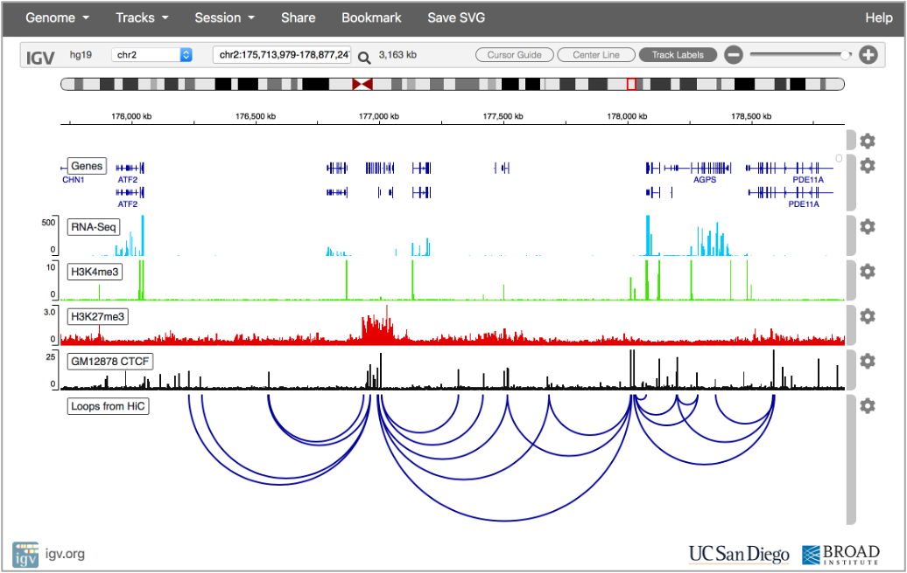
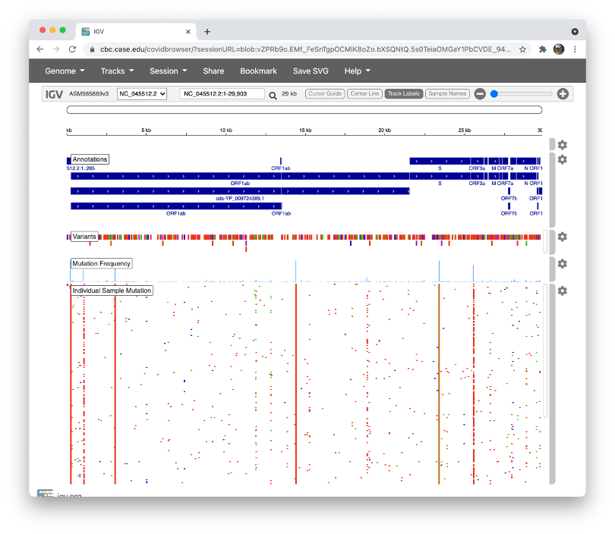
IGV Web App
IGV application in a web browser
Runs in a browser – no software to download
Supports easy sharing of visualizations as tiny URLs
Configurable genome and track menus for custom installation

Slide 5
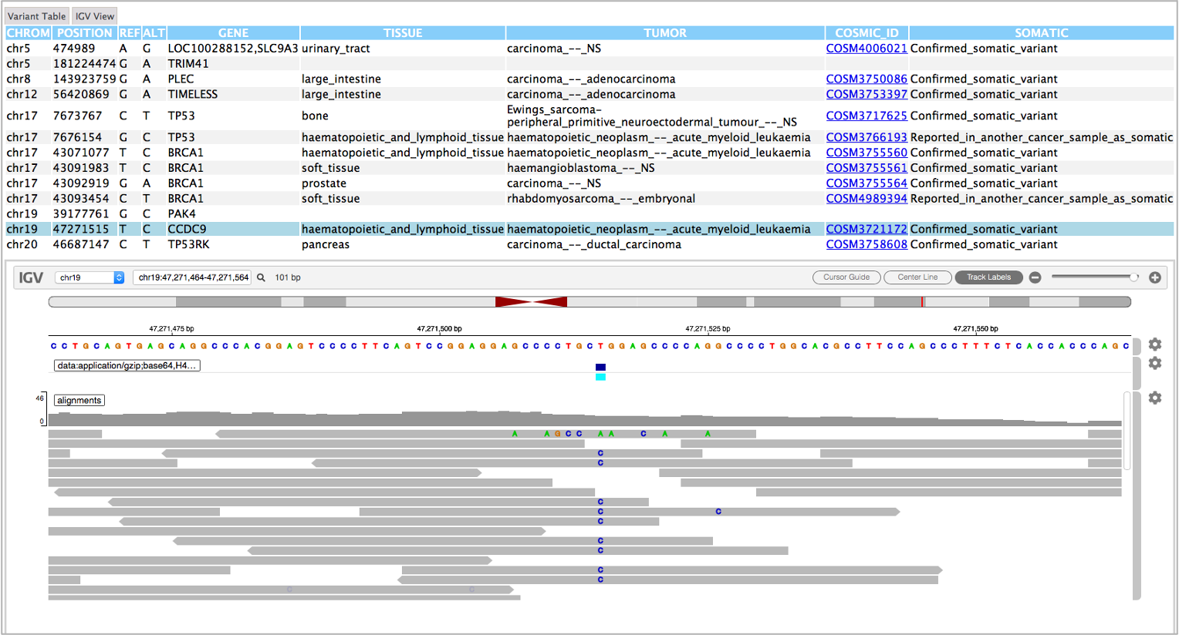
IGV Reports
Creates a standalone report for variant review
Input => BAM/CRAM, VCF, Sequence, and annotation files
Output => Single HTML file including all data for regions of interest
No network connection or access to source data needed to view
Table view
of variants
Alignments for
selected variant

Slide 6
IGV Brief History
2008 – Initial release of IGV desktop application for genome visualization of cancer datasets from primarily microarray-based assays for copy number, mutations, and gene expression.
2009 – Introduced support for viewing NGS sequence alignments data in the nascent SAM/BAM format.
Continuous evolution with support for RNA-seq data, 3rd gen long-read sequence data, called variants in VCF format, “*”-seq, RNA structure, and more
2016 – Released igv.js, an embeddable JavaScript component.
2018 – Released IGV-Web a standalone, client-only web app (https://igv.org/app)
~22 million launches of IGV Desktop since 2011; currently ~90,000 weekly
~19 million page hits for igv.js since 2016; currently ~120,000 weekly
~12,000 citations in the scientific literature

Slide 7
New Sustainment U24 - Goals
- Evolve IGV to keep pace with the needs of the cancer genomics community.
- Maintain IGV to ensure continued high levels of utility, usability, and reliability.
- Support the IGV user and open-source developer communities.

Slide 8
Evolve IGV
We will continue to evolve IGV to leverage recent and future advances in genomics technologies and methods that are key to moving cancer research and treatment forward
Community driven process. Some initial goals include:
Improved visualizations of indels in both long and short read alignments.
New options for viewing long range structural events, including integration with external visualizations.
Integration with external tools for local re-alignment and assembly for the interpretation of structural variants.

Slide 9
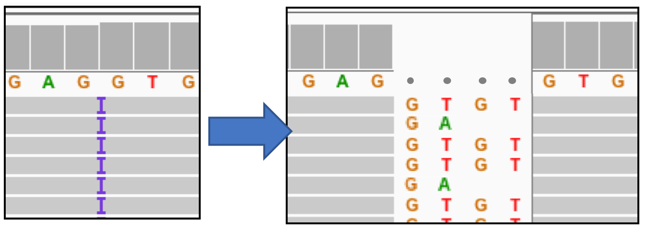
Evolve IGV
Example 1: Improved visualization for indels

Slide 10
Evolve IGV
Example 1: Improved visualization for indels
Represents an insertion

Slide 11
Evolve IGV
Example 1: Improved visualization for indels
Reference sequence
Represents an insertion

Slide 12
Evolve IGV
Example 1: Improved visualizations for indels
??? Nowhere to put it
Reference sequence
Represents an insertion

Slide 13
Evolve IGV
Example 1: Improved visualization for indels

Slide 14
Evolve IGV
Example 1: Improved visualization for indels
Expanded reference

Slide 15

Evolve IGV
Example 2: Improved visualizations of structural variants
Interactive circular view
Collaboration with the JBrowse team
Data courtesy of the Schatz laboratory

Slide 16
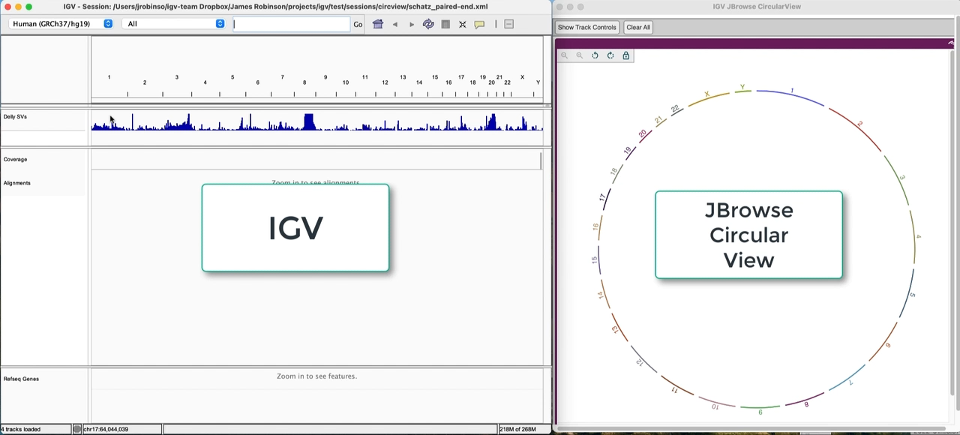
Evolve IGV
Example 2: Improved visualizations of structural variants
Interactive circular view
Collaboration with the JBrowse team

Slide 17
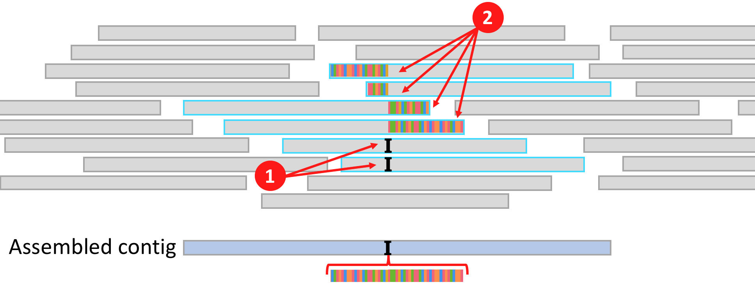
Evolve IGV
Example 3: Local realignment and assembly
1
Insertion markers
2
Clipped alignments

Slide 18
Evolve IGV
Example 3: Local realignment and assembly
Turn on “show soft clips”
1
Insertion markers
2
Clipped alignments

Slide 19
Evolve IGV
Example 3: Local realignment and assembly
Assemble selected reads
1
Insertion markers
2
Clipped alignments

Slide 20
Evolve IGV
Example 3: Local realignment and assembly
Assembled contig
1
Insertion markers
2
Clipped alignments

Slide 21
Maintain IGV
Software tools require continual effort to maintain usability and quality
Primary drivers of these improvements and fixes in IGV:
  The IGV user community (the squeaky wheel)
  Changes in the computing and software technology environment (deprecated language features, security requirements, new data access methods, improved software packaging tools, etc.)
  Frequent releases deliver improvements and bug fixes in a timely manner
    17 releases in past 12 months
    Current development build always available

Slide 22
Support IGV
1. Supporting IGV’s large and diverse end user community
Ongoing direct user support via IGV help forum and GitHub
Overhaul of documentation and training materials
  Review for usability and completeness
  Move to simpler Markdown platform
  Host doc source in GitHub repo and support pull requests for community updates
2. Supporting IGV’s community of software developers
The users of the igv.js component are software developers
  ~180,000 NPM package downloads in the past year
  Direct support via GitHub issues
Developers contribute to the IGV desktop and igv.js code
  79 external contributors on GitHub (IGV + igv.js)
  Code reviews of pull requests

Slide 23
Resources
Project site: https://igv.org
Help forum: https://groups.google.com/group/igv-help
GithHub: https://github.com/igvteam
IGV Web App: https://igv.org/app
Contact: Email: igv-team@broadinsitute.org
Email: jrobinso@ucsd.edu
Twitter: @igvteam

