Slide 1
Informatics tools for identification, prioritization and clinical application of neoantigens (pVACTools)
ITCR Annual Meeting
September 22, 2021
Malachi Griffith, PhD
Associate Professor, Department of Medicine
Associate Professor, Department of Genetics
Washington University School of Medicine
mgriffit@wustl.edu
griffithlab.org
@malachigriffith

Slide 2
The goal of one class of cancer immunotherapy is to leverage the immune system’s ability to attack non-self or “foreign” cells (recognized by their neoantigens)
Examples of therapies that leverage neoantigens:
Checkpoint inhibition therapies
Allogeneic / Autologous vaccines
Personalized neoantigen vaccines
Neoantigen adoptive T cell transfer
Engineered neoantigen T cell
Neoantigen CAR T cell
Normal Cell
WT ‘self’ antigen
recognized as self
Cancer Cell
Neoantigen ‘non-self’ antigen
recognized as foreign
Notes:
A major focus of our work is on understanding how T cells can recognize tumor cells by their unique features. Our goal here is to really leverage the immune system’s remarkable ability to identify and destroy cells infected with non-self or “foreign” elements. Instead of the foreign element here being a pathogen that has invaded a cell, it is the tumor cell itself.
The reason this works is because tumors acquire somatic mutations and these genomic alterations create unique peptides that can be recognized as foreign.
Depicted here is an example of the simplest form of neoantigen. A single nucleotide change leading to a single amino acid substitution.
In normal cells, the wild type peptide may be presented by MHC but it will be recognized as self by the immune system
In the tumor cells, if the altered version of the peptide is presented it can lead to T cell recognition and ultimately cell death.
Two relatively new forms of cancer therapy that both rely on this principle are checkpoint inhibition therapies and personalized neoantigen vaccines.
In checkpoint blockade therapy you are inhibiting signaling molecules that the tumor upregulates to avoid immune recognition, effectively taking the breaks off of the immune system so that it can more aggressively recognize foreign antigens in the tumor.
In personalized neoantigen vaccines you are identifying a set of these peptides and delivering them to the patient to stimulate an immune response against the unique features of their tumor.
Neoantigens are antigens encoded by tumor-specific mutated genes.
Tumor-specific antigen presented by MHC Class I or II molecules on the cell surface
Created by somatic mutations in cancer leading to expression only on tumor cells
Tumor-specific epitopes (‘Neoepitopes’) are unique to each patient
These unique tumor epitopes result from somatic changes in the tumor genome (i.e. non-synonymous substitutions, insertions, deletions, splice site alterations, fusions, etc.)
Historically, experimental techniques have not been capable of rapidly and systematically identifying neoepitopes …

Slide 3
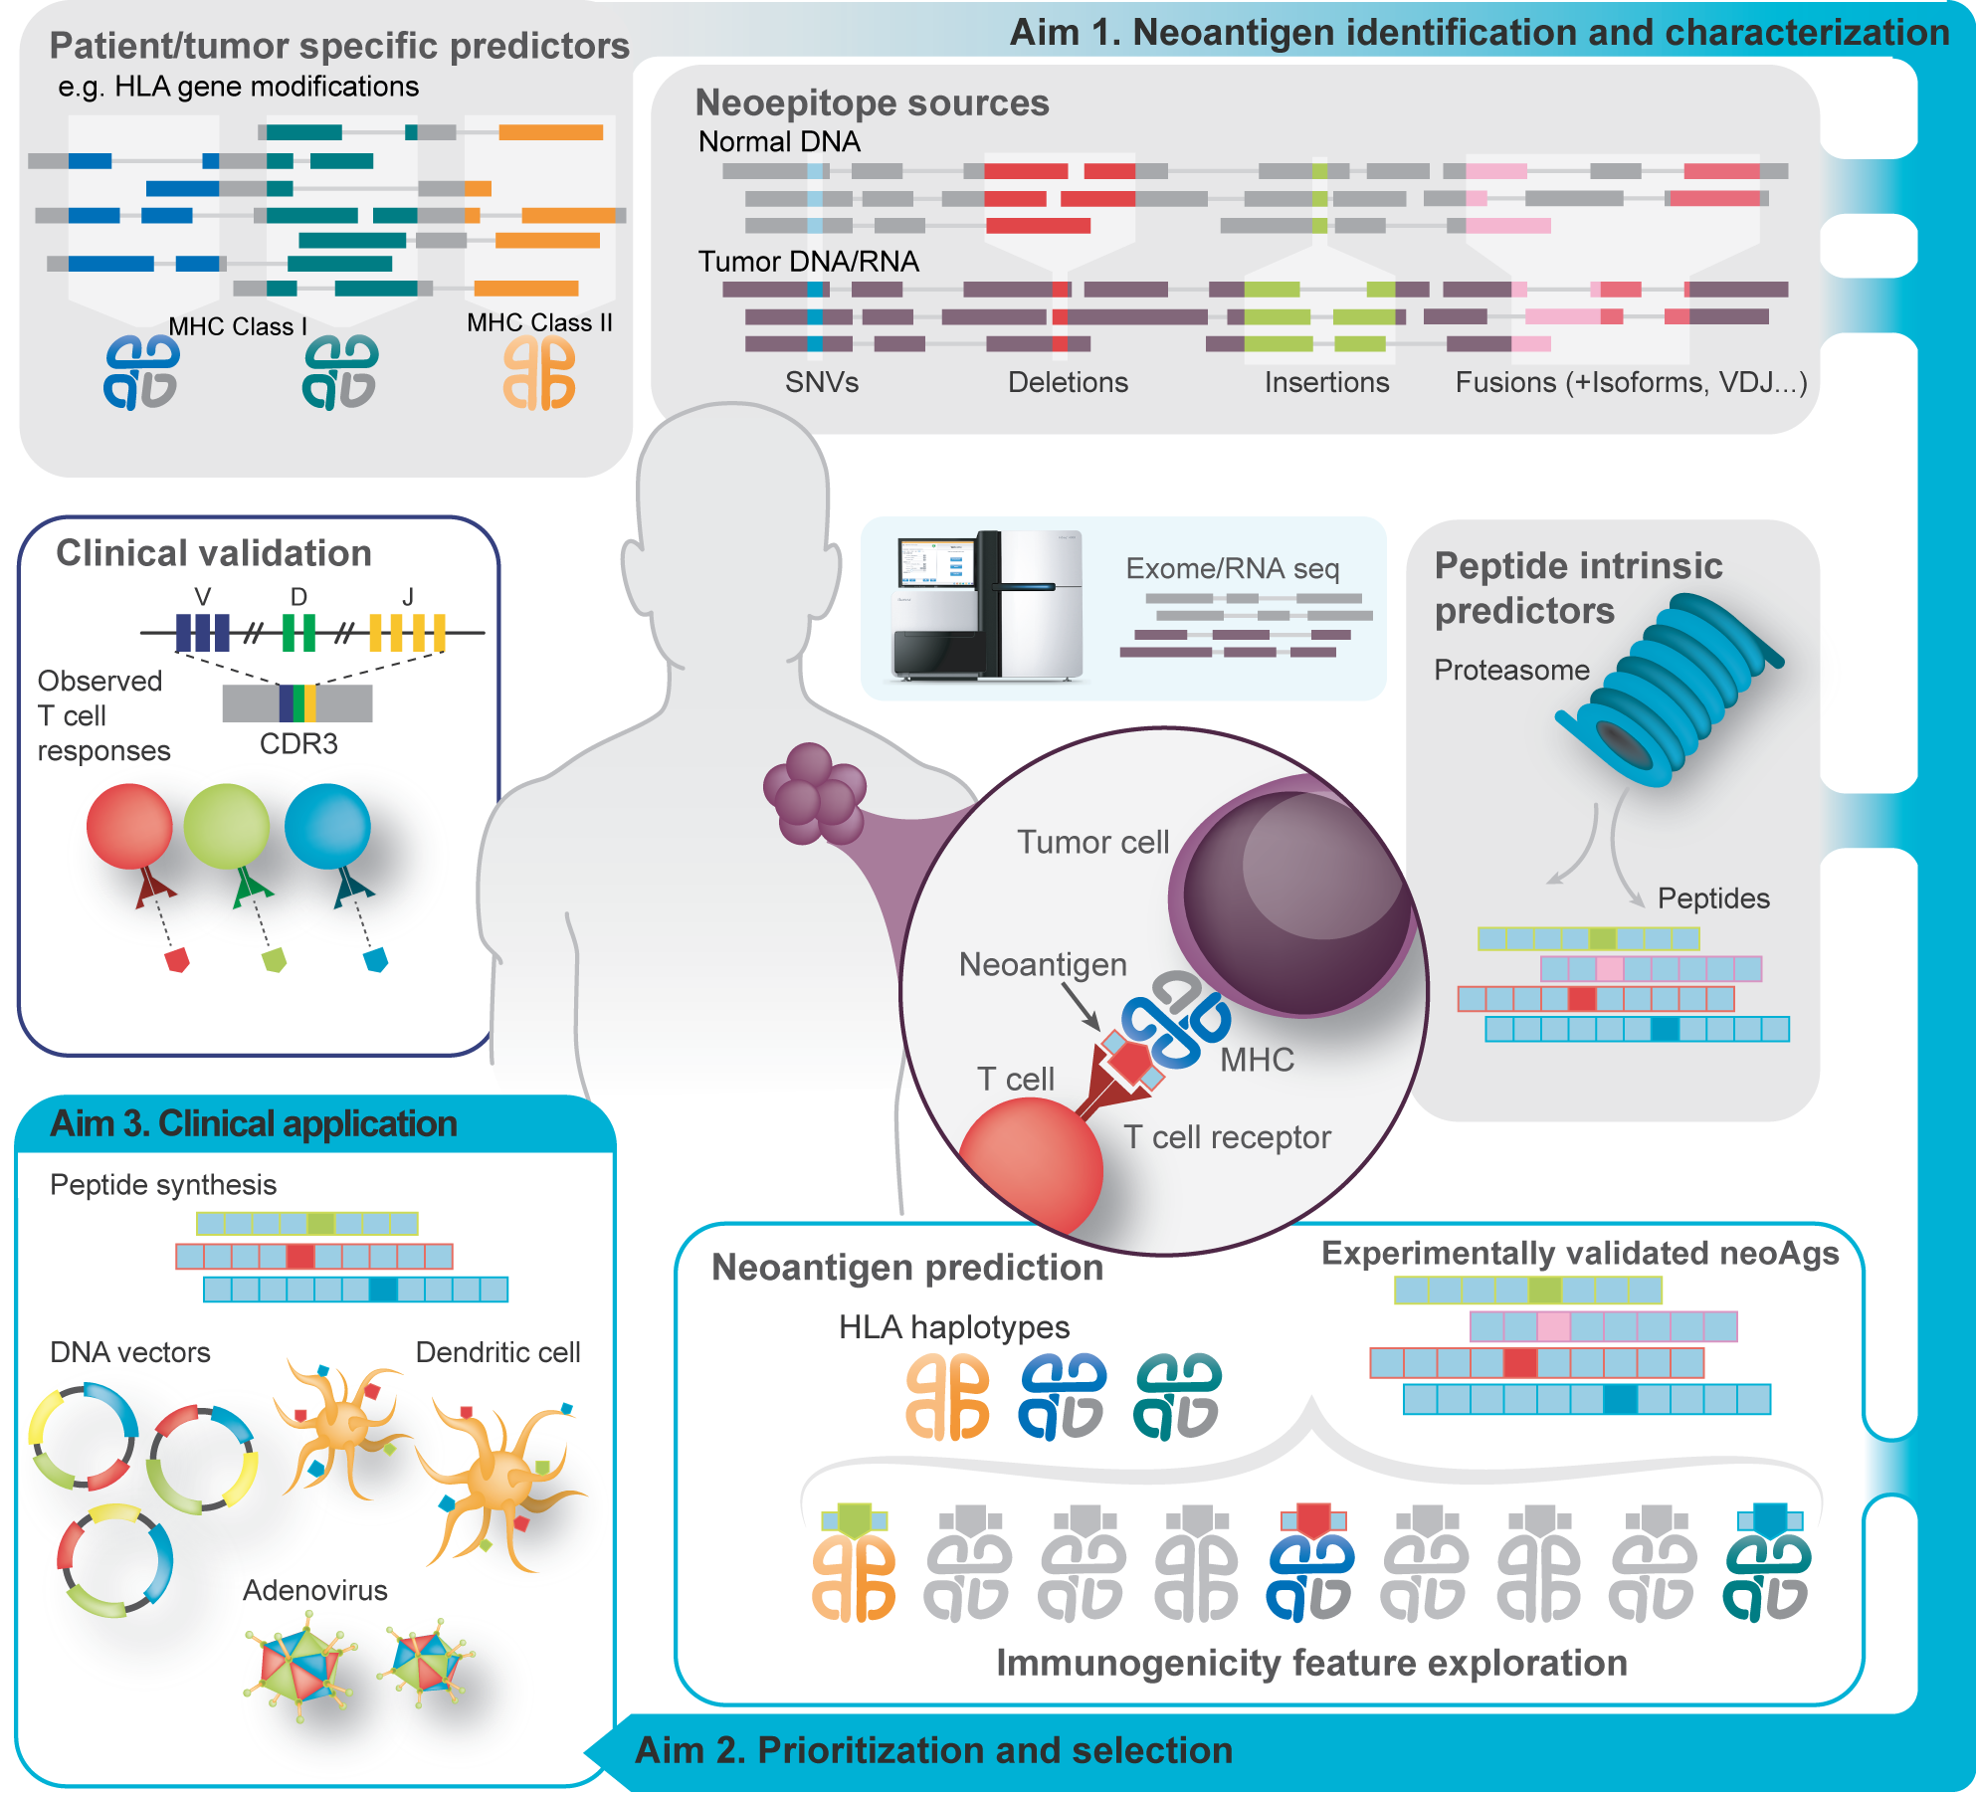
Neoantigen characterization relies on a very complex analysis workflow
Notes:
Identifying neoantigens and designing a personalized neoantigen vaccine is a complex workflow
At a high level, one starts with tumor samples from a patient.
Sequence data are mined to detect a variety of somatic variant types and determine the HLA alleles of the patient.
Additional predictors are applied to anticipate peptide processing, transport and stability.
The unique peptides of the patients tumor are modeled to predict their binding and presentation by the patients MHC alleles.
Finally a set of usual 5-30 of the best candidate neoantigens are selected and packaged into a vaccine (which may be formulated in a variety of ways) and delivered to the patient.
All of this is done as quickly as possible
One of the inspiring things about this approach is that it builds on everything we have been doing to advance tumor genome sequencing and analysis over the past 20 years. Literally several dozen bioinformatics tools developed in labs around the world are needed to go from raw data to a finalize vaccine design personalized for each patient’s tumor and MHC complement. We are standing on the top of a mountain here and the view is spectacular.

Slide 4
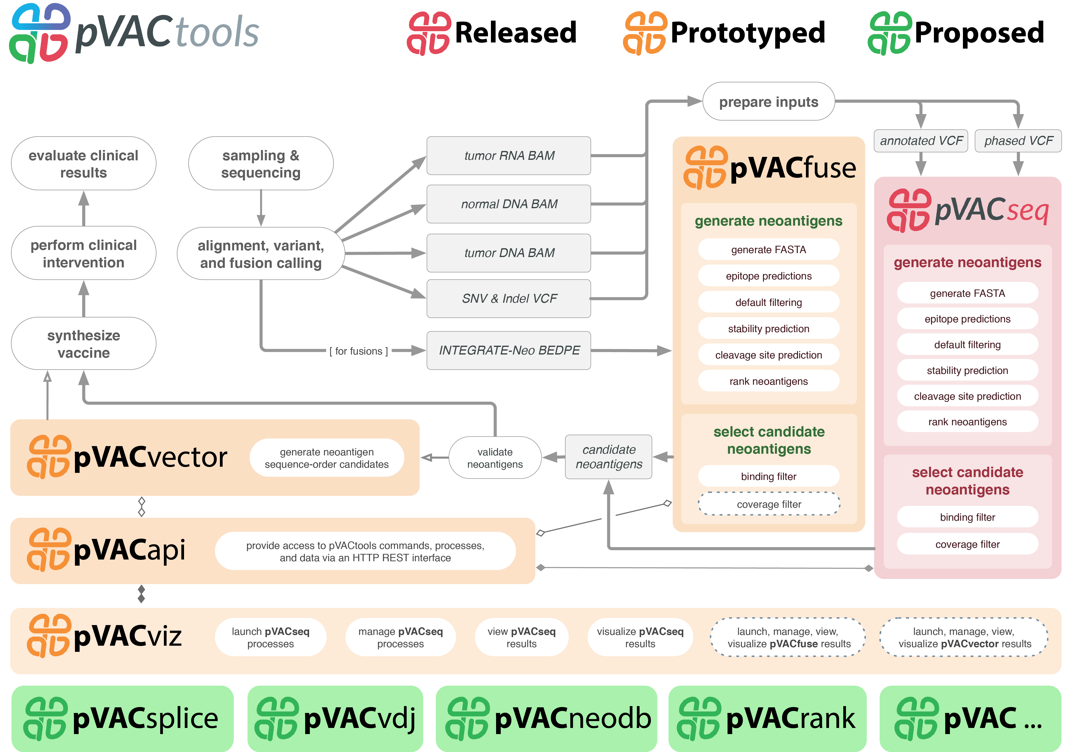
pVACtools (pvactools.org) was created to facilitate neoantigen identification
Inputs
Expression data
Variants (VCF)
Dependencies
VAtools
IEDB
MHCflurry
MHCnuggets
NetChop
NetMHCstab
Vaxrank
Agfusion
…
Susanna Kiwala
Hundal and Kiwala et al. 2019
Notes:
We created pVACtools to facilitate the process of end-to-end neoantigen analysis including consideration of the features I have just introduced as examples and many more. pVACtools is a highly modular analysis tool kit implemented in Python that is designed to support each step of neoantigen analysis. Its modularity is aimed at supporting customized approaches and use cases for neoantigen analysis ranging from basic to translational studies. We use it in several contexts but probably most heavily to create personalized neoantigen vaccine design in collaboration with an immunotherapy tumor board for a variety of clinical trials.
I don’t expect you to read all these details but, in broad terms it breaks the process down into components of data QC, HLA typing, various kinds of somatic variant detection, prioritization, visualization and packaging into a vaccine formulation.
To maximize the broad adoption of pVACtools and integration into other workflows we have tried to always use standard file formats for inputs and outputs. Essentially everything it needs for most functionality can be encoded in a single input VCF. In order to incorporate some features specific to neoantigens we created another tool VAtools to help users prepare this VCF.
If you want to learn more about this tool I would encourage you to visit pvactools.org
pVACseq - Neoantigen prediction for SNVs and Indels
pVACfuse - Neoantigen prediction for fusions
pVACvector - Optimizing design of spacers and shortlisted neoantigens to prevent high-affinity junctional epitopes (DNA Vector vaccines)
pVACviz - Browser-based UI for launching, managing, reviewing, and visualizing the results of pVACtools processes
pVACapi - HTTP REST interface to the pVACtools suite

Slide 5
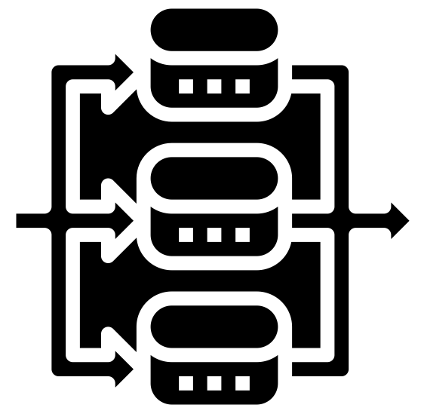
pVACtools modularity aims to broadly support neoantigen related analyses and clinical applications
Algorithms implemented
Prioritization, reporting, etc.
Neoantigen
analysis classes
Automated
orchestration
MHCflurry
binding_filter
run
MHCnuggetsI
coverage_filter
pvacseq
MHCnuggetsII
tsl_filter
NNalign
top_score_filter
pvacbind
run
NetMHC
download_example_data
NetMHCIIpan
install_vep_plugin
pvactools
pvacfuse
run
NetMHCcons
list_valid_alleles
NetMHCpan
allele_specific_cutoffs
pvacvector
run
PickPocket
generate_protein_fasta
download_cwls
SMM
generate_report
Workflow definitions
SMMPMBEC
reference_proteome
pvacview
run
SMMalign
cleavage
netChop
stability
Parallelization implemented
netMHC Stab
visualize

Slide 6
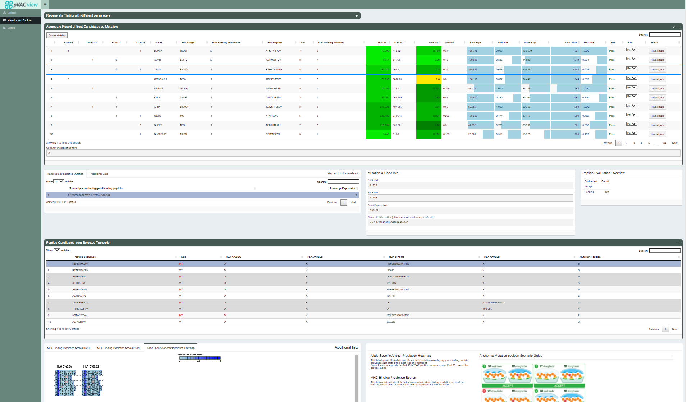
Demo: pVACview integrates complex data and features for neoantigen characterization
pvacview.org (https://griffithlab.shinyapps.io/pvacview/)
Huiming Xia
Notes:
As I’m sure you can appreciate by now, there are a lot of relevant factors that we want to take into account when modeling neoantigens.
In our own studies we are tackling this challenge in two ways.
The first, involves trying to organize and synthesize important features into a report and developing an interactive graphical interface to aid our immunotherapy tumor board in evaluating each neoantigen and selecting candidate for cancer vaccines.
Shown here is a brief demo of this interface which we call pVACview
This tool is designed to leverage the pVACtools suite of tools. However, we use a simplified aggregated report of candidates and JSON formatted input for the features of each neoantigen in the hopes that others could plug it and the end of their own established workflows.
To review candidates you start by loading these input files, you are then presented with a list of candidates summarized to the level of somatic variants (one line per mutation).
From this view you can see the number of peptides meeting basic criteria and details on the variant itself such as gene expression, allele specific expression, tumor clonality, and MHC binding metrics for the best candidate arising from this mutation.
The interface then allows you to drill down and get a lot more information about each individual peptide including: transcript specific annotations and expression information, the peptide sequence, the position of the mutated amino acid relative to MHC anchor site predictions, and results from multiple individual MHC binding prediction algorithms. We currently use an ensemble approach with 8-10 algorithms used to evaluate every candidate.
As you go, you can select a status for each candidate and when the review is complete you can save and export your prioritized candidates.
Figure caption:
Potential sources of “non-self” tumor neoantigens. Genomic alterations such as point mutations (A), indels (B) and gene fusions (E) can result in the generation of missense and frameshift neoantigens. Splicing aberrations such as the retention of cancer-specific exons (C) and introns (D) can also lead to frameshift neoantigens. Epigenetic changes can alter the expression levels of immunogenic genomically-encoded proteins (F) including viral proteins from integrated chronically-infected cells (EBV, HPV), cancer-testis antigens (e.g., MAGE-A4) and proteins derived from LINE and HERV elements. Post-transcriptional changes (G), including translation of upstream open reading frames (uORF), stop codon readthrough and protein modifications, such as methylation, phosphorylation and acetylation, can generate tumor specific neoantigens as well.

Slide 7
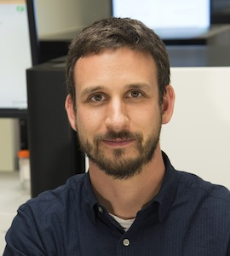
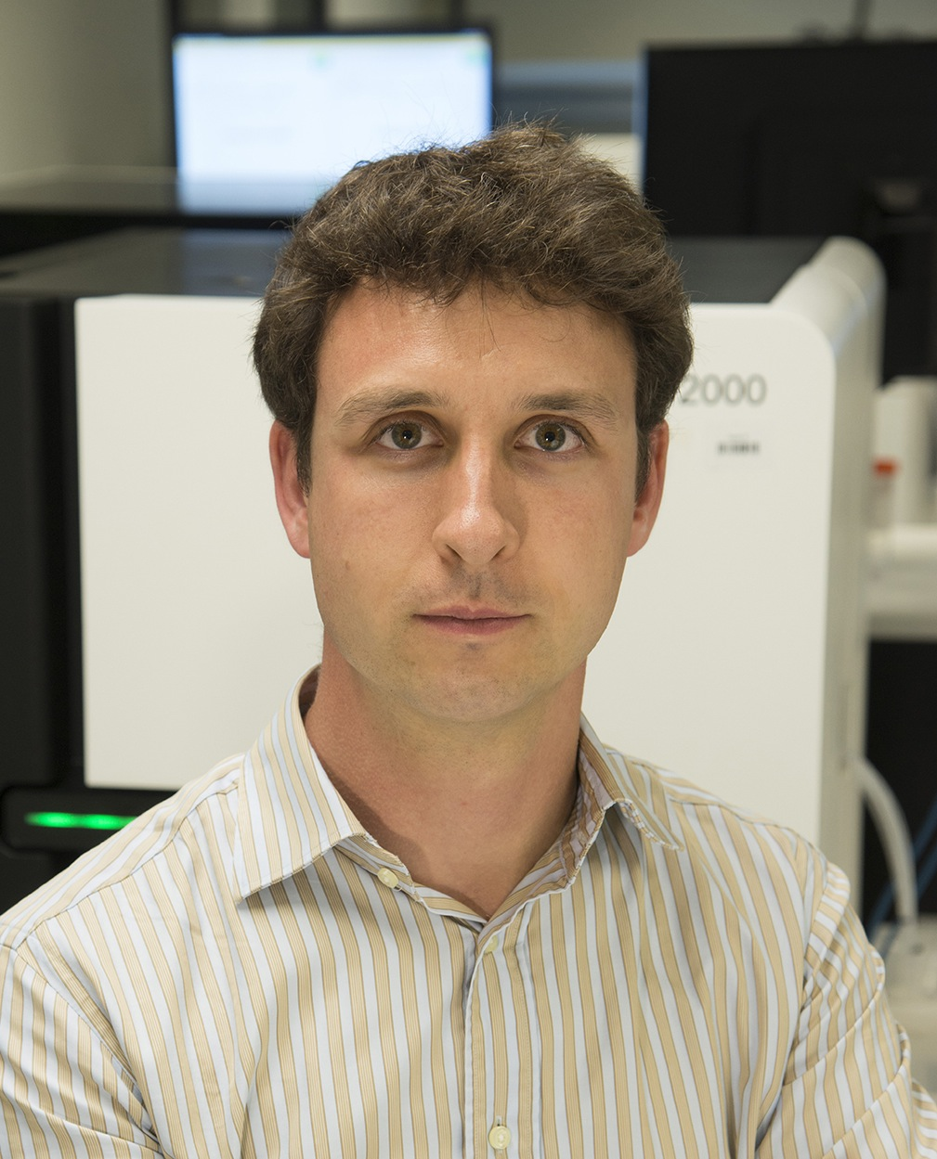
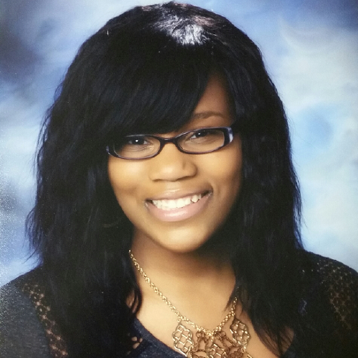
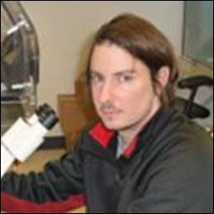
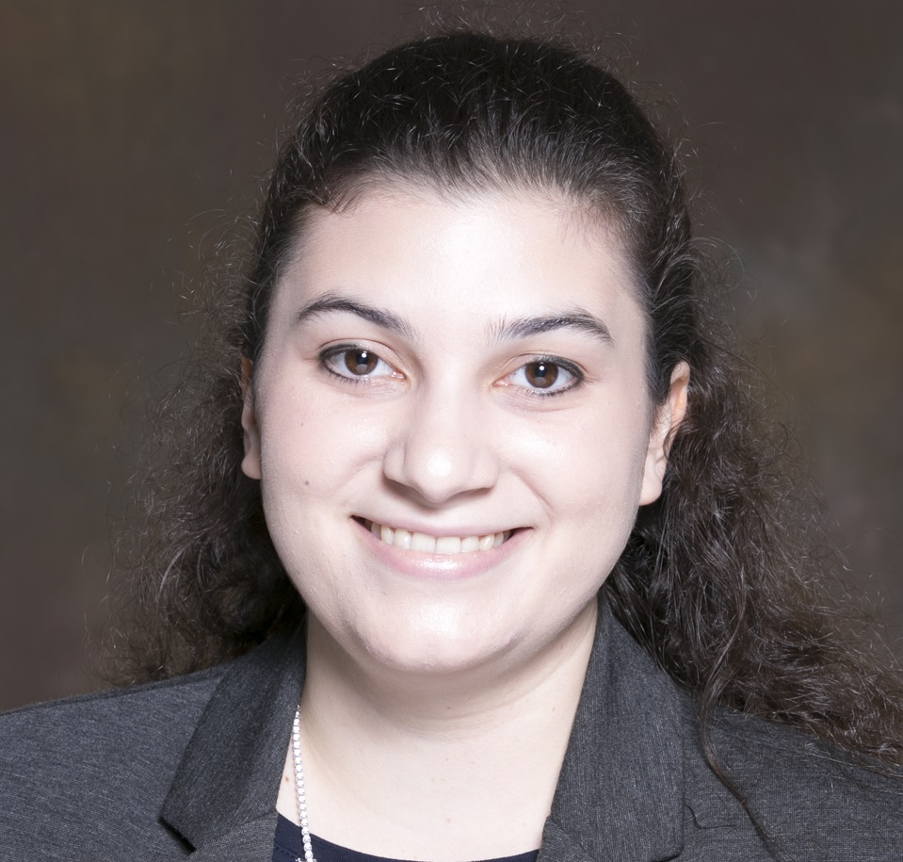
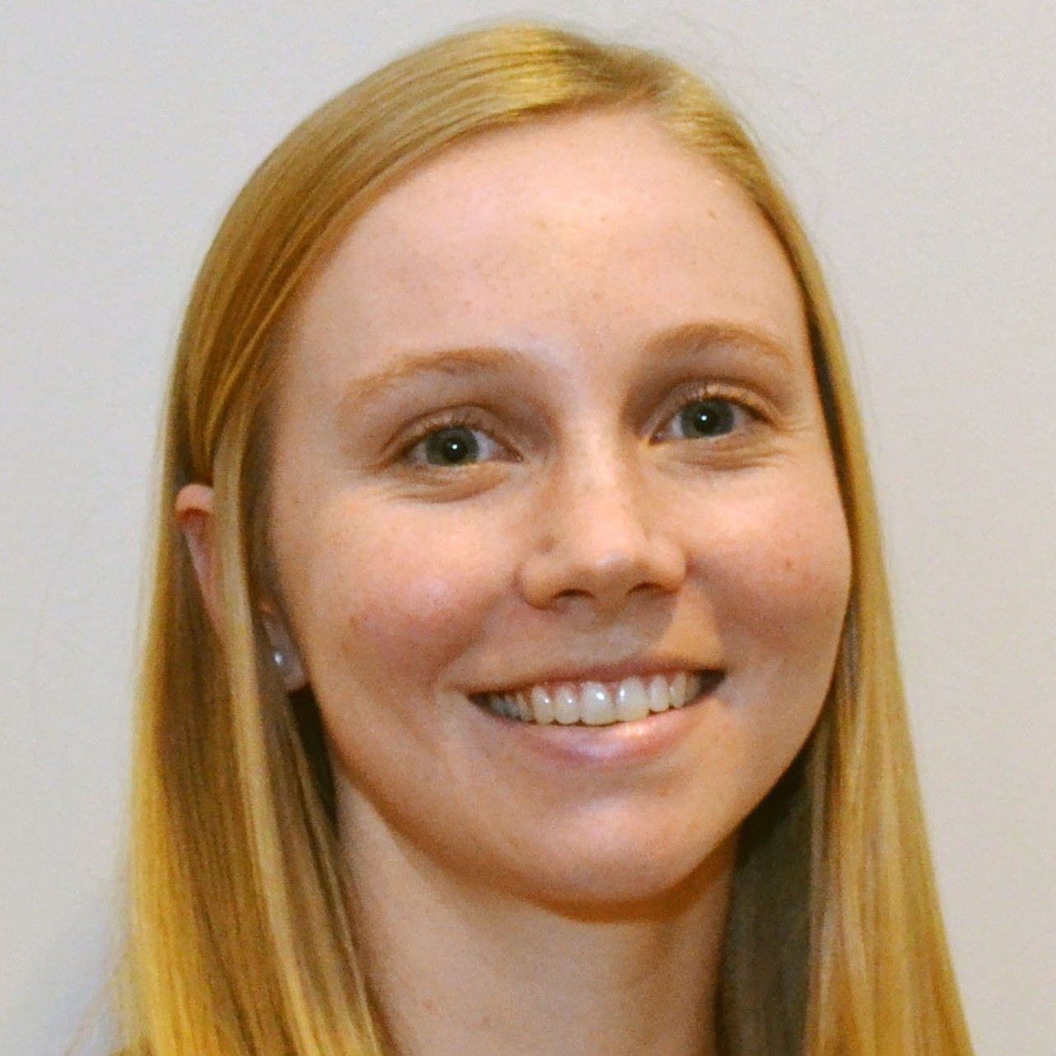
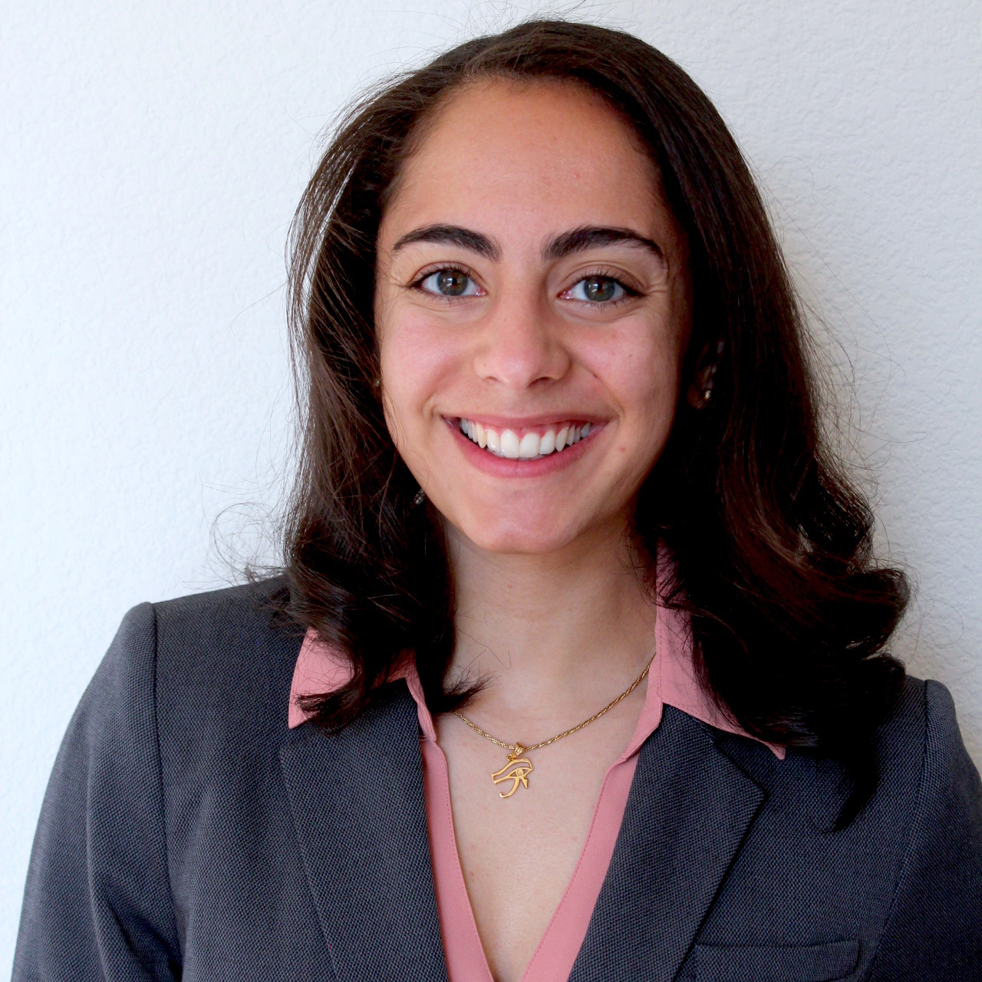
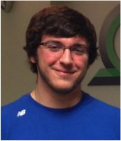
Acknowledgements
Malachi
Griffith
Obi
Griffith
Erica Barnell
Katie
Campbell
Kaitlin Clark
Adam
Coffman
Kelsy Cotto
Arpad Danos
Sharon Freshour
Felicia Gomez
Jasreet
Hundal
Susanna Kiwalla
Kilannin
Krysiak
Lynzey
Kujan
Josh
McMichael
Matthew Mosior
Cody
Ramirez
Megan Richters
Peter Ronning
Lana Sheta
Zachary
Skidmore
Nick
Spies
Lee
Trani
Alex
Wagner
Jason Walker
Alex Wollam
Huiming Xia
Co-investigators: William Gillanders, Todd Fehniger, Josh Swamidass, Robert Schreiber

Slide 8
pVACtools development is guided in part by the needs of ongoing personalized cancer vaccine trials at WASHU and elsewhere
Personalized cancer vaccine trials providing input:
Kidney Cancer (n = 15 patients)
NCT03598816 (James Hsieh)
Glioblastoma (n = 30 patients)
NCT03422094 (Gavin Dunn)
Breast Cancer (n = 54 patients)
NCT02348320 (William Gillanders)
NCT03199040 (William Gillanders)
Follicular Lymphoma (n = 20 patients)
NCT03121677 (Todd Fehniger)
Prostate Cancer (n = 20 patients)
NCT03532217 (Russell Pachynski)
Pancreatic Cancer (n = 15 patients)
NCT03122106 (William Gillanders / Daniel Laheru)
Melanoma (n = 12 patients)
NCT03092453 (Beatriz Carreno / Gerald Linnette)
Colorectal Cancer (n = 12 patients)
NCT03730948 (Beatriz Carreno / Kim Reiss-Binder)
HLA typing
https://neoantigen.clinwiki.org/
Liu and Mardis, 2017
Notes:
With that in mind, we have involved ourselves in several clinical trials to test personalized neoantigen vaccines
I am aware of 29 of these trials world wide, of which our group is involved in designing the vaccines for 10.
At this early stage, these are mostly phase I, and small, primarily testing for safety
But nevertheless they allow us to explore and refine the approach in variety of tumors types and clinical scenarios with a truly wonderful group of clinical collaborators who make up our informal immunotherapy tumor board.
Results are yet to emerge for most of these. In fact, just yesterday, in order to be at this meeting I missed the first internal presentation of results from the most advanced of these trials. I hear second hand that the take home message is that the side effects appear minimal, evidence of T cell response is detected in most cases, and tumor responses and survival are promising (with the caveat that these are very early days and phase I trials are not robustly powered to assess outcome).

Slide 9
Funding
pVACtools is supported by the National Cancer Institute (NCI) of the National Institutes of Health (NIH) under Award Number U01CA248235
This work was also supported by Washington University School of Medicine, the McDonnell Genome Institute, the National Human Genome Research Institute (R00HG007940) and the V Foundation for Cancer Research (V Scholar, V2018-007)
Notes:
- I would be happy to take any questions with any remaining time.

Slide 10
pVACtools is an open source modular tool kit
Goal is to create a tool suite that supports a broad user group with neoantigen analysis needs
Multiple organisms
Basic science -> clinical trials
Multiple therapeutic modalities
Implemented in Python3
Leverages IEDB API, VaxRank, MHCflurry, MHCNuggets, and other open source efforts
https://github.com/griffithlab/pVACtools
License
Was NPOSL-3.0, next release will be BSD
Documentation
http://pvactools.org/
http://pmbio.org/
CWL/Cromwell/Docker pipelines
https://github.com/genome/analysis-workflows

