Slide 1
The Small Business Innovation Research (SBIR) Program
MING ZHAO, PhD
SBIR DEVELOPMENT CENTER NATIONAL CANCER INSTITUTE
September 23, 2021

Slide 2
27 INSTITUTES & CENTERS AT THE NIH
The Office of the Director (OD)
National Institute
on Aging (NIA)
National Institute
on Alcohol Abuse
& Alcoholism (NIAAA)
National Institute
of Allergy & Infectious
Diseases (NIAID)
National Institute of Arthritis &
Musculoskeletal &
Skin Diseases (NIAMS)
National Cancer
Institute (NCI)
National Institute of
Child Health & Human
Development (NICHD)
National Institute on Deafness &
Other Communication
Disorders (NIDCD)
National Institute of
Dental and Craniofacial
Research (NIDCR)
National Institute of
Diabetes & Digestive &
Kidney Diseases (NIDDK)
National Institute
on Drug Abuse (NIDA)
National Institute
of Environmental
Health Sciences (NIEHS)
National Eye
Institute (NEI)
National Institute
of General Medical Sciences
(NIGMS)
National Heart, Lung, & Blood
Institute (NHLBI)
National Human
Genome Research
Institute (NHGRI)
National Institute
of Mental Health
(NIMH)
National Institute of
Neurological Disorders &
Stroke (NINDS)
National Institute
of Nursing Research
(NINR)
National Institute on
Minority Health &
Health Disparities (NIMHD)
National Center
for Complementary &
Integrative Health (NCCIH)
Fogarty
International
Center (FIC)
National Center
for Advancing Translational
Sciences (NCATS)
National Library
of Medicine (NLM)
National Institute
of Biomedical Imaging &
Bioengineering (NIBIB)
NIH Clinical
Center (CC)
Center for Information
Technology (CIT)
Center for Scientific
Review (CSR)
No funding authority
NCI SBIR
Development Center

Slide 3
NCI SBIR CORE ACTIVITIES
CENTRAL OVERSIGHT
Administer all 400+ SBIR/STTR awards at the NCI
GUIDANCE
Help prepare for application, resubmission, & discuss funding options
OUTREACH
Attend conferences/workshops & visit organizations/universities to raise awareness of the program
FUNDING
Seed emerging technology areas through targeted grant & contract funding opportunities
NETWORKING
Maintain a network of investors and facilitate connections between portfolio companies & investors/strategic partners
TRAINING
Provide entrepreneurship training on key topics such as IP, regulatory strategy, & how to build a strong team

Slide 4
CONGRESSIONALLY MANDATED PROGRAM
 |  | Set Aside for FY20
SBIR SMALL BUSINESS INNOVATION RESEARCH | Set-aside program for small business concerns to engage in Federal R&D with the potential for commercialization Federal agencies with an extramural R&D budget > $100M | $157M (3.2%)
STTR SMALL BUSINESS TECHNOLOGY TRANSFER | Set-aside program to facilitate cooperative R&D between small business concerns and U.S. research institutions with the potential for commercialization Federal agencies with an extramural R&D budget > $1B | $22M (0.45%)
 | Total | $1.18B for NIH $179M for NCI

Slide 5
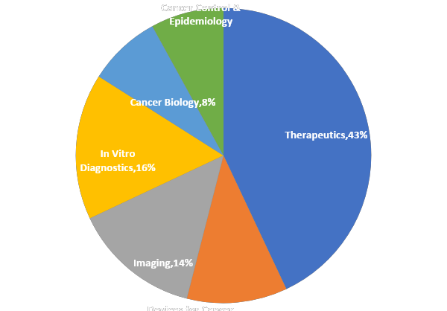
NCI SBIR/STTR PORTFOLIO (n=475)
$173M in FY19 for SBIR/STTR awards
86% Grants, 14% Contracts

Slide 6
ELIGIBILITY
Applicant must be a Small Business Concern (SBC)
Organized for-profit U.S. business
(based in the U.S. and work performed in the U.S.)
500 or fewer employees, including affiliates
˃ 50% U.S.- owned by individuals and independently operated
OR
˃ 50% owned & controlled by another (one) business concern that is ˃ 50% owned & controlled by one or more individuals
OR
˃ 50% owned by multiple venture capital operating companies, hedge funds, private equity firms, or any combination of these (SBIR ONLY)

Slide 7
CRITICAL DIFFERENCES
SBIR |  | STTR
Permits research institution partners (e.g., universities) | PARTNERSHIP | Requires research institution partners (e.g., universities)
Small business may outsource ~33% of Phase I activities and 50% of Phase II activities | DIVISION OF LABOR | Minimum 40% of the work should be conducted by the small business (for profit), and minimum of 30% by a U.S. research institution (non-profit)
The PD/PI’s primary employment (i.e., >50%) MUST be with the SBC for the duration of the project period | PI INVOLVMENT | PI primary employment not stipulated (min.10% effort to project)
The award is ALWAYS made to the small business concern.

Slide 8
FUNDING MECHANISMS
GRANTS
CONTRACTS
Omnibus Solicitation
Investigator initiated
3 receipt dates (January, April, September)
CONTRACT
TOPICS
NCI priority areas
strong potential for commercial success
significant NCI oversight
1 receipt date
Areas of interest to commercial sector
NCI scientific
& technology
priorities
Targeted Solicitation
Focused/NCI gap/ priority areas
Variable receipt dates

Slide 9
THREE-PHASE PROGRAM
DIRECT TO PHASE II(SBIR Only)
NCI SBIR PHASE IIB BRIDGE AWARD
CROSSING THE VALLEY OF DEATH
PHASE III
PHASE I
PHASE II
FAST-TRACK (PHI I & II)
Proof-of-Concept Up to $400,000 over 6 to 12 months | Research & Development Commercialization plan required Up to $2M over 2 years | Technology validation & clinical translation Follow -on funding for SBIR Phase II awardees from any federal agencies Expectation that applicants will secure substantial 3rd party investor funds $4M over 2-3 years | Commercialization stage Use of non-SBIR/STTR funds

Slide 10
UPDATES ON SBIR/STTR FUNDING OPPORTUNITIES AT NCI

Slide 11
FUNDING OPPORTUNITIES
TITLE | SBIR FOA | STTR FOA | RECEIPT DATES
Omnibus Solicitation | PA-21-259 (General) PA-21-260 (Clinical Trial) | PA-21-262 (General) PA-21-261 (Clinical Trial) | Standard Receipt Dates April 5; January 5; September 5
SBIR Technology Transfer (technology transfer out of NIH intramural labs) | PA-18-705 (SBIR only) | No STTR
Illuminating the Druggable Genome (IDG) | PA-19-034 | PA-19-033
Development of Highly Innovative Tools and Technology for Analysis of Single Cells | PA-20-047 | PA-20-025
SBIR IMAT (Innovative Molecular Analysis Technology) Development | PAR-18-303 (SBIR only) | No STTR
Contract Solicitation | PHS 2022-1 (SBIR only;TBA) | No STTR | ~ October 2021
Phase IIB Bridge Award | RFA-CA-21-XXX (TBA) | Same as SBIR | ~ August 2021

Slide 12
Funding Opportunities for Low-Resource Settings
TITLE |  |  | RECEIPT DATES
Notice of Special Interest (NOSI): National Cancer Institute SBIR/STTR Program Announcement Regarding Cancer Prevention, Diagnosis, and Treatment Technologies for Low-Resource Settings
Standard Receipt Dates
April 5; January 5; September 5
The NOSI encourages SBIR/STTR grant applications from small business concerns (SBCs) proposing commercially-directed research for the development of cancer prevention, diagnosis, or treatment technologies to improve cancer outcomes in low- and middle-income countries (LMICs), and low-resource settings in the US.
Specifically, the NOSI encourages grant applications from SBCs to develop or adapt, apply, and validate existing or emerging technologies into user-friendly products for cancer prevention, diagnosis, or treatment in low-resource settings.
The technologies may include but are not limited to tools for vaccine dissemination/delivery, imaging, in vitro diagnosis, or treatment of pre-cancerous (pre-neoplastic) or cancerous lesions that are preventable or treatable within low-resource settings.
Strong emphasis is placed on technologies that directly provide or immediately lead to treatment options available in the local health system.
Projects funded by the NOSI may include patient enrollment in foreign countries. It should be noted that applicants are required to include a statement in their applications on why these resources are not available in the US if a portion of the work is performed outside of the US.
Products addressing cancers of the cervix, colon/rectum, esophagus, and oral cavity are particularly encouraged for this NOSI. However, applications may address any single cancer type.
For funding consideration, applicants must include “NOT-CA-21-062” (without quotation marks) in the Agency Routing Identifier field (box 4b) of the SF424 R&R form
NCI SBIR
Development Center
NOT-CA-21-062: https://grants.nih.gov/grants/guide/notice-files/NOT-CA-21-062.html

Slide 13
CONTRACTS FY2022 – NCI TOPICS
Therapeutics (3/17)
Development of Senotherapeutic Agents for Cancer Treatment
Cancer Treatment Technologies for Low-Resource Settings
Synthetic Biology Gene Circuits for Cancer Therapy
Medical Devices (3/17)
Developing Unbiased Medical Technologies to Reduce Disparities in Cancer Outcomes
Ultra-Fast Dose Rate (FLASH) Radiation Detectors and Safety Systems
Devices to Treat Secondary Lymphedema Following Cancer Treatment
Clinical Diagnostics and Molecular Analysis (7/17)
New Technologies to Analyze Extra-Chromosomal DNA in Cancer
3D Spatial Omics for Molecular and Cellular Tumor Atlas Construction
Understanding Cancer Tumor Genomic Results: Technology Applications for Community Providers
Advanced Sample Processing Platforms for Downstream Single-Cell Multi-Omic Analysis
Cancer Prevention and Diagnosis Technologies for Low-Resource Settings
At-Home Screening for Hepatitis C Virus
Quantitative Biomarkers as Medical Device Development Tools for Cancer
Information Technology and Bioinformatics (2/17)
Development of Computer-Aided Diagnosis Tools for Upper and Lower Gastrointestinal Tract Cancer Prevention
Evaluation Datasets as Medical Device Development Tools for Testing Cancer Technologies
Manufacturing Technologies(1/17)
Advanced Manufacturing to Speed Availability of Emerging Autologous Cell-Based Therapies
NCI SBIR
Development Center

Slide 14
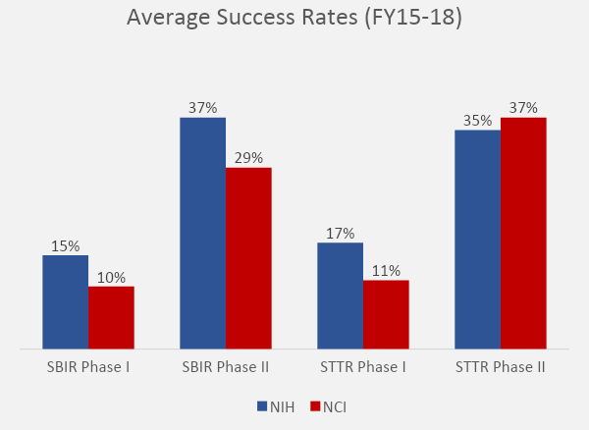
BE RESILIENT
You are not alone!
Remember the three Rs:
Review your summary statement
Revise your application
Resubmit and try again!
Talk to your program officer. We are here to help!

Slide 15
NCI SBIR RESOURCES
INVESTOR INITATIVES PROGRAM
WEBINARS (PLAN)
Connect companies to follow on funding
Develop & maintain a network of investors and industry partners.
Informational Webinars with content relevant to early-stage start-ups. Webinar content shared by peers.
I-CORPS @ NIH
CARE (REGULATORY PROGRAM)
Entrepreneurial Training Program
Understand Value Proposition, Business Model and Stakeholders.
Connecting Awardees with Regulatory Experts at FDA
Sharing FDA information with companies.
RESOURCE WORKSHOPS
MENTORING PROGRAM*
Educate and Connect companies with federal and non-federal commercialization Resources.
Industry & experienced mentor program for start-ups
EXECUTIVE ROUNDTABLE
TABA (NEEDS ASSESSMENT)
Peer Mentoring Platform for C-Level Officers to share experience and expertise
NIH Managed Technical and Business Assistance
External Contractor to help assess company’s gap/need areas.

Slide 16
GET IN TOUCH WITH US!
CONTACT NCI SBIR PROGRAM BEFORE YOU APPLY.
SEND US YOUR SPECIFIC AIMS PAGE.
Web: https://sbir.cancer.gov Email: ncisbir@mail.nih.gov Twitter: @NCISBIR LinkedIn: http://bit.ly/ncisbirlinkedin

Slide 17
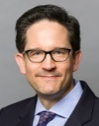
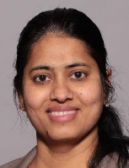
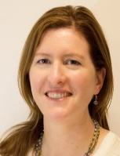
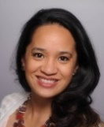
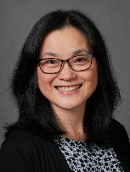
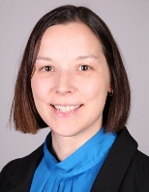
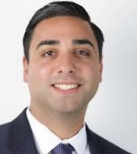
REACH OUT TO AN NCI SBIR PROGRAM DIRECTOR
 | Michael Weingarten, MA Director NCI SBIR Development Center |  | Greg Evans, PhD Lead Program Director Cancer Biology, E-Health, Epidemiology, Research Tools |  | Deepa Narayanan, MS Lead Program Director Imaging, Clinical Trials, Radiation Therapy, Investor Initiatives |  | Kory Hallett, PhD Lead Program Director Monoclonal Antibodies, Immunotherapy, Biologics, and Program Analysis
Contact us to get started! Send your Specific Aims page to ncisbir@mail.nih.gov and we will help you set up a call with one of our program directors! |  |  | Christie Canaria, PhD Program Director Cancer/Biological Imaging, Research Tools, Devices, I-Corps at NIH |  | Nancy Kamei, PharmD, MBA Program Director Cancer Therapeutics |  | Jonathan Franca-Koh, PhD, MBA Program Director Cancer Biology, Biologics, Small Molecules, Cell Based Therapies, Phase IIb Bridge
 |  |  | Jian Lou, PhD Program Director In-Vitro Diagnostics, Theranostics, early-stage drug development, Bioinformatics, Investor Initiatives |  | Monique Pond, PhD Program Director Biologics, Research Tools and Regulatory Resources |  | Amir Rahbar, PhD, MBA Program Director In-Vitro Diagnostics, Biologics, Therapeutics, Proteomics
 |  |  | William Bozza, PhD Program Director Biologics, Protein Therapeutics, Regulatory (CMC) |  | Patricia Weber, DrPH Program Director Digital Health, Therapeutics, Biologics, Resources Workshop |  | Ming Zhao, PhD Program Director Cancer Diagnostics & Therapeutics, Cancer Control & Prevention, Molecular Imaging, Bioinformatics, Stem Cells

Slide 18
THANK YOU
CONTACT INFO
NCI SBIR DEVELOPMENT CENTER
ncisbir@mail.nih.gov
240.276.5300

