Slide 1
Thriving as a Biomedical Researcher
Jennifer Wiggins, MA, LPC
Wellness Advisor
jennifer.wiggins@nih.gov

Slide 2
Outline
Unpack perceptions and messaging on wellness
Explore the importance of investing in mental health and wellness
Barriers and challenges to maintaining wellness
Address areas for wellness growth and goal setting
Discuss pillars of community connectedness
Identify resources

Slide 3
General Wellness

Slide 4
The Wellness Journey
Consider your relationship with wellness
Reflect upon the history
What does the data tell you?
Strategize
Determine realistic goals and expectations
Identify barriers, supports and resources
Implement and collect more data
Successes, failures, and uncertainties
Utilize reward system
Reevaluate, reestablish, and keep going!
What is working? What is not?

Slide 5
Culture and Wellness
Places of Origin
Family/parenting
Cultural norms
Geography
Power Dynamics
Hierarchical systems
Expectations
Media
Experiences

Slide 6
Potential Barriers to Wellness
Time (literal and figurative)
Perception
Access
Resources
Socioeconomic status
Education/knowledge
Geography
Religious values
Historical racism/marginalization
Bias
Representation
Preventative health
Language
Generational trauma

Slide 7
Tapping Into Your Resilience
Consider what protective features are present in your life
Reflect upon the resources that are available to you
Acknowledge when you need support and ask for help
Remember to be kind to yourself (self-compassion)
Be creative
Plan for your wellness

Slide 8
Stress and the Impact
What is stress?
How does it impact us?
Stress is an adaptive response that is meant to protect us
Stressors can be internal and external
Stressors can be something that we see, hear, smell, touch, or taste
Stress can be chronic
You can deal with a stressor, but not the stress itself
Cognitions and perspective
Emotions/mood
Relationships
Communication
Productivity
Overall health

Slide 9
Know Your Personal Stress Signals
How does your stress show up?
Physically (e.g., headaches, body tension, stomach issues, fatigue, elevated heart rate, rapid and shallow breathing)
Mentally (e.g., trouble focusing, racing thoughts, negative inner chatter, forgetting things)
Emotionally (e.g., fear, anxiety, helplessness, anger, feeling overwhelmed, feeling unmotivated)
Behaviorally (e.g., over or under-eating, over or under-sleeping, losing things, relying on alcohol/other drugs, having a short fuse with others, procrastinating)
All are “messengers” that we need to pay attention to

Slide 10
Wellness Planning

Slide 11
To Do Well, We Have To Be Well
What we do and what we don’t do to take care of our…
Body
Mind
Heart
Spirit

Slide 12
What is Your Perspective?
Perspectives that we hold about the world and how we believe that we fit into it impacts our ability to access a growth mindset
Fixed mindset can keep us stuck in polarized thinking (always being right or wrong, winning or losing, happy or sad)
Expands energy and can promote negative thinking
Growth mindset allows supports us being grounded in sustainability and balance (yes and, what if this does work out, what was learned)
Expands energy towards big picture thinking

Slide 13
Healthy Habits that Support the Growth Mindset
Know your responses to discomfort and uncertainty
Cognitive, physical and emotional
Be sure to listen to it and discern
Be proactive and plan ahead
Utilize protective features
Enlist a growth mindset and tap into your resilience
Control for what you can
Find grace and compassion
Communicate, communicate, communicate!
Needs, wants and wishes

Slide 14
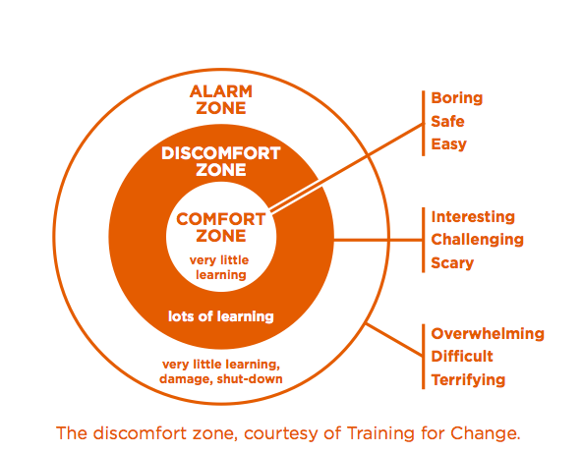
Let’s Grow: Embracing the Discomfort Zone

Slide 15
Why do People Struggle with Consistency??
Lack of patience
Focused on outcome instead of process
Perfectionist tendencies
Inner critic
Self-doubt
Cognitive distortions
Emotion regulation
Need for instant gratification
Unclear goals and focus
Unsupportive habits
Perspectives on people, places, and things
External pressures

Slide 16
Supportive Activities
Keystone Habits
The basics
Activities of daily living
Sleeping and eating schedule
Planning
Movement
Self-compassion
Gratitude
Supportive self-talk
Data Collection– how do you work and learn?
Triggers
Peak activity time
Protective features
Increase willpower
Remove temptations
Consider your overall wellness
Coping with stressors supports habit formation
Practice patience
Choose motivation tools
Rewards
Accountability

Slide 17
Community & Connectedness

Slide 18
Importance of Connectedness- The Pillars
Belonging
Self-worth and confidence
Workplace values
Communication

Slide 19
Belonging and its Benefits
Belonging is related to experiences such as:
Mattering
Identification
Social connection
Social belonging is an intrinsic human need
Pre-pandemic, 40% of people report feeling isolated at work
Leads to greater self-acceptance which leads to better self-efficacy
Increases commitment and engagement
Promotes productivity and quality

Slide 20
Self-worth & Confidence
Stress can cause us to become emotionally unregulated
Emotional dysregulation can cause us to question identity
Often driven by core beliefs, cognitive distortions, or imposter fears
Establishing or re-establishing ourselves in a community requires us to learn
When acclimating, we often use comparison to determine worth and skill
Limits engagement with growth mindset

Slide 21
Communication
Each community has communication norms, it is important to observe them
Verbal and non-verbal
Communicating in the pandemic has created greater challenge
Virtual world, hybrid allowances, etc.
Minimizes casual interactions
We must have understanding of how we communicate, our communication needs, and how our communication style interacts with others

Slide 22
Teaching/Mentorship and Feedback Matters
Types of feedback have an impact on the kind of mindset that gets fostered
Praising intelligence and ability promotes a fixed mindset
Praising hard work and effort cultivates growth mindset
Mentors with a fixed mindset are more likely to:
Judge mentees with a low potential in comparison their growth minded peers
Engage in comfort-oriented feedback
Comfort feedback contains messages that sound caring and give reassurance but also seek to take pressure off – suggesting some easier paths or less pressured situations
Strategy-oriented feedback also sounds caring but is focused on addressing the existing challenges in a solutions-focused way

Slide 23
Workplace Values
We all carry values in our life and it is important to define those for ourselves
Values set the stage; they guide our career and motivate us
Creating points of compromise is an essential part of any relationship, but we do not want to lose ourselves
Rank and score
Re-evaluate
Understand context

Slide 24
Navigating Value Misalignment
Culture dictates how we interpret and engage courage and vulnerability
Courage and vulnerability triggers both emotional and cognitive responses
Common emotional responses: fear, hopelessness, anxiety, anger, frustration, uncertainty
Common cognitive responses:
I am weak
I will get into trouble
I just need to power through
They exist on a spectrum, both small and large acts
Inaction is an action
Courage and vulnerability offer growth opportunity

Slide 25
Tools
Reflect
Observe
People
Norms
Responses
Develop and identify values
Use the data– pre & post
Consider a sustainable future
Communicate
Information gather
Develop relationships– avoid transaction
Ask for help
Needs & wants
Mentor up
Connect with others (in lab & outside)
Consider the big picture
Engage growth mindset

Slide 26
Resources

Slide 27
OITE Wellness Resources
Individual advising
Groups
Skills groups
Support groups
Resilience drop in discussions
Meditation
Thriving Thursdays
Miscellaneous wellness training programs
Becoming a Resilient Scientist
Mental Health Series

Slide 28
Thank You!
Visit www.training.nih.gov for videos, blogs and other career development resources
Reach out -- oite-wellness@nih.gov

