Slide 1
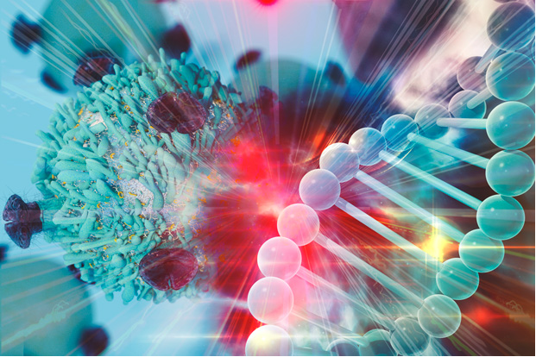
  MicroLab Origins
  Emily Greenspan
  Center for Biomedical Informatics and Information Technology
  National Cancer Institute
Notes:
Unlike webinars which are focused on disseminating information, the purpose of µLabs is to

Slide 2
Envisioning Computational Innovations for Cancer Challenges (ECICC) Community Building
Joint Design of Advanced Computing Solutions for Cancer (JDACS4C)
2016-present
NCI-DOE partnership to advance exascale HPC through cancer research
Cancer Challenges & Advanced Computing MicroLabs
Virtual interactive events, ongoing
Broadly engage the cancer and HPC communities
1st MicroLab: June 11, 2019:
Discussed ideas and challenges relating 4 Cancer Challenge Areas
2nd MicroLab: Sept 25, 2019:
Develop use cases and persona through the lens of the 4 Cancer Challenge Areas
ECICC Scoping Meeting
March 6-7, 2019, LLNL
Community brainstorming identified four major Cancer Challenge Areas
Vision for computing
innovation
CANCER
Build the
community
Grow the
community
COMPUTING
Vision for cancer
challenge

Slide 3
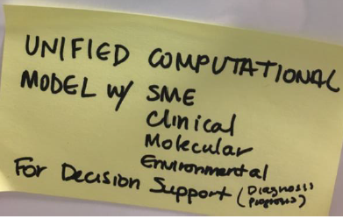
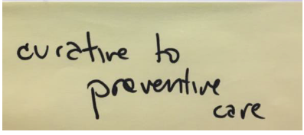
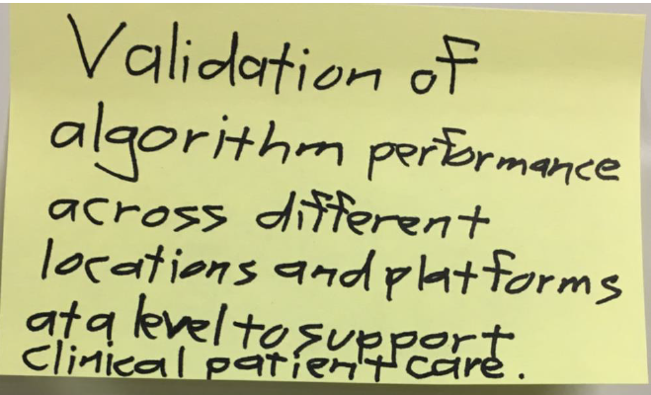
Envisioning Computational Innovations for Cancer Challenges (ECICC) Events
ECICC Scoping Meeting
  March 6-7, 2019 @LLNL, over 80 attendees (including CSBC, PSON, ITCR grantees)
  Goals
    Identify lean-in cancer challenge areas that advance current cancer research computational practices and compel development of innovative computational technologies
    Build a computational oncology community & multidisciplinary engagement/collaboration
    Define the types of cultural shifts in cancer research that could be possible with high-performance computing (HPC)
Cancer Challenges & Advanced Computing MicroLab virtual events
  June 11, 2019, over 200 participants spanning 50 organizations
  Discussion topics based on community-identified Cancer Challenge Areas
    Generating large-scale synthetic data to protect PII
    Using machine learning for iterative hypothesis generation
    Creating a cancer patient “digital twin” to optimize personalized treatment decision making
    Developing adaptive cancer treatments
Notes:
Meeting held March 6-7, 2019 at Livermore Valley Open Campus (LLNL)
81 total attendees! (73 current members on NCIP Hub site, https://nciphub.org/groups/cicc/overview)
Overall excellent mix of organizations (academia, government, national labs, industry), disciplines (computer science, biomedical engineering, cancer biology, clinical oncology, biomedical informatics, data science) and career stages represented
Attendees from 8 DOE National Labs
Immersive, creative, open-minded approach
DOE impressed with the enthusiasm and expertise of the cancer research community and the high level of ideas presented

Slide 4

What Happens After Today’s MicroLab?
By Friday
All the use cases will be posted on the Hub site
Within 2 weeks
Organizers will compile and assimilate the community’s recommendations from all the use cases
By mid-October
The community’s collective recommendations for next steps will be posted on the Hub site (as editable Google docs)
You will be asked to prioritize or rank the ideas
Watch for the email announcement!
Notes:
that push the limits of current cancer research computational practices and compel development of innovative computational technologies; and

Slide 5
Join the Community Hub Site!
If you are not already a member:
Today’s participants will receive an email invitation
Please accept the invitation, add your profile & photo and get to know the community
Notes:
that push the limits of current cancer research computational practices and compel development of innovative computational technologies; and

Slide 6

Today’s Presenters
Synthetic Data
  Nick Anderson, University of California, Davis
  Bill Richards, BWH/Harvard University
Hypothesis Generation Using ML
  Amber Simpson, Queen’s University
Digital Twin
  Tina Hernandez-Boussard, Stanford University
  Paul Macklin, Indiana University
Adaptive Treatments
  John McPherson, University of California, Davis
Notes:
that push the limits of current cancer research computational practices and compel development of innovative computational technologies; and

Slide 7
  Cancer Challenge Area:
  Synthetic Data
  Nick Anderson, UC Davis
  Bill Richards, BWH/Harvard
Notes:
Unlike webinars which are focused on disseminating information, the purpose of µLabs is to

Slide 8
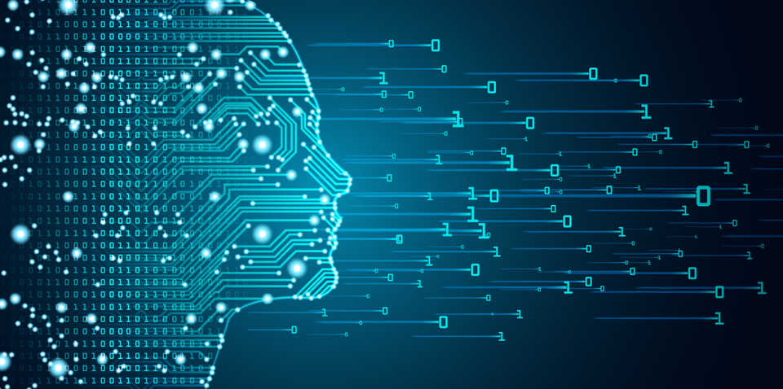
Synthetic Data: Overview
De-identification to protect PII may “over-sanitize” data or introduce bias when applied to very large data sets
Clinical data sets appropriate to develop and validate new methods and models are scarce
Synthetic data derived from clinical data sets
Statistically identical to the clinical reference dataset
Broadly sharable
Contain neither PHI nor PII
Not re-linkable
Notes:
1

Slide 9
Challenge Area: Synthetic Data
  Methods for reproducibly generating new and unlinkable synthetic data sets, rules and appropriate descriptive metadata from “reference” clinical data (1:1)
  Methods for generating new and unlinkable synthetic datasets from clinical data “seeds” and permutation rules (1:many)
  Methods for developing sets of uniquely distinguished and high-quality data sets for large “population simulation” studies (1:n-k)
  Methods for comparing new algorithms tested solely on synthetic data sets on “reference” clinically identifiable data sets (and visa versa) (1:1)
Notes:
that push the limits of current cancer research computational practices and compel development of innovative computational technologies; and

Slide 10
  Cancer Challenge Area:
  Hypothesis Generation Using Machine Learning
  Amber Simpson, Queen’s University
Notes:
Unlike webinars which are focused on disseminating information, the purpose of µLabs is to

Slide 11
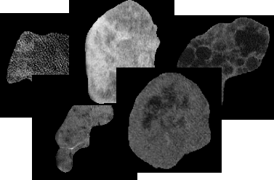
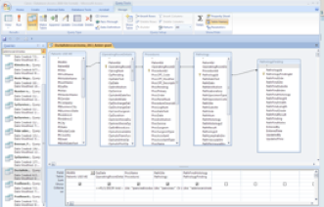
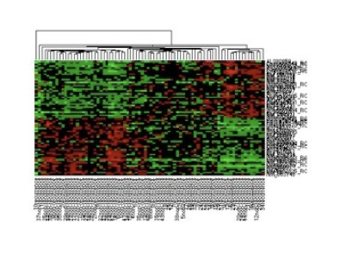
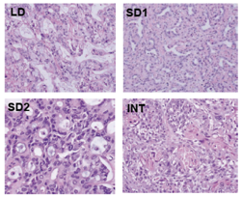
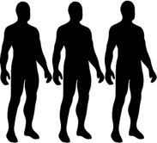
Hypothesis Generation Using Machine Learning: The Big Idea
Patient Data
  ML has the potential to efficiently guide hypothesis generation and experimental design for cancer clinical trials.
  ML has the potential reveal new relationships in large, complex data sets to guide cancer research and novel targeted therapies.
+
=
Pre-clinical Data
Notes:
that push the limits of current cancer research computational practices and compel development of innovative computational technologies; and

Slide 12
Hypothesis Generation Using Machine Learning: Overview
  Machine learning is not really used clinically - how do we change this?
  Cancer data conundrum: researchers and clinicians are inundated with more information than they can handle, while, at the same time, there are sizeable gaps in the biological systems information that is required for research and clinical advance
  ML is key to addressing both hurdles:
    ML can provide guidance to experimentalists on what to study and the sequence in which to attack questions.
    ML is a critical bridge between large, complex data sets and mining actionable meaning from the data. ML has the unique ability to discover and use algorithms to cluster observations (data), and to do so iteratively with experimentation, in an active learning process.
Notes:
that push the limits of current cancer research computational practices and compel development of innovative computational technologies; and

Slide 13
  Cancer Challenge Area:
  Digital Twin
  Tina Hernandez-Boussard, Stanford University
  Paul Macklin, Indiana University
Notes:
Unlike webinars which are focused on disseminating information, the purpose of µLabs is to

Slide 14

Patient Phenotype
Cancer Treatment Options
Digital Twin Simulation Using HPC
Personal History
Family History
Clinical
Genome
Behavioral
Transcriptome
Imaging
Proteome
Physiological
Immunome
Exposome
Metabolome
Microbiome
Personalized Care Trajectories
Shared Decision
Making

Slide 15
Why Now?
What would this enable?
Precision oncology requires a coordinated multidisciplinary, multi- institutional effort with access to sufficient data and computational resources.
Recently, advances in both digital data and technologies have created an ecosystem to leverage these advances for precision oncology
Great potential to help patients reach treatment goals.
Aggregated data from populations could improve national strategies for cancer screening, prevention, research investment, and structuring healthcare systems.
Model personalized benefit from different treatment modalities
  Incorporate genetic, environment, and social factors to predict individual trajectory
Predict outcomes and side-effects throughout patients’ health trajectories
  Advance patient-valued care
Virtual clinical trials
  Synthetic controls
  Expand generalizability
Population Estimates

Slide 16
  Cancer Challenge Area:
  Adaptive Treatments
  John McPherson, UC Davis
Notes:
Unlike webinars which are focused on disseminating information, the purpose of µLabs is to

Slide 17
Adaptive Treatments:
Precision oncology involves analyzing a patient tumor and tailoring therapy to best treat this individual tumor.
However, a significant portion of tumors do not respond as predicted and relapse is not uncommon.
Can we better predict the response of a tumor to a particular therapy and most importantly chart the expected course that the tumor will take to evade therapy?
Adaptive therapies would then be administered that specifically change during the course of treatment to thwart this tumor evolution in both the short-term and long-term.
Treatment then becomes proactive and less reactive.
Imagine the experiments/data that you need to advance these concepts.

Slide 18
Imagining Adaptive Treatments
  Datasets:
    Robust longitudinal mutational profiling with treatment courses and outcomes are needed.
    Deep mutational analysis to identify tumor subclones.
    Deep analyses of changes in tumor and metastases microenvironments over time.
  Analytics:
    Scalable ML approaches for:
      modeling of all processes impacted by somatic mutation;
      prediction of potential emerging tumor drivers;
      and modeling of changes in tumor microenvironments.
  Culture changes:
    Data sharing has often hit ethical and legal barriers.
    Patient advocacy and involvement is essential.
  What would you do?

Slide 19
  Use Case Demonstration
  Paul Macklin
  Indiana University
Notes:
Unlike webinars which are focused on disseminating information, the purpose of µLabs is to

Slide 20
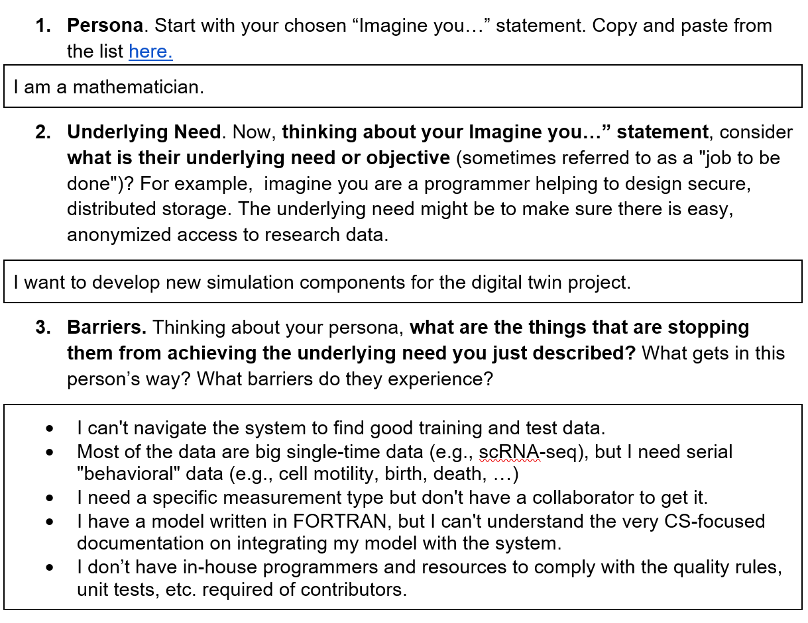
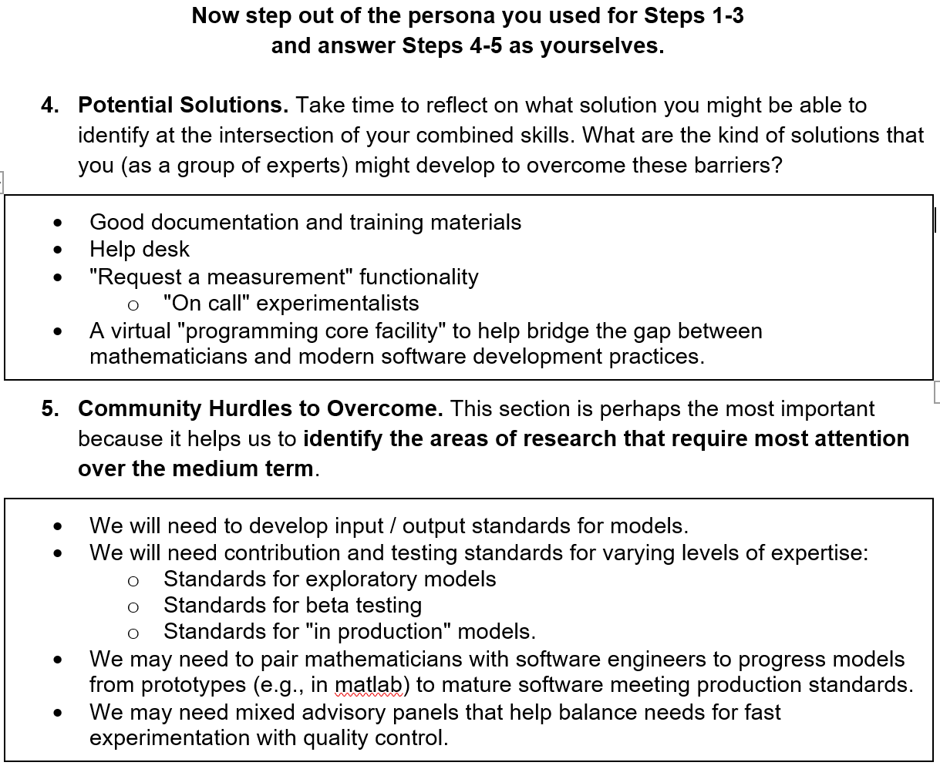
Sample use case: mathematician

Slide 21
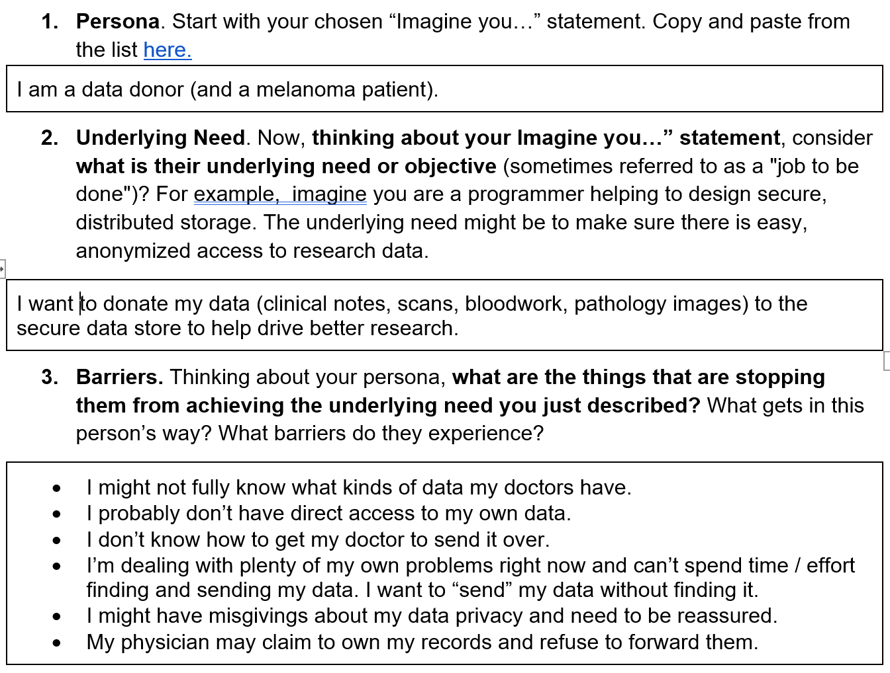
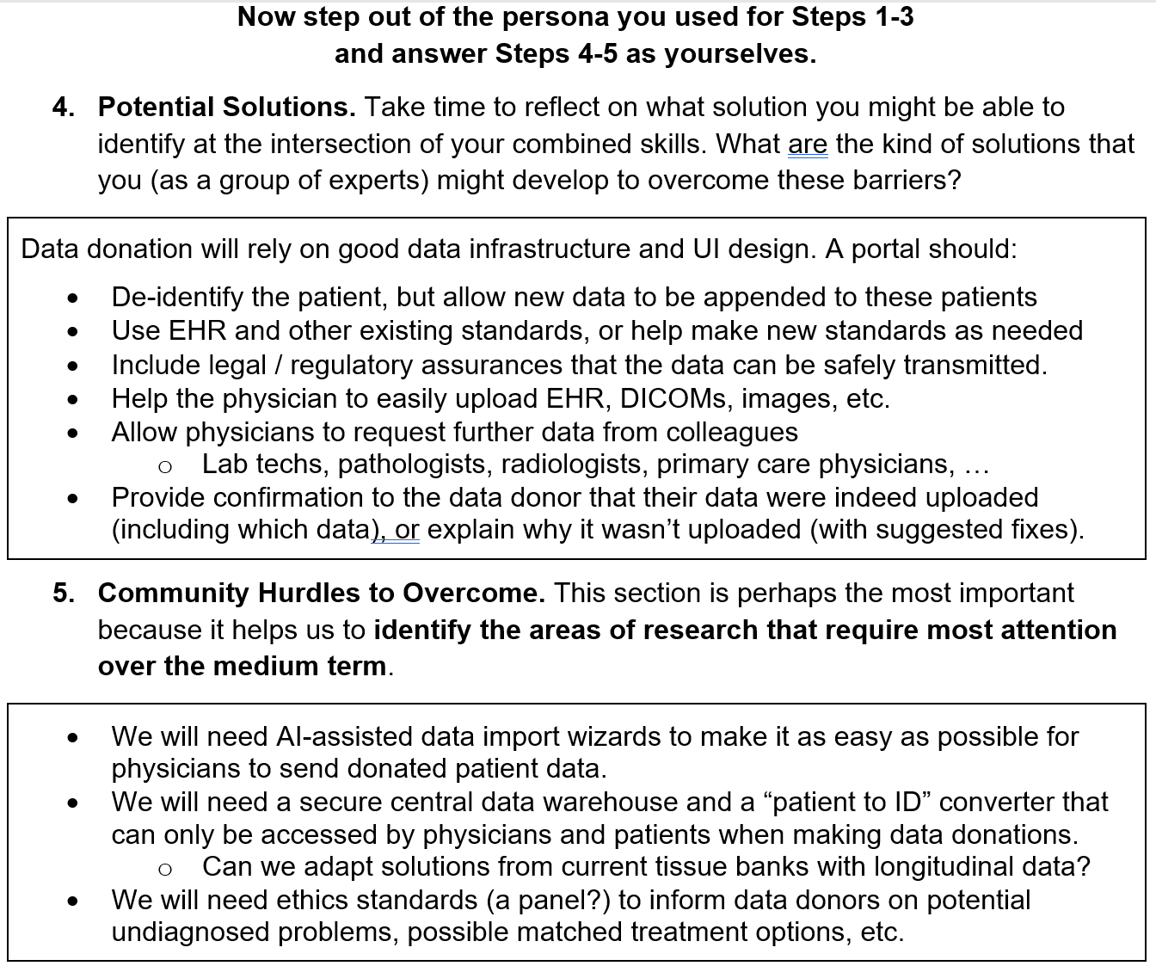
Sample use case: (patient) data donor

