Slide 1
Envisioning Computational Innovations for Cancer Challenges Scoping Meeting
Why Now?
Emily Greenspan, National Cancer Institute
Carolyn Lauzon, Department of Energy, Office of Science
March 6-7, 2019
Livermore Valley Open Campus at Lawrence Livermore National Laboratory

Slide 2
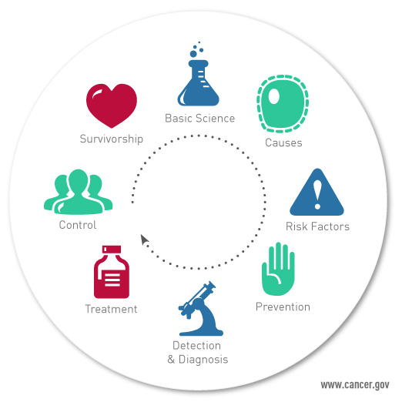
To develop the knowledge base that will lessen the burden of cancer in the United States and around the world.
NCI Mission
ECICC Scoping Meeting, March 6-7, 2019
2
Notes:
Key message: The NCI coordinates the National Cancer Program, which conducts and supports research, training, health information dissemination, and other programs with respect to the cause, diagnosis, prevention, and treatment of cancer, rehabilitation from cancer, and the continuing care of cancer patients and the families of cancer patients.

Slide 3

NCI Precision Oncology: 2006-2018
More than a decade of illuminating the underlying causes of primary untreated tumors – omics characterization
DESCRIPTIVE ANALYTICS
APOLLO Network
ECICC Scoping Meeting, March 6-7, 2019
3
Notes:
The NCI efforts over the last 10+ years reflect precision medicine perspective - Interventions to prevent, diagnose or treat a disease based on a molecular and/or mechanistic understanding of the causes, pathogenesis, and/or pathology of the disease. Where the individual characteristics of the patient are sufficiently distinct, interventions can be concentrated on those who will benefit, sparing expense and side effects for those who will not.
Historical data set at NCI are aimed at trying to understand the causes of primary, untreated tumors and elucidate their underlying genomics (TCGA - ~11,000 tumors), proteomics (CPTAC), and anatomical data (imaging archive)
We spent a lot of time doing this because in early years data was hard to reproduce. We want to give as close to ground truth to the community as possible.
Omics characterization underpin precision medicine clinical trials, which seek to match patient tumor types to targeted therapies - NCI MATCH (genomics based) and the APOLLO network (proteome + genome)
These efforts all represent descriptive analytics (what we see) – what’s the future and how do we take advantage of all this new data to move towards predictive analytics (what we should see) and prescriptive analytics (what we should do)

Slide 4
Growing Volume and Complexity of Cancer Data
Exascale Data Threshold
ECICC Scoping Meeting, March 6-7, 2019
4
Notes:
Growing volumes and complexity of data being generated and captured. This is one of the key motivators for why now. We are able to generate and capture enough observables about complex biological systems that new computing is needed. This is a key connector for the cancer biologists
Compels thinking about predictive and prescriptive analytics

Slide 5
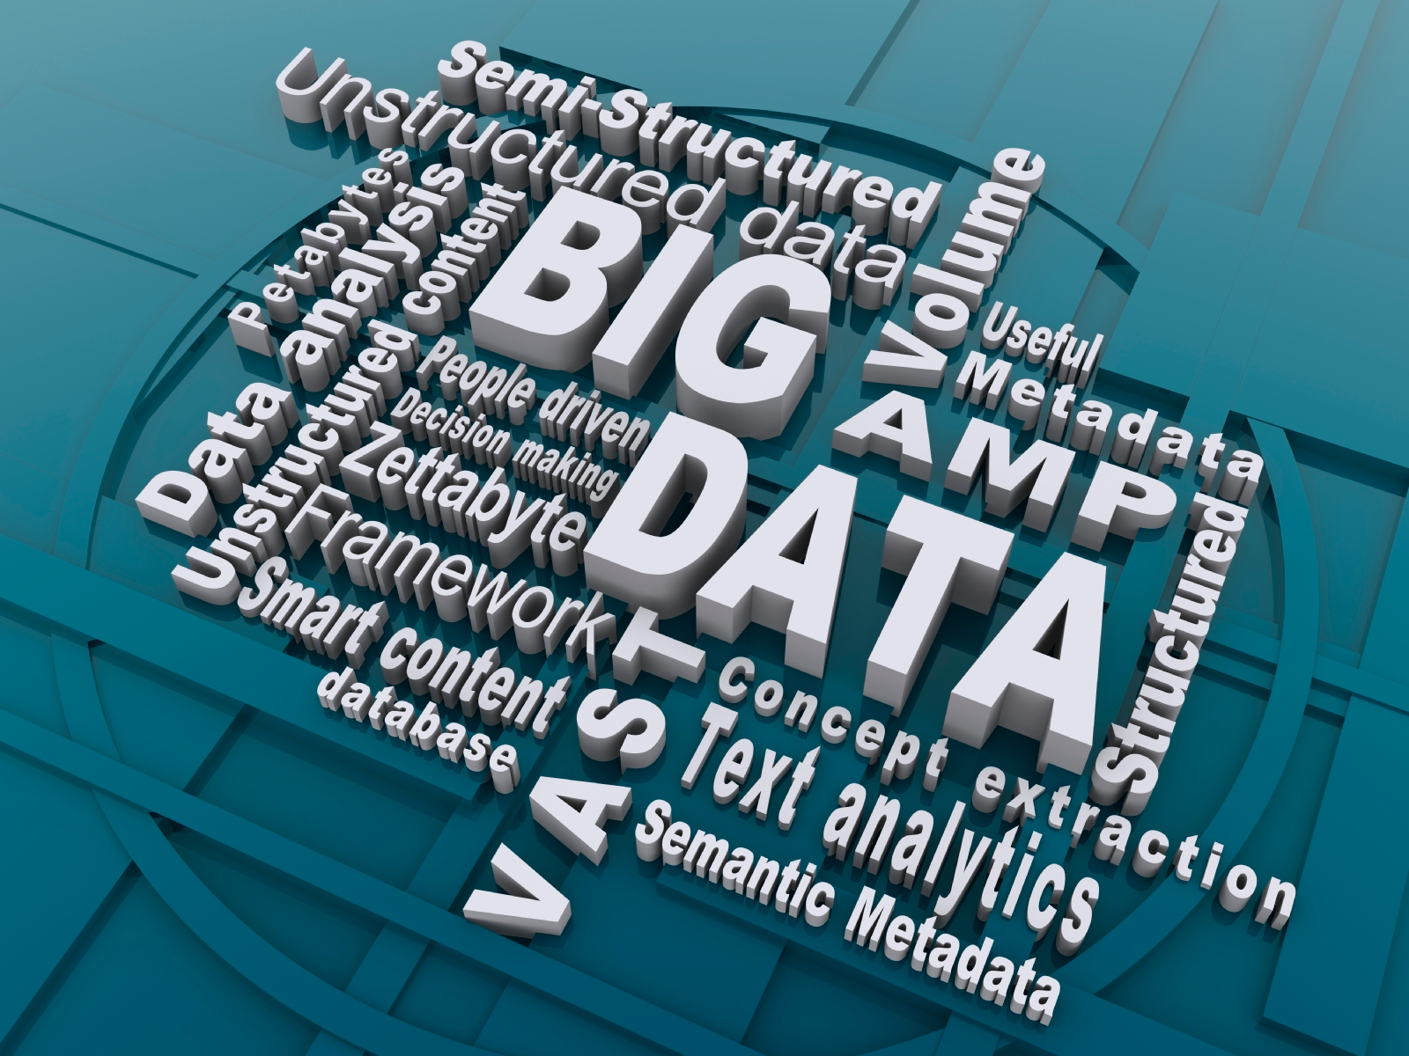
Growing Volume and Complexity of Cancer Data
    Genomic data
    Proteomic data
    Metabolomic data
    Clinical Data
      EMR/EHR
      Imaging
      Observations
    Self-reported data
    Social media
    IoT Data
      Environment
      Individual wearable devices
    Simulation data
    Research data and observations
    Molecular data
    … and more
ECICC Scoping Meeting, March 6-7, 2019
5

Slide 6

Towards a National Learning Healthcare System for Cancer
ECICC Scoping Meeting, March 6-7, 2019
6
S. Hawgood, et al., Sci Transl Med. 2015;
ER Hsu, et al., Clin Pharmacol Ther. 2017
Notes:
Colleagues at NCI and DOE laid out a vision for a National Learning Healthcare System for Cancer – relevant data on all cancer patients is accessible, shareable and contributing to our current knowledge
Data – need a scalable, interoperable data infrastructure to access, connect, analyze multimodal datasets and need a seamless data environment where patient data is consistently captured and shared
Analysis – more data is valuable only if we can effectively analyze, integrate, visualize to derive knowledge – to do this we need powerful data analytics, advanced computing, molecular to population scale simulations STRESS IIMPORTANCE OF ADVANCED COMPUTING AND PREDICTIVE SIMULATIONS
Workforce – to use new data science capabilities and technologies need a continuum from computer scientist to basic researchers to clinicians – everyone needs to interact and understand each other; Commonality in workforce needs

Slide 7






NCI-DOE Collaboration:
Joint Design of Advanced Computing Solutions for Cancer (JDACS4C)
Exascale
technologies
driving advances
NCI
National
Cancer
Institute
DOE
Department
of Energy
Cancer driving
computing
advances
Initiatives Supported
NSCI and PMI
DOE-NCI partnership to advance exascale development through cancer research
Notes:
NCI and DOE signed 5 year MOU in June 2016 for co-design of exascale computing technologies and their application to cancer precision medicine
Initial 3 year pilot program developed is JDACS4C between NCI and DOE to advance cancer research through application of large scale computing while providing design input for future large scale computing systems to DOE through the application of complex, highly heterogeneous datasets
Program is now in its third year.
Program was enabled by National Strategic Computing Initiative and Precision Medicine Initiative
DOE brings computational expertise and capability with their infrastructure
NCI brings subject matter expertise and sources of data
Program involves four DOE national laboratories (Argonne, Lawrence Livermore, Los Alamos, and Oak Ridge), Frederick National Laboratory,
NCI Division of Cancer Treatment and Diagnostics, Division of Cancer Control and Population Sciences

Slide 8
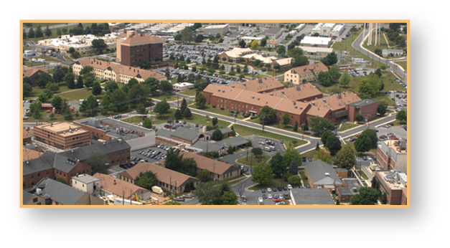
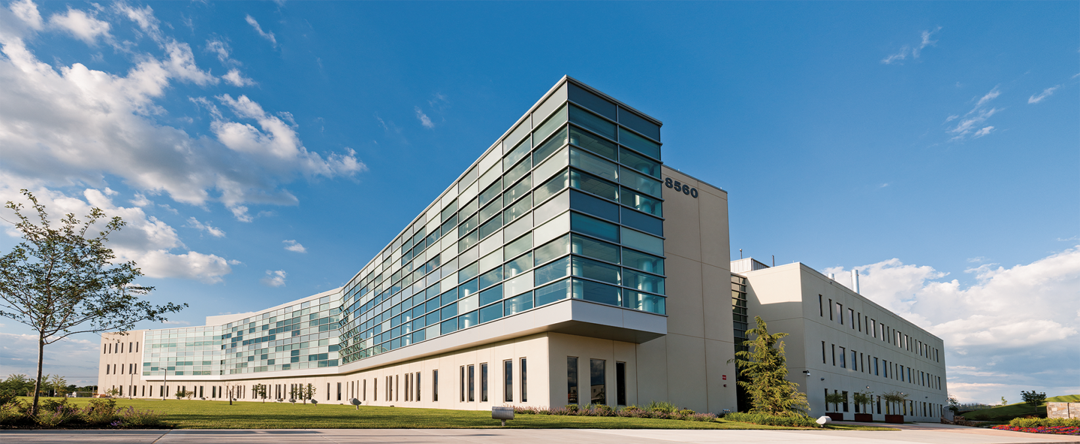
Frederick National Laboratory for Cancer Research
FNLCR is the only Federally Funded Research and Development Center (FFRDC) dedicated exclusively to biomedical research
  Operated in the public interest by Leidos Biomedical Research, Inc (formerly SAIC-Frederick) on behalf of the National Cancer Institute
Main campus located on 70 acres at Ft. Detrick, MD
  Leidos Biomed employees co-located with NCI researchers and other contractors on the NCI Campus at Frederick
  Additional Leidos Biomed scientists at Bethesda and Rockville sites
Mission
Provide a unique national resource for the development of new technologies and the translation of basic science discoveries into novel agents for the prevention, diagnosis and treatment of cancer and AIDS.
ECICC Scoping Meeting, March 6-7, 2019
8

Slide 9
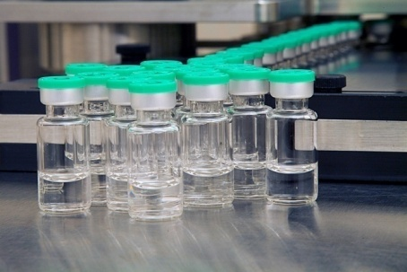
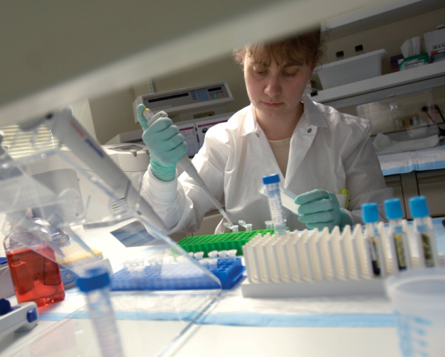
Research and Development at FNLCR
Research & Development
  Basic Research: New knowledge about AIDS and cancer
  Applied R&D: New diagnostics and therapeutics
  Clinical Research: Clinical trials and laboratory analysis
  cGMP manufacturing: Biologicals and vaccine production
Specialties
  Genomics, proteomics, and metabolomics
  Bioinformatics and imaging
  Nanotechnology
  Animal models
  Tumor cell biology and virology
  Immunology and inflammation
Data science key to enabling R&D activities and specialties
ECICC Scoping Meeting, March 6-7, 2019
9

Slide 10

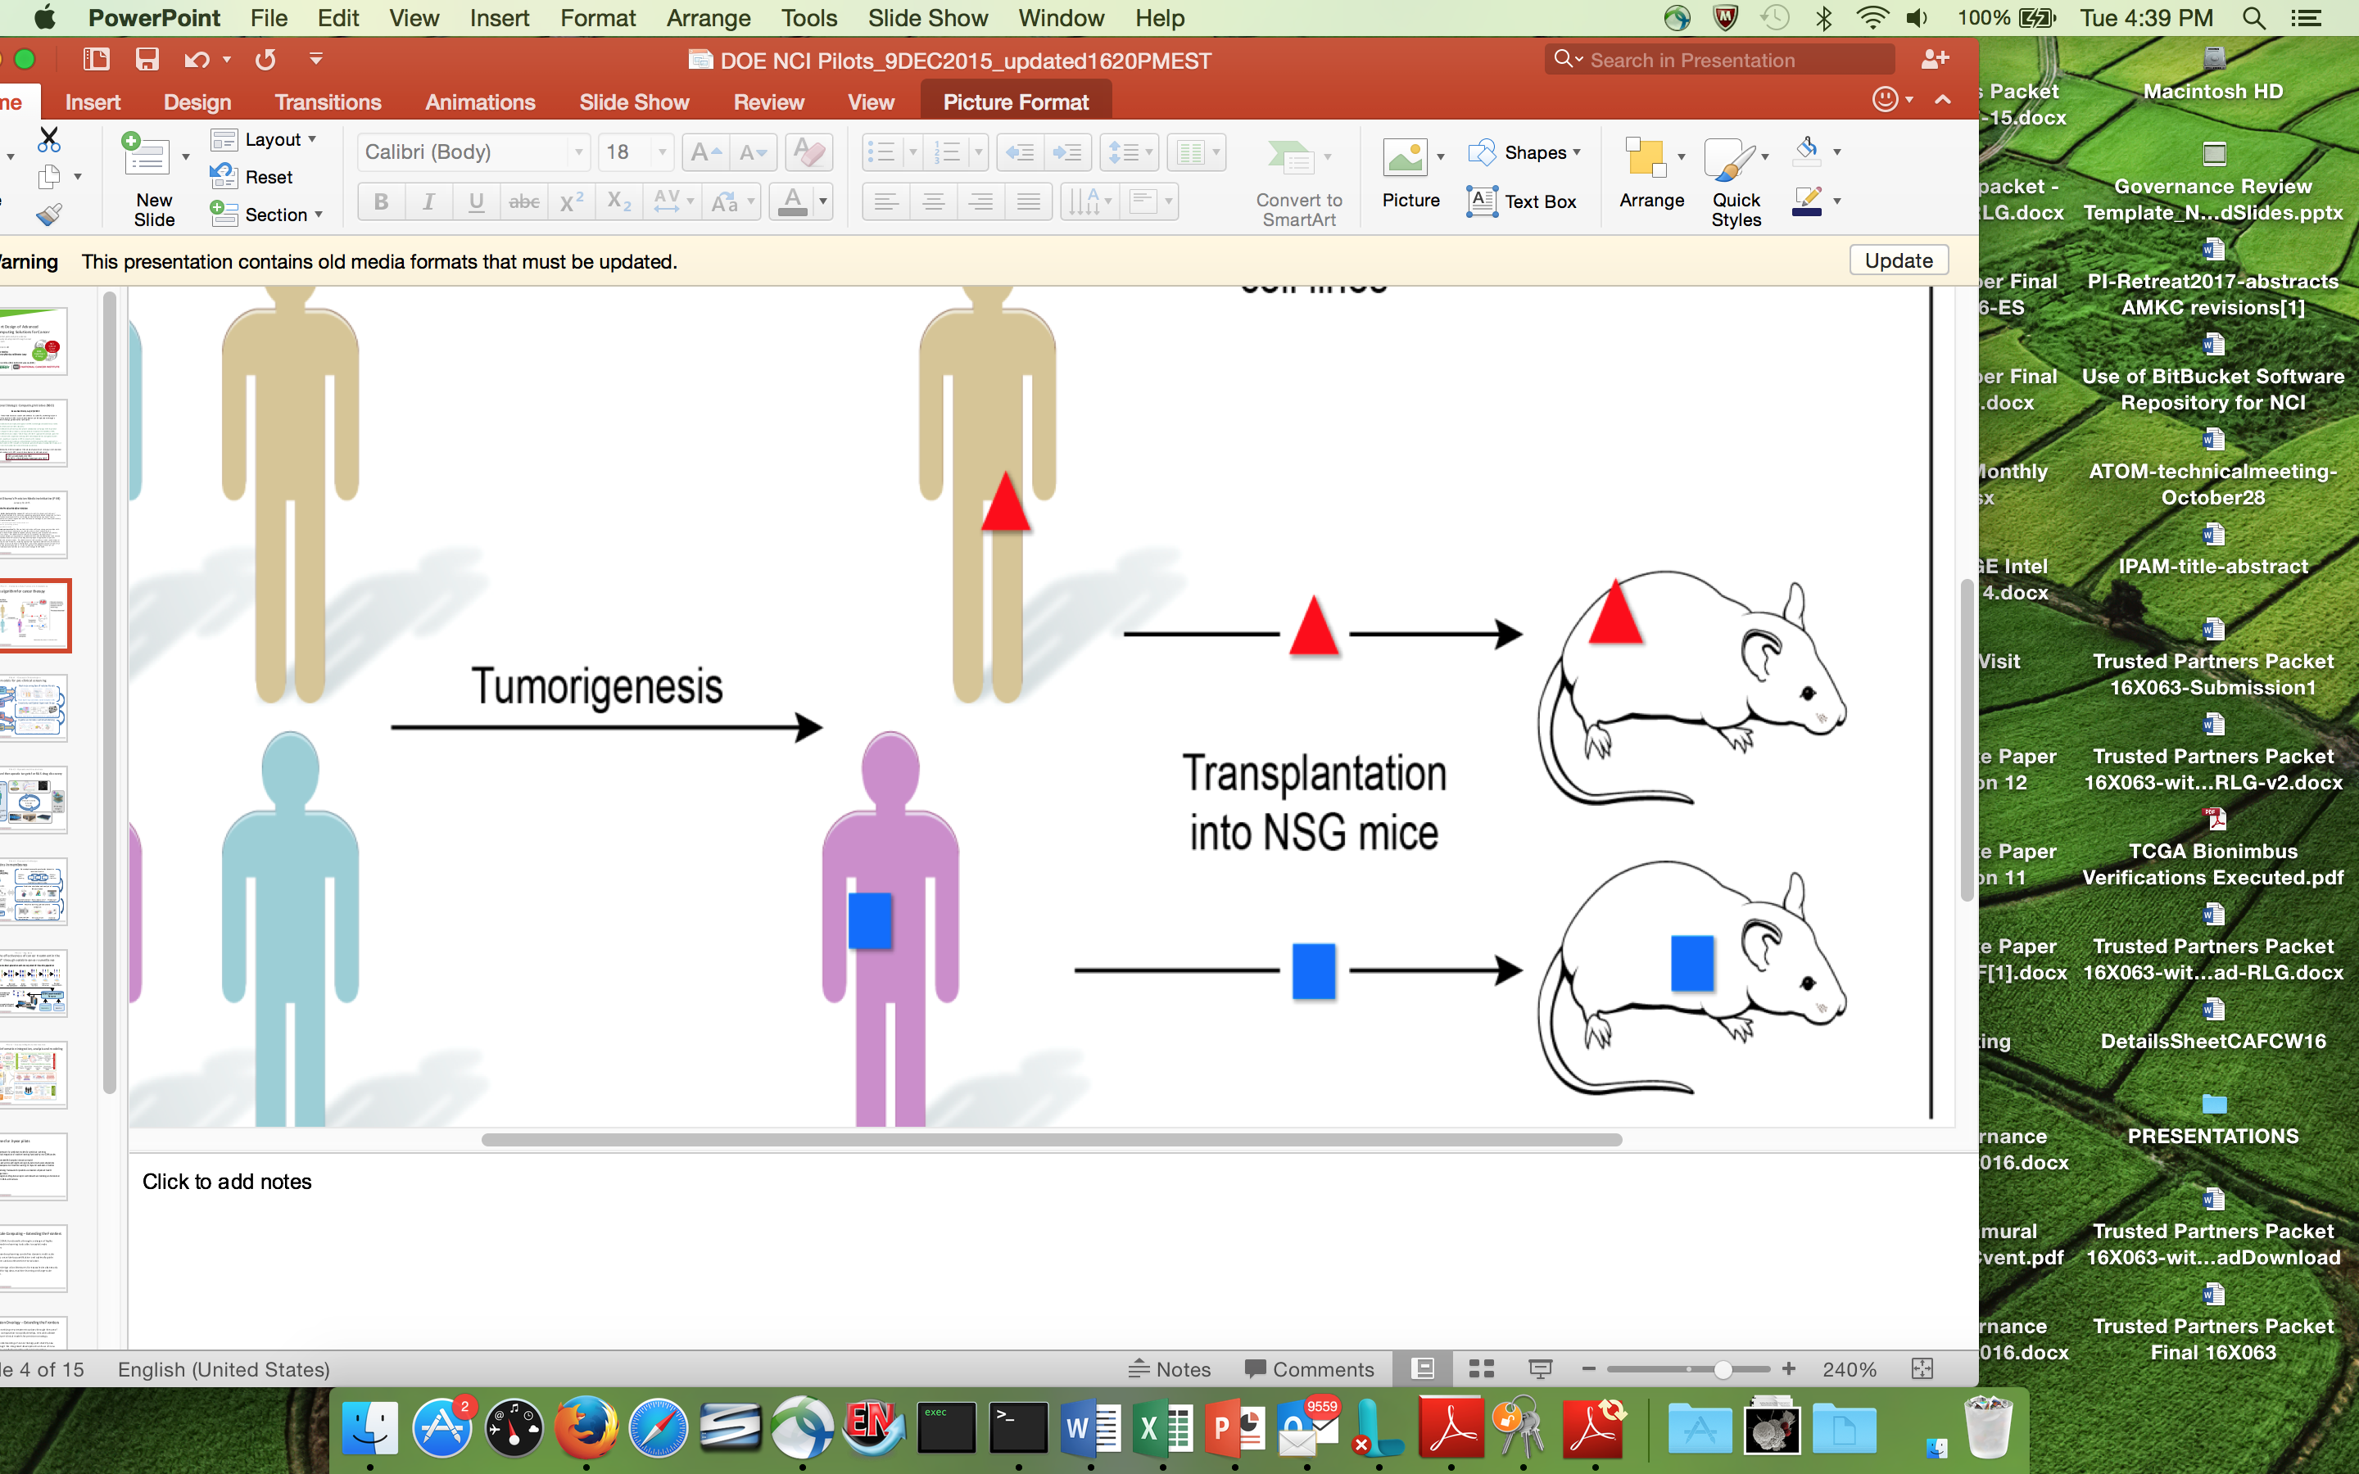
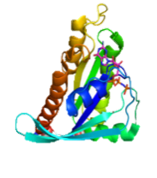
JDACS4C: Pioneering New Computational Capabilities
Clinical Domain – Precision oncology surveillance
Expanded SEER database information capture
Modeling patient health trajectories
Pre-clinical Domain – Improved predictive models
Computational/hybrid predictive models of drug response
Improved experimental design
Population cancer models
Pilot 1
Preclinal
Molecular Domain – Multiscale biological models
Models for RAS-RAS complex interactions
Insight into RAS related cancers
Molecular
Pilot 2
Multiple distinct cancer models
Single mechanism
ECICC Scoping Meeting, March 6-7, 2019
10

Slide 11
Why Now?
Expand and Broaden Impact and Engagement
Exascale
technologies
driving advances
NCI
National
Cancer
Institute
CANCER
Vision for computing
innovation
PREDICTIVE ANALYTICS
DOE
Department
of Energy
ECICC Scoping Meeting
BUILD A COMMUNITY
COMPUTING
Cancer driving
computing
advances
Vision for cancer
challenge
ECICC Scoping Meeting, March 6-7, 2019
11
Notes:
Working together for ~3 years – now is the opportunity to expand and broaden the impact and bring in new engagements and collaborations
Use ECICC meeting to start to build a community – today we have attendees from government, national labs, academia and industry across various disciplines and domains in cancer and computing research
Want to push towards a vision for what cancer challenges will compel innovation in computing and what computing innovations will drive knowledge and innovation in cancer
Move towards predictive (what we should see) and even prescriptive (what we should do) analytics

Slide 12
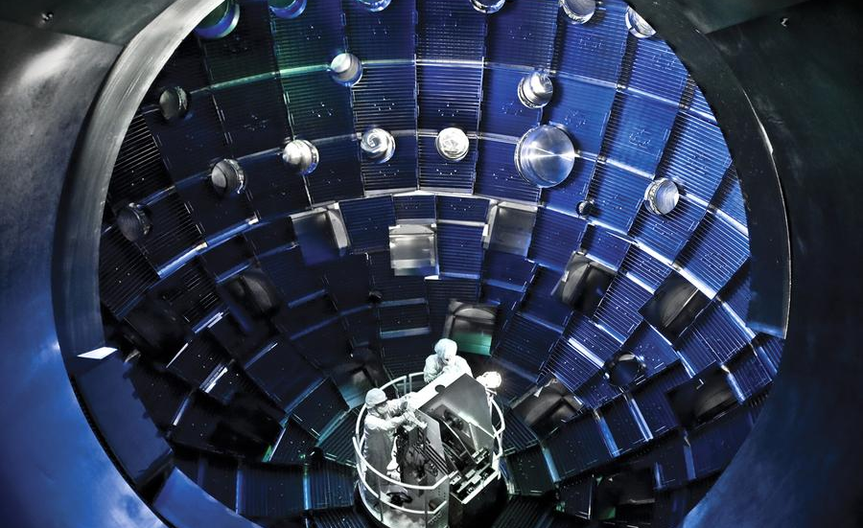
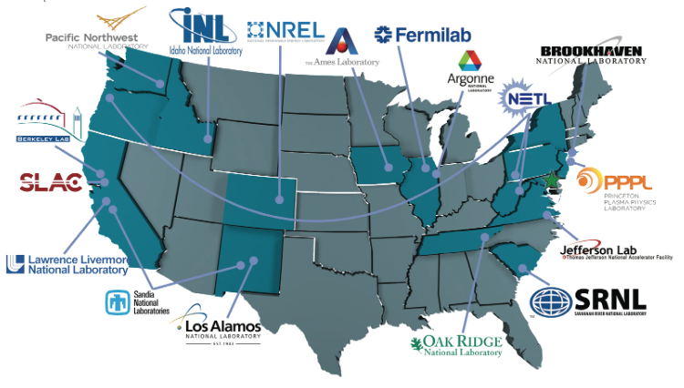
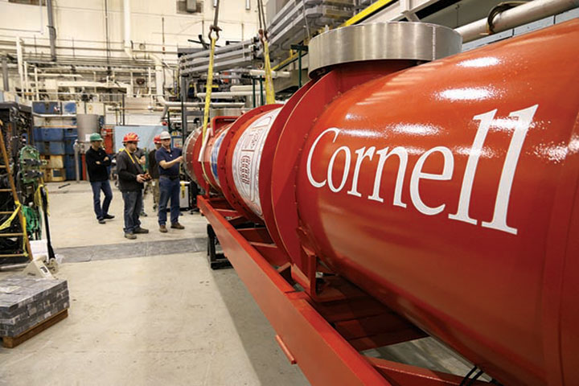
DOE Mission
To ensure America’s security and prosperity by addressing its energy, environmental and nuclear challenges through transformative science and technology solutions.
World leading experimental facilities
Most Energetic Laser Facility Ever Built
National Ignition Facility, Lawrence Livermore Natl Lab
Stewardship;
Big Science, Large Teams
17 national laboratories
Accelerator Test Facility, Brookhaven National Lab
Supported by DOE Accelerator Stewardship Program
ECICC Scoping Meeting, March 6-7, 2019
12
Notes:
8 here with us today!
National ignition facility LLNL – most energetic laser facility every built
You will here more about Doe capabilities in panel later today
Single largest supporter of basic research in the physical science in the U.S.

Slide 13
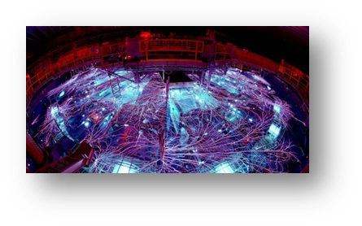
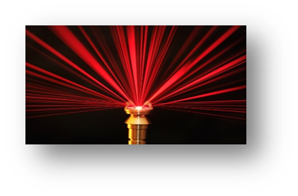
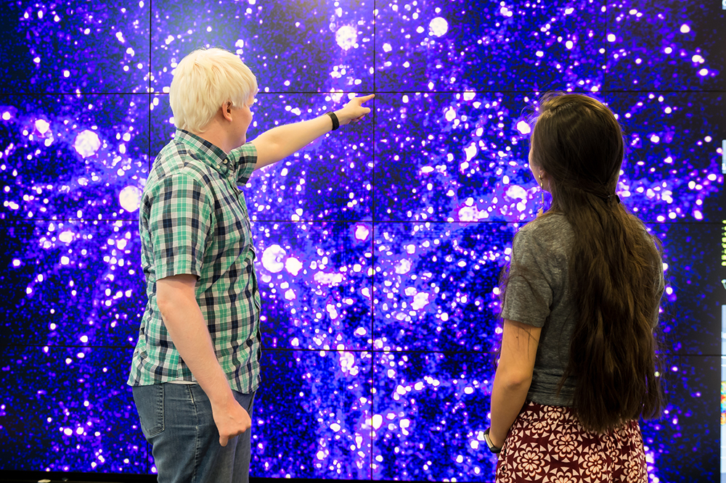
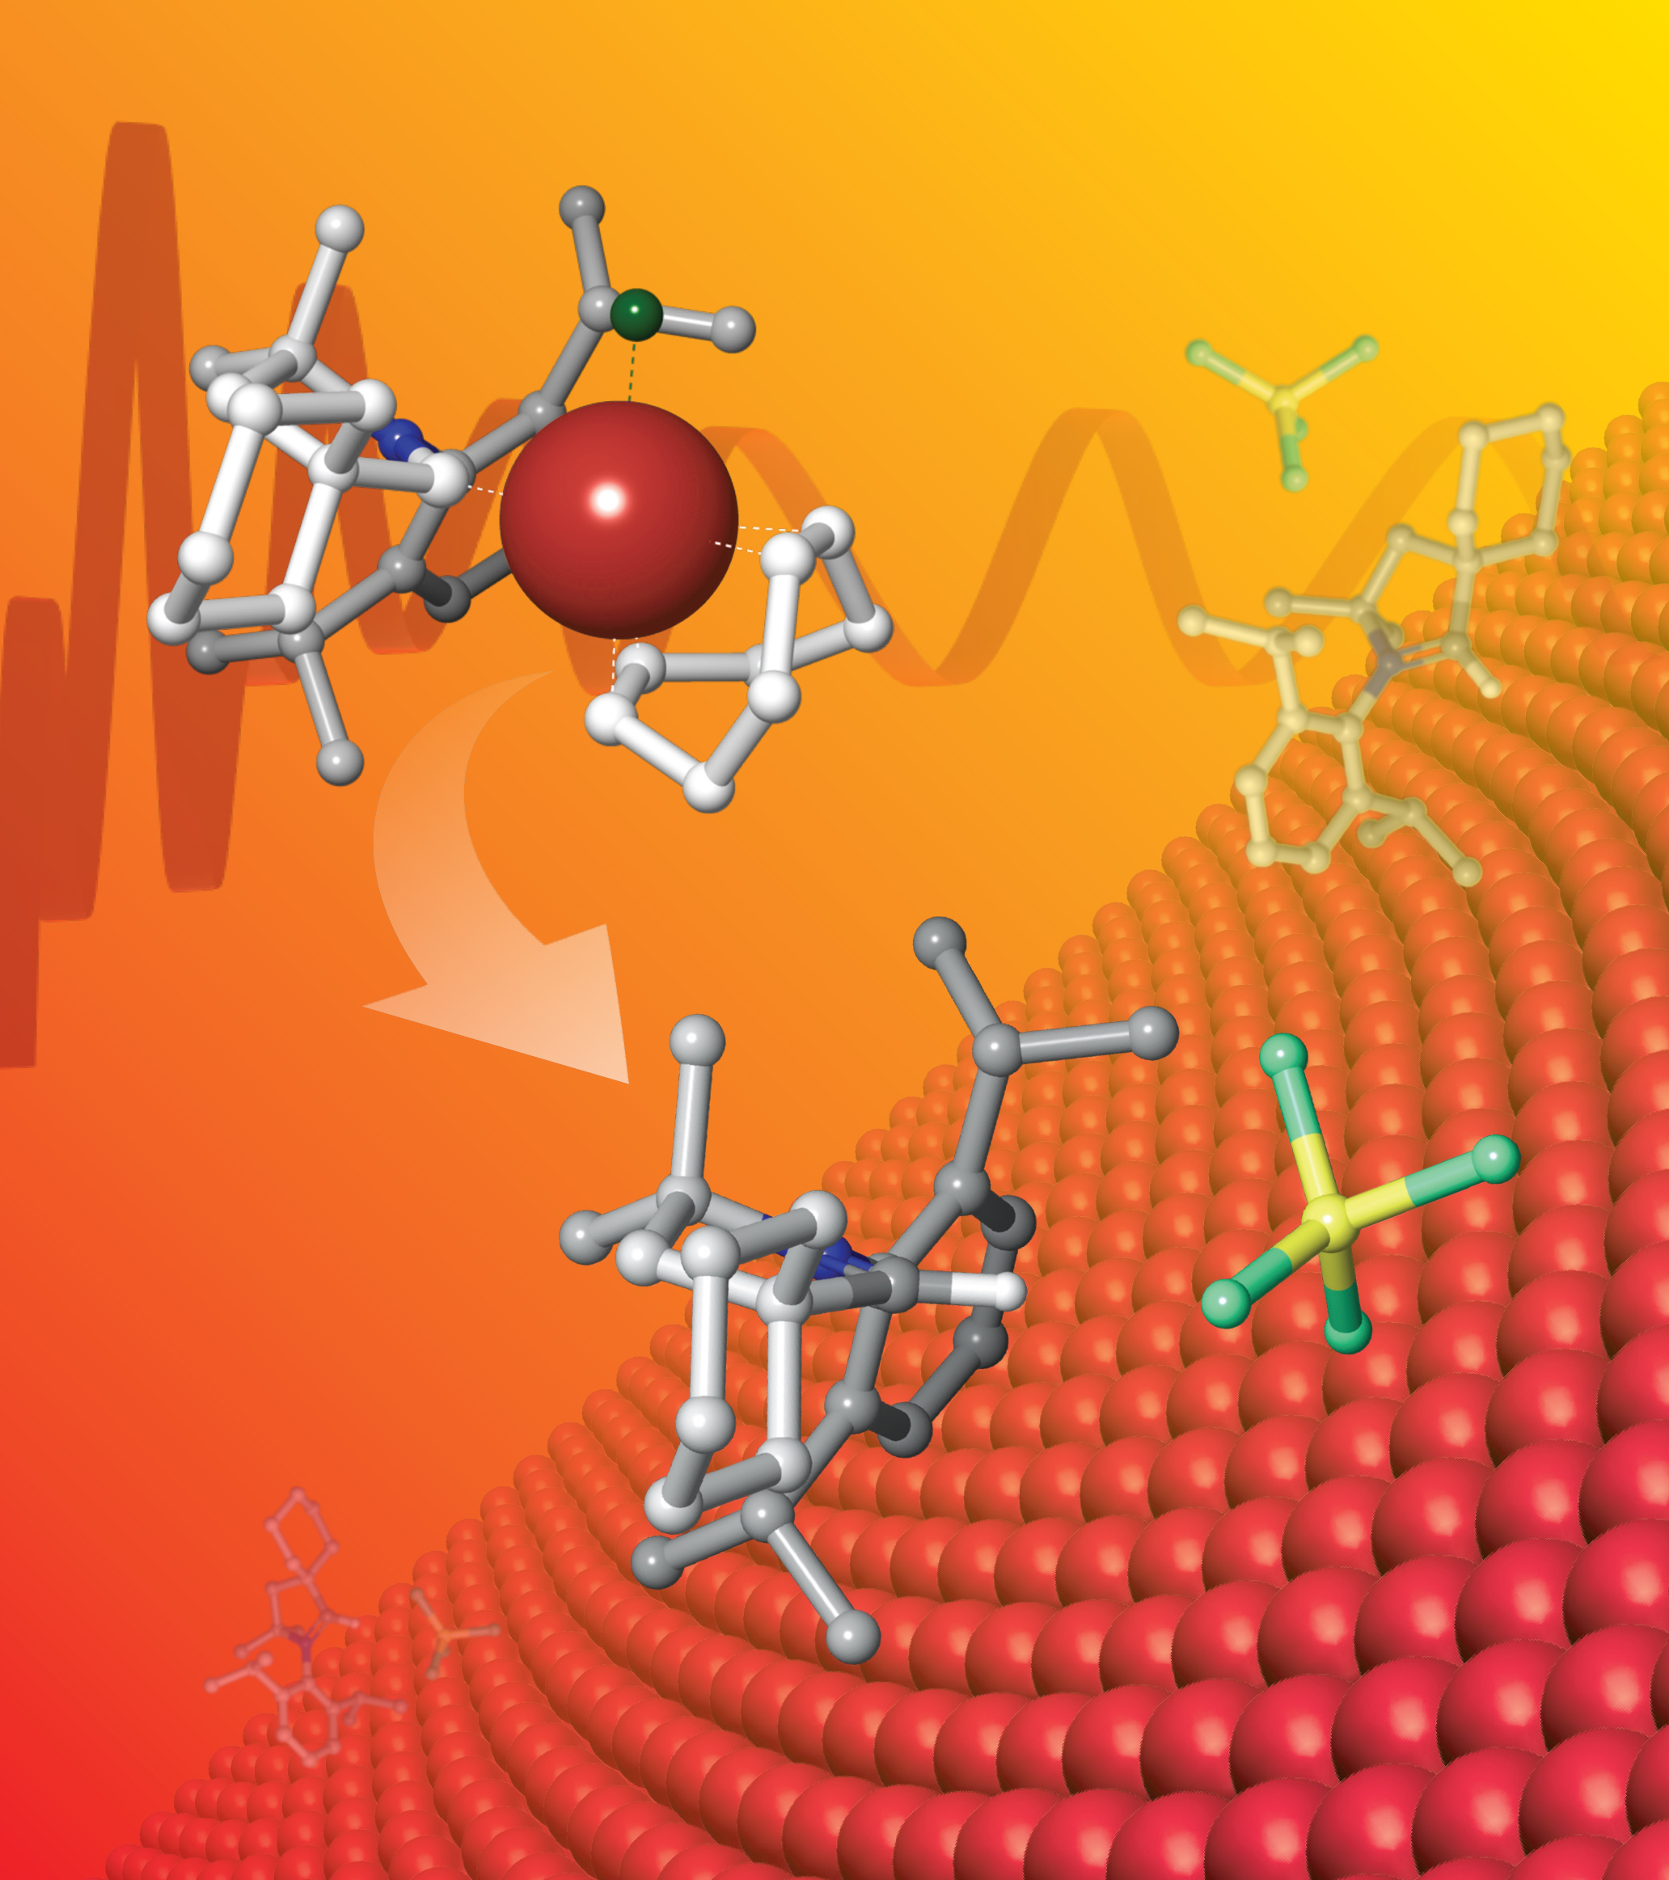
DOE Mission and Computing
Nuclear Stockpile Stewardship
To sustain a safe, secure, and effective nuclear deterrent through the application of science, technology, engineering, and manufacturing.
DOE Science Mission
  Mission Computing
  Leadership Computing
  (among the most advanced <HPC> in the world in terms of performance in solving scientific and engineering problems)
ECICC Scoping Meeting, March 6-7, 2019
13
Notes:
Deploy and Provide sustained access by the research community in the United States to leadership systems
“Z-machine” - SNL
HACC simulation-ANL

Slide 14
2019 World’s Most Powerful Computers
1. United States
2. United States
3. China
4. China
5. Switzerland
6. United States
7. Japan
8. Germany
9. United States
10. United States
11. United States
12. United States
https://www.top500.org/
ECICC Scoping Meeting, March 6-7, 2019
14
Notes:
11&12 also Units staes

Slide 15
2019 World’s Most Powerful Computers
1. United States
2. United States
3. China
4. China
5. Switzerland
6. United States
7. Japan
8. Germany
9. United States
10. United States
11. United States
12. United States
https://www.top500.org/
ECICC Scoping Meeting, March 6-7, 2019
15
Notes:
11&12 also Units staes

Slide 16
DOE Leads the World in Computing
1. United States - DOE
2. United States - DOE
3. China
4. China
5. Switzerland
6. United States - DOE
7. Japan
8. Germany
9. United States - DOE
10. United States - DOE
11. United States - DOE
12. United States - DOE
https://www.top500.org/
ECICC Scoping Meeting, March 6-7, 2019
16
Notes:
11&12 also Units staes

Slide 17
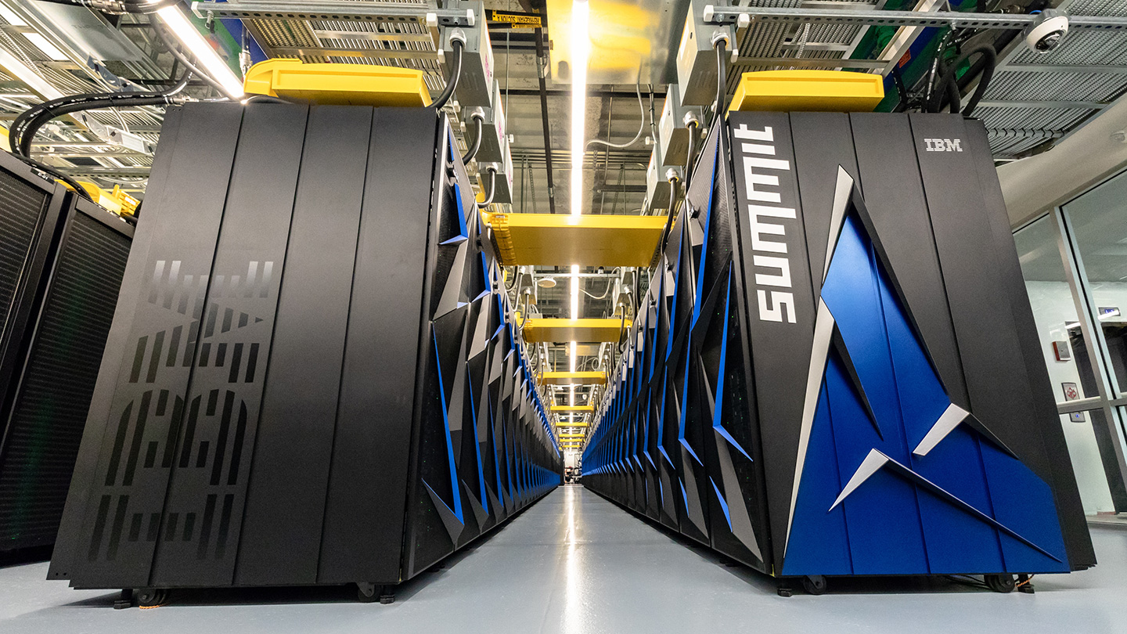
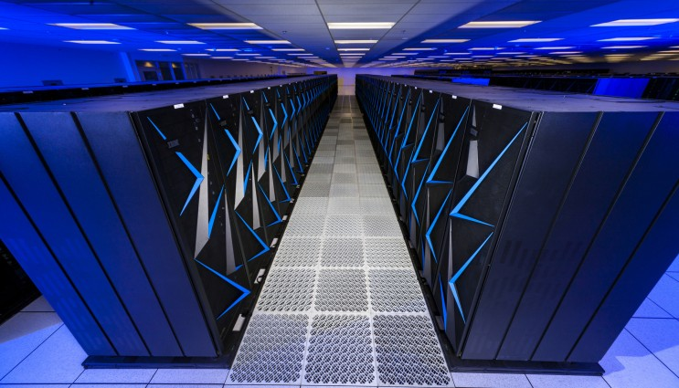
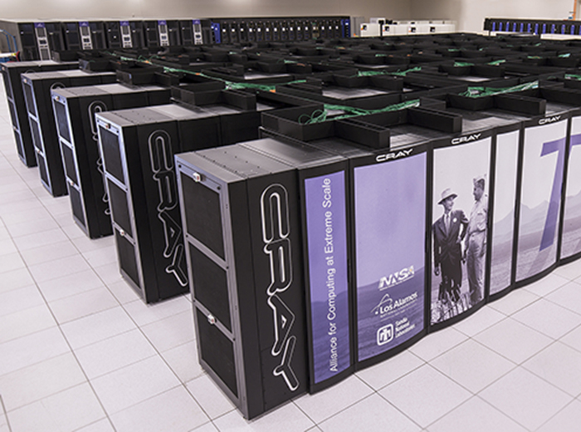
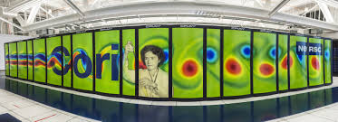
DOE Leads the World in Computing
1. United States - DOE
2. United States - DOE
3. China
4. China
5. Switzerland
6. United States - DOE
7. Japan
8. Germany
9. United States - DOE
10. United States - DOE
11. United States - DOE
12. United States - DOE
Summit, Oak Ridge National Laboratory
Leadership Computing Mission
Sierra, Lawrence Livermore National Laboratory
Nuclear Stockpile Stewardship
Cori, Lawrence Berkeley Laboratory
DOE Science Mission
Trinity, Los Alamos and Sandia National Laboratories
Nuclear Stockpile Stewardship
ECICC Scoping Meeting, March 6-7, 2019
17
Notes:
11&12 also Units staes

Slide 18
Absence of Full Experimental Tests
Requires New Investments and Workforce Development in Predictive Computing
1951-1962 above ground experimental test
1962-1992 underground experimental test
1992 Nuclear Test Ban Treaty
Exascale
Petascale
Laptop
Cell Phone
Number of
Experimental Tests
Compute Power (Flops)
Slide courtesy Lawrence Livermore National Laboratory
ECICC Scoping Meeting, March 6-7, 2019
18
Notes:
DOE experience in computing with real-world consequences
PETA= million billion
If every human bein on earth (10B) performed 100 million calculations per second – wed get exascal
eXA = grains of sand on planet, number of insects, 100,000 exa = starts in universe (<1day)
If every man, woman and child on earth (7.2 billion) performed 2.8 million calculations per seconds they would perform at a rate of 20 petaops (BG/Q)
If every man, woman and child on earth (7.2 billion) performed one calc per second, they would need to calc for 2.7E6 seconds (one month= 2.6E6) to perform at 20PF

Slide 19
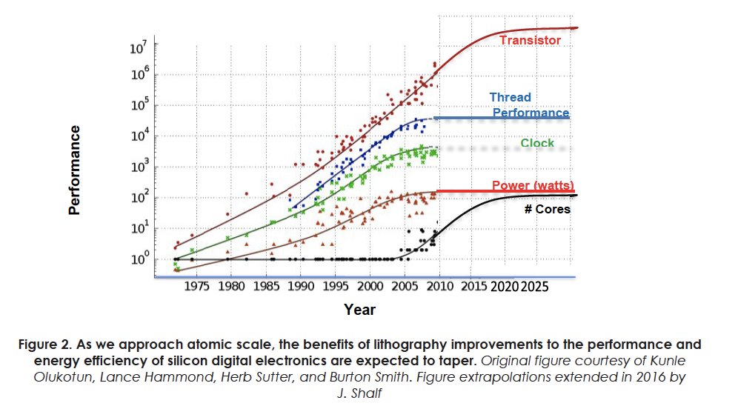
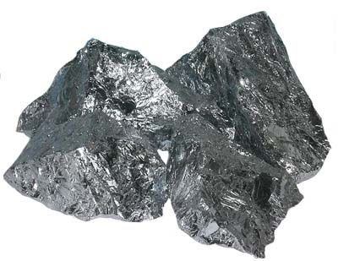
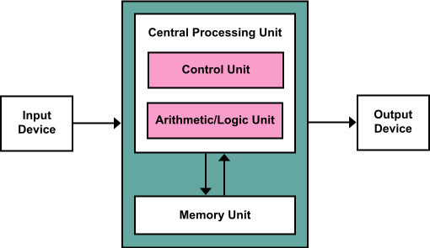
Why Now? End of Moore’s Law
‘Same as Usual’ has done well, until now.
ECICC Scoping Meeting, March 6-7, 2019
19

Slide 20
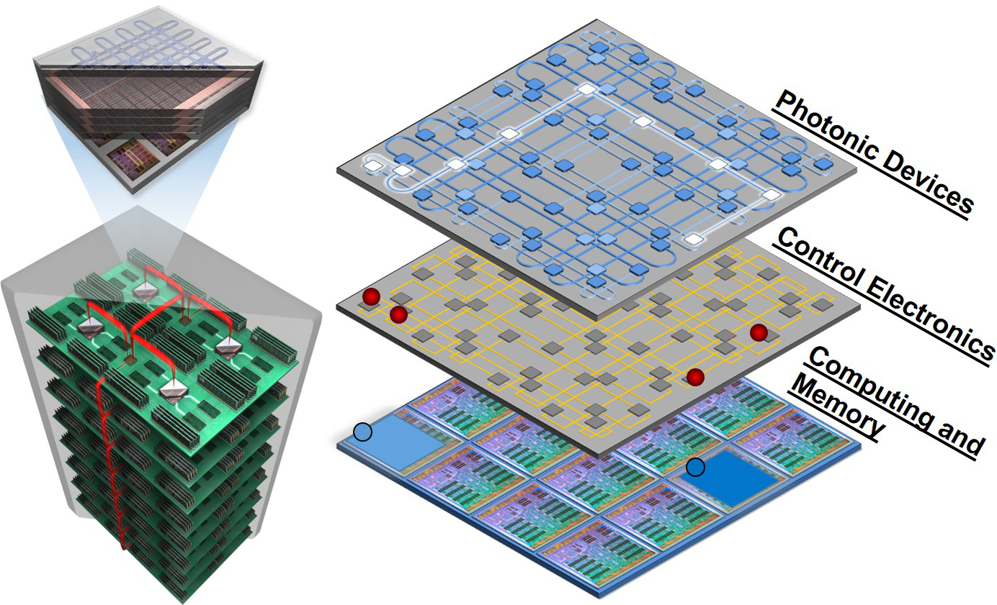
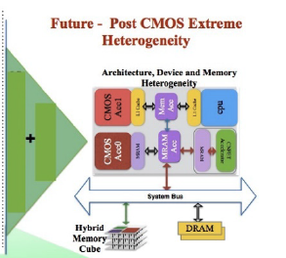
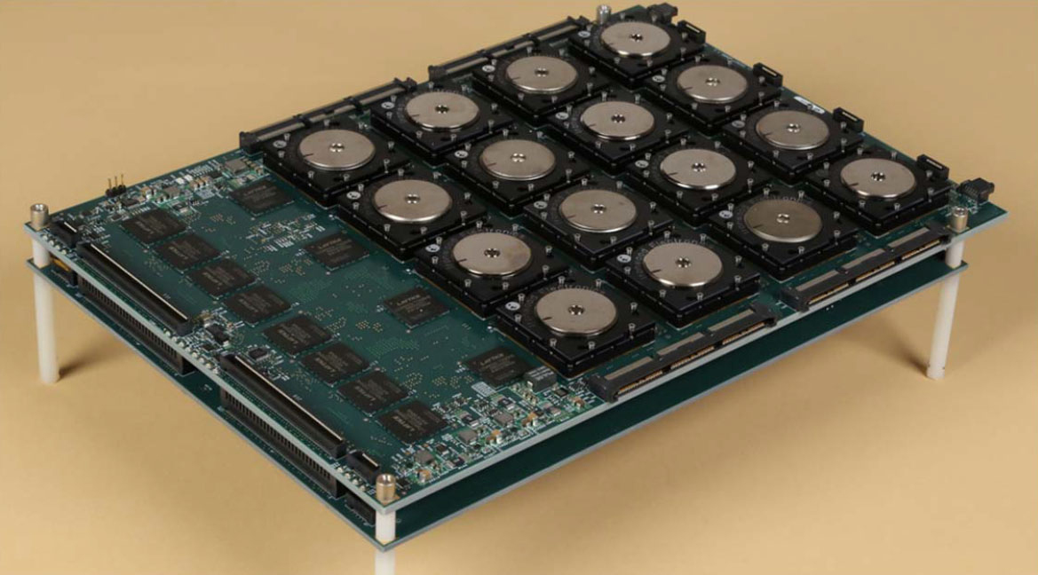

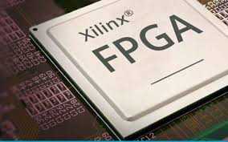
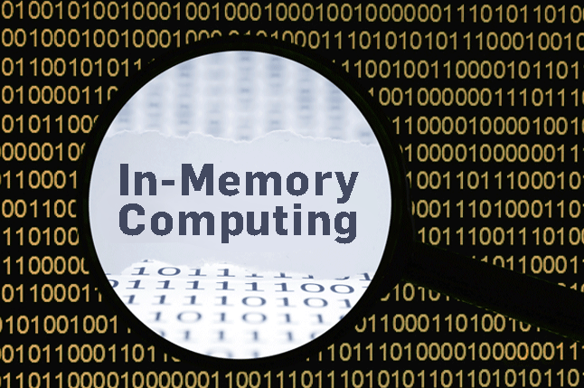
Why Now? Renaissance in Computing Technology and Applications
Photonic Communication in Computers
(Karen Bergman, Columbia Univ)
Progressively Heterogeneous Systems
Neuromorphic Computing
“Brain Inspired” Chips
(IBM TrueNorth Chip)
Quantum
Computers
Field Programmable Gate Arrays
ECICC Scoping Meeting, March 6-7, 2019
20

Slide 21
How do we drive computing solutions in the new technology era? (near term: AI, heterogeneous architectures and memory, data movement and processing)
We need partnerships in science and technology fields outside DOE traditional spaces to inspire fresh thinking.
ECICC Scoping Meeting, March 6-7, 2019
21

Slide 22
Cancer: Exciting Challenges at Intersection of Data, Model and Simulation, and Machine Learning that Push DOE Thinking
S. Hawgood, et al., Sci Transl Med. 2015;
ECICC Scoping Meeting, March 6-7, 2019
ER Hsu, et al., Clin Pharmacol Ther. 2017
22
Notes:
Embedded in precision oncology goals are data challenges and physics problems that are exciting and push DOE thinking
-multi-scale, multi-physics
-complex data
-unknown underlying physical models
--help us think in new ways about computing

Slide 23
Your challenges inspire new thinking
Accelerate cancer research by bringing our long history in working computing at cutting edge and largest scales to deliver real-world impacts
Accelerate DOE HPC technology and Uncertainty Quantification (UQ) methodology research by inspiring fresh thinking and innovation in new era of computing
ECICC Scoping Meeting, March 6-7, 2019
23

Slide 24
ECICC Scoping Meeting Goals
  Identify lean-in cancer challenge areas that push the limits of current cancer research computational practices and compel development of innovative computational technologies
  Build a community, multi-disciplinary engagement, and collaboration among cancer, data, and computational scientists to create transformative impact
  Demonstrate how to break down silos and work across domains, disciplines, organizations
  Define the types of cultural shifts in cancer research that could be possible with high-performance computing (HPC)
ECICC Scoping Meeting, March 6-7, 2019
24

Slide 25
EXTRA

Slide 26
Compute Capabilities over time
NCI Advanced Biomedical
Computing Center
Application expertise
Infrastructure innovations
Novel algorithms
NIH CIT/Biowulf
Large scale production
Storage
Data transfer
Infrastructure
US Department of Energy
Extreme scale systems
Network innovations
$478M in FY14 to
Advanced Computing Research
ECICC Scoping Meeting, March 6-7, 2019
26

Slide 27
Predictive Modeling and Simulation
Computational Science (~60%)
Molecular Dynamics
Computational Chemistry
Data Transformation (~40%)
Genomics
Image processing
Transform and Manage Data
Analysis, Search and Compare
Data Science
Analytics
(Estimated usage numbers for provided by Sean Davis, NCI Center for Cancer Research)

Slide 28
JDACS4C
Integrated Precision Oncology
Exascale
technologies
driving advances
Molecular
Pre-clinical
Population
NCI
National
Cancer
Institute
Pre-clinical Domain – Improved predictive models
Computational/hybrid predictive models of drug response
Improved experimental design
DOE
Department
of Energy
Cancer driving
computing
advances
Clinical Domain – Precision oncology surveillance
Expanded SEER database information capture
Modeling patient health trajectories
Initiatives Supported
NSCI and PMI
Molecular Domain – Multiscale biological models
Models for RAS-RAS complex interactions
Insight into RAS related cancers
CANcer Distributed Learning Environment (CANDLE)
Scalable Deep Learning for Cancer
JDACS4C established June 27, 2016 with signed MOU between NCI and DOE

Slide 29
Prescriptive cancer models
Patient specific disease ensembles
Multiple distinct cancer models
Single cancer
ensemble
Multi-scale
Multi-cell models
Multi-mechanism
Multi-ensemble
Multi-scale
Single cell models
Single mechanism
Single ensemble
Multi-mechanism
Single ensemble
Single mechanism
Single trial
Molecular domain
Cellular domain
Clinical domain

Slide 30
Envisioning Computational Innovations for Cancer Challenges Scoping Meeting
HPC in Cancer Research Brief Overview
Amy Gryshuk, LLNL and Eric Stahlberg, FNLCR
March 6-7, 2019
Livermore Valley Open Campus at Lawrence Livermore National Laboratory

Slide 31
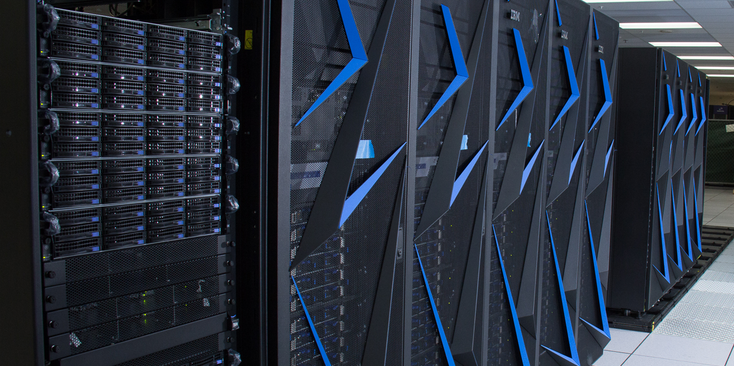
Current supercomputer designed to excel at both machine learning and traditional (PDE-based) workloads
“Sierra” @ LLNL (#2 top500)
4,320 nodes
8,640 IBM Power9 CPUs
17,280 NVIDIA Volta GPUs
1,572,480 cores
94.6 PFLOP/s
1.38 PB memory
Next generation computers promise to be even more complex
Notes:
Installation was challenging – water cooled, weight limits, etc.
Building that houses it is also amazing – and still has plenty of room! Recommend anyone visiting to get the tour.

Slide 32
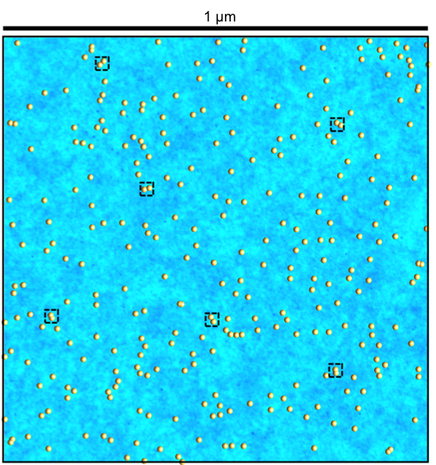
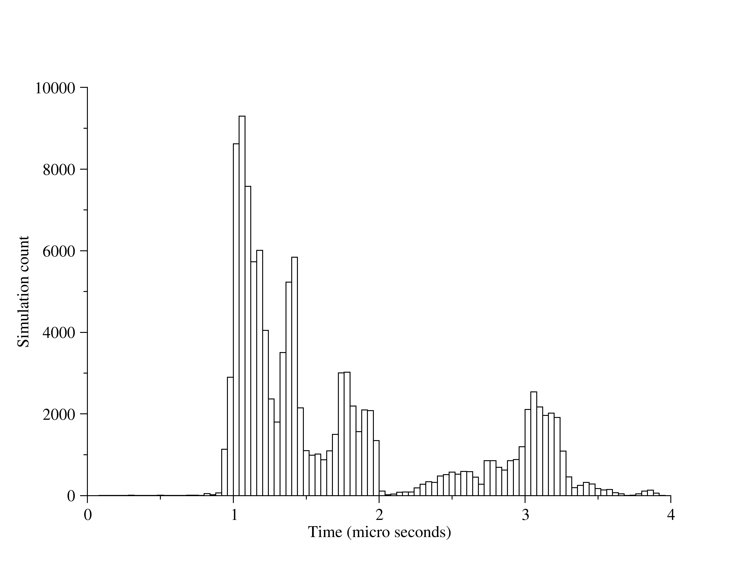
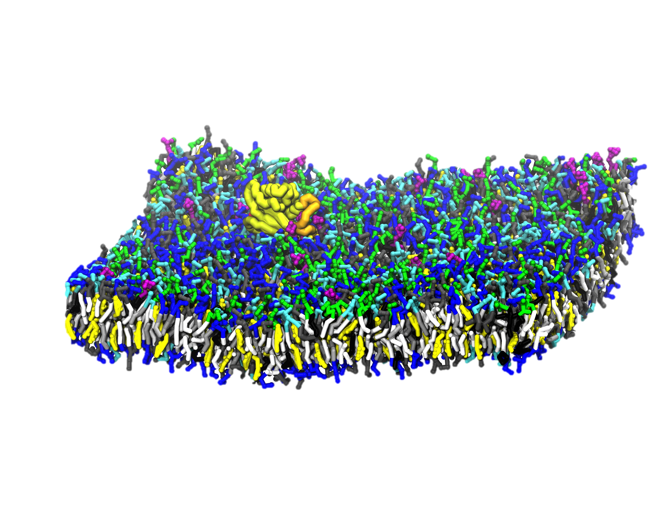
Campaign 1 – RAS membrane dynamics
DDFT simulation:
1 μm²
300 KRAS
152 μs
2,200,000 patches
CG simulations:
30x30 nm²
140,000 particles
1-5 KRAS
116,008 simulations
1+ μs each
200 ms aggregated
300,000,000 analyzed frames
Notes:
9998458500000 total ddcMD time steps
The 2418 not finished simulations where removed.

Slide 33
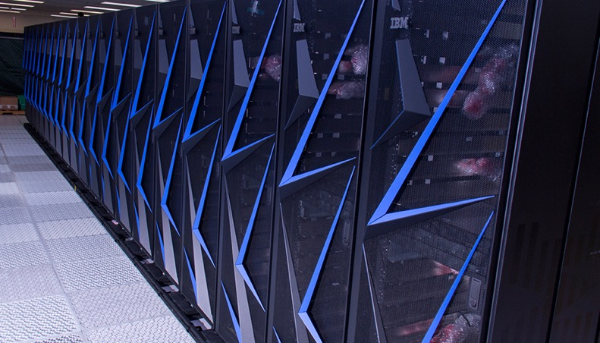
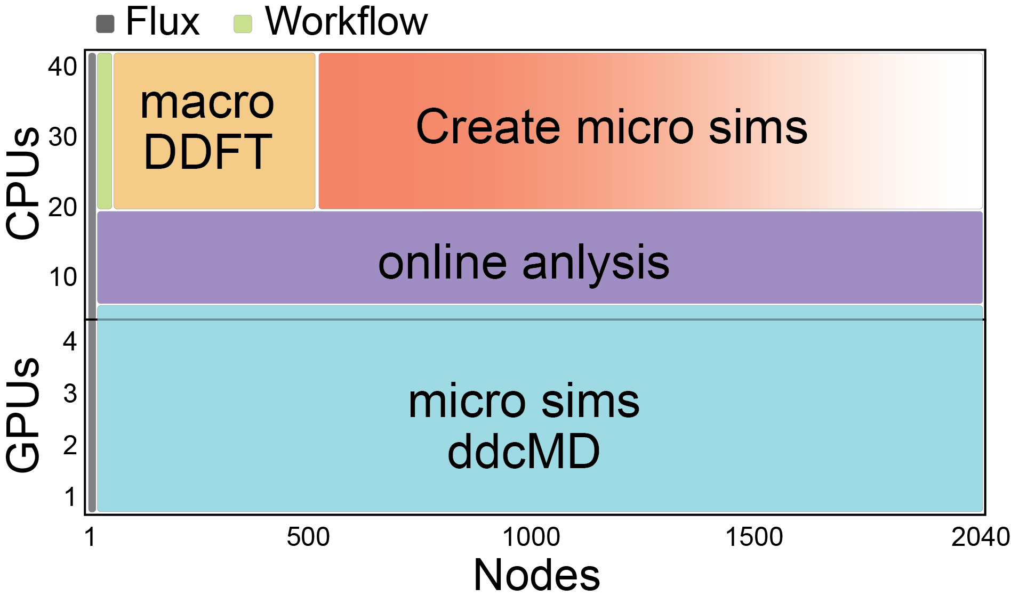
Campaign 1 – RAS membrane dynamics
Sierra computer
Excellent linear scaling:
Low 15 nodes
High 4200 nodes (full machine)
Online analysis allows for less frequent storage of raw simulation data. Current data size: 320 TB.
Total node hours 1.4 M (5.6 M GPU hours)
For a 2040 node “typical” run:
~1h startup to max load after restart
GPU load 97% (99% after startup)
GPU utility 22% of peak
CPU load 60-100% depending on CG setup needs
Notes:
Running Martini on sierra GPU’s ddcMD 22% of peak – compared to ~10% from GROMACS.
For all the 320 TB data we only used 8M inodes

Slide 34
LLNL Computational Capabilities… mention a little as we’re at this location
NNSA lab
Getting 1-2 slides from Fred
2nd largest computer – SIERRA
Ran splash app – Pilot 2 – looking at membrane dynamics
Collaborative nature of the engagement…
Other systems at LLNL – mission to DOE NNSA ASC

Slide 35
JDACS4C: Extending the Frontiers for DOE and NCI
DOE Exascale Computing – Extending the Frontiers
  Broaden CORAL functionality through co-design of highly scalable machine learning tools able to exploit node coherence.
  Explore how deep learning can define dynamic multi-scale validation, uncertainty quantification and optimally guide experiments and accelerate time-to-solution.
  Shape the design of architectures for exascale simultaneously optimized for big data, machine learning and large-scale simulation.
NCI Precision Oncology – Extending the Frontiers
  Identify promising new treatment options through the use of advanced computation to rapidly develop, test and validate predictive pre-clinical models for precision oncology.
  Deepen understanding of cancer biology and identify new drugs through the integrated development and use of new simulations, predictive models and next-generation experimental data.
  Transform cancer care by applying advanced computational capabilities to population-based cancer data to understand the impact of new diagnostics, treatments and patient factors in real world patients.
ECICC Scoping Meeting, March 6-7, 2019
35
Notes:
Proceeding for nearly 2 years now – end of year mark at September 2018.
Example of a dynamic integrated collaboration between 2 agencies – DOE and NCI. From DOE’s perspective – JDACS4C has enabled co-design conversations for computational needs via these three identified pilot projects. These projects help to shape the design of the computational architectures in the future and as the needs for the biological projects. Apply ML, DL, and UQ tools for this exemplar project on the biological side that can then be brought back in for DOE mission needs.

Slide 36
Panel 2

Slide 37
Panel 3

Slide 38
ECICC Scoping Meeting Goals
  Identify lean-in cancer challenge areas that push the limits of current cancer research computational practices and compel development of innovative computational technologies
  Build a community, multi-disciplinary engagement, and collaboration among cancer, data, and computational scientists to create transformative impact
  Demonstrate how to break down silos and work across domains, disciplines, organizations
  Define the types of cultural shifts in cancer research that could be possible with high-performance computing (HPC)

Slide 39
EXTRA/END

Slide 40
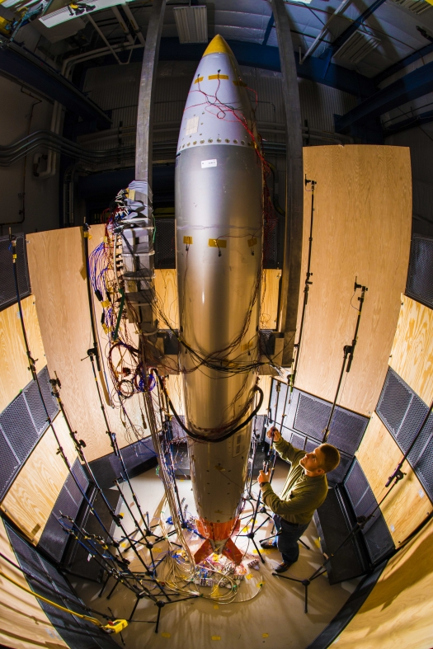
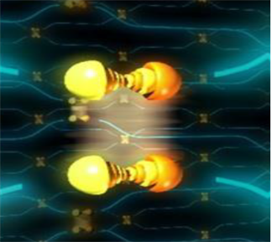
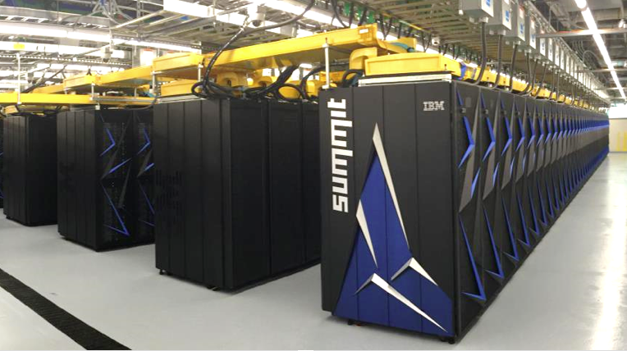

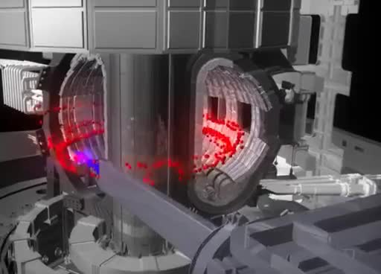
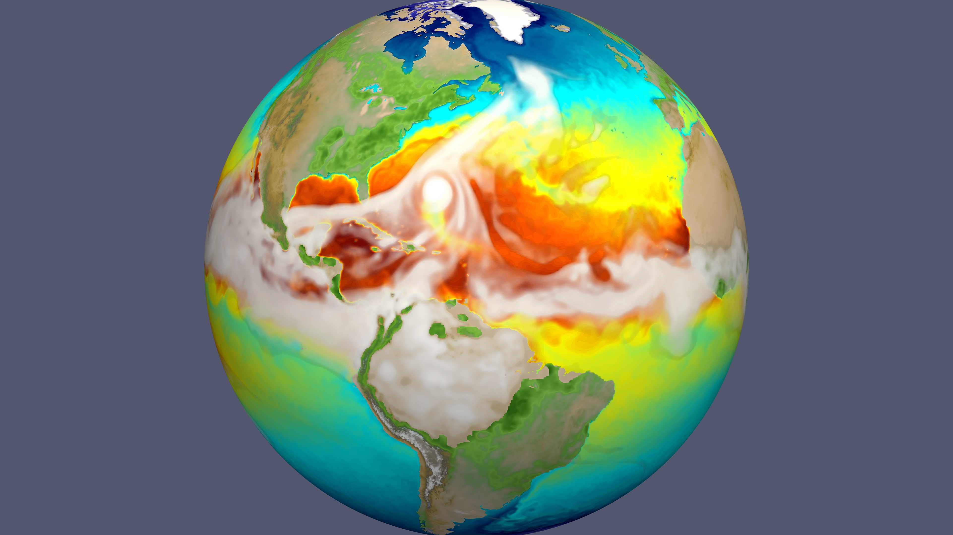
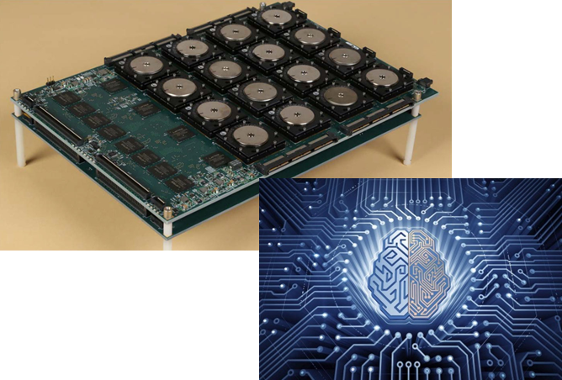
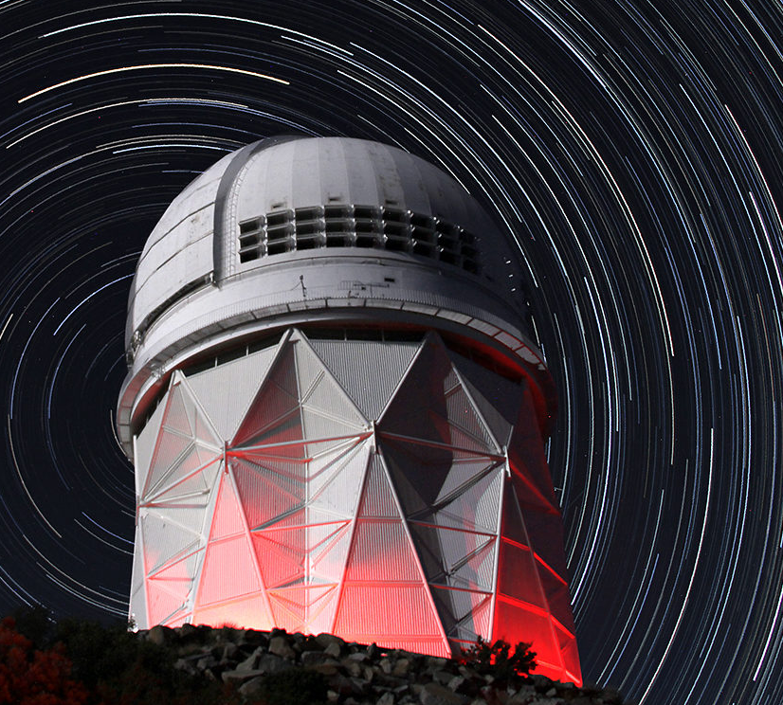
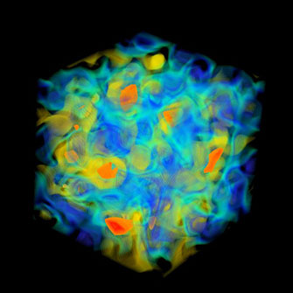
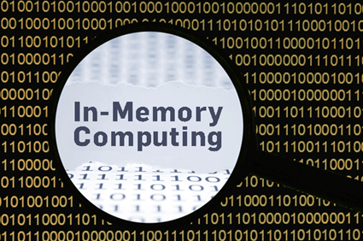
Notes:
How do we drive computing solutions and set standard for leadership computing in this new era of technology?
Lqcd=bnl
Earth moedel - PNNL

Slide 41
Why Now?
Nuclear Stockpile Safety and Security
Workforce development
Benefits of working in open science community
Underlying computer science and applied mathematics challenges translate to NNSA mission
DOE Science Mission
  Leadership Computing
  Mission: Sustain and enhance US technological and economic leadership in HPC research and deployment
  Need: Multidisciplinary efforts to develop next generation advanced computing platforms for science and engineering

Slide 42
Why Now?
National Strategic Computing Initiative (July 2015) - Calls upon DOE, a “lead agency” to partner with “deployment agencies” (includes NIH) to maximize impact of HPC for the United States
Nuclear Stockpile Safety and Security
Workforce development
Benefits of working in open science community
Underlying computer science and applied mathematics challenges translate to NNSA mission
DOE Science Mission
  Leadership Computing
  Mission: Sustain and enhance US technological and economic leadership in HPC research and deployment
  Need: Multidisciplinary efforts to develop next generation advanced computing platforms for science and engineering

