Slide 1
The Intersection of Oncology and Computing
Warren A. Kibbe, Ph.D.
Professor, Biostatistics & Bioinformatics
Chief Data Officer, Duke Cancer Institute
warren.kibbe@duke.edu
#PredictiveModeling
#Computing
#DataScience
#PopulationScience
@wakibbe
Special thanks to Mike Hogarth, UCSD and NCI for some of the slides

Slide 2
As of January 2019, there are an estimated
16,900,000
cancer survivors in the U. S.
From https://cancercontrol.cancer.gov/ocs/statistics/statistics.html , based on Bluethmann SM, Mariotto AB, Rowland, JH. Anticipating the ''Silver Tsunami'': Prevalence Trajectories and Comorbidity Burden among Older Cancer Survivors in the United States. Cancer Epidemiol Biomarkers Prev. (2016) 25:1029-1036

Slide 3
Data is pervasive

Slide 4
Take homes
Data generation is no longer the bottleneck – data management, analysis, reasoning are
Pace of technology change and innovation continues to increase
Devices are ubiquitous, smart, connected. Platform for new insights
Data science is everywhere
Computing will enable us to move from observation to prediction to intervention & prevention
Understanding the patient context, the patient trajectory, is key

Slide 5
Technology Backdrop
Devices, smart phones, smart homes, smart cars, smart cities
Real World Evidence
Built Environment Data
Precision Medicine – Learning Health
Single-cell measurements
Data Science
Technology now allows us to measure our world, our environment, our interactions, and ourselves at scale

Slide 6
Fundamental Changes
Data generation is not the bottleneck
Most data are now ‘digital first’
Old statistical models assuming variable independence are inadequate – systems and pathways are not independent!
Project management is critical in scaling population science
Well-defined experiments are still key

Slide 7
Technology innovation is permeating our society and the world at an ever increasing pace. The iPhone sold a billion units in about 5 years. The Sony Walkman took almost 30 years to reach 200 million

Slide 8
Changes in Oncology
Understanding Cancer Biology
Anatomic vs molecular classification
Health vs Disease

Slide 9
Understanding Patient Trajectories
We are all guilty of looking under the lamp post

Slide 10
Understanding Patient Trajectories
We are now measuring a few more points along the path

Slide 11
Understanding Patient Trajectories
But we really need to be able see the whole road

Slide 12
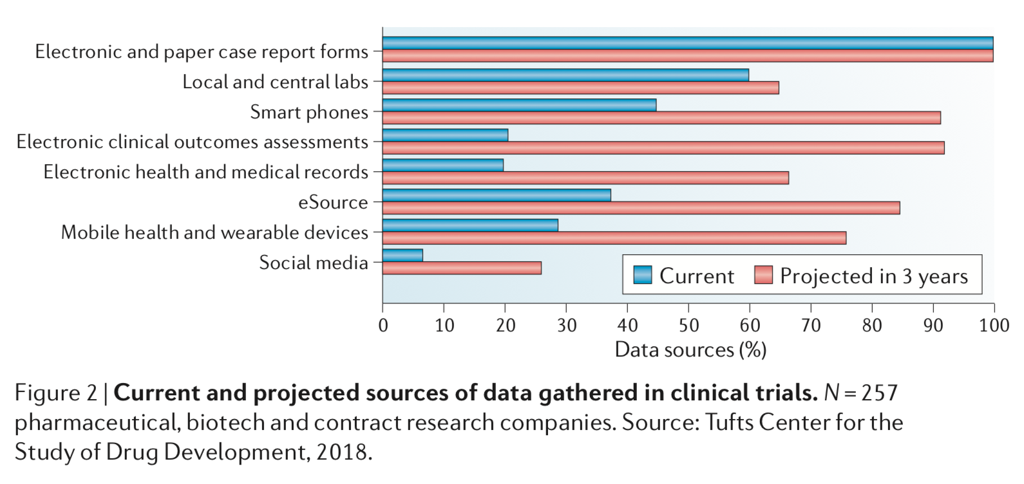
Data sources are evolving

Slide 13
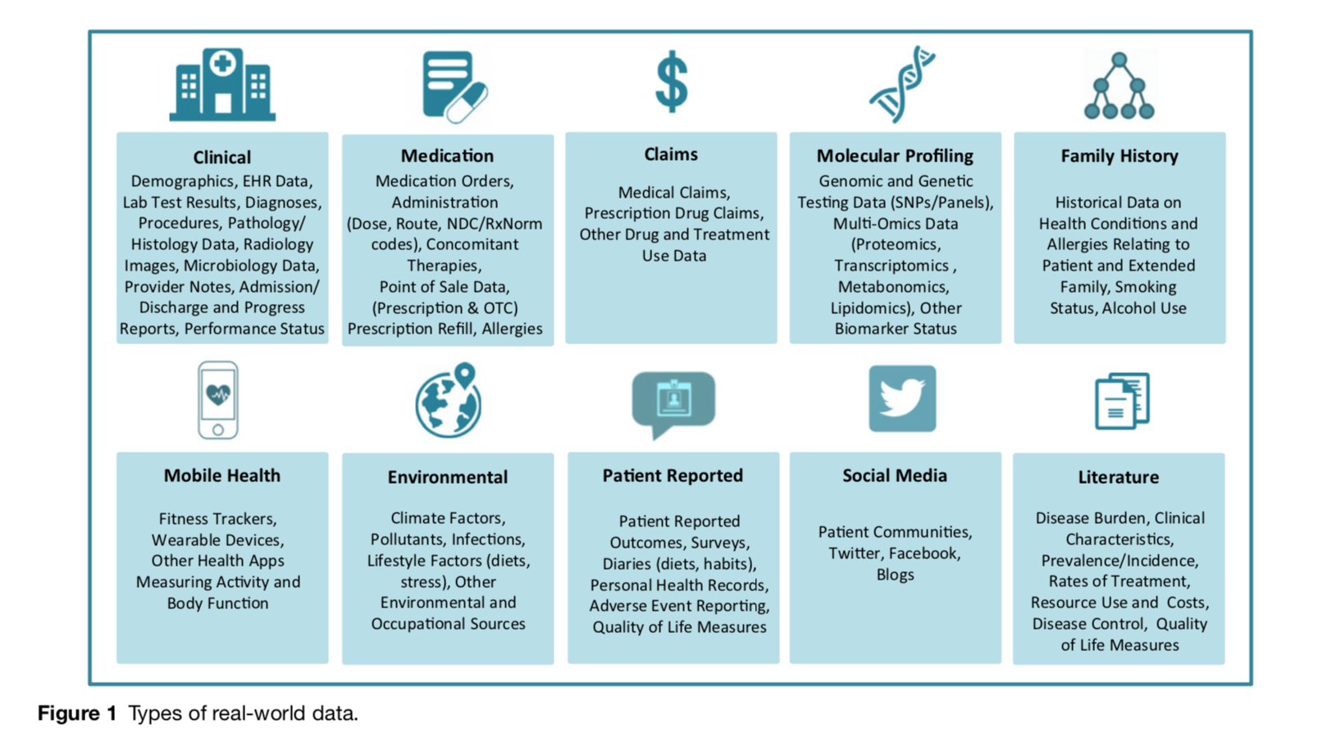
Types of “Real-World Data”

Slide 14
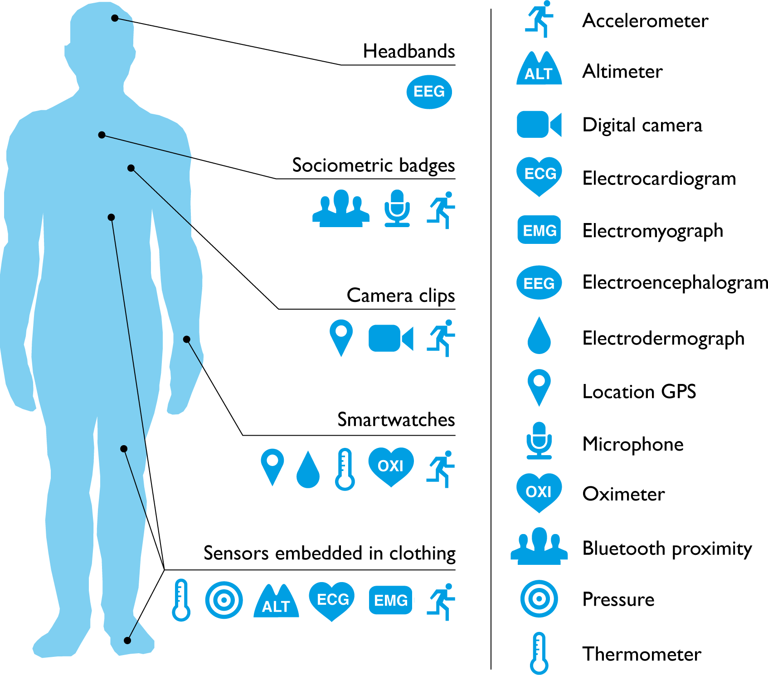
Mobile sensors to enhance monitoring of effects of new therapies

Slide 15
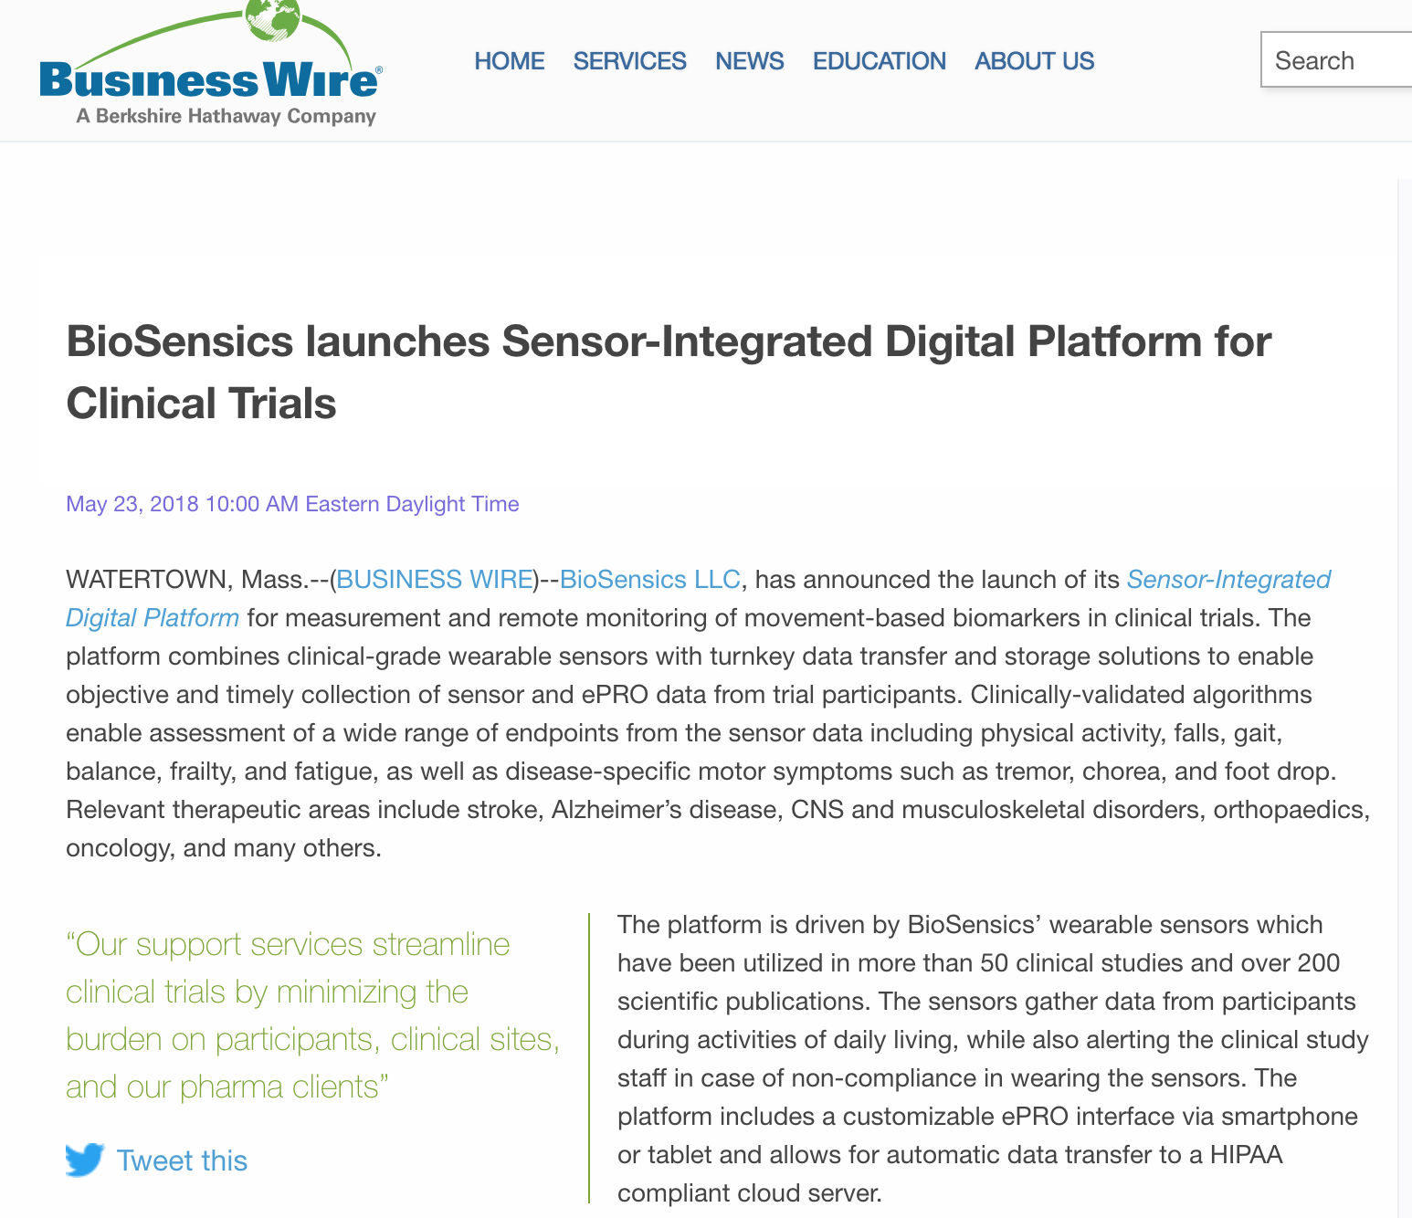
Emergence of ‘eHealth biomarkers’

Slide 16
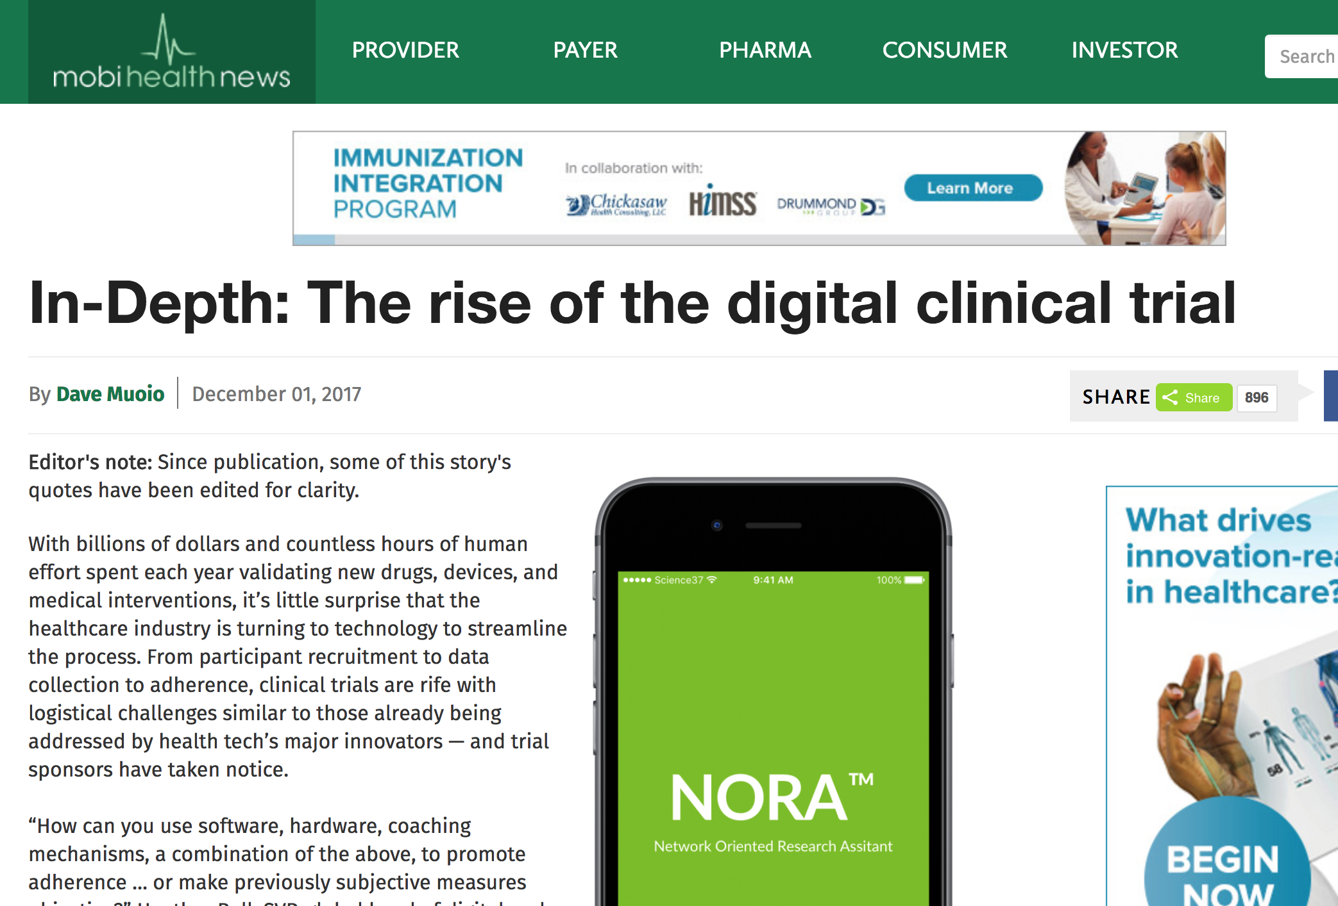
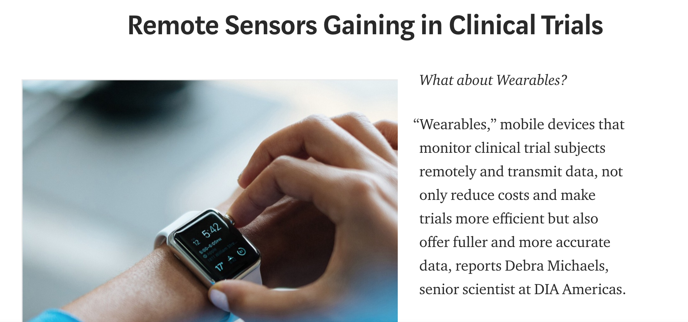
The ‘digital clinical trial’

Slide 17
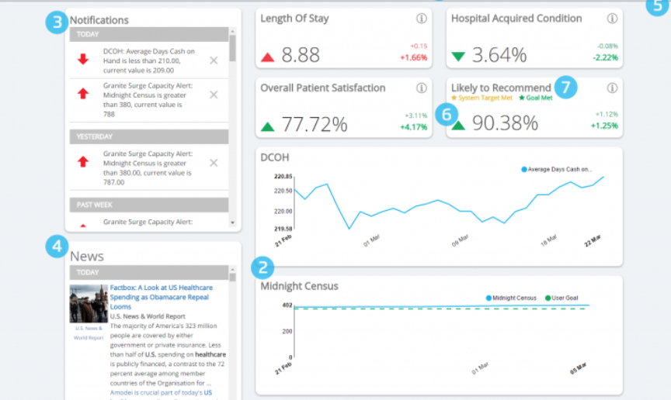
Emergence of “population health analytics” to measure quality
Requires very similar infrastructure, tools, and data to outcomes/pragmatic research with RWD

Slide 18
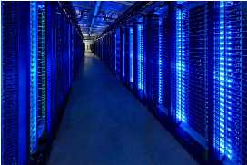
Data Sharing and the FAIR Principles
FAIR – Making data Findable, Accessible, Attributable, Interoperable, Reusable, and provide Recognition
Force11 white paper
https://www.force11.org/group/fairgroup/fairprinciples
Notes:
It is only through data sharing that we unlock the value of data

Slide 19
To improve, I need (good) data!

Slide 20
Defining Clinical Data Quality

Slide 21
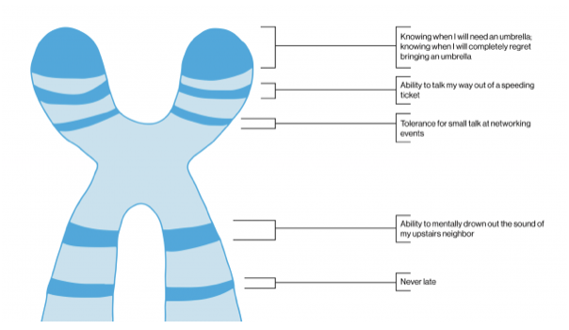
Issues in Healthcare
Evidence is not consistently accessible and structured
Outcomes are not connected to care
Patient trajectories are not calculated or easily accessible

Slide 22
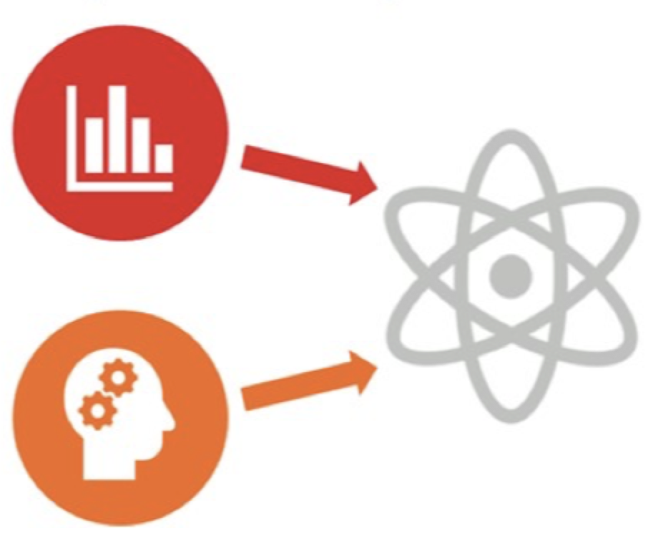
Population Health
More data is ‘digital first’ every day
Decision aids are needed
Good UX and responsive computing and analytics are critical for improving health outcomes
Population engagement through ‘All of Us’ and Sync4Science

Slide 23
Precision Medicine

Slide 24
Population vs Individual vs Clinic

Slide 25
Health vs Disease
What is ’normal’? What is ‘health’?
Systematic and measurement error
Biological & environment heterogeneity
Population Health
Notes:
We now have tools to let us both understand social determinants of health and build ‘early warning systems’ to identify people who are have acute medical issues

Slide 26
Access to data has changed-Epic

Slide 27
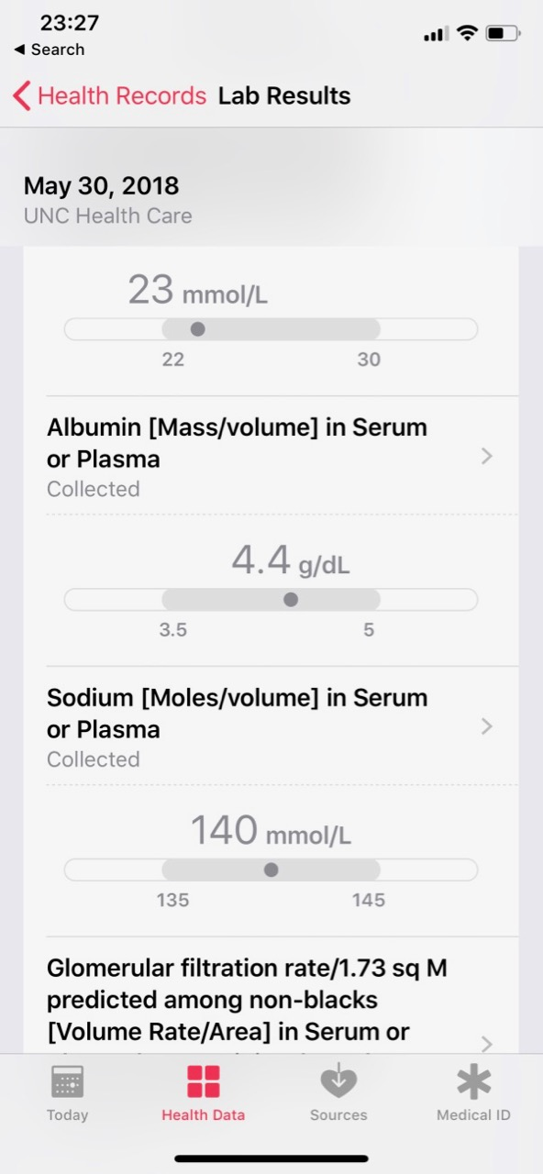
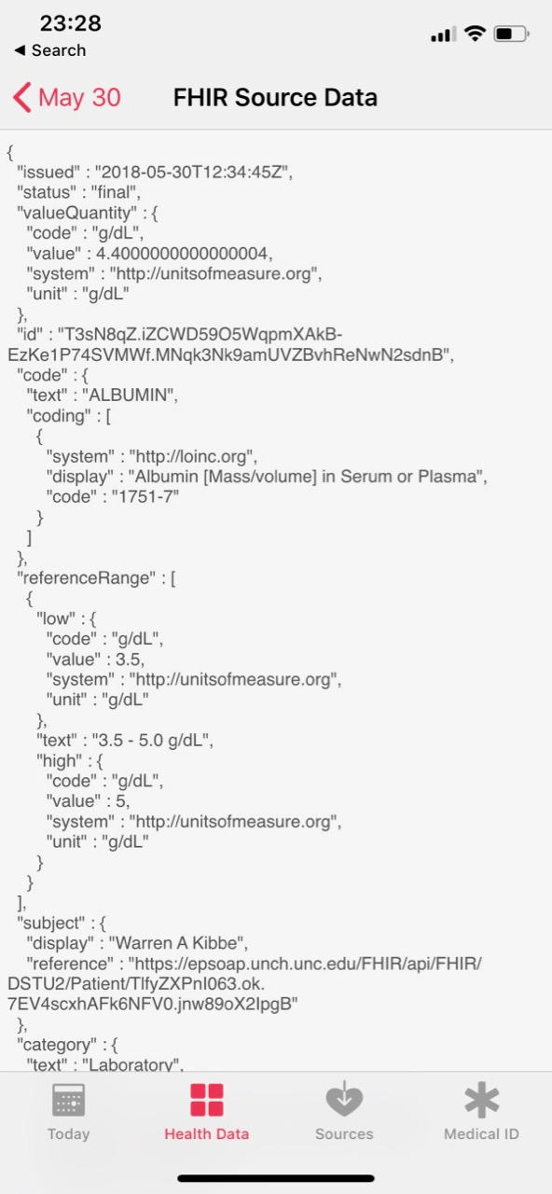
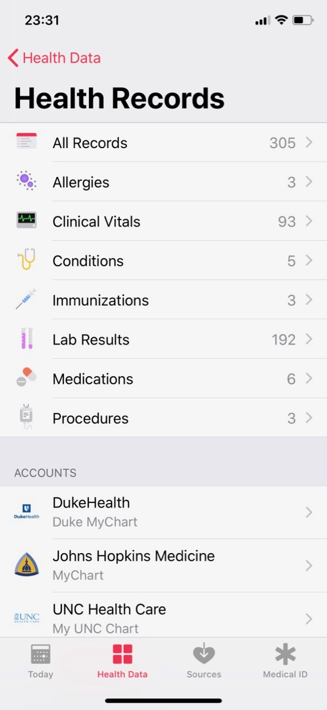
From Apple Health App
Note the FHIR JSON source in the third panel. Cool!

Slide 28
Data Science Hype
Using data increases its value
Notes:
Be careful of the hype. The promise is solid, but the snakeoil is real

Slide 29
Machine Learning and Data Analytics are mainstream

Slide 30
Applying Machine Learning
Image analysis at scale, with well characterized error, uncertainty and confidence
Support for Molecular Tumor Boards, linking mutations with evidence for intervention
Decision Support such as ‘This patient has melanoma with BRAF V600E mutations. Consider a targeted therapy like Trametinib or Vemurafenib’
Identification of high risk patients, like ‘Your patient is at high risk for re-admittance. Patients with APACHE scores, MI, and pain medications have a x in y probability of remittance based on 2014-2018 data.

Slide 31
Applying Machine Learning
Using –omic and functional data to understand complex biological networks involved in homeostasis, disease, health in the context of life and healthcare

Slide 32
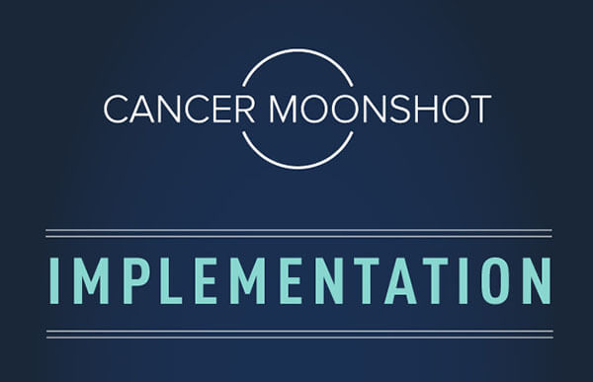
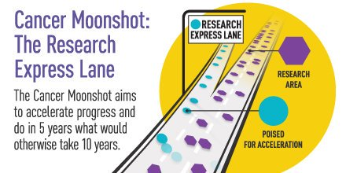
Cancer Moonshot includes Machine Learning and Data Analytics

Slide 33
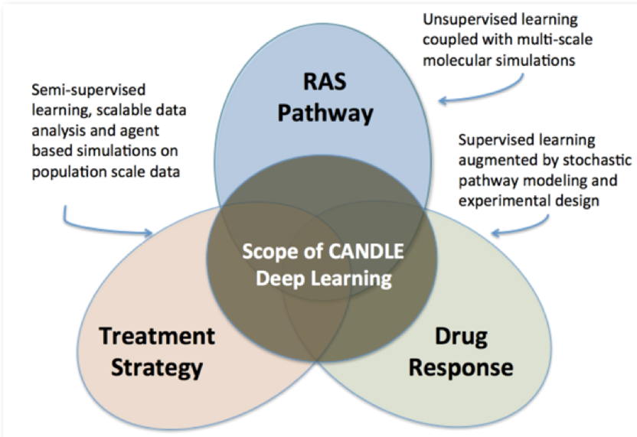
NCI – DOE pilots

Slide 34
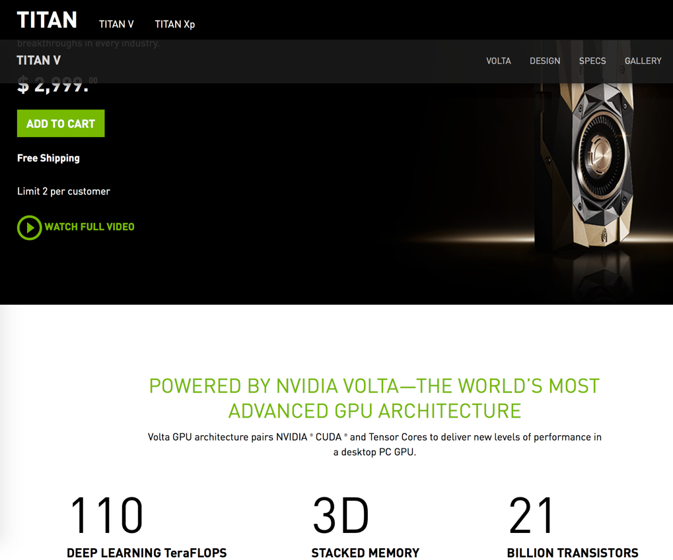
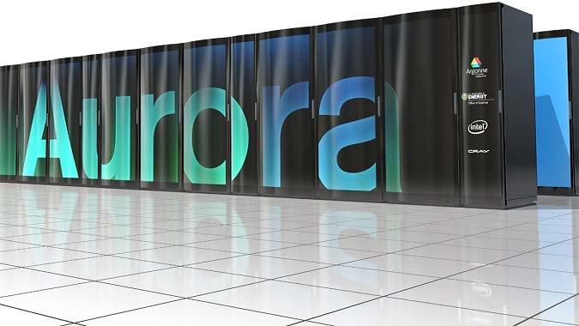
Machine Learning and Data Analytics requires computing horsepower

Slide 35
Project GENIE
http://www.cbioportal.org/genie/login.jsp
http://cancerdiscovery.aacrjournals.org/content/7/8/818
Project GENIE has already released 38,000 cancer genomes. Kudos to Drs. Charles Sawyers at MSKCC and Shawn Sweeney at AACR and so many people for making this happen.

Slide 36
Applying Machine Learning
Using sensors, IoT devices to understand and intervene individually at a national scale before an acute episode
Opportunities in prevention, monitoring for adverse events in patients being given therapy, behavior and improving survivorship

Slide 37
Questions?
Warren A. Kibbe, Ph.D.
warren.kibbe@duke.edu
@wakibbe

