Slide 1
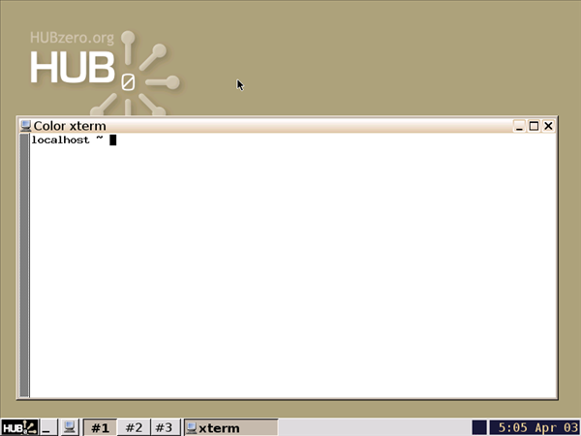
Using simulation workspaces to “submit” jobs and workflows
Michael McLennan
HUBzero® Platform for Scientific Collaboration
Purdue University
This work licensed under
Creative Commons
See license online:
by-nc-sa/3.0

Slide 2
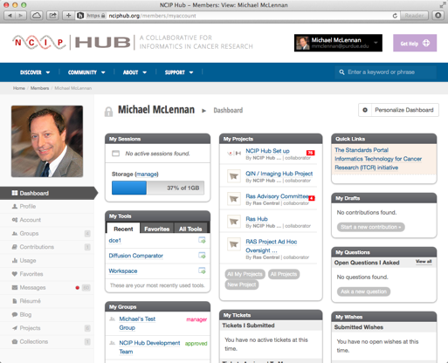
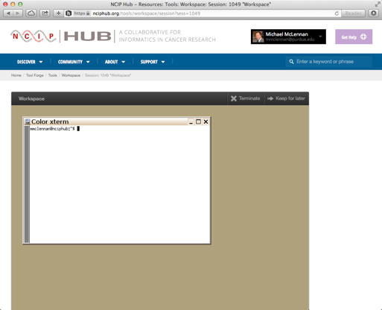
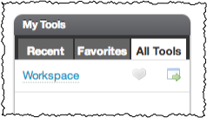
Launching workspaces
Find it on your dashboard:
Success!

Slide 3
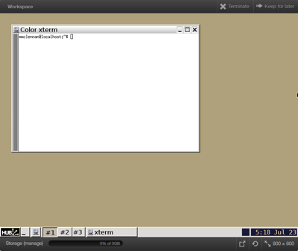
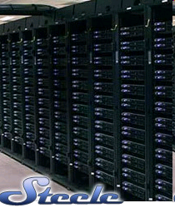
What is a workspace?
Full-featured Linux desktop
For tool developers
For researchers
Accessible from any web browser
Still running after you close your browser
Access to computational clusters
File storage provided by the hub
local
clusters
File server

Slide 4
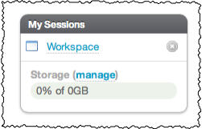
Accessing running workspaces
Close the browser
Still running, and listed under “my sessions”

Slide 5
Closing workspaces
Click on “Terminate”
Click here to terminate

Slide 6
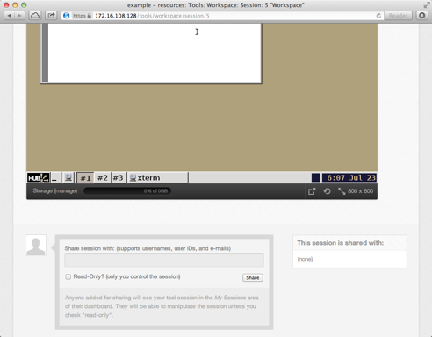
Resize the screen

Slide 7
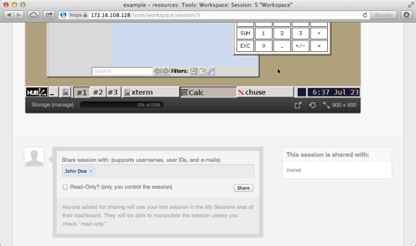
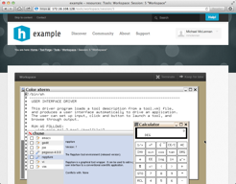
Share your screen
Share the session
with these people
johndoe
Check this box if
you don’t want to
share control

Slide 8
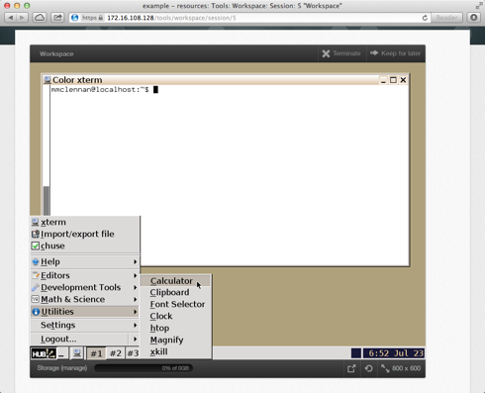
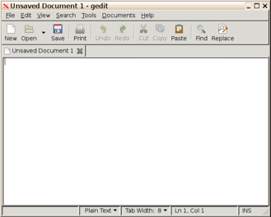
Explore the desktop
Editors:
geany
gedit
vim
emacs
“Start”
menu
New terminal
window

Slide 9
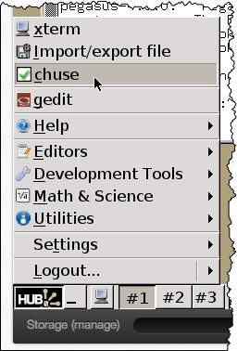
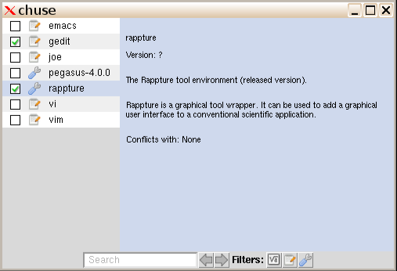
Choosing common utilities
Takes effect for the next new
terminal window that you open

Slide 10
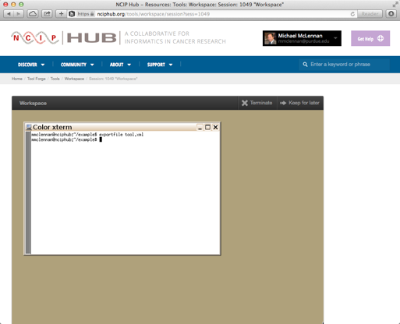
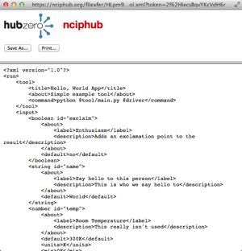
Downloading files
Easy way to download:
exportfile tool.xml
Tools can provide “download”
function by exec’ing this
command

Slide 11
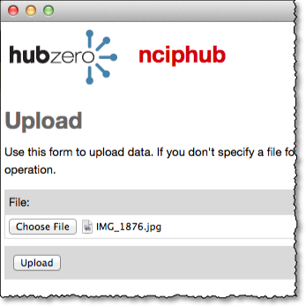
Uploading files
Easy way to upload:
importfile
Tools can provide “upload”
function by exec’ing this
command
IMG_1876.jpg

Slide 12
Direct access to your files
sftp yourlogin@nciphub.org
Use your login and password for the hub

Slide 13
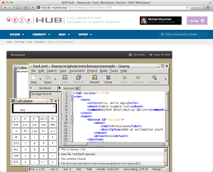
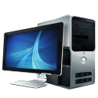
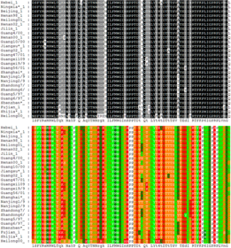
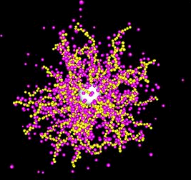
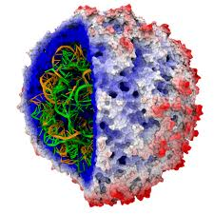
Research Computing Environment
NAMD
Access research codes and remote supercomputers

Slide 14
Submit: Parameter Sweeps
If you normally run a command like this…
spice3 –b circuit
Submit to remote resources like this…
submit –v DiaGrid spice3 –b circuit
submit –p @@res=100,1k,10k spice3 –b @:circuit
submit –p @@res=100,1k,10k –p @@cap=1u,10u,100u spice3 –b @:circuit
submit –d indata.csv spice3 –b @:circuit
submit –p @@num=1:100 spice3 –b circuit@@num
submit –p @@file=glob:circuit* spice3 –b @@file

Slide 15
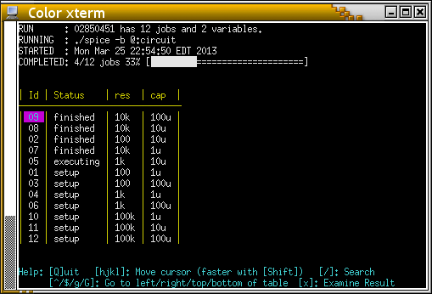
Submit: Parameter Sweeps
If you normally run a command like this…
spice3 –b circuit
Submit to remote resources like this…
submit –v DiaGrid spice3 –b circuit
submit –p @@res=100,1k,10k spice3 –b @:circuit
submit –p @@res=100,1k,10k –p @@cap=1u,10u,100u spice3 –b @:circuit
submit –d indata.csv spice3 –b @:circuit
submit –p @@num=1:100 spice3 –b circuit@@num
submit –p @@file=glob:circuit* spice3 –b @@file

Slide 16
Demo: BLASTX
submit blastx-2.2.28 -query test.fasta \
-db /group/diagrid/databases/ncbi/week-24-2014/nr \
-html -out output
exportfile output
submit -p @@seq=glob:seq* blastx-2.2.28 -query @@seq \
-db /group/diagrid/databases/ncbi/week-24-2014/nr \
-html -out output

Slide 17
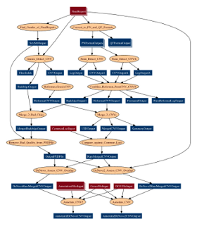
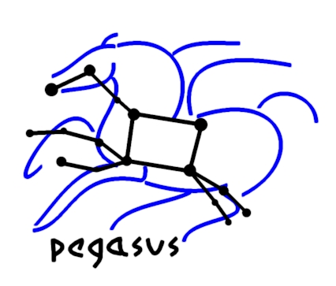
Automated Workflow
Pegasus Workflow Management System (est. 2001)
Ewa Deelman USC Information Sciences Institute
Development Team:
Gideon Juve, Rajiv Mayani,
Mats Rynge, Karan Vahi
http://pegasus.isi.edu

Slide 18
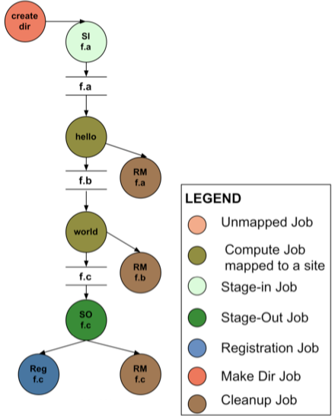
How does Pegasus work?
APIs for
workflow
specification
DAX
=
DAG in XML
Executable Workflow
(After Pegasus Planning)
Workflow
Spec

Slide 19
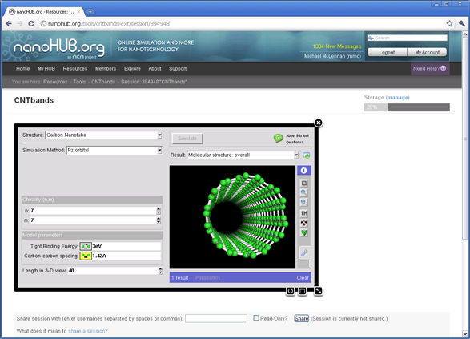
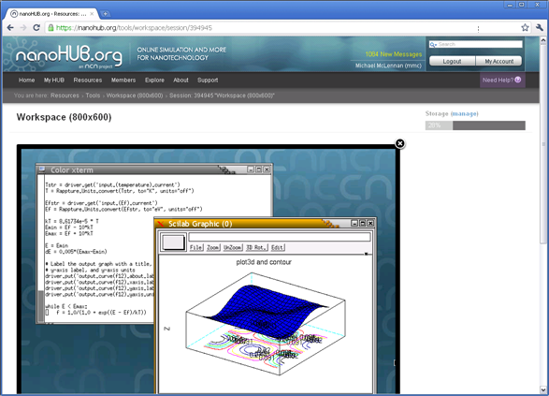
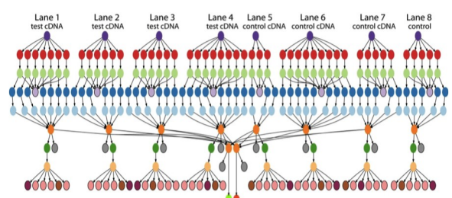
Submitting Your Pegasus Workflow
submit pegasus-plan --dax myworkflow.dax
Hub Web Server
Execution Host 1
Execution Host 2
. . .
Pegasus “DAX”
Workflow

Slide 20
Two Audiences
Researchers
Casual Users
Use “workspace” (remote desktop)
Launch simulation jobs on grid/cloud
Share desktops
Build and deploy tools
Use “tools” (app store)
Simple, intuitive interfaces
Share tools

Slide 21
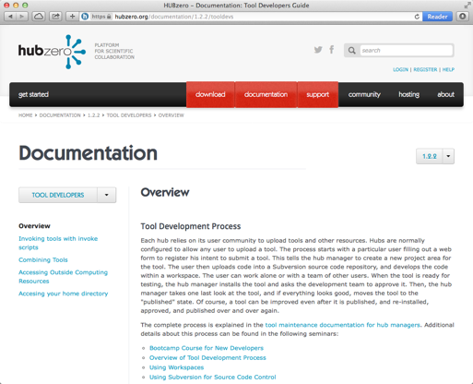
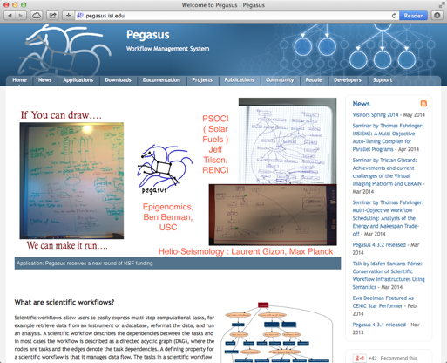
More Information
https://hubzero.org/documentation/1.2.2/tooldevs
https://hubzero.org/resources/779
https://hubzero.org/resources/834
https://hubzero.org/resources/pegtut
http://pegasus.isi.edu

